Slide 1
UKMOD training course set up meeting
Daria Popova, Matteo Richiardi & Justin van de Ven
ISER, University of Essex

Slide 2
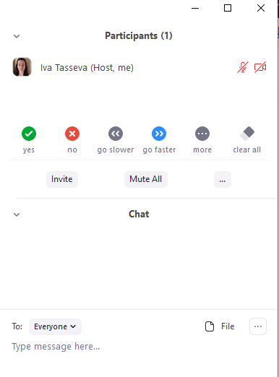
The Zoom meeting
Justin van de Ven will be the host for this session
Feel free to unmute yourself and ask a question; or type in a question in the chat
meeting controls

Slide 3
Installation
Follow the online directions for accessing UKMOD at:
  https://www.microsimulation.ac.uk/ukmod/access
These directions walk through:
  Downloading and installing EUROMOD
  Downloading and installing UKMOD
  Applying for UKMOD input data
Only installing EUROMOD and UKMOD is needed prior to the training session.

Slide 4
Step 1: installing euromod

Slide 5
EUROMOD installer file
Download the installer file from:
https://www.microsimulation.ac.uk/euromod/access
Run the installer file
  If you see a warning that “Windows protected your PC”, click on “More info”, and select “Run anyway”

Slide 6
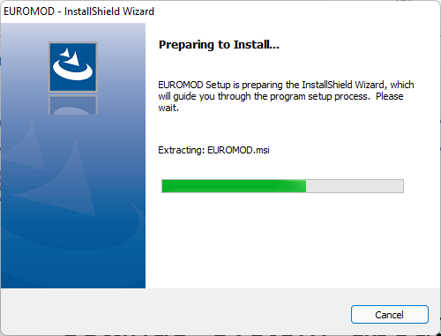
Installing EUROMOD

Slide 7
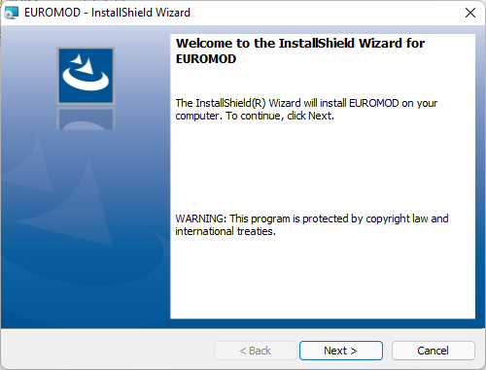
Installing EUROMOD

Slide 8
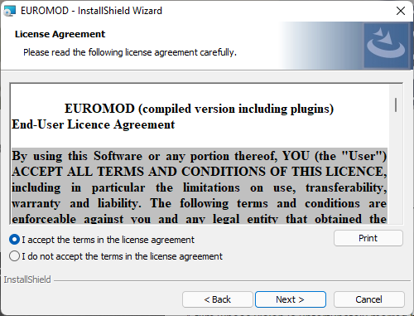
Installing EUROMOD

Slide 9
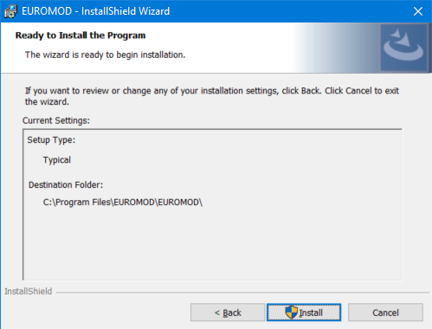
Installing EUROMOD
You will need to have administrative rights to this computer!

Slide 10
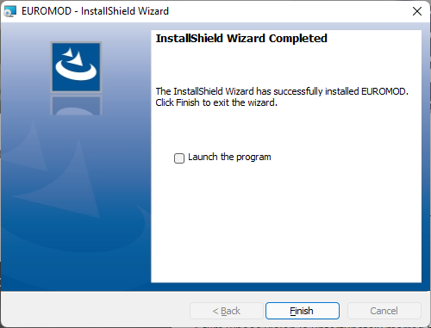
Installing EUROMOD

Slide 11
Installing EUROMOD
Optionally, you can download and install the latest UKMOD statistics presenter templates
Follow the directions under Step 1 at:
https://www.microsimulation.ac.uk/euromod/access

Slide 12
Step 2: INSTALL UKMOD

Slide 13
Installing EUROMOD
Download the most recent release of UKMOD described under “Step 2” at:
https://www.microsimulation.ac.uk/euromod/access

Slide 14
Extract the zip folder
The UKMOD_PUBLIC_XY.YY.zip folder should be saved in your downloads folder
Extract the files to a folder you can easily access. Here I am extracting them to c:\UKMOD
XY.YY is the version number of the release

Slide 15
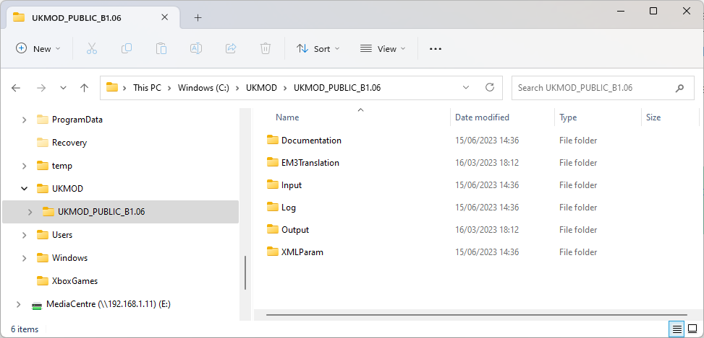
UKMOD Folders

Slide 16
UKMOD Folders
Documentation files (Country Report, help file, etc.)

Slide 17
UKMOD Folders
UKMOD input data to be stored here

Slide 18
UKMOD Folders
Log file (lists model changes)

Slide 19
UKMOD Folders
Simulation output will be saved here

Slide 20
UKMOD Folders
Tax-benefit code by country (in xml format)

Slide 21
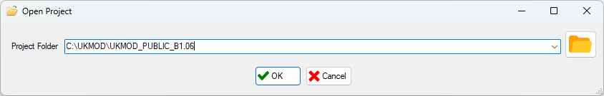
Linking EUROMOD with UKMOD
Open EUROMOD
Add path to UKMOD
the path to the model

Slide 22
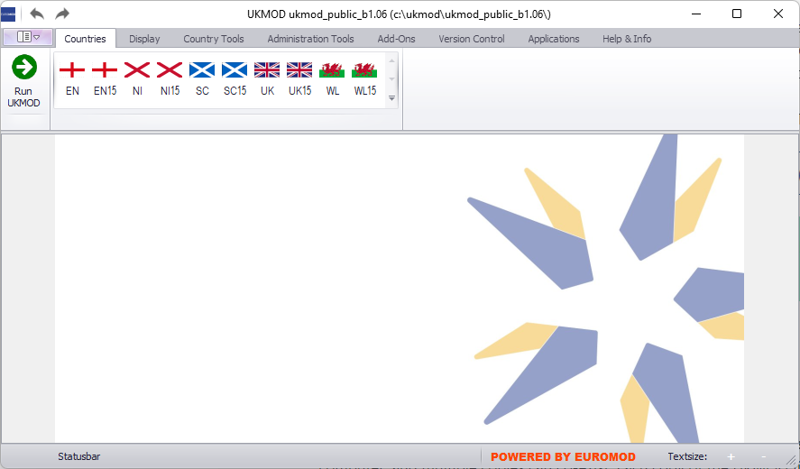
EUROMOD and UKMOD are linked!

Slide 23

Questions

