Slide 1
Workplace Mentor Workshop
March 2025
Jo Etherton. jethera@essex.ac.uk
Kerry Hardy kerry.hardy@essex.ac.uk

Slide 2
“I can demonstrate consistently full competence in this area and provide evidence’’
What, Why and When?

Slide 3
DA programmes differ from ‘mainstream’ university degrees in four ways:
They prioritise combining work-based learning and higher academic learning
They are more explicitly aligned with external standards requirements and endorsing bodies
They can be funded through the Apprenticeship Levy paid by large employers.
The system is employer-led and apprentices are employees
‘’While mainstream university degrees are anchored in academic or disciplinary bodies of knowledge exercised through ‘academic tasks’ and delivered by specialised staff primarily on campuses, DAs are oriented towards work-based learning and assessment delivered by academic and practitioner staff (Welbourn et al., 2019).’’

Slide 4
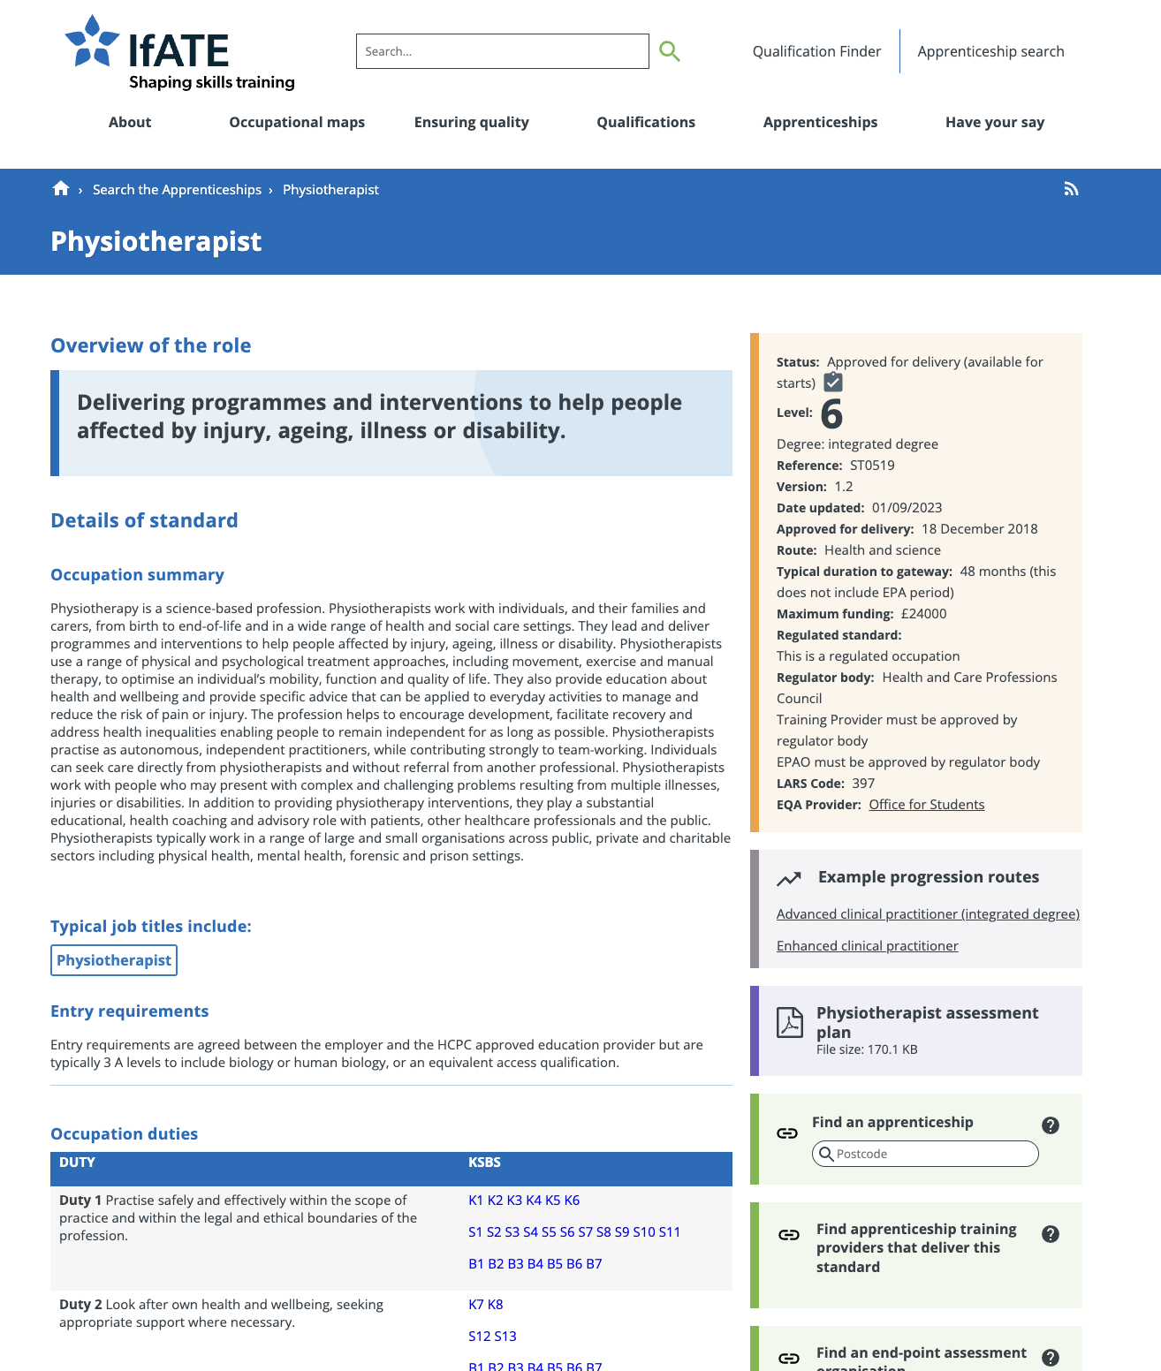
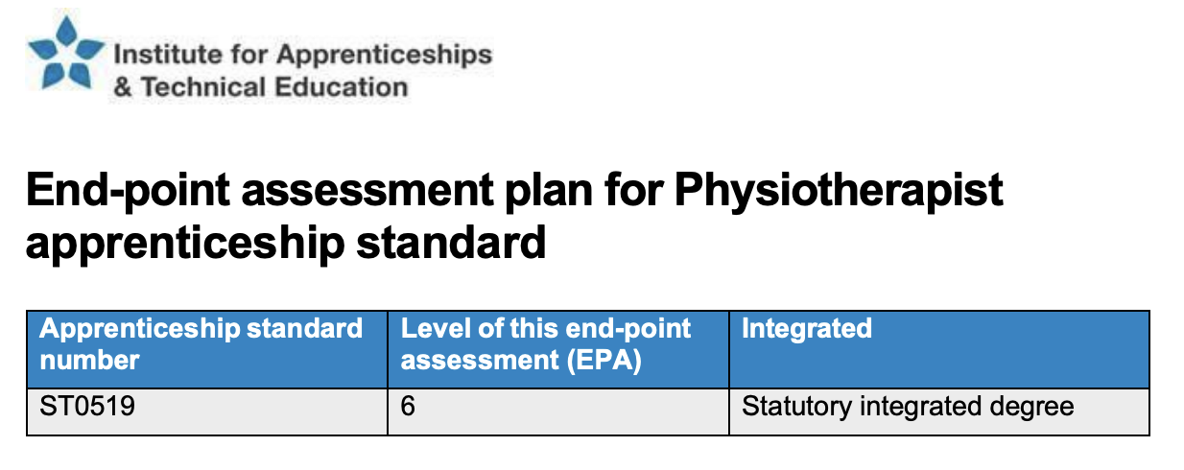
Notes:
Explain : practical period - Gateway assessment - End point assessment

Slide 5
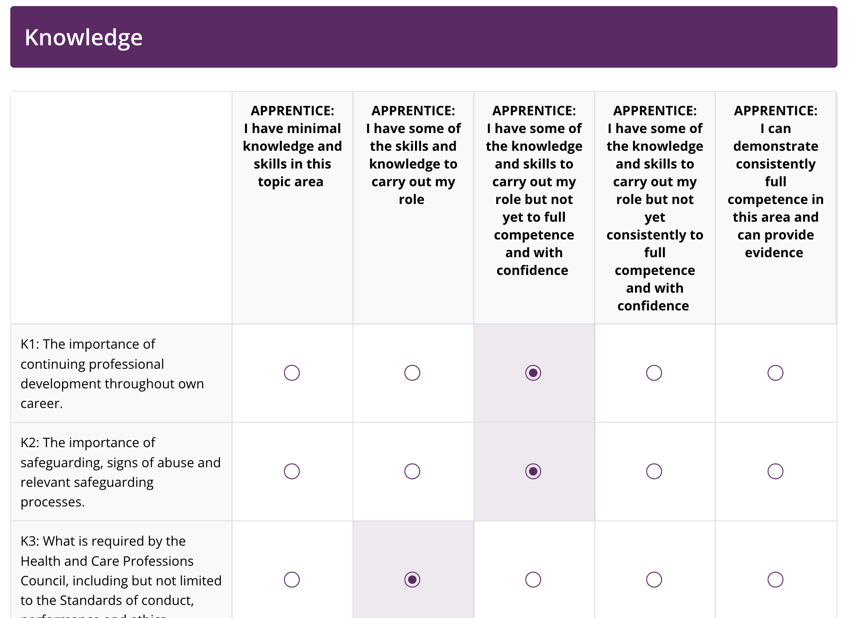
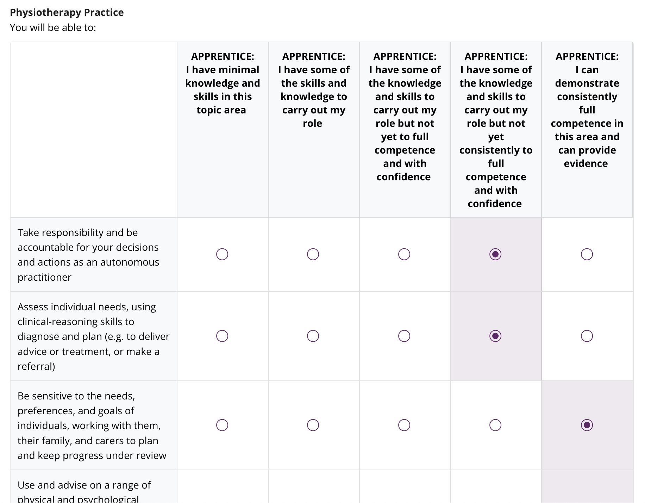
Skills Scan’s
epad
CSP Portfolio
Notes:
Academically we assess apprentice’s understanding and achievement of KSB’s via standardized assessment in predictable , pre planned controlled tasks with planned outcomes. We have grades and scores to reflect this assessment outcome. In uni and on placement.
In practice, in the workplace: what you are looking for in relation to master and competence of these KSB;s is unique to your services, and what being a physiotherapist means and looks like in your context and your team. Your judgment is captured on these skills scans/discussed and considered in progress reviews ‘’refernces to questions about satisfaction with progress and being ‘on track’ for EPA as predicated.

Slide 6
Portfolio: a systematic collection of student work that represents student activities, accomplishments, and achievements over a specific period of time.
University
Workplace
Introduce to professional portfolios as part of HCPC requirement (USO)
Practicalities of using CSP portfolio tool (portfolio v’s profile; generating sharing links etc) (USO)
Assessment of portfolio development skills (USO/DSO and P4P)
Understand practice of K.S.B’s in workplace context
Track and assess mastery/competence of KSB’s
Support apprentice to identify and engage in workplace activities to develop and evidence competence
Advocate for and communicate with others about apprentieces changing roles and responsibilities

Slide 7
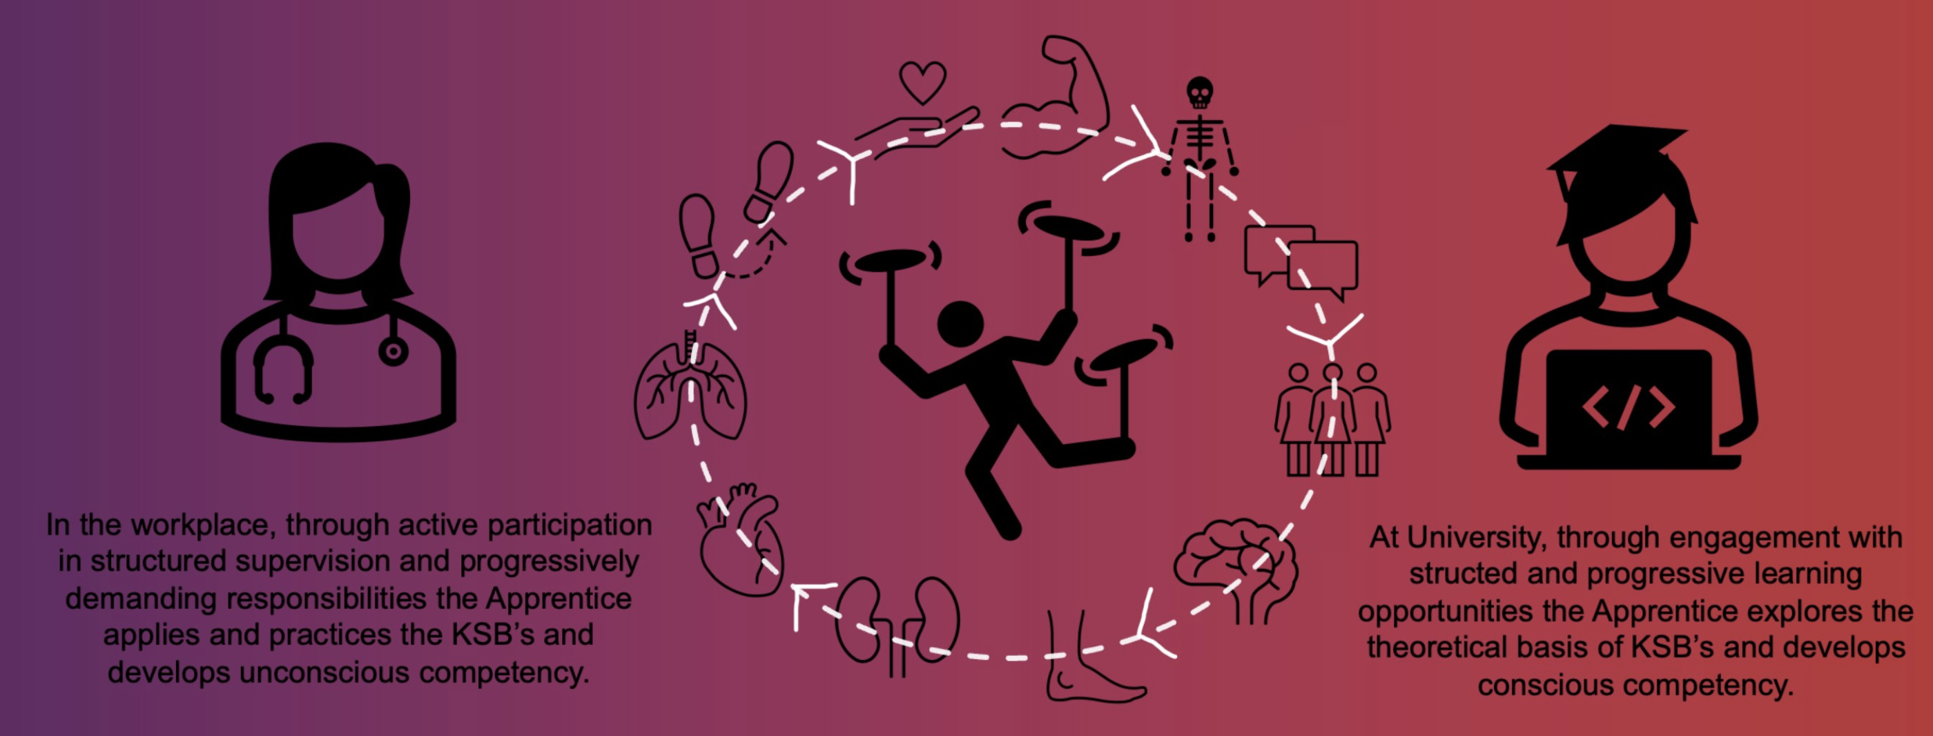
Apprenticeship document guidance SWAY
https://sway.cloud.microsoft/lAGkiQ7qe6nuECHt

Slide 8
Physiotherapy DA portfolio…….
What?
Why?
When?

