Slide 1
UKMOD training course
Daria Popova, Matteo Richiardi & Justin van de Ven
ISER, University of Essex
July 2024

Slide 2

Welcome!

Slide 3
Course structure
Mix of lecture and hands-on exercises
Extra exercises offered to do after the course
Please ask questions, and interrupt if terminology is unclear
Tell us what you would like to do with the model

Slide 4
Course outline – day 1
Session 1: Introduction to UKMOD
Session 2: Overview of how UKMOD works and a first simulation
Session 3: The UKMOD programming interface and implementing a simple reform
Session 4: More detail concerning the structure of UKMOD and introduction of two basic model functions
Session 5: Error handling, more detail concerning alternative types of model functions

Slide 5
Introduction: static tax-benefit models, distributional analysis and the UKMOD project

Slide 6
UKMOD is a static tax-benefit microsimulation model

Slide 7
What does “microsimulation” mean?
refer to a wide area of modelling techniques that:
operate at the level of individual units (persons, households, vehicles, firms, etc.)
apply rules to simulate changes in state or behavior of these units
estimate distributional outcomes after applying these rules at the micro level
application in different areas, e.g.:
traffic and transportation
demand for health care
spatial planning
tax-benefit policies

Slide 8
Types of tax-benefit microsimulation model
 | Static | Dynamic
Non-Behavioural | Individual characteristics are fixed Behaviour is fixed Short-term analysis (“morning after”) Focus on direct effects of policies
Behavioural | Individual characteristics are fixed Behaviour react to incentives Medium-term analysis (“a few months”) Focus on direct and indirect effects of policies | Individual characteristics change over time Behaviour explicitly modelled Longer-term analysis (“a few years/decades”) Focus on direct and indirect effects of policies and population change

Slide 9
Microsimulation: Why
To reconstruct things we do not observe:
  Missing variables
  (Future states)
  Counterfactuals
With respect to other modelling exercises:
  Focus on micro-units, and micro-rules
  Flexibility brought about by the computational approach: everything that can be algorithmically described can be simulated.

Slide 10
Static tax-benefit models
Units of analysis: households, benefit units, and persons
Rules: tax-benefit policies (mostly):
  Cash transfers
    Means-tested benefits
    Non-means-tested benefits
    Pensions
  Social insurance contributions (SIC)
  Direct taxes: Income tax, including tax allowances and tax credits, capital gains tax

Slide 11
Why use a tax-benefit model?
Easy to “change the rules” and explore counterfactuals
Policy rules account for interactions between parts of tax and benefit system:
  basic state pension is taxable, so higher BSP means more income tax revenue
  Universal Credit depends on after-tax earnings, so a rise in income tax rate implies higher spend on UC

Slide 12

UKMOD
Microdata
on households (and individuals)
Tax-benefit policy rules
current or historical systems
representative of the population
hypothetical systems
Calculation of benefit entitlements & tax liabilities
for every household
under multiple tax-benefit systems
Analysis
household incomes
fiscal impact
work incentives
Accounts for:
interactions between policies
interactions between policies and household characteristics
heterogeneity of household characteristics

Slide 13
UKMOD
An open-access, flexible and transparent static tax-benefit microsimulation model:
  no hard-wiring; everything is parameterised
  (relatively) easy to simulate structural reforms
  extensive and growing documentation
  a growing community of users
  uses EUROMOD software, which provides a flexible user interface
  additional simplified interfaces and online models
  freely available!
Notes:
Open access: “the most used microsimulation model in the world”
Many users and stakeholders – quality assurance
Bridging the gap between academic research and policymaking
Increasingly recognised in the academic literature
Recent papers appeared in top economic and social policy journals
well embedded in the income distribution literature
(Input micro-data access handled separately)
2. Highly flexible, but organised, documented, validated and transparent
Purpose-built software: “tax-benefit modelling” language; user interface; “plug-ins” and “add-ons” for special purpose analysis
(Relatively) easy to simulate major reforms to policy structures (without programming skills); many types of application
(Spin-offs for non-EU countries; enhanced national models)

Slide 14
UKMOD and related models
Other models for the UK exist:
  UK government: HMT (IGOTM), DWP (PSM)
  IFS: TAXBEN
  IPPR: The “Institute of Public Policy Research Tax-Benefit Model”: https://www.mmuperu.co.uk
UKMOD is freely available; well-documented; flexible and transparent; goes back to 2005 and looks forward to 2027

Slide 15
Ways of using UKMOD
To analyse the impact of actual or hypothetical tax-benefit changes on the distribution of income, fiscal aggregates or work incentives:
  We have coded up some standard analysis into UKMOD (the “Statistics Presenter” and “In-depth analysis tool”)
  Or you can analyse the micro-data produced by UKMOD using your own statistical software (we are not covering that in this course)

Slide 16
Ways of using UKMOD
You can use UKMOD as a tool in a more complicated piece of analysis, by:
  Doing further analysis on the output data
    What are the labour supply responses to a change in Universal Credit?
    How would higher spending on UC reduce poverty, as proposed by the Social Mobility Commission?
  Adjusting the input data set
    How would a rise in earnings inequality affect the distribution of income?
    How does demographic change affect government revenues?
  Linking UKMOD to other models (e.g. dynamic models)

Slide 17
UKMOD
What it covers

Slide 18
Taxes
Tax type | Tax name | Treatment in UKMOD
National Insurance Contributions (NICs) | Employees NICs | S
 | Self-employed NICs | S
 | Employers NICs | S
 | Credited (State) National Insurance Contributions | S (*)
Private pension contributions |  | PS
Direct Taxes | Income Tax | S
 | Council Tax | I
 | Capital Gains Tax | E
 | Inheritance Tax | E
 | Property and Stamp Duties | E
Indirect Taxes | Valued Added Tax (VAT) | E
 | Excises | E
Notes: “E”: excluded from the model as it is neither included in the micro-data nor simulated; “I”: included in the micro-data but not simulated; “PS” partially simulated as some of its relevant rules are not simulated; “S” simulated although some minor or very specific rules may not be simulated.
(*) Simulated only in 2020-21 with simulation of Covid-19 shocks.

Slide 19
Benefits
Contributory benefits are earnings-replacement benefits and pensions. Entitlement to these benefits depends on having met certain conditions regarding National Insurance contributions. Some contributory benefits are subject to specific tests on current income.
Non-contributory, non-means-tested benefits depend on certain contingencies such as disability or (lone) parenthood but do not require contributions to have been made and are not subject to an income test.
Non-contributory, means-tested benefits depend on a range of personal and family circumstances but also on family incomes – benefit entitlement is reduced if family incomes increase.
Tax credits have changed their name, format and administering authority over the past 15 years. In practice, despite being administered by the tax authorities, tax credits are like cash benefits and are treated as such in UKMOD.

Slide 20
Benefits: contributory
Benefit type | Benefit name | Treatment in UKMOD
Contributory (aka National Insurance Benefits) | Bereavement benefit | I
 | Employment and Support Allowance (ESA) | I
 | Incapacity Benefit | I
 | Jobseeker’s Allowance (JSA): | PS(*)
 | Maternity Allowance (MA) | I
 | State Pension | I
 | Winter Fuel Allowance | S
 | Self-Employed Income Support Scheme (SEISS) | S
Notes: “E”: excluded from the model as it is neither included in the micro-data nor simulated; “I”: included in the micro-data but not simulated; “PS” partially simulated as some of its relevant rules are not simulated; “S” simulated although some minor or very specific rules may not be simulated.
(*) Simulated only in 2020-21 with simulation of Covid-19 shocks.

Slide 21
Benefits: non-contributory, non-means-tested
Benefit type | Benefit name | Treatment in UKMOD
Non-contributory, non-means-tested | Attendance Allowance (AA) | I
 | Carer’s Allowance (CA) | I
 | Child Benefit (CB) | S
 | Disability Living Allowance (DLA) | I
 | Guardian’s Allowance | E
 | Industrial Injuries Disablement Benefit | I
 | Personal Independence Payment (PIP) | I
 | Scottish Carer’s Allowance Supplement | PS
 | Scottish Child Winter Heating Assistance | S
 | Severe Disablement Allowance (SDA) | I
 | Sure Start Maternity Grant | S
 | War Pension | PS
 | Widow’s Pension | PS
 | Winter Fuel Allowance | S
Notes: “E”: excluded from the model as it is neither included in the micro-data nor simulated; “I”: included in the micro-data but not simulated; “PS” partially simulated as some of its relevant rules are not simulated; “S” simulated although some minor or very specific rules may not be simulated.
(*) Simulated only in 2020-21 with simulation of Covid-19 shocks.

Slide 22
Benefits: non-contributory, means-tested
Benefit type | Benefit name | Treatment in UKMOD
Means-tested | Best Start Grant | S
 | Child Tax Credit (CTC) | S
 | Council Tax Reduction (CTR) | S
 | Employment and Support Allowance (income-based) | S
 | Housing Benefit (HB) | S
 | Income Support (IS) | S
 | Jobseeker’s Allowance (income-based) | S
 | Local Housing Allowance (LHA) | PS
 | Pension Credit (PC) | S
 | Scottish Child Payment | S
 | Social Fund | E
 | Universal Credit (UC) | S
 | Working Tax Credit (WTC) | S
Notes: “E”: excluded from the model as it is neither included in the micro-data nor simulated; “I”: included in the micro-data but not simulated; “PS” partially simulated as some of its relevant rules are not simulated; “S” simulated although some minor or very specific rules may not be simulated.
(*) Simulated only in 2020 with simulation of Covid-19 shocks.

Slide 23
Benefits: others
Benefit type | Benefit name | Treatment in UKMOD
Other (not strictly) benefits | Child support | I
 | Foster Allowances | E
 | Occupational and approved personal pensions | E
 | Statutory Maternity Pay (SMP) | S (**)
 | Statutory Paternity Pay (SPP) | S(**)
 | Statutory Sick Pay (SSP) | S(**)
 | Student loans | I
 | Training allowances and Education Maintenance Allowance | I
Covid-19 Market income support schemes | Coronavirus Job Retention Scheme (CJRS) | S (*)
 | Self-Employed Income Support Scheme (SEISS) | S (*)
Notes: “E”: excluded from the model as it is neither included in the micro-data nor simulated; “I”: included in the micro-data but not simulated; “PS” partially simulated as some of its relevant rules are not simulated; “S” simulated although some minor or very specific rules may not be simulated.
(*) Simulated only in 2020-21 with simulation of Covid-19 shocks.
(**) Included in the data but not simulated in the baseline

Slide 24
UKMOD
How it works

Slide 25
Three components
UKMOD consists of three components:
Input micro-data
Tax-benefit policy code, i.e. the UKMOD model
EUROMOD software

Slide 26
How does UKMOD work?
Original micro-data
(FRS or UKHLS for the UK)
Model: Tax-benefit policy code
(via the EUROMOD User Interface)
Input micro-data
(FRS, UKHLS or hypothetical households data)
Policy simulations
(EUROMOD software)
Output micro-data =
input micro-data + additional simulated variables
Tools for analysis: Statistics Presenter, In-depth Analysis tool
(or statistical software e.g. Stata)

Slide 27
UKMOD in this course
EUROMOD Software
Model (tax-benefit code):
  Training version of the model broadly reflecting UK policy in 2026
Input micro-data
  Training data supplied with the public access model
All materials are freely available for download from the internet
Notes:
EUROMOD is continuously being developed and improved

Slide 28

Exercise 1
You will learn:
  How UKMOD files are organised
  How to link the UKMOD model to the User Interface (UI)
  How to run the model and produce output micro-data
  How to analyse the output micro-data with the Statistics Presenter Tool
We will do the exercise together!
  Each step is described in the following slides to permit you to return to them later

Slide 29
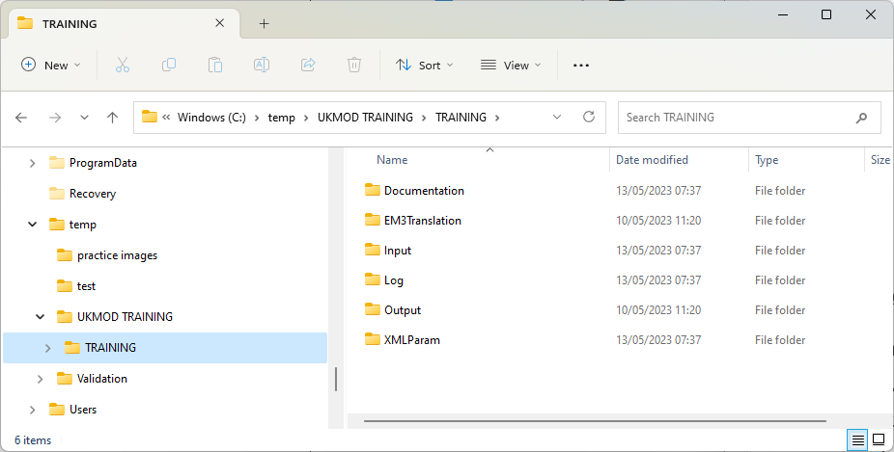
UKMOD files
Documentation
Set structure
of folders
Input data
Log file
Output data
Country files
(=tax-benefit code)

Slide 30
UKMOD via the
User Interface (UI)
Original micro-data
(FRS for the UK)
Model: Tax-benefit policy code
(via the EUROMOD User Interface)
Input micro-data
(FRS or hypothetical households data)
Policy simulations
(EUROMOD software)
Output micro-data =
input micro-data + additional simulated variables
Tools for analysis: Statistics Presenter
(or statistical software e.g. Stata)

Slide 31
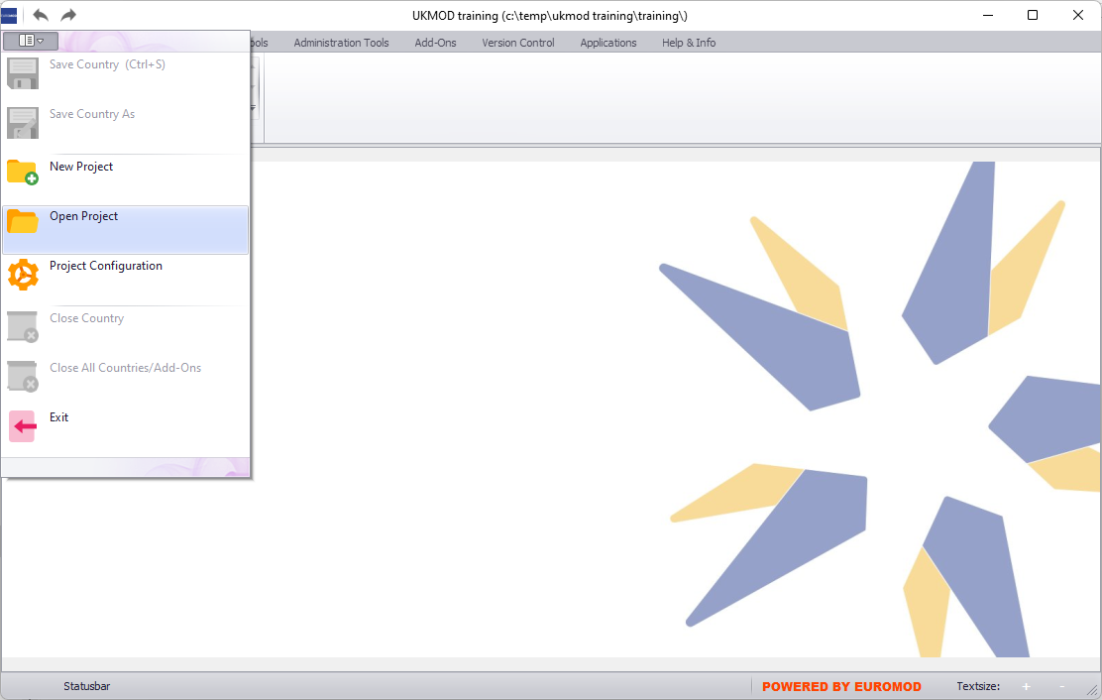
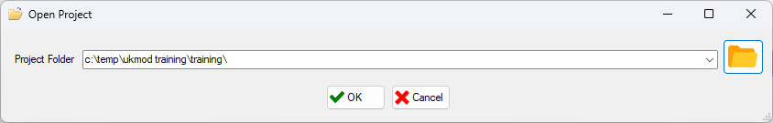
Linking the model to the UI

Slide 32
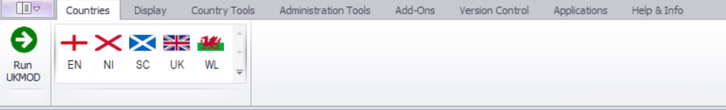
User Interface (UI)
Ribbon bar
Country models
Run button

Slide 33
Running UKMOD &
Producing output data
Original micro-data
(FRS for the UK)
Model: Tax-benefit policy code
(via the EUROMOD User Interface)
Input micro-data
(FRS or hypothetical households data)
Policy simulations
(EUROMOD software)
Output micro-data =
input micro-data + additional simulated variables
Tools for analysis: Statistics Presenter
(or statistical software e.g. Stata)

Slide 34
Running the model
34
UKMOD is run via the Run button
We can run the model (simultaneously) for:
i) one country and
one or more systems
ii) several countries
(and systems)
iii) all countries and systems and for all data

Slide 35
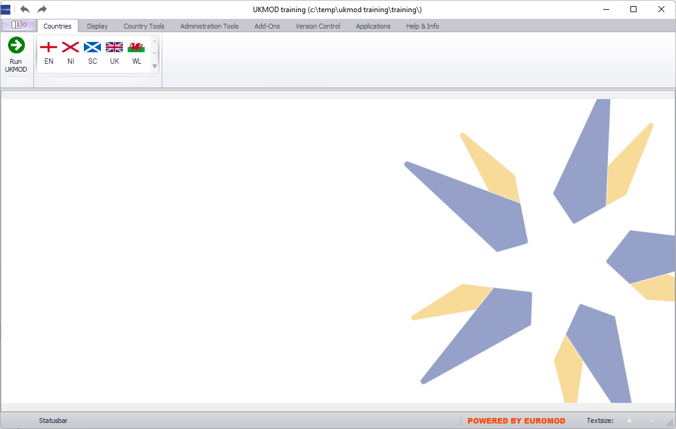
Running a single system
Run button

Slide 36
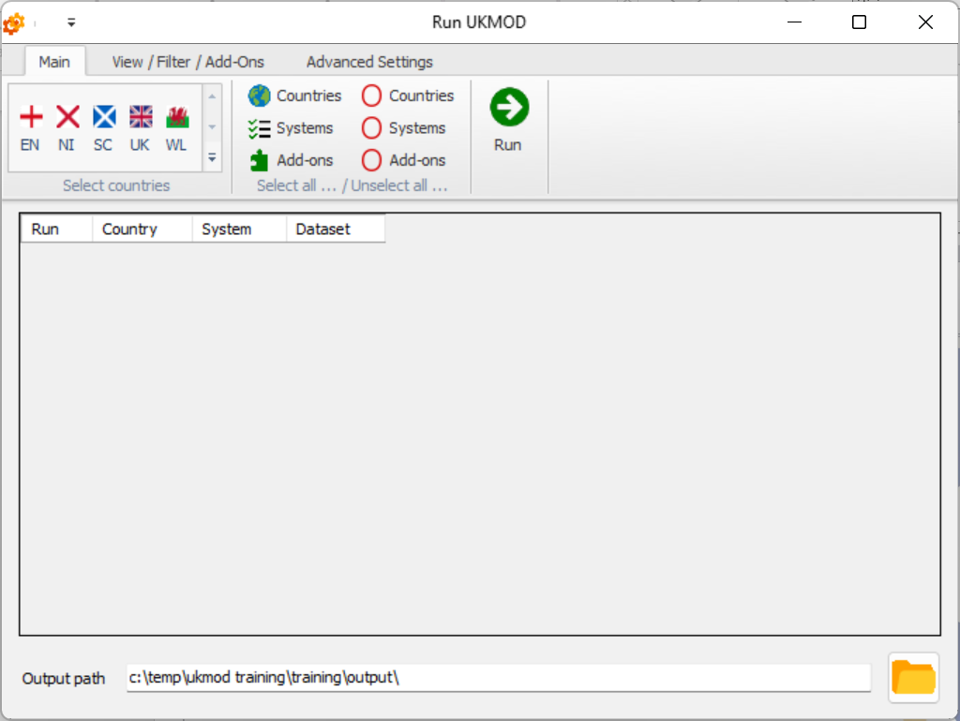
Running a single system
Select a country

Slide 37
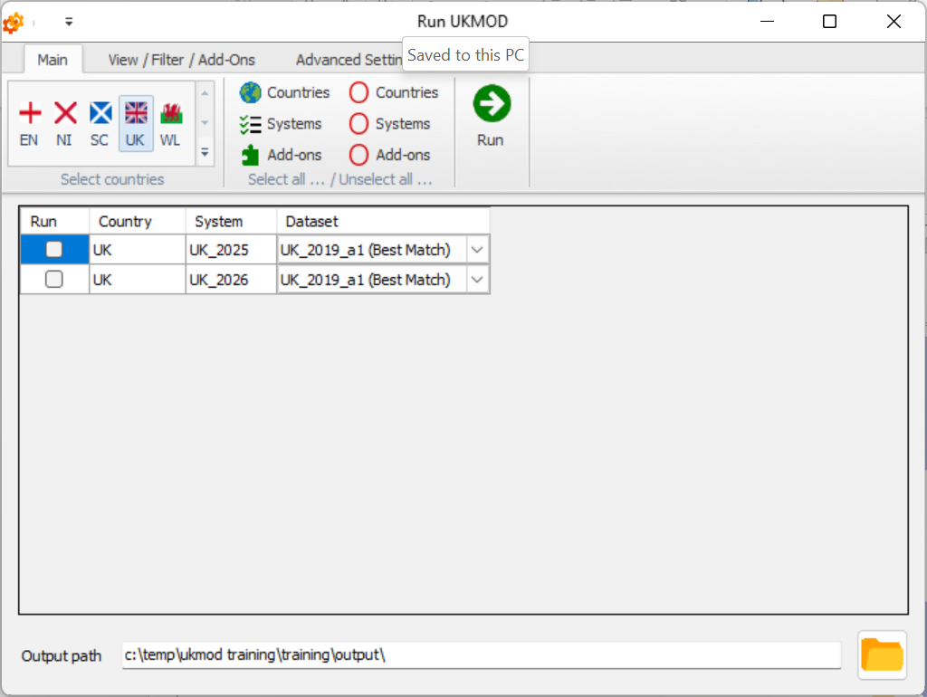
Running a single system
Select a system

Slide 38
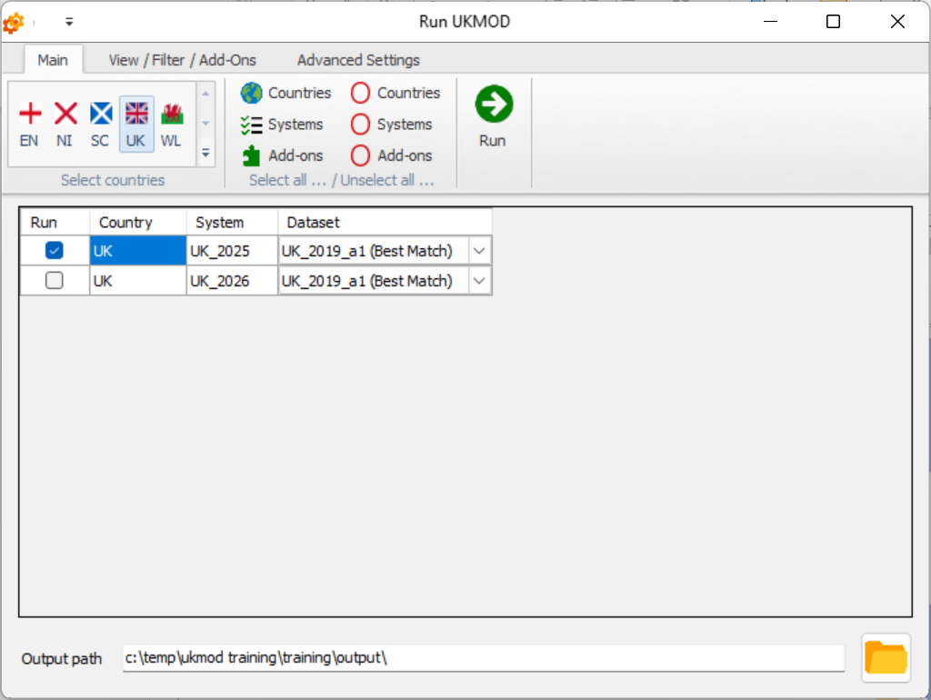
Running a single system
Select a dataset

Slide 39
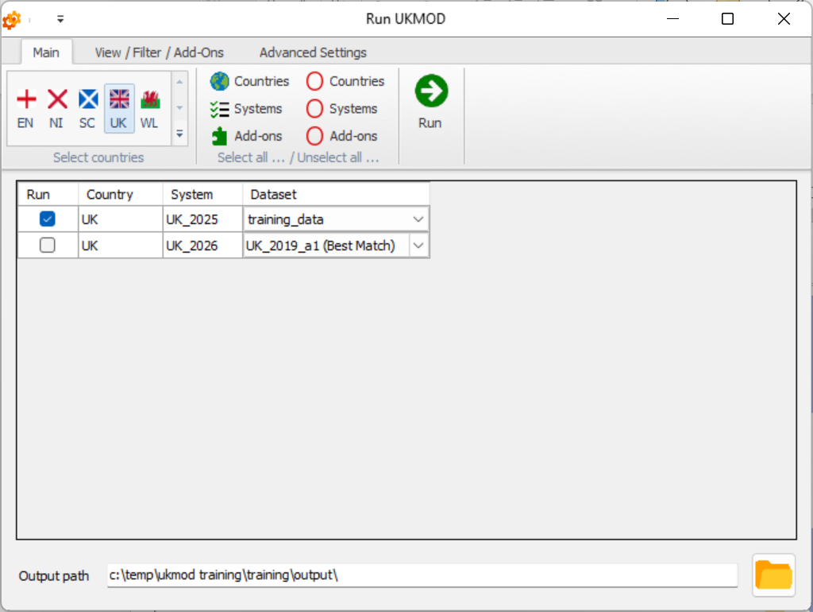
Running a single system
run

Slide 40
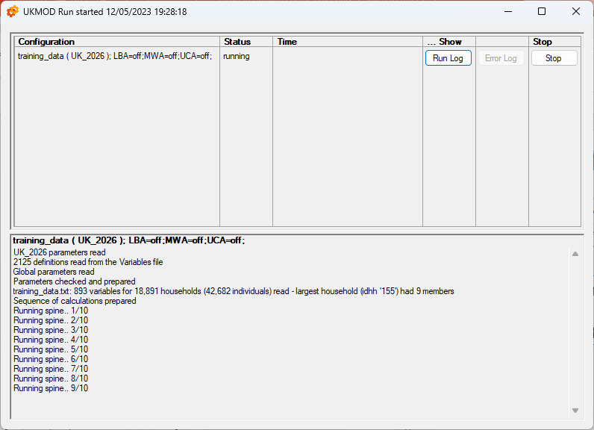
Running a single system
40
data and systems running
some details about the calculations

Slide 41
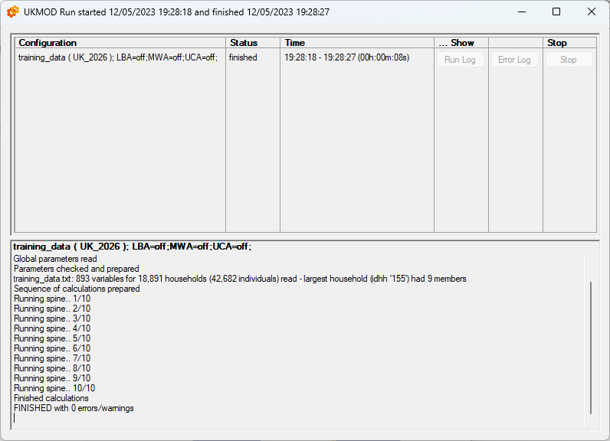
Running a single system
41

Slide 42
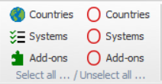
Running multiple systems
select all countries/
all systems
unselect all countries/
all systems

Slide 43
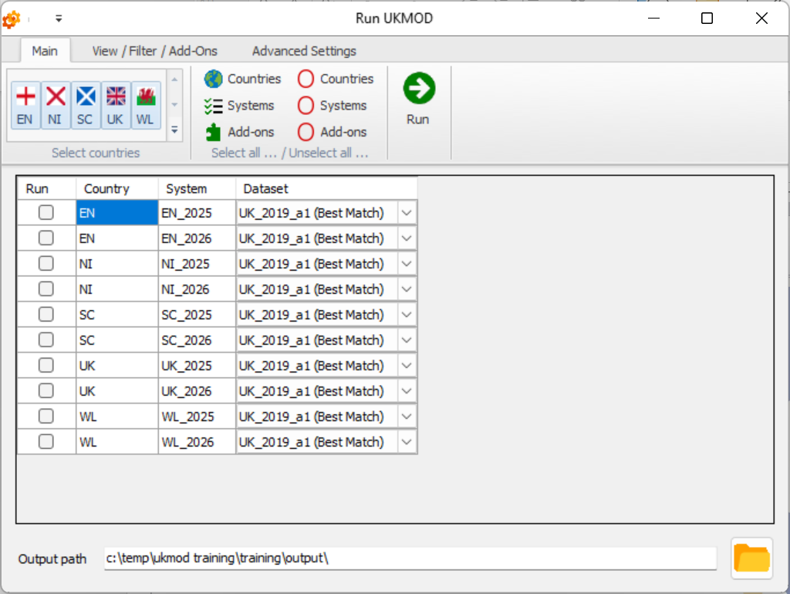
Running multiple systems
Select all systems

Slide 44
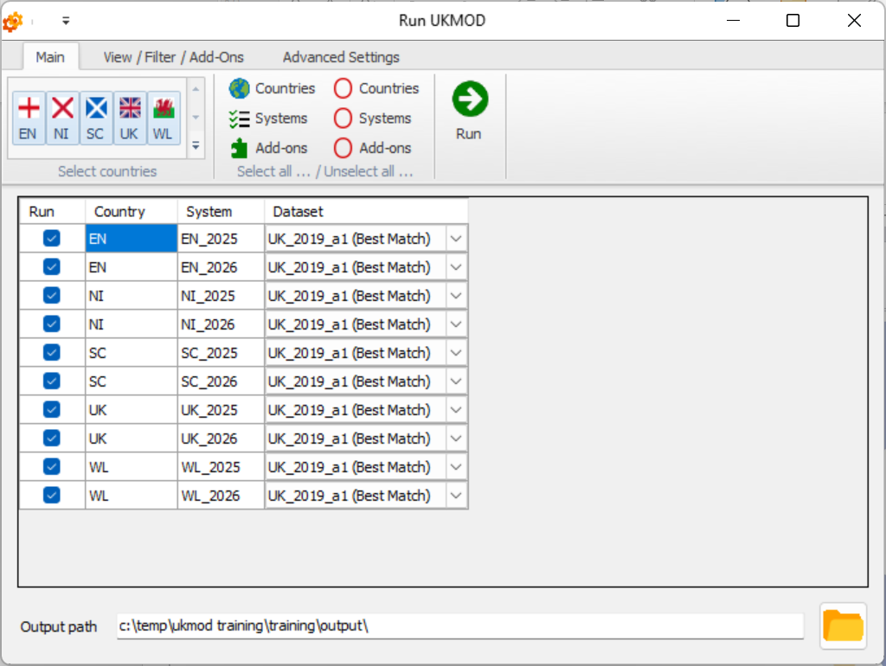
Running multiple systems
Select a dataset

Slide 45
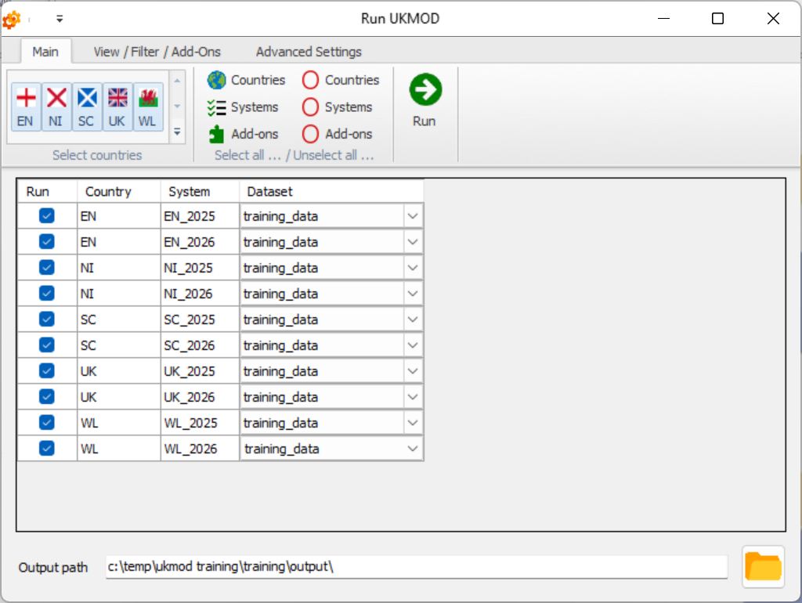
Running multiple systems
run

Slide 46
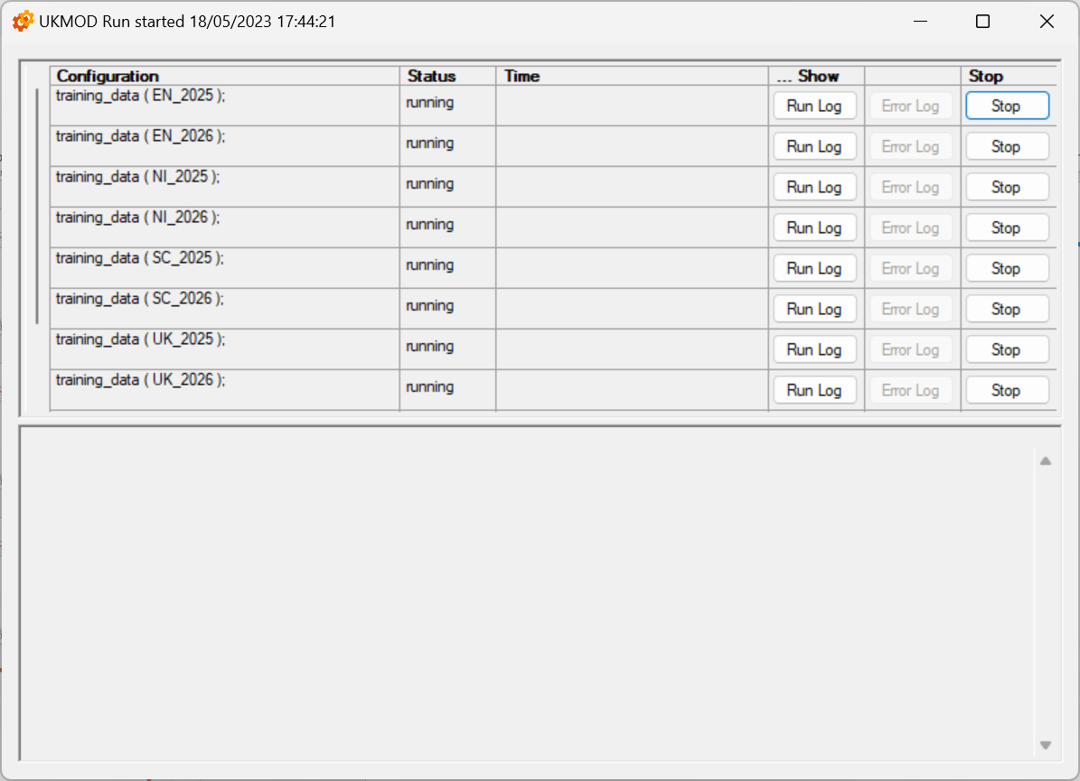
Running multiple systems

Slide 47
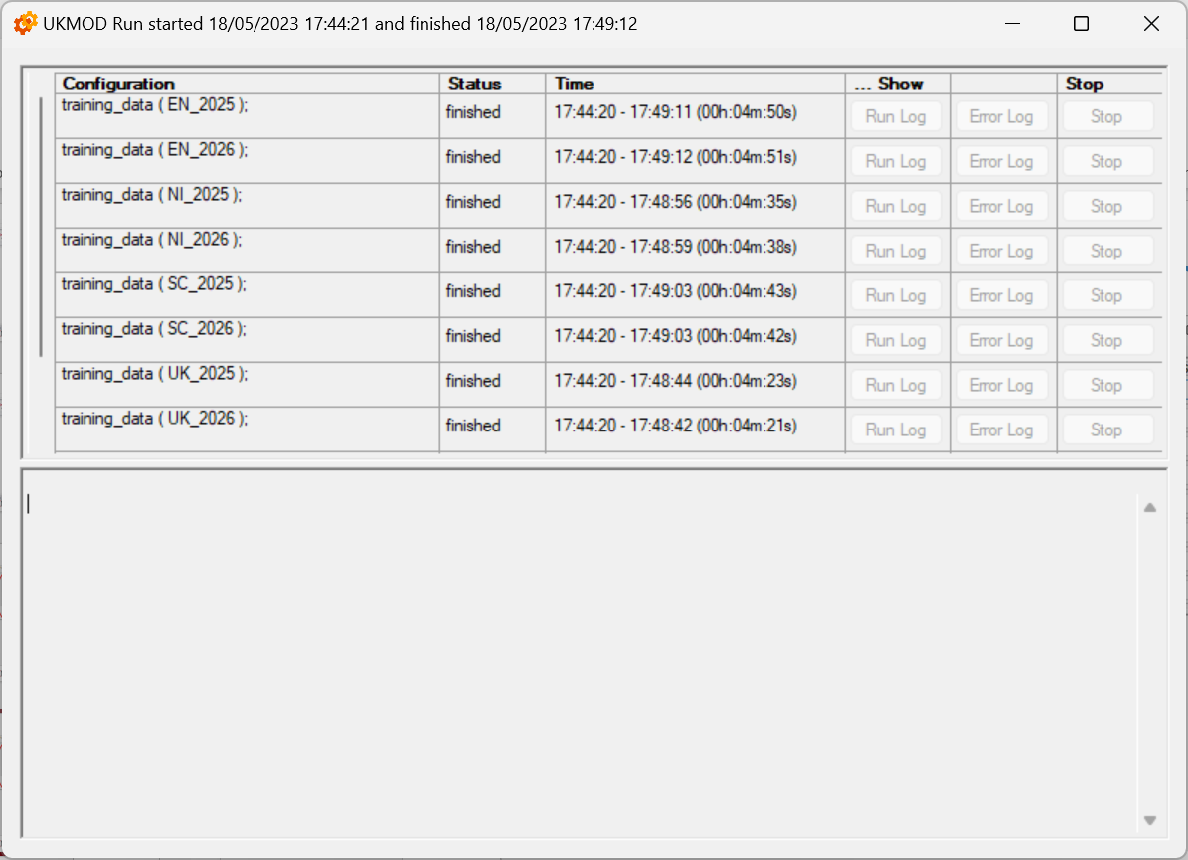
Running multiple systems

Slide 48

Statistics Presenter Tool
Original micro-data
(FRS for the UK)
Tax-benefit policy rules and parameters
(EUROMOD User Interface)
Input micro-data
(FRS or hypothetical households data)
Policy simulations
(EUROMOD software)
Output micro-data =
input micro-data + additional simulated variables
Tools for analysis: Statistics Presenter
(or statistical software e.g. Stata)

Slide 49
Statistics Presenter Tool
The tool estimates:
  distributional measures of income (poverty rates, Gini, S80/20, income shares, decomposition of income sources, gainers and losers)
  fiscal costs (government revenues and expenditures)
Notes:
Euromod outputs are in effect microdata to be used with statistical software.
Use the Statistics presenter tool to create outputs to that purpose.

Slide 50
Statistics Presenter Tool
The tool calculates income statistics for:
  a single country and policy system
  several countries/policy systems
  baseline and reform scenario and calculates difference in the income indicators
  a particular type of income (e.g. income taxes) if stronger focus on that income
Results can be exported in Excel tables
Notes:
Results can be exported in Excel and csv formats

Slide 51
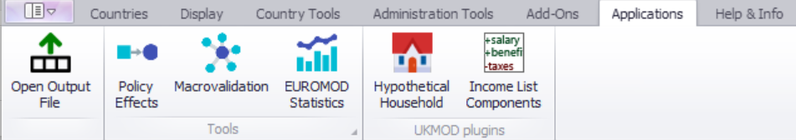
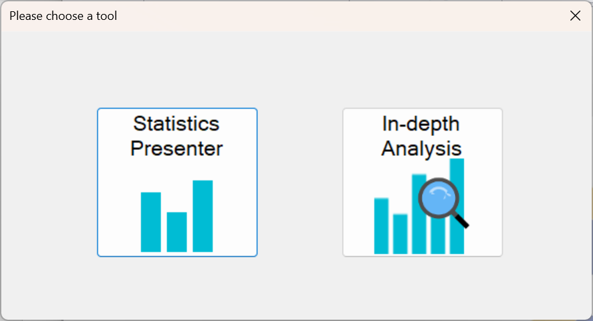
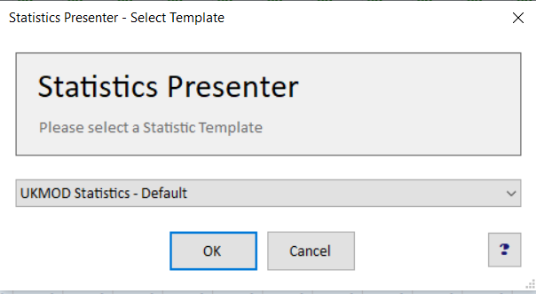
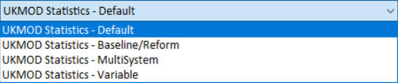
Statistics Presenter – Default

Slide 52
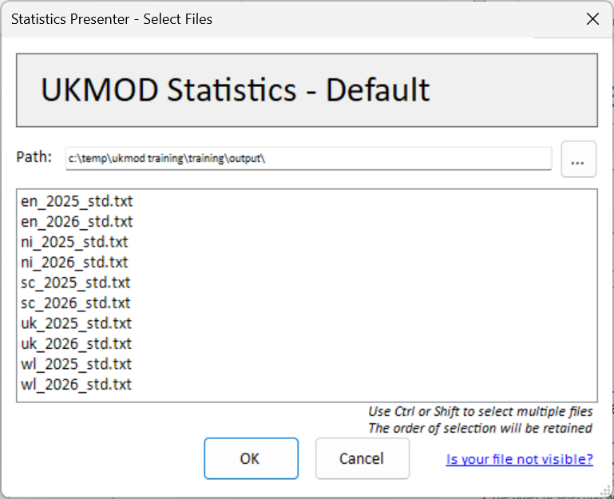
Statistics Presenter Tool – Default
list of all output micro-data available in the output folder

Slide 53
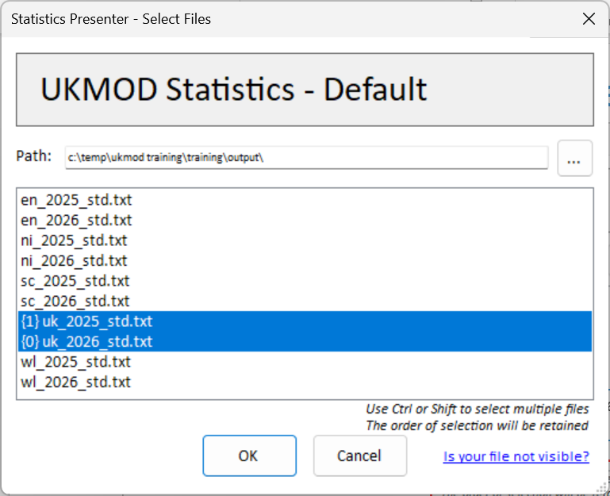
Statistics Presenter Tool – Default
I have selected the 2026 output micro-data first and the 2025 data second

Slide 54
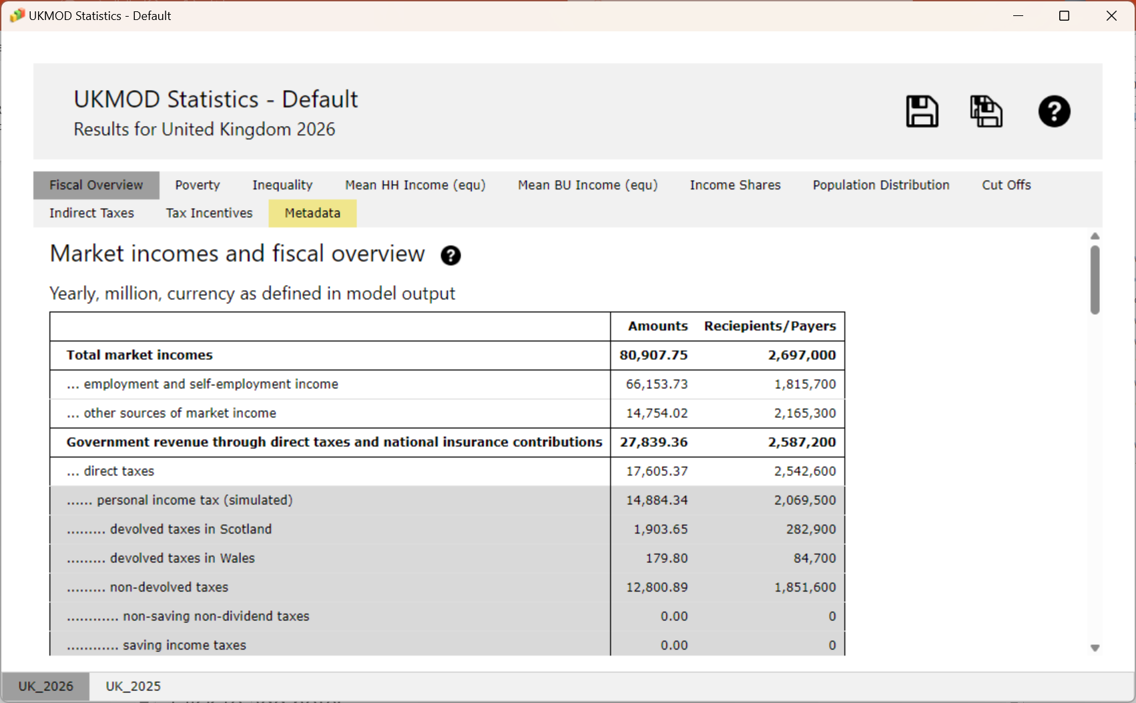
Statistics Presenter Tool – Default
country and system for which results are produced
export results to excel
table notes
9 tables with results
one sheet per output micro-data file (2026 first, 2025 second)

Slide 55
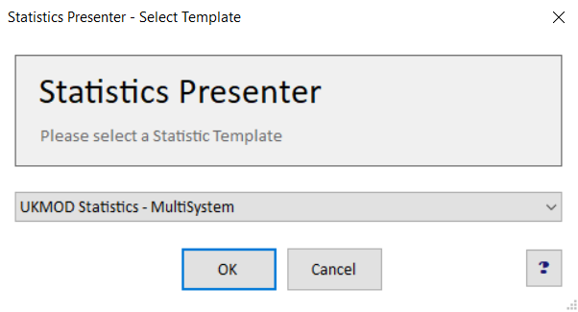
Statistics Presenter – MultiSystem

Slide 56
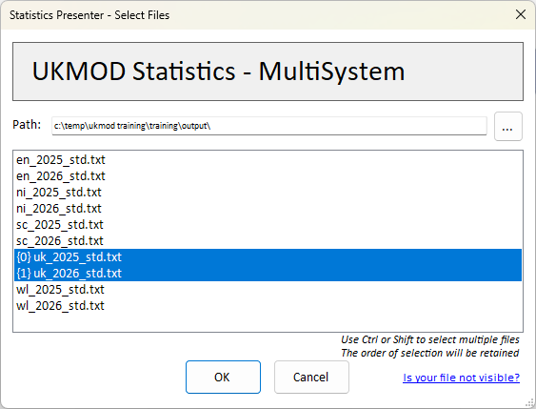
Statistics Presenter – MultiSystem

Slide 57
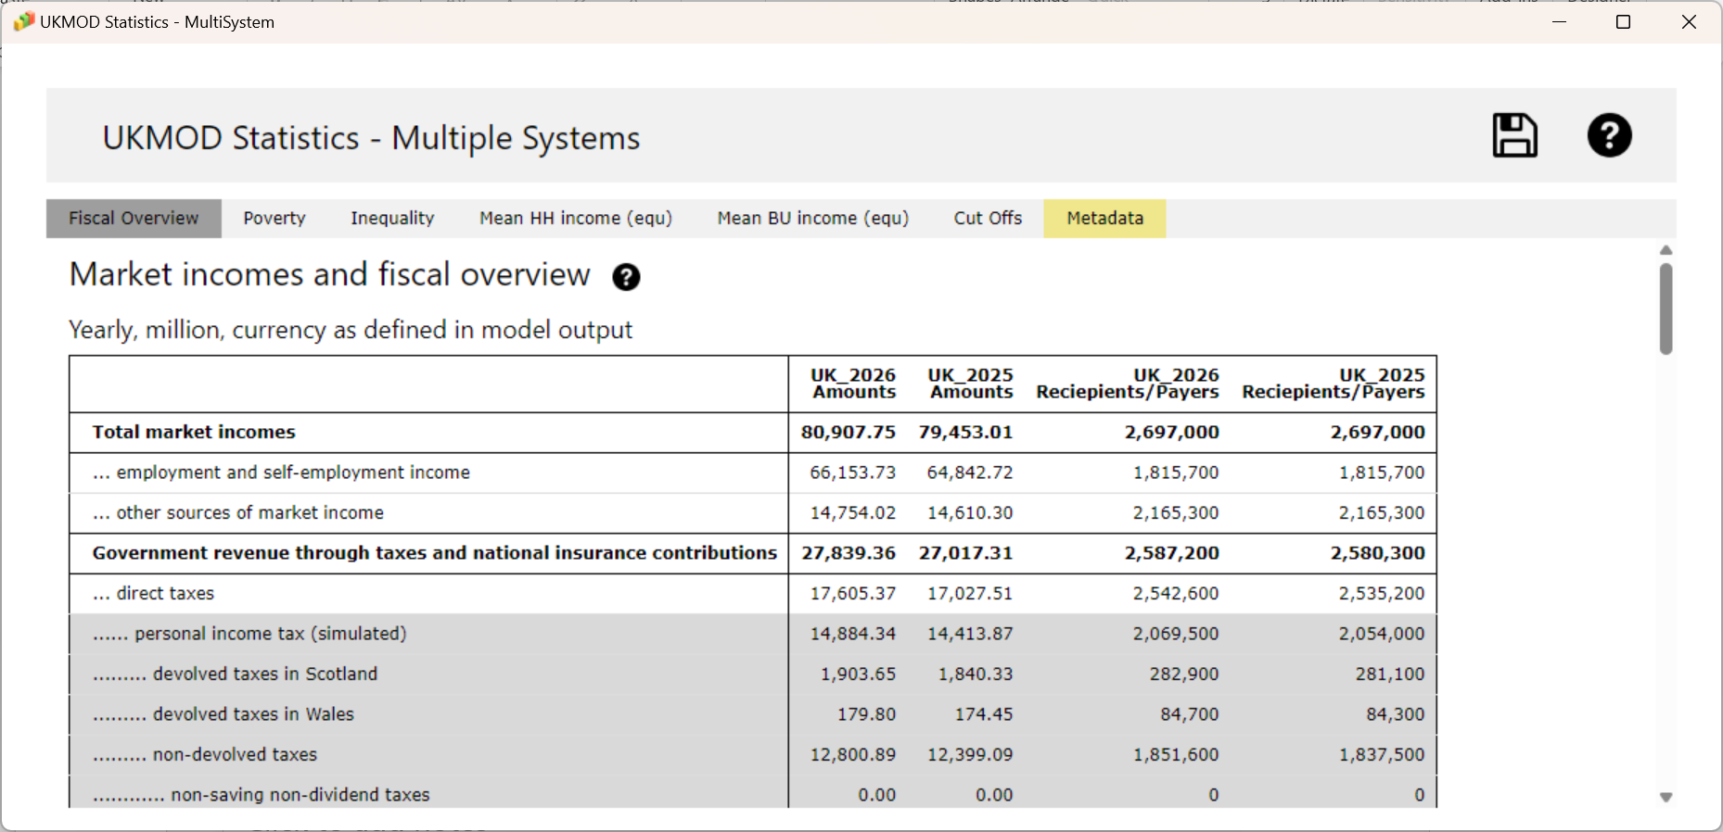
Statistics Presenter – MultiSystem
one column per system

Slide 58

Summary: Exercise 1
You learned how to:
  Open the model
  Run a single system or several systems at the same time
  Analyse the output micro-data with the Statistics Presenter, using the:
    Default template
    MultiSystem template

Slide 59

Questions

Slide 60
UKMOD via the
User Interface (UI)
Original micro-data
(FRS for the UK)
Model: Tax-benefit policy code
(via the EUROMOD User Interface)
Input micro-data
(FRS or hypothetical households data)
Policy simulations
(EUROMOD software)
Output micro-data =
input micro-data + additional simulated variables
Tools for analysis: Statistics Presenter
(or statistical software e.g. Stata)

Slide 61
In this section, you will learn about:
The building blocks of EUROMOD tax-benefit microsimulation language:
  Policies
  Functions
  Parameters
  Cells
    Operators
    Arguments

Slide 62
Policies
Policy
Function
Parameter
Parameter
Parameter
a block of functions completes a policy simulation
policy names end (usually) with the country acronym
  policies can have any name – but good to follow naming conventions
comments (in the comments column) explain what the policy intends to simulate
policies are run in the order they appear
  order of policies is called the ‘spine’
Notes:
Parameters stored in XML and manipulated via the UI
Calculation by the EUROMOD software

Slide 63
Structure of a policy
Policy column includes policy name, function and parameter names
    order of policies and functions reflects order of calculations
    groups (Grp/No) used to define conditional policy blocks
System columns include the values of the tax-benefit parameters by policy year
Comments column includes policy description

Slide 64
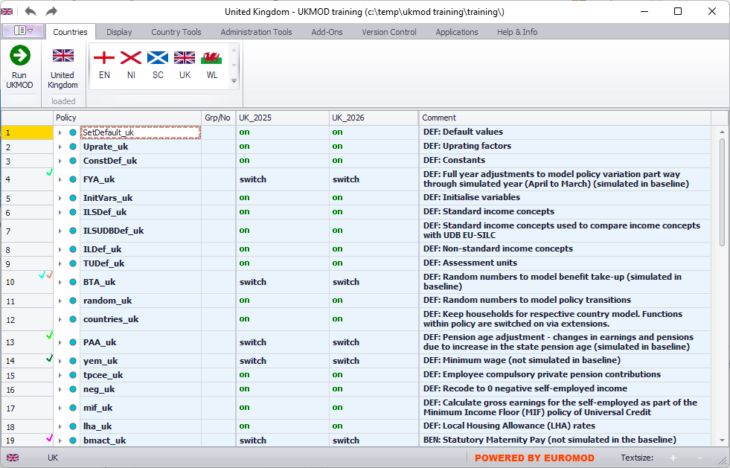
Working environment
systems
open country by clicking on a flag
comments
policies

Slide 65
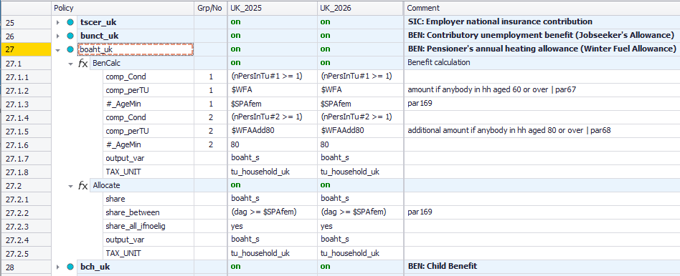
Example of a policy
policy column
group column
system columns
comments column
system
policy name
policy description
function #1
parameters
policy switch
function switch
parameter
cell

Slide 66
Example of a policy
Grp 1
Grp 2

Slide 67
Parameters
Policy
Function
Parameter
Parameter
Parameter
Can be:
    common to several functions or specific to one function
    compulsory (i.e. error generated if not used) or optional
    which parameters are compulsory/optional depend on the function
Order of parameters in a function is not important
    but order of functions in a policy is!
Manipulated via context menu (right-click)
    only relevant parameters for the given function are shown
Drag & drop can be used

Slide 68
Cells
Determines effect of a parameter on a system
Content varies depending on the parent function
  switches
  amounts
    #w #m #y #d #c #l #s
  operators
    + - * / ^ % ! | & > = <
    if() abs() min() max() ln() log() exp() sqrt() ceiling() floor() round()
  arguments:
    variables, constants, income lists, queries, tax units
    we will discuss arguments throughout this course

Slide 69
Exercise 2
You will learn to:
  How to make a copy of an existing system
  How to alter the copy to reflect a simple reform
    increase child benefit amount for the first child in the UK in 2026 by £10 per week
  Run reform system and analyse its effects using Statistics Presenter
We will do the exercise together!
  Each step is described in the following slides if you want to return to them later

Slide 70
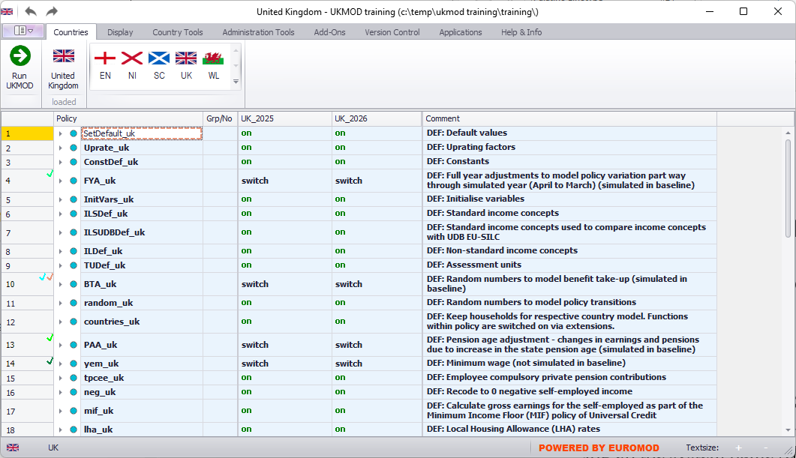
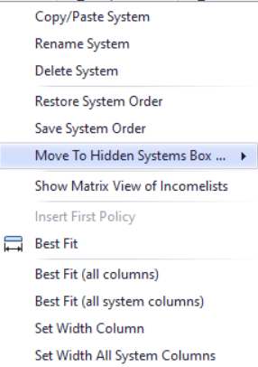
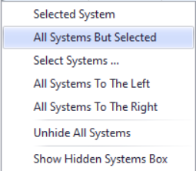
Hiding systems
right-click on system

Slide 71
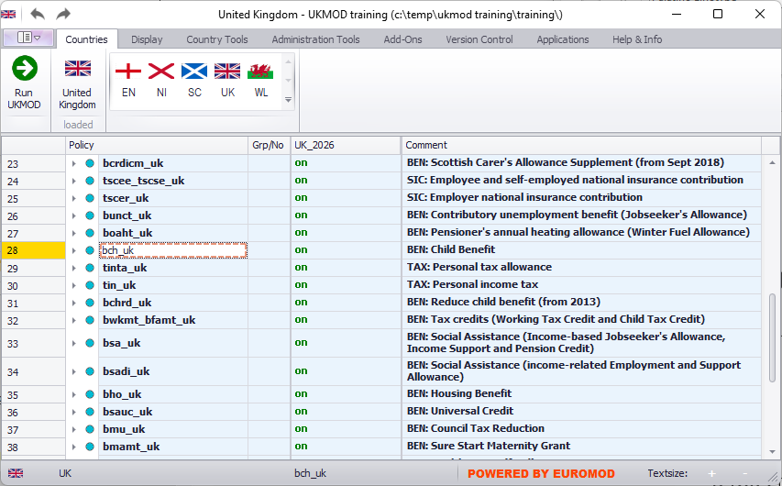
Expanding a policy
double-click the policy cell
click on triangle on the left of the policy name

Slide 72
Expanding a policy
right-click on policy name to active context menu
context menu: select option “Expand All Functions”

Slide 73
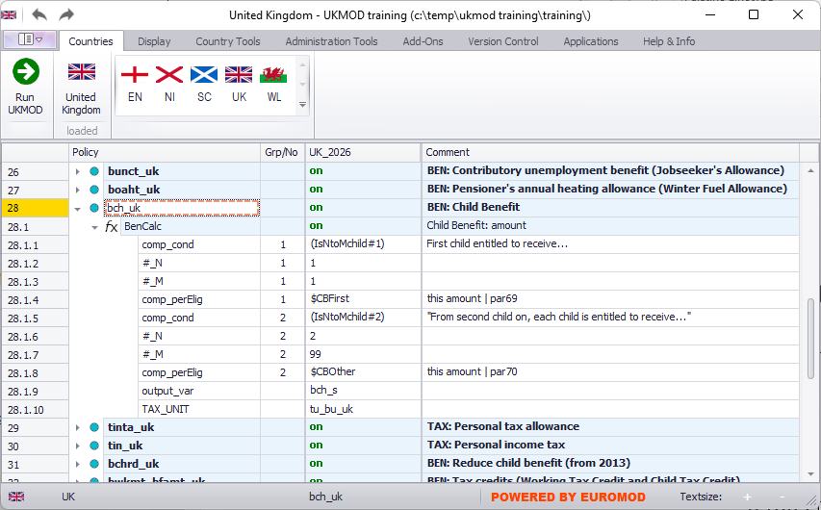
Check existing policy
The benefit amount for the first child is £25.45 per week

Slide 74
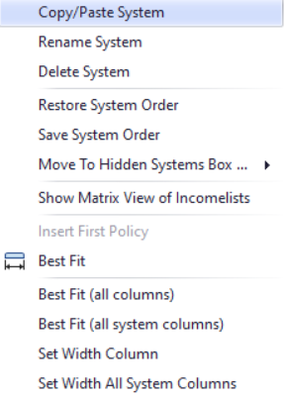
Copying a system
right-click on system name

Slide 75
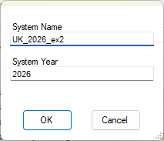
Copying a system
type in a reform system name

Slide 76
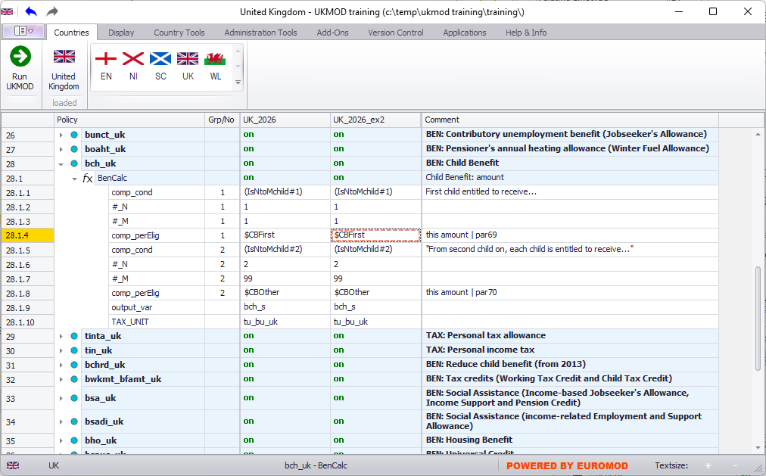
Copying a system
reform is identical to the baseline

Slide 77
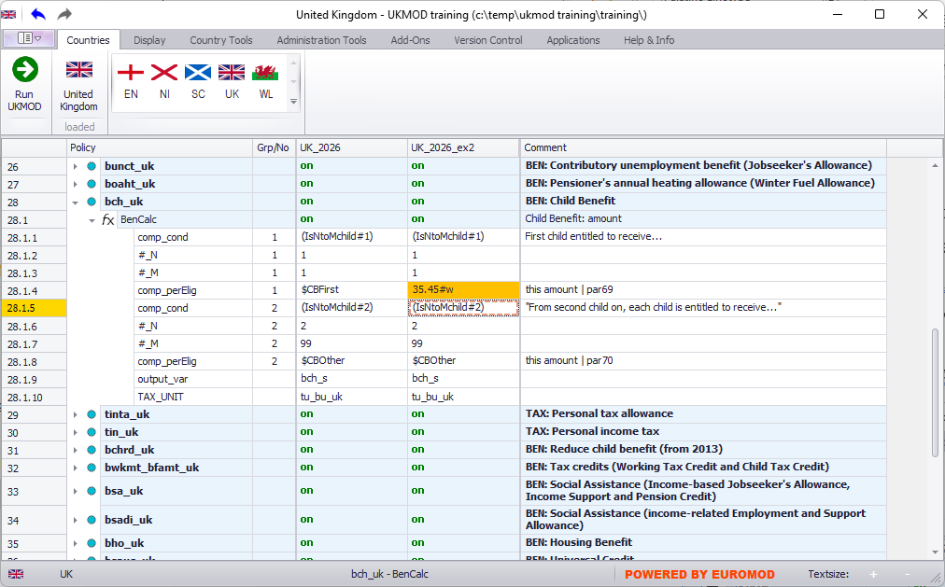
Implementing a reform
new amount; difference compared to baseline is highlighted (“conditional formatting” option)

Slide 78
Saving changes
access the file options

Slide 79
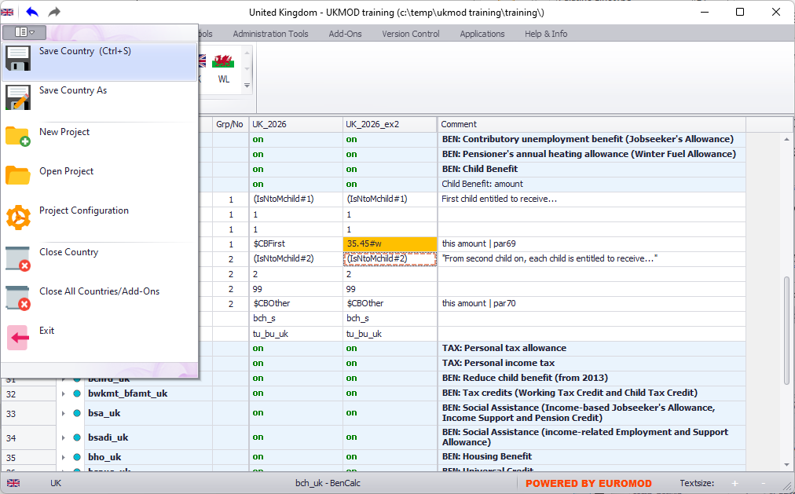
Savings changes
save changes

Slide 80
Run the base-line and reform
Run UKMOD

Slide 81
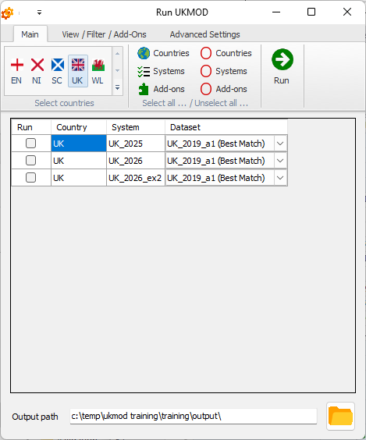
Run the base-line and reform

Slide 82
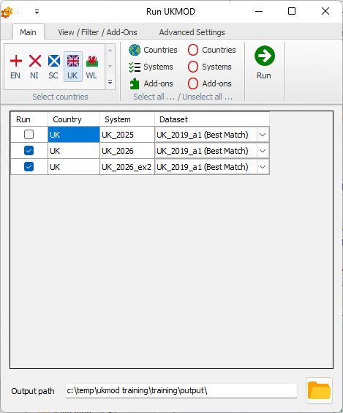
Run the base-line and reform
produce output for both the baseline and reform

Slide 83
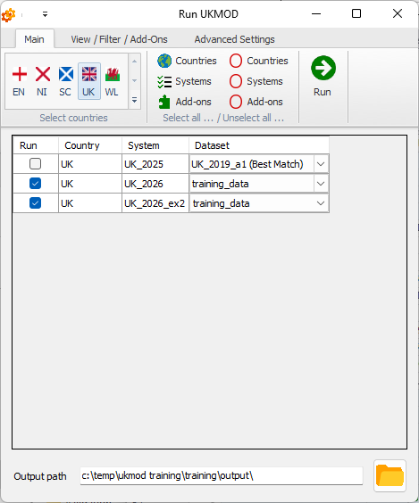
Run the base-line and reform
Use training data

Slide 84
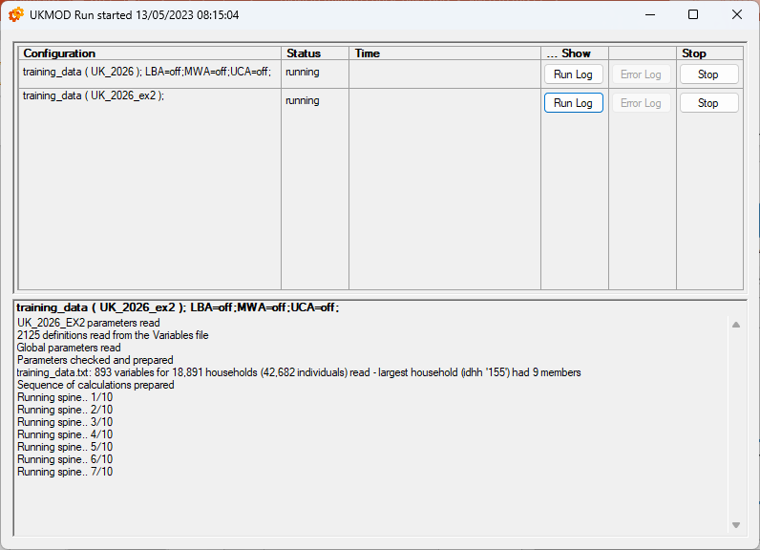
Run the base-line and reform
produce output for both the baseline and reform

Slide 85
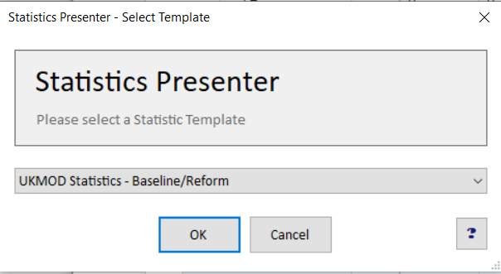
Analysing output

Slide 86
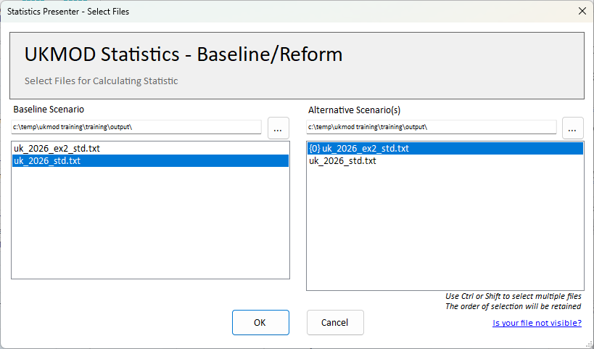
Analysing output

Slide 87
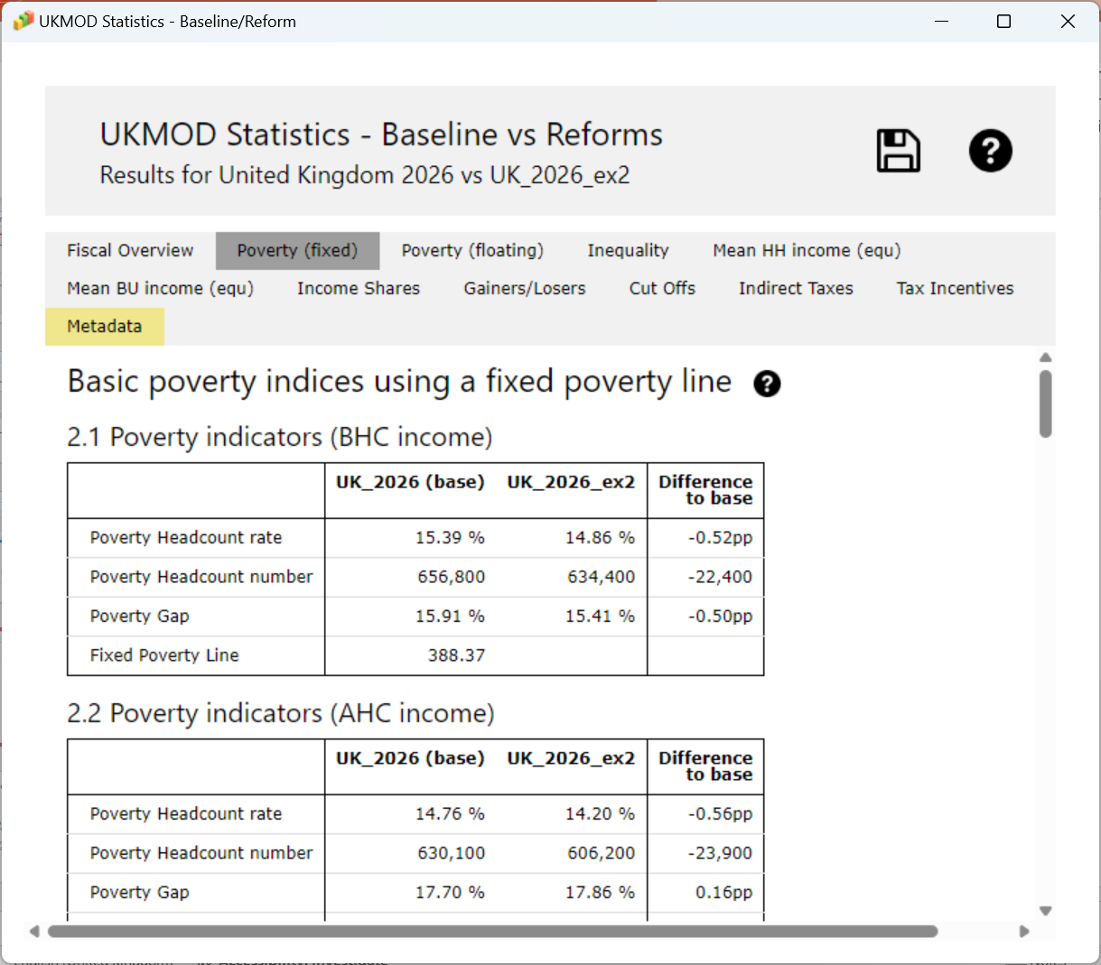
Analysing output

Slide 88
Summary: Exercise 2
You learned:
  how to add a reform system
  about basic options such as (un)hiding systems, expanding a policy and conditional formatting
  how to analyse the baseline and reform output micro-data with the Statistics Presenter, using:
    Baseline/Reform template

Slide 89
Questions

Slide 90
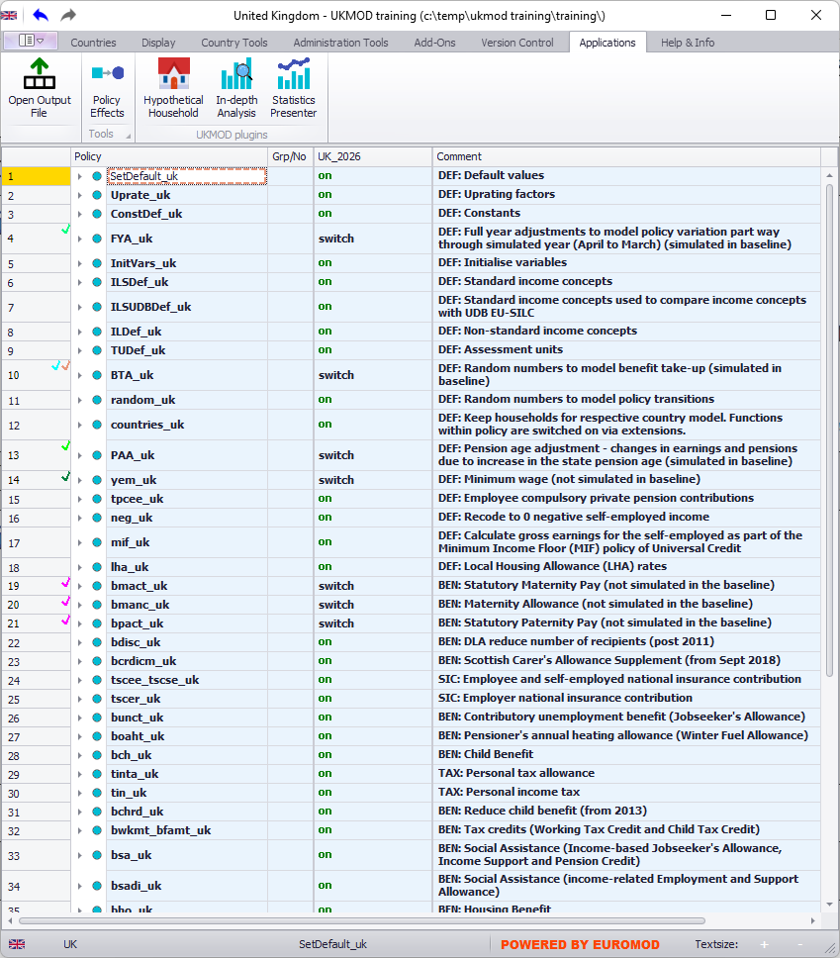
UKMOD: The policy Spine

Slide 91
In this section, you will learn about:
The policy spine:
  The order of policies is called the ‘spine’
  We will take a quick tour through the policies in the UK model
    the models for England, Northern Ireland, Scotland and Wales have the same policy spine
  See the UKMOD Country Report for more details

Slide 92
Policies in the spine
DEFINITIONS
define certain parameters or concepts; or do some pre-policy calculations
e.g. define assessment units; index (uprate) earnings if input micro-data year lags behind policy year
TAX AND BENEFIT CALCULATIONS
(almost) every tax and benefit implemented in a separate policy; policy name according to our naming convention
e.g. bch_uk (Child Benefit → b: benefit, ch: child)
OUTPUT
defines what variables to be included in the output micro-data and assessment unit for the results
e.g. include both simulated and non-simulated variables; output individual-level results

Slide 93
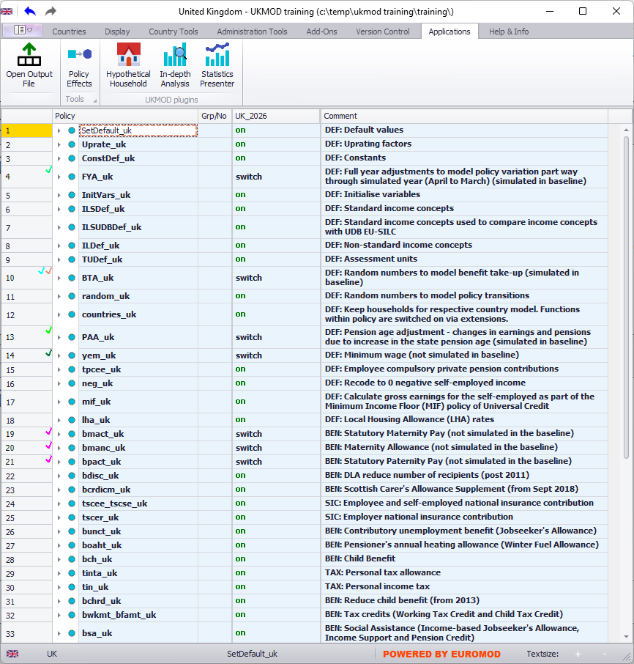
Definitions

Slide 94
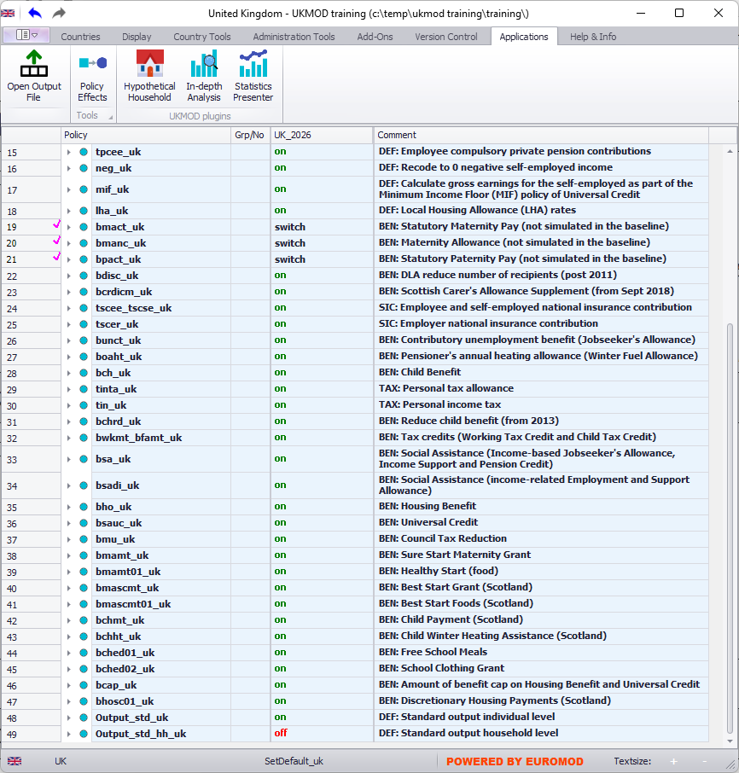
Tax and benefit calculations
National Insurance contributions for employees and self-employed implemented in a single policy due to interactions
Working and Child Tax Credit implemented in a single policy due to interactions

Slide 95
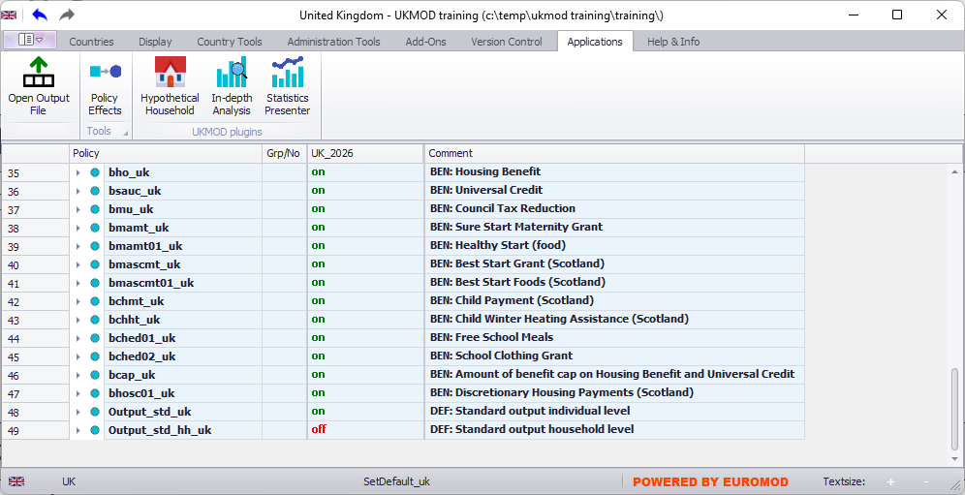
Output

Slide 96
UKMOD: THE POLICY functions elig & arithOp
Policy |  | System Name | Comment
Elig |  | on | Made-up example: condition to pay employee NI contributions
 | elig_cond | yem>0 & !IsCivilServant | with positive earnings (yem) and not a civil servant (!IsCivilServant)
 | TAX_UNIT | tu_individual_uk | assessment unit used for the calculations
ArithOp |  | on | Made-up example: pension contributions
 | Who_Must_Be_Elig | one | calculations carried out if at least one member of assessment unit fulfills condition from last Elig function
 | formula | yem*0.08 | 8% for Old-age Pension Fund
 | output_var | tsceepi_s | result saved in the variable tsceepi_s (t: tax, sc: social contributions, ee: employee, pi: pension insurance, _s: simulated)
 | TAX_UNIT | tu_individual_uk | assessment unit used for the calculations

Slide 97
Calculating a benefit/tax
What are the policy rules:
  Who is entitled to the benefit/liable to the tax, i.e. the assessment unit:
    e.g. the individual, family or household
  What eligibility criteria apply:
    e.g. with earnings up to £800 per month and receives no pensions
  What is the benefit/tax amount:
    e.g. £20 per week or 20% of taxable income
Write down the policy rule
  Using EUROMOD tax-benefit language

Slide 98
In this section, you will learn about:
Assessment units
  basic idea
Eligibility criteria
  using the Elig function
Benefit/tax amount
  using the ArithOp function
Parameter types
  amounts, formulas, queries

Slide 99
Assessment units
Main assessment units (TAX_UNIT) defined in UKMOD:
tu_household_uk: all individuals of the household are in the same unit.
tu_individual_uk: each individual of the household forms its own unit.
tu_bu_uk: the benefit unit, i.e. the nuclear family - the couple (cohabiting or married) or single adult plus any dependent children
  The household may be split into several units of different size.

Slide 100
Functions: Elig
Used to implement eligibility conditions
Compulsory parameters: elig_cond, TAX_UNIT
Eligibility condition is defined in elig_cond
  Creates a variable equal to 0 or 1 (by default sel_s)
    Save result in alternative name by specifying Output_Var
  Condition makes use of operators and queries
  Subsequent functions reference the result of an Elig function via parameter Who_Must_Be_Elig

Slide 101
Functions: Elig
Policy |  | System Name | Comment
Elig |  | on | Made-up example: condition to pay employee NI contributions
 | elig_cond | !IsCivilServant | not a civil servant (!IsCivilServant)
 | TAX_UNIT | tu_individual_uk | assessment unit used for the calculations
limiting calculations to non-civil servants

Slide 102
Functions: ArithOp
Arithmetic Operator
Compulsory parameters: formula, output_var, TAX_UNIT
  formula describes the calculation to perform
  The result of the calculation is stored in output_var
    To add the result to output from a previous function, use output_add_var
Now let’s have a look at some key parameter values we can use for formula
  amounts, operators, queries
Policy |  | System Name | Comment
ArithOp |  | on | Made-up example: child benefit
 | formula | 25#w*nDepChildrenInTu | £25 per week for each dependent child in the assessment unit
 | output_var | bch_s | result saved in the variable bch_s (b: benefit, ch: child, _s: simulated)
 | TAX_UNIT | tu_bu_uk | assessment unit used for the calculations

Slide 103
Function amounts
Monetary (numbers; use . for decimal) followed by their time period:
  #m for monthly (no conversion)
  #y for yearly
  #q for quarterly
  #w for weekly
  #d for daily
  #l for labour day
  #s for six day labour week
  #c for capital (no conversion)
Default is #m (monthly)
Policy |  | System Name | Comment
ArithOp |  | on | Made-up example: child benefit
 | formula | 25#w*nDepChildrenInTu | £25 per week for each dependent child in the assessment unit
 | output_var | bch_s | result saved in the variable bch_s (b: benefit, ch: child, _s: simulated)
 | TAX_UNIT | tu_bu_uk | assessment unit used for the calculations

Slide 104
Function operators
+ - * / ^ % ! | & > = < ()
if() abs() min() max() ln() log() exp() sqrt() ceiling() floor() round()
Policy |  | System Name | Comment
ArithOp |  | on | Made-up example: child benefit
 | formula | (25#w + xed/2)*nDepChildrenInTu - bed_s | £25 per week plus half of educational expenses (xed), for each dependent child in the assessment unit; and deduct any education benefits (bed_s)
 | output_var | bch_s | result saved in the variable bch_s (b: benefit, ch: child, _s: simulated)
 | TAX_UNIT | tu_bu_uk | assessment unit used for the calculations

Slide 105
Function queries
Frequently used ready-made calculations
The result of a query is:
  yes (=1) or no (=0) (e.g. IsDepChild)
  some (monetary or non-monetary) value (e.g. nDepChildrenInTu).
Well-documented in the Help file of the User Interface
Query | Description | Parameters
IsDepChild | Returns 1 if a person is a 'dependent child', i.e. fulfils the DepChildCond of the assessment unit specification, 0 otherwise.
nDepChildrenInTu#x | Returns the number of dependent children in the assessment unit who fulfil dag >= parameter #_AgeMin and dag <= parameter #_AgeMax. | #_AgeMin, #_AgeMax (optional)

Slide 106

Function queries
No need to learn the query names by heart
→ use “IntelliSense” feature to find and select the desired query
ArithOp |  | on | Made-up example: child benefit
 | formula | 25#w*n | £25 per week for each dependent child in the assessment unit
 | output_var | bch_s | result saved in the variable bch_s (b: benefit, ch: child, _s: simulated)
 | TAX_UNIT | tu_bu_uk | assessment unit used for the calculations

Slide 107
Functions: ArithOp
ArithOp |  | on | Made-up example: pension contributions
 | formula | yem*0.08 | 8% of earnings (yem) for Old-age Pension Fund
 | output_var | tsceepi_s | result saved in the variable tsceepi_s (t: tax, sc: social contributions, ee: employee, pi: pension insurance, _s: simulated)
 | TAX_UNIT | tu_individual_uk | assessment unit used for the calculations
calculations in ArithOp are carried out for everyone with earnings, including civil servants

Slide 108
Functions: Elig and ArithOp
Policy |  | System Name | Comment
Elig |  | on | Made-up example: condition to pay employee NI contributions
 | elig_cond | !IsCivilServant | not a civil servant (!IsCivilServant)
 | TAX_UNIT | tu_individual_uk | assessment unit used for the calculations
ArithOp |  | on | Made-up example: pension contributions
 | Who_Must_Be_Elig | one | calculations carried out if at least one member of assessment unit fulfills condition from last Elig function
 | formula | yem*0.08 | 8% of earnings (yem) for Old-age Pension Fund
 | output_var | tsceepi_s | result saved in the variable tsceepi_s (t: tax, sc: social contributions, ee: employee, pi: pension insurance, _s: simulated)
 | TAX_UNIT | tu_individual_uk | assessment unit used for the calculations

Slide 109
Functions: Elig and ArithOp
Who_Must_Be_Elig: calculations of the function are carried out if…
  one: one member of the assessment unit is eligible
  one_adult: one adult member of the assessment unit is eligible
  all: all members of the assessment unit are eligible
  all_adults: all adult members of the assessment unit are eligible
  nobody: calculations are carried out for each assessment unit (default)
By default the Who_Must_Be_Elig parameter will refer to values stored in the variable sel_s
  1 denotes eligible and 0 not eligible
This can be altered by defining an alternative variable name in the optional parameter elig_var

Slide 110
Functions: Elig and ArithOp
 |  |  |  | Will the calculations in ArithOp be carried out if: who_must_be_elig=
idhh | idperson | dag | sel_s | one | one_adult | all | all_adults | nobody
1 | 11 | 80 | ? | ? | ? | ? | ? | ?
1 | 12 | 60 | ?
1 | 13 | 40 | ?
2 | 21 | 80 | ? | ? | ? | ? | ? | ?
2 | 22 | 6 | ?
3 | 31 | 80 | ? | ? | ? | ? | ? | ?
4 | 41 | 40 | ? | ? | ? | ? | ? | ?
4 | 42 | 40 | ?
Which units will be eligible when who_must_be_elig set to nobody?
Only 1 and 2
Only 4
Only 3
1, 2, 3 and 4
Policy |  | System Name | Comment
Elig |  | on | Made-up example: eligibility condition for social assistance
 | elig_cond | dag>=80 | individual should be of age (dag) of 80+ years
 | TAX_UNIT | tu_individual_uk | assessment unit is the INDIVIDUAL
ArithOp |  | on | Made-up example: social assistance amount
 | Who_Must_Be_Elig | ? | who in the assessment unit must fulfil eligibility condition
 | formula | 100#m | benefit amount is £100
 | output_var | bsa_s | result saved in the variable bsa_s (b: benefit, sa: social assistance, _s: simulated)
 | TAX_UNIT | tu_household_uk | assessment unit is the HOUSEHOLD
1
0
0
yes
yes
no
no
yes
1
0
yes
yes
no
yes
yes
1
yes
yes
yes
yes
yes
0
0
no
no
no
no
yes

Slide 111
Functions: Elig and ArithOp
Policy |  | System Name | Comment
ArithOp |  | on | Made-up example: child benefit
 | formula | 25#w*nDepChildrenInTu | £25 per week for each dependent child in the assessment unit
 | output_var | bch_s | result saved in the variable bch_s (b: benefit, ch: child, _s: simulated)
 | TAX_UNIT | tu_bu_uk
Elig |  | on | Made-up example: eligibility condition
 | elig_cond | IsLoneParentOfDepChild | if a lone parent of a dependent child
 | TAX_UNIT | tu_bu_uk
ArithOp |  | on | Made-up example: child benefit supplement for lone parents
 | Who_Must_Be_Elig | one | at least one person in the benefit unit should be a lone parent
 | formula | 15#w | £15 per week for the assessment unit
 | output_add_var | bch_s | add answer to the result of the previous function, saved in the variable bch_s
 | TAX_UNIT | tu_bu_uk
Notes:
1st ArithOp: no filtering conditions
Show help for query IsLoneParentOfDepChild
Show help for Who)_Must_be_Elig

Slide 112


User Interface: Adding a function
Policy |  | System Name | Comment
Elig |  | on | Made-up example: eligibility condition
 | elig_cond | IsLoneParentOfDepChild | if a lone parent of a dependent child
 | TAX_UNIT | tu_bu_uk
find existing function, after/before which to place new function, and right-click on function or parameter name to open “menu”

Slide 113
User Interface: Adding a parameter
Policy |  | System Name | Comment
Elig |  | on | Made-up example: eligibility condition
 | elig_cond | IsLoneParentOfDepChild | if a lone parent of a dependent child
 | TAX_UNIT | tu_bu_uk
ArithOp |  | on | Made-up example: child benefit supplement for lone parents
 | formula | 15#w | £15 per week for the assessment unit
 | output_add_var | bch_s | add answer to the result of the previous function, saved in the variable bch_s
 | TAX_UNIT | tu_bu_uk
find relevant function and right-click on function or parameter name to open “menu”

Slide 114


User Interface: Adding a parameter
function parameters refer to

Slide 115
Exercise 3
Implement a reform to the Child Benefit (bch_uk), based on UK 2026 system
Use the functions Elig and ArithOp to introduce a £30 p.w. supplement for families with 2+ children
Run reform system and analyse impact on household incomes of the reform using the Statistics Presenter
This time you will do the exercise on your own!

Slide 116
Summary: Exercise 3
You learned how to use Elig and ArithOp to implement a benefit, using
  Who_Must_Be_Elig to link Elig and ArithOp
  Queries & amount parameters
  Parameter output_add_var
You learned how to add a new function and a parameter

Slide 117
Questions

Slide 118

Handling Errors

Slide 119
In this section, you will learn:
How to handle errors in the model:
  How to read/interpret the error message
  How to find the location of the error in the model

Slide 120

Handling errors
typo in the syntax:
35.45# instead of 35.45#w

Slide 121

Handling errors

Slide 122

Handling errors
location of the error: policy, function, parameter
unique identifier for the exact place of the error in the model

Slide 123

Handling errors
search policies, functions or parameters by their identifier

Slide 124


Handling errors
copy unique identifier from error log and paste it here

Slide 125

Handling errors
Output folder: log file (text format)
Same info as in the running dialogue box
Logs contain time stamp of their creation
Info about EUROMOD version, policy system where error occurred and dataset used

Slide 126
Types of function
Policy
Function
Parameter
Parameter
Parameter
System functions
functions used to define some general settings
e.g. to define income lists and tax units
Policy functions
functions used to implement tax-benefit policies
e.g. define eligibility, calculate amount etc.
Special functions
more advanced functions that perform more complicated tasks
e.g. loops, change parameters at run-time etc.
we already learned about Elig and ArithOp
we will also learn about BenCalc, SchedCalc, Allocate
not covered in this course
we will learn about DefIL, DefConst, DefTU, DefVar, DefOutput, Uprate

Slide 127
UKMOD: THE POLICY FUNCTION bencalc
Policy |  | Grp/No | System Name | Comment
BenCalc |  |  | on | Made-up example: child benefit
 | Comp_Cond | 1 | nDepChildrenInTu>=1 & IsDepChild | if at least one dependent child in the assessment unit…
 | Comp_perElig | 1 | 20#w | …benefit amount is £20 per week per child
 | Comp_Cond | 2 | IsDepChild & IsDisabled | if a child with a disability in the assessment unit…
 | Comp_perElig | 2 | 10#w | …£10 per week for each child with a disability
 | Comp_Cond | 3 | IsLoneParentOfDepChild | if a lone parent in the assessment unit…
 | Comp_perTU | 3 | 5#w | …£5 per week for the assessment unit
 | output_var |  | bch_s
 | TAX_UNIT |  | tu_bu_uk | assessment unit used for the calculations

Slide 128
In this section, you will learn about:
The function BenCalc
  Combines Elig and ArithOp functions
  Used to implement benefits
  Compulsory parameters: Comp_Cond, Comp_PerTU/Comp_PerElig, output_var, TAX_UNIT
Policy |  | Grp/No | System Name | Comment
BenCalc |  |  | on | Made-up example: child benefit
 | Comp_Cond | 1 | nDepChildrenInTu>=1 & IsDepChild | if at least one dependent child in the assessment unit…
 | Comp_perElig | 1 | 20#w | …benefit amount is £20 per week per child
 | Comp_Cond | 2 | IsDepChild & IsDisabled | if a child with a disability in the assessment unit…
 | Comp_perElig | 2 | 10#w | …£10 per week for each child with a disability
 | Comp_Cond | 3 | IsLoneParentOfDepChild | if a lone parent in the assessment unit…
 | Comp_perTU | 3 | 5#w | …£5 per week for the assessment unit
 | output_var |  | bch_s
 | TAX_UNIT |  | tu_bu_uk | assessment unit used for the calculations

Slide 129
Function BenCalc
Comp_Cond used to define a condition
  Reflects elig_cond in Elig
Comp_perTU or Comp_perElig used to calculate a formula
  Reflects formula in ArithOp
  Comp_perTU: amount is added once to the assessment unit
  Comp_perElig: amount is added once for each individual, fulfilling the condition, in the assessment unit
Groups used to combine Comp_Cond and either Comp_perTU or Comp_perElig into one component (not both)
Can set upper and lower limits for each component
  Comp_Lowlim
  Comp_Uplim

Slide 130
Comp_perTU vs Comp_perElig
Policy |  | Grp/No | System Name | Comment
BenCalc |  |  | on | Made-up example: child benefit
 | Comp_Cond | 1 | nDepChildrenInTu>=1 & IsDepChild | if at least one dependent child in the assessment unit…
 | Comp_perTU | 1 | 20#w | …benefit amount is £20 per week PER BENEFIT UNIT
 | output_var |  | bch_s
 | TAX_UNIT |  | tu_bu_uk | assessment unit used for the calculations
Policy |  | Grp/No | System Name | Comment
BenCalc |  |  | on | Made-up example: child benefit
 | Comp_Cond | 1 | nDepChildrenInTu>=1 & IsDepChild | if at least one dependent child in the assessment unit…
 | Comp_perElig | 1 | 20#w | …benefit amount is £20 per week PER CHILD
 | output_var |  | bch_s
 | TAX_UNIT |  | tu_bu_uk | assessment unit used for the calculations

Slide 131
Function BenCalc
Example: A lone parent family with two children, one with a disability, will receive ?
£55#w
Policy |  | Grp/No | System Name | Comment
BenCalc |  |  | on | Made-up example: child benefit
 | Comp_Cond | 1 | nDepChildrenInTu>=1 & IsDepChild | if at least one dependent child in the assessment unit…
 | Comp_perElig | 1 | 20#w | …benefit amount is £20 per week per child
 | Comp_Cond | 2 | IsDepChild & IsDisabled | if a child with a disability in the assessment unit…
 | Comp_perElig | 2 | 10#w | …£10 per week for each child with a disability
 | Comp_Cond | 3 | IsLoneParentOfDepChild | if a lone parent in the assessment unit…
 | Comp_perTU | 3 | 5#w | …£5 per week for the assessment unit
 | output_var |  | bch_s
 | TAX_UNIT |  | tu_bu_uk | assessment unit used for the calculations

Slide 132
The query IsNtoMchild#x
IsNtoMchild#x is useful for implementing payments that vary by the number of children
  Returns 1 if a person belongs to the n to m eldest dependent children of the assessment unit, 0 otherwise.
  n and m are defined by footnote parameters #_N and #_M.
Policy |  | Grp/No | System Name | Comment
BenCalc |  |  | on | Made-up example: child benefit
 | Comp_Cond | 1 | IsNtoMchild#1 | if the dependent child is…
 | #_N | 1 | 1 | ...the first (eldest) child
 | #_M | 1 | 1
 | Comp_perElig | 1 | 20#w | benefit amount is £20 per week for the first (oldest) child
 | Comp_Cond | 2 | IsNtoMchild#2 | if the dependent child is…
 | #_N | 2 | 2 | …the second or any other child
 | #_M | 2 | 99
 | Comp_perElig | 2 | 10#w | benefit amount is £10 per week for any other child
 | output_var |  | bch_s
 | TAX_UNIT |  | tu_bu_uk | assessment unit used for the calculations
- footnote parameters are referred to by #
- they are grouped together with main parameter they refer to

Slide 133

Function BenCalc
Modelling benefits withdrawal

Slide 134
Function BenCalc
Withdraw parameters: subtract something from the calculated sum of components
  Withdraw_Base: variable or income list against which the benefit is withdrawn
  Withdraw_Rate: rate at which benefit is withdrawn against the base (e.g. 0.10 = 10 pennies for every pound)
  Withdraw_Start: level of the base where withdrawal starts
  Withdraw_End: level of the base where benefit hits 0
Result = benefit - (base - start) * rate
Rate and End cannot be used simultaneously:
rate = benefit / (end - start)
All monetary values converted to a common time scale
  e.g. withdrawal base of annual income is converted to weekly income before evaluation of the means test for a weekly benefit

Slide 135
Function BenCalc
Policy |  | Grp/No | System Name | Comment
BenCalc |  |  | on | Made-up example: child benefit
 | Comp_Cond | 1 | IsLoneParentOfDepChild | if there is a lone parent in the assessment unit…
 | Comp_perTu | 1 | 20#w | …benefit amount is £20 per week, if assessment unit has earnings up to £20,000 per year
 | Withdraw_Base |  | yem | withdraw benefit amount as earnings (yem) increase
 | Withdraw_Start |  | 20000#y | withdraw benefit amount if earnings equal or exceed £20,000 per year
 | Withdraw_Rate |  | 0.1 | 10% are withdrawn for each £1 earned above £20,000 per year
 | output_var |  | bch_s
 | TAX_UNIT |  | tu_bu_uk | assessment unit used for the calculations
the calculations done with the withdraw parameters apply to the sum of all components
withdraw parameters do not need to be grouped

Slide 136
Exercise 4
Use the BenCalc function to add a supplement to child benefit worth up to £30 per week payable to benefit units with at least two dependent children to the 2026 tax and benefit system for the UK.
The supplement should be withdrawn until it is exhausted at the rate of £1 per week for each £10 of employment earnings per week, on any employment earnings in excess of £20,000 per year.
Run reform system and analyse impact on household incomes of the reform using the Statistics Presenter

Slide 137
Summary: Exercise 4
You learned how to use BenCalc to implement a benefit
  Grouping together Comp_Cond and Comp_perTU
  Using optional parameters Withdraw_Base, Withdraw_Start, Withdraw_Rate

Slide 138
Questions

Slide 139

End of Day 1

