Slide 1
UKMOD training course
Daria Popova & Justin van de Ven
ISER, University of Essex
1-2 July 2024

Slide 2
Re-cap of Day 1
We learned about:
How to use the policy functions Elig and ArithOp
How to link them via the parameter Who_must_be_elig
The parameter output_add_var
How to use the policy function BenCalc
Parameters Comp_perTU/Comp_perElig and Comp_Cond
How to combine/group together parameters via column Grp/No
Parameter operators and queries
Handling errors

Slide 3
Outline for Day 2
Day 2:
UKMOD policy function SchedCalc
UKMOD system functions DefConst and DefIl
Exercise using functions SchedCalc and DefConst
Exercise using function DefIL
UKMOD policy function Allocate
UKMOD system function DefTU
Exercise using function DefTU
UKMOD system functions Uprate, DefVar
UKMOD system functions DefOutput and SetDefault

Slide 4
Types of function
Policy
Function
Parameter
Parameter
Parameter
SYSTEM FUNCTIONS
functions used to define some general settings
e.g. income lists and tax units
POLICY FUNCTIONS
functions used to implement tax-benefit policies
e.g. define eligibility, calculate amount
SPECIAL FUNCTIONS
more advanced functions that perform more complicated tasks
e.g. loops, change parameters at run-time
In day 1 we learned about Elig, ArithOp and BenCalc
Today we will learn about SchedCalc and Allocate
not covered in this course
we will learn about DefConst, DefIL, DefTU, Uprate, DefVar, DefOutput, SetDefault
Notes:
argument

Slide 5
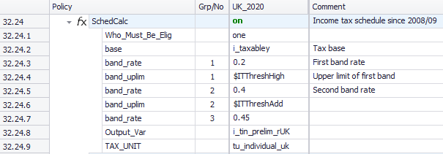
UKMOD: policy FUNCTION SchedCalc

Slide 6
Function SchedCalc
Used (mainly) for progressive taxes
Tax schedule
Tax bands: Band_UpLim / Band_LowLim
Tax rate: Band_Rate
Tax base: Base
“group” together Band_Rate and Band_UpLim/Band_LowLim
Instead of rates, for fixed amounts use Band_Amount
Policy |  | Grp/No | System Name | Comment
SchedCalc |  |  | on | Made-up example: income tax
 | Base |  | tintb_s | income tax calculated based on taxable income (t: tax, in: income, tb: tax base, _s: simulated)
 | Band_Rate | 1 | 0.2 | first band rate: 20%
 | Band_LowLim | 1 | 12500#y | first band rate applies on income above £12.5k per year…
 | Band_UpLim | 1 | 50000#y | …and up to £50k per year
 | Band_Rate | 2 | 0.4 | second band rate: 40%
 | Band_UpLim | 2 | 150000#y | second band rate applies on income above £50k and up to £150k per year
 | Band_Rate | 3 | 0.45 | third band rate: 45%; applies on income above £150k per year
 | output_var |  | tin_s | result saved in variable tin_s (t: tax, in: income, _s: simulated)
 | TAX_UNIT |  | tu_individual_uk | assessment unit used for the calculations

Slide 7
Function SchedCalc
Joint taxation: Quotient
Result = ((Base/Quotient)*Tax schedule)*Quotient
Policy |  | Grp/No | System Name | Comment
SchedCalc |  |  | on | Made-up example: income tax based on joint taxation
 | Base |  | tintb_s | income tax calculated based on taxable income (t: tax, in: income, tb: tax base, _s: simulated)
 | Band_Rate | 1 | 0.2 | first band rate: 20%
 | Band_LowLim | 1 | 12500#y | first band rate applies on income above £12.5k per year…
 | Band_UpLim | 1 | 50000#y | …and up to £50k per year
 | Band_Rate | 2 | 0.4 | second band rate: 40%
 | Band_UpLim | 2 | 150000#y | second band rate applies on income above £50k and up to £150k per year
 | Band_Rate | 3 | 0.45 | third band rate: 45%; applies on income above £150k per year
 | Quotient |  | 2 | Base is divided by the quotient before the schedule is applied. Afterwards the result is multiplied by the quotient.
 | output_var |  | tin_s | result saved in variable tin_s (t: tax, in: income, _s: simulated)
 | TAX_UNIT |  | tu_couple_uk | assessment unit used for the calculations
Notes:
Check EM help for simpler example

Slide 8
Function SchedCalc
Simple_Prog: apply highest marginal tax rate reached by base on the whole income
Policy |  | Grp/No | System Name | Comment
SchedCalc |  |  | on | Made-up example: income tax
 | Base |  | tintb_s | income tax calculated based on taxable income (t: tax, in: income, tb: tax base, _s: simulated)
 | Band_Rate | 1 | 0.2 | first band rate: 20%
 | Band_LowLim | 1 | 12500#y | first band rate applies on the whole income if income is between £12.5k per year…
 | Band_UpLim | 1 | 50000#y | …and £50k per year
 | Band_Rate | 2 | 0.4 | second band rate: 40%
 | Band_UpLim | 2 | 150000#y | second band rate applies on the whole income if income is between £50k and up to £150k per year
 | Band_Rate | 3 | 0.45 | third band rate: 45%; applies on the whole income if income is above £150k per year
 | Simple_Prog |  | yes
 | output_var |  | tin_s | result saved in variable tin_s (t: tax, in: income, _s: simulated)
 | TAX_UNIT |  | tu_individual_uk | assessment unit used for the calculations

Slide 9
UKMOD: SYSTEM FUNCTIONS DefConst, DefIL

Slide 10
Functions: DefConst
The DefConst function defines named arguments that take the same value for population subgroups within each policy system
notated as $<var> where <var> is replaced by the variable name
Advantages:
Differences in rates and thresholds between policy systems can be observed as variation over a single row of the policy spine
Simplifies updating of tax-benefit parameters
Facilitates application of the same policy constant in multiple cells of the policy spine

Slide 11
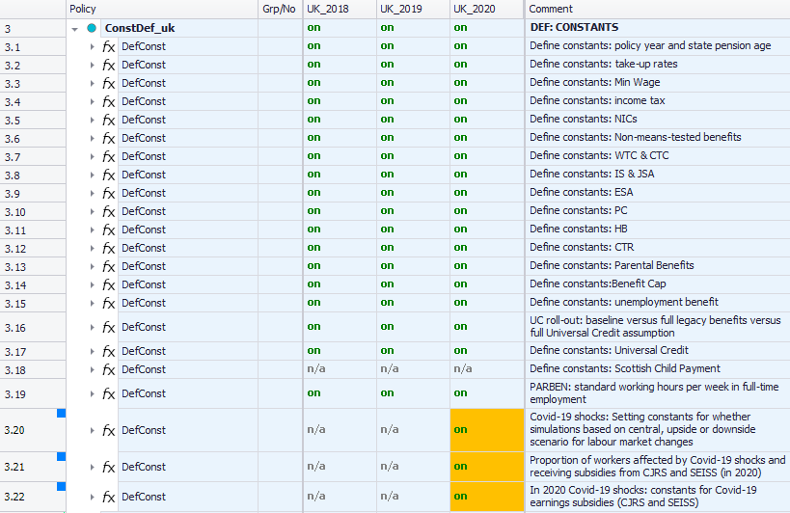
Functions: DefConst

Slide 12
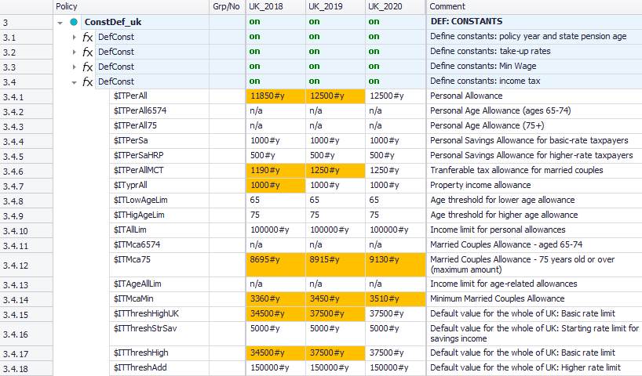
Functions: DefConst
user-defined constant names $IT<name> in “parameters” column
changes to constant values highlighted
Notes:
The naming convention here is inconsistent with EUROMOD conventions…

Slide 13
The parameter “condition” in DefConst
Allows for multiple definitions of the same constant with conditions
Similar to an “if” statement in most programming languages
A base/default value needs to be defined
If more than one condition is true, the matching condition with the largest group number determines the final constant value
Policy |  | Grp/No | System Name | Comment
DefConst |  |  | on | Made-up example: Defining income tax parameters as constants
 | $ITThreshHigh |  | 37500#y | Income tax threshold - base/default value needs to be defined first before conditions can be used
 | Condition | 1 | drgn1=12 | if region (drgn1) is Scotland…
 | $ITThreshHigh | 1 | 30930#y | …this value applies (overwrites default value)
 | Condition | 2 | drgn1=11 | if region is Wales...
 | $ITThreshHigh | 2 | 37500#y | … this value applies (overwrites default value)
Default value applies to England and Northern Ireland, as no separate conditions given for these regions

Slide 14
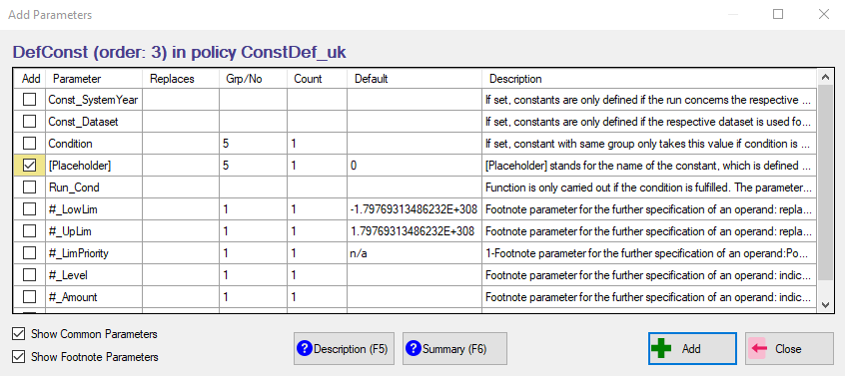
How to add a new constant
right-click on DefConst function
select “Add Parameter Form”
select parameter “[Placeholder]”
type in constant name in place of [Placeholder]
Notes:
Can only add one parameter at a time

Slide 15
Functions: DefIL
Income lists are aggregates of several income sources
“Standard”, used for distributional analysis (e.g. household net income) or fiscal overview (e.g. income taxes)
“Non-standard”, used for policy implementation (e.g. taxable income)
System function DefIL is used to define income lists
naming convention:
prefix ils_ for “standard”
prefix il_ for “non-standard”
“standard”, defined in the policy ILSDef_uk
Used by the Statistics Presenter
“non-standard”, usually defined in the policy ILDef_uk

Slide 16
Functions: DefIL
Aggregates of variables, pre-defined income lists, fixed amounts, constants
Operations: +, -, fractions (e.g. +0.5), n/a (not applicable)
Use
once defined, available for all subsequent functions and policies
behave like monetary variables, with values specific to each observation in the input dataset (unlike constants)
saved as part of the model output dataset

Slide 17
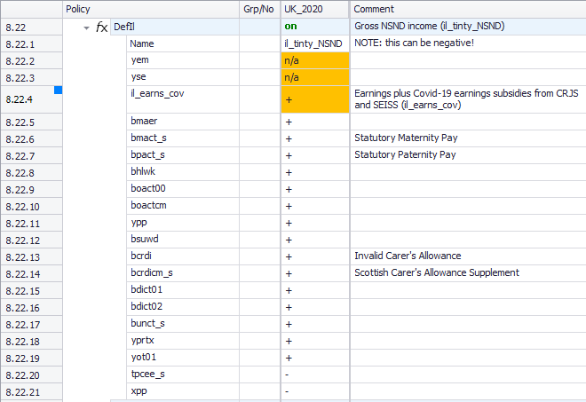
Functions: DefIL
user-defined income list name in “system” column
- components of the income list
- some are being added, other subtracted
income lists can be included in other income lists

Slide 18
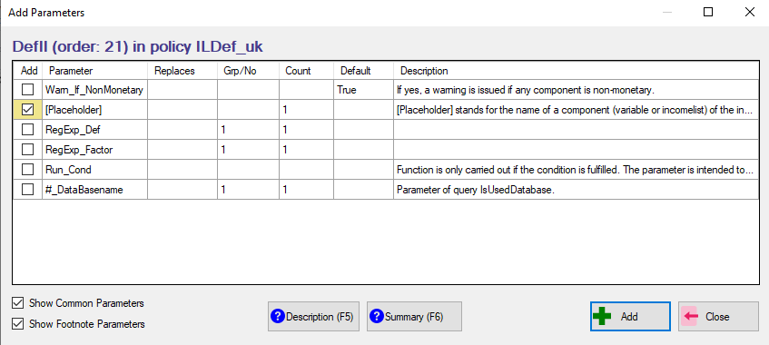
Adding a term to an income list
right-click on DefIL function
select “Add Parameter Form”
select parameter “[Placeholder]”
type in component name in place of [Placeholder]

Slide 19
Standard income lists
Defined in every country
Built in a comparable way to facilitate cross-national analysis
ils_earns: earnings
ils_origy: market incomes
ils_pen: public pensions
ils_bennt: non-means-tested benefits
ils_benmt: means-tested benefits
ils_ben: all benefits and public pensions
ils_tax: taxes
ils_sicee: employee SICs
ils_sicse: self-employed SICs
ils_sicer: employer SICs
ils_sicdy: total SICs
ils_dispy: disposable income
ils_bensim: simulated benefits
ils_taxsim: simulated taxes
Remember:
If you add a new policy that simulates a new benefit/tax, then you need to add the benefit/tax to the right income list!

Slide 20
Structure of standard income lists
Ils_origy
Ils_pen
Alternative categorisation of benefit types:
Ils_b1_bun
Ils_b2_bsaho
Ils_b1_bho
Ils_b2_bfaed
Ils_b1_bed
Ils_b1_bfa
Ils_b1_bcb
Ils_b2_penhl
Ils_b1_boa
Ils_b1_bsu
Ils_b1_bdi
Ils_b1_bhl
Ils_b1_bsa
Ils_ben
Ils_benmt
Ils_bent
Ils_dispy
Ils_tax
Ils_taxsim
Ils_earns
Ils_sicee
Ils_sicer
Ils_sicdy
Ils_sicse
Ils_sicct
Ils_sicot
Ils_origyrepy
Ils_bensim
Plus country specific income lists to calculate implicit tax rates

Slide 21
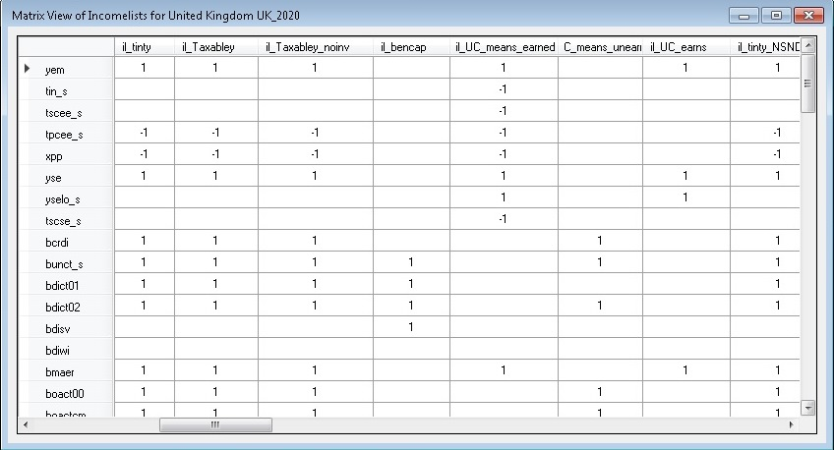
Income lists – Matrix view
Summary of income list components

Slide 22
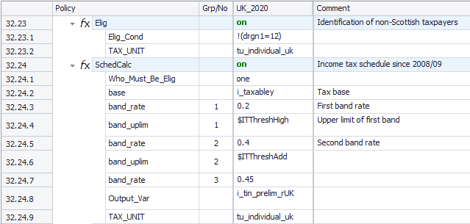
Understanding SchedCalc
We can now read and understand the code written in the SchedCalc function

Slide 23
Questions

Slide 24
Exercise 5
Use the SchedCalc and DefConst functions to modify the income taxes applicable to non-savings non-dividend income in Scotland in 2026.
The higher rate of 42% is applied to annual income up to £90,000;
The additional rate of 47% is applied to annual income between £90,001 and £125,140;
A new top rate of 50% is applied to annual income above £125,140.
Analyse effects of the reform.

Slide 25
Exercise 5
Copy the system UK_2026 and call the copy UK_2026_ex5
Alter the SchedCalc function that evaluates non-savings non-dividend income taxes in Scotland to include a new tax band
Add model constants to control application of the new tax band
Use the revised structure to modify the income taxes so that:
The higher rate of 42% is applied to annual income up to £90,000
The additional rate of 47% is applied to annual income between £90,000 and £125,140
A new top rate of 50% is applied to income above £125,140
Run the baseline and reformed systems and analyse the distributional impact using the Statistics Presenter

Slide 26
Summary: Exercise 5
You learned how to use SchedCalc to reform the income tax policy
Adding and modifying Band_Rate, Band_UpLim
Adding or changing values to income tax band thresholds using constants defined in the ConstDef policy (via a DefConst function)

Slide 27
Exercise 6
We will analyse the distributional and budgetary effects of excluding child benefit from the benefits cap.
Copy the system UK_2026 and call the copy UK_2026_ex6
Identify the income list that defines the benefits subject to the benefit cap
Alter the income list to omit child benefit
Run the reformed system and analyse its distributional impact using the Statistics Presenter

Slide 28
Summary: Exercise 6
You learned:
How the benefit cap policy works in UKMOD
How exemptions from the benefit cap are taken into account (e.g. il_bcap_exempt)
Which benefits are subject to the cap and how they are taken into account by UKMOD (e.g. il_bencap)
There are separate calculations of the benefit cap when it applies to HB (brd_s) and when it applies to UC (brduc_s)
Benefit cap affect net disposable income by reducing means-tested benefit (ils_benmt)

Slide 29
Questions

Slide 30
UKMOD: POLICY FUNCTION Allocate
Policy |  | System Name | Comment
Allocate |  | on | Made-up example: Allocate Housing Benefit to the person responsible for housing costs and council tax
 | Share | bho_s | Housing Benefit to be reallocated between the members of the assessment unit (b: benefit, ho: housing, _s: simulated)
 | Share_Between | dhr=1 | share the benefit between those responsible for the housing (dhr=1)
 | Share_All_IfNoElig | yes | if noone is responsible for the housing, share among all members
 | output_var | bho_s | save result in bho_s: result of Allocate function overwrites the current value of the variable
 | TAX_UNIT | tu_bu_uk | assessment unit used for the calculations

Slide 31
Function Allocate
UKMOD output is at the individual level by default!
The value of a policy function is generally assigned to the head of the assessment unit
For all other members of the unit and for those in units that are not identified as eligible:
output_var is set to zero
output_add_var not changed (or set to 0 if undefined before)
result_var is set to zero.
The Allocate function is used to share/allocate a variable between members of an assessment unit
It can therefore divide the output from other policy functions among assessment unit members that are not the head

Slide 32
Function Allocate
Parameters of Allocate
Share: which variable to split
amount to split first summed up across assessment unit members
Share_Between: condition parameter; who are the members ‘participating’ in the split
default is all members of the assessment unit
Share_Prop: in what proportion to split between the various qualifying members (i.e. those satisfying the Share_Between condition)
default is sharing in equal proportions

Slide 33
Function Allocate
Allocate reallocates amounts between members of assessment units (subject to conditions)
Policy |  | System Name | Comment
Allocate |  | on | Made-up example: Allocate Housing Benefit to the person responsible for housing costs and council tax
 | Share | bho_s | Housing Benefit to be reallocated between the members of the assessment unit (b: benefit, ho: housing, _s: simulated)
 | Share_Between | dhr=1 | share the benefit between those responsible for the housing (dhr=1)
 | Share_All_IfNoElig | yes | if no one is responsible for the housing, share among all members
 | output_var | bho_s | save result in bho_s: result of Allocate function overwrites the current value of the variable
 | TAX_UNIT | tu_bu_uk | assessment unit used for the calculations

Slide 34
Function Allocate
Allocate reallocates amounts between members of assessment units (subject to conditions)
Policy |  | System Name | Comment
Allocate |  | on | Made-up example: Allocate the income tax - based on joint taxation - between the couple's partners
 | Share | tin_s | Income Tax to be reallocated between the partners of the couple (t: tax, in: income, _s: simulated)
 | Share_Prop | yem | share the income tax in proportion to the persons' earnings
 | Share_equ_Ifzero | yes | if no one has earnings, then income tax is shared equally between the couple's partners
 | Ignore_neg_prop | yes | if someome's earnings are negative, they are ignored (i.e. considered to be zero)
 | output_var | tin_s | save result in tin_s: result of Allocate function overwrites the current value of the variable
 | TAX_UNIT | tu_couple_uk | assessment unit used for the calculations

Slide 35
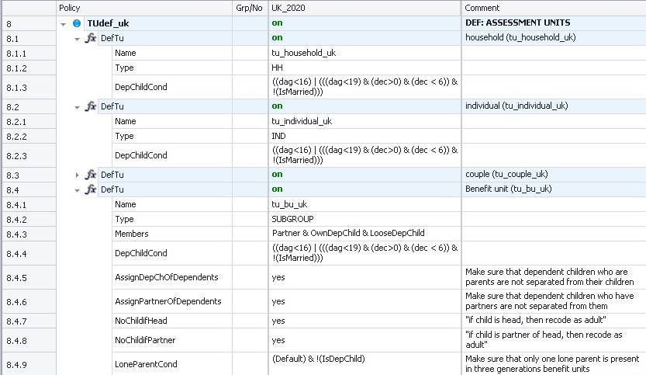
UKMOD: Assessment (Tax) Unit & the system function DefTU

Slide 36
In this lecture, you will learn about:
What assessment (tax) units are and how they work
How the head and other members of the assessment unit is defined in UKMOD
How to avoid splitting up families
Footnote parameters
How assessment units are implemented in UKMOD, using the system function DefTU

Slide 37
Assessment Unit
Unit: group of household members to be considered together
Defined with System function DefTU usually in policy TUDef_uk
Defined the first time used by the model
(although can be updated – see UpdateTU)
Naming convention: tu_<name>_uk
Parameter Type in DefTU defines the composition of the tax unit
HH: all individuals of the household are in the same unit.
IND: each individual of the household forms its own unit.
SUBGROUP: individuals determined by parameter Members form a unit. The household may be split into several units of different size.
Notes:
H 9.37

Slide 38
Type of assessment/tax unit
Policy |  | System Name | Comment
DefTu |  | on | Made-up example: individual
 | Name | tu_individual_uk
 | Type | IND
 | DepChildCond | dag<16 | (dag<19 & IsInEducation & !IsMarried) | aged less than 16; or less than 19, in education and not married
DefTu |  | on | Made-up example: household
 | Name | tu_household_uk
 | Type | HH
 | DepChildCond | dag<16 | (dag<19 & IsInEducation & !IsMarried) | aged less than 16; or less than 19, in education and not married
DefTu |  | on | Made-up example: nuclear family
 | Name | tu_family_uk
 | Type | SUBGROUP
 | Members | Partner & OwnDepChild | head, head's partner, own dependent children
 | DepChildCond | dag<16 | (dag<19 & IsInEducation & !IsMarried) | aged less than 16; or less than 19, in education and not married
Notes:
H 9.37

Slide 39
Assessment units: examples
description | idhh | idperson | idpartner | idmother | idfather | dag | Household | Individual | Subgroup (e.g. Family)
typical family | 1 | 101 | 102 | 0 | 0 | 30 | A1 | A1 | A1
 | 1 | 102 | 101 | 0 | 0 | 28 | A1 | B1 | A1
 | 1 | 103 | 0 | 102 | 101 | 3 | A1 | C1 | A1
 | 1 | 104 | 0 | 102 | 101 | 1 | A1 | D1 | A1
couple.without children | 2 | 201 | 202 | 0 | 0 | 56 | A2 | A2 | A2
 | 2 | 202 | 201 | 0 | 0 | 55 | A2 | B2 | A2
lone parent | 3 | 301 | 0 | 0 | 0 | 35 | A3 | A3 | A3
 | 3 | 302 | 0 | 301 | 0 | 6 | A3 | B3 | A3
single | 4 | 401 | 0 | 0 | 0 | 25 | A4 | A4 | A4
two singles living together | 5 | 501 | 0 | 0 | 0 | 22 | A5 | A5 | A5
 | 5 | 502 | 0 | 0 | 0 | 23 | A5 | B5 | B5
large family | 6 | 601 | 602 | 606 | 0 | 48 | A6 | A6 | A6
 | 6 | 602 | 601 | 0 | 0 | 45 | A6 | B6 | A6
 | 6 | 603 | 0 | 602 | 601 | 20 | A6 | C6 | B6
 | 6 | 604 | 0 | 602 | 601 | 15 | A6 | D6 | A6
 | 6 | 605 | 0 | 602 | 601 | 10 | A6 | E6 | A6
 | 6 | 606 | 0 | 0 | 0 | 70 | A6 | F6 | C6

Slide 40
Head of the tax unit
The head of a tax unit is by default
the highest income member
System Configuration: Income for Head Definition
the oldest
with the smallest personal id (i.e. idperson)
Additional, optional specifications for the head:
Query | Value type | Default | Description
HeadDefInc | variable or incomelist | ils_origy | Incomelist used for determining who has highest income in the assessment unit, see parameter ExtHeadCond.
ExtHeadCond | condition | !IsDepChild | Condition further defining the head of the assessment unit.
StopIfNoHeadFound | yes/no | no | If set to yes: an error is issued if ExtHeadCond rules out all household members. If set to no: no error issued, instead ExtHeadCond is dropped for affected households.
NoChildIfHead | yes/no | no | If set to yes (possible) child status is removed if person is the Head of the assessment unit.
NoChildIfPartner | yes/no | no | If set to yes (possible) child status is removed if person is Partner as defined by parameter PartnerCond.

Slide 41
Members of the tax unit
If tax unit type is SUBGROUP, parameter Members defines which hh members form a unit
Relations are often defined with respect to the head of the unit
e.g. Partner, OwnChild, DepParent
The status of each member is defined by a <name>Cond parameter
e.g. PartnerCond, OwnChildCond, DepParentCond
Conditions allow for prefixes denoting variables relating the reference unit’s head and partner:
e.g. head:idperson = idpartner checks if the value of idperson of the head of the assessment unit equals idpartner for the current observation

Slide 42
Members of the tax unit
Query | Default | Description
Members | n/a | Specifies which members of the household form a unit, if parameter Type is set to SUBGROUP, e.g. Partner & OwnChild.
PartnerCond | head:idperson=idpartner | Condition defining who is a partner, i.e. the partner of the head.
DepChildCond | 0, i.e. nobody is a child | Condition defining who is a dependent child. The parameter equals 0, i.e. nobody is child, if not defined or set to n/a. However, setting the parameter to Default is the same as typing !IsParent & idpartner=0.
OwnChildCond | head:idperson=idmother | head:idperson=idfather | partner:idperson=idmother | partner:idperson=idfather | Condition defining who is an own child: either the head or the head's partner is the mother/father of the child.
OwnDepChildCond | IsOwnChild & IsDepChild | Condition defining who is an own dependent child.
LooseDepChildCond | idmother=0 & idfather=0 & IsDepChild | Condition defining who is a loose dependent child.
DepParentCond | head:idmother=idperson | head:idfather=idperson | partner:idmother=idperson | partner:idfather=idperson | Condition defining who is a dependent parent, i.e. the parent of the head or the head's partner.
DepRelativeCond | 0, i.e. nobody is a dependent relative | Condition defining who is a dependent relative.
LoneParentCond | IsParentOfDepChild & idpartner=0 | Condition defining who is a lone parent.

Slide 43
Examples: Members of the tax unit
Head: subsequent variable refers to the head
Partner: subsequent variable refers to the partner of the head
Default setting can be overwritten or combined with further specifications
Policy |  | System Name | Comment
DefTu |  | on | Made-up example: couple with dependent parents
 | Name | tu_couple1_uk
 | Type | SUBGROUP
 | Members | Partner & DepParent | head, head's partner and dependent parents
 | DepParentCond | head:idmother=idperson | head:idfather=idperson | overwriting the default condition: only include parents of the head
DefTu |  | on | Made-up example: couple
 | Name | tu_couple2_uk
 | Type | SUBGROUP
 | Members | Partner | head and head's partner
 | PartnerCond | Default & IsMarried | default condition (i.e. head's partner) + partner is married

Slide 44
Examples: Members of the tax unit
DepChildCond: determines who is the dependent child
OwnDepChild: “a son or daughter” (see OwnChildCond), who is a dependent child
LooseDepChild: “someone, who is a dependent child, but doesn’t cohabit with parent/s”
Policy |  | System Name | Comment
DefTu |  | on | Made-up example: nuclear family
 | Name | tu_family1_uk
 | Type | SUBGROUP
 | Members | Partner & OwnDepChild | head, head's partner and own dependent children
 | DepChildCond | dag<=15 | definition of the dependent child: aged 15 or less
idhh | idperson | idpartner | idmother | idfather | dag | ils_origy | IsHead | IsPartner | IsDepChild | IsOwnDepChild | IsLooseDepChild | tax unit
1 | 101 | 102 | 0 | 0 | 44 | 2000 | no | yes | no | no | no | A
1 | 102 | 101 | 0 | 0 | 45 | 2100 | yes | no | no | no | no | A
1 | 103 | 0 | 102 | 101 | 14 | 400 | no | no | yes | yes | no | A
1 | 104 | 0 | 0 | 0 | 12 | 0 | yes | no | yes | no | yes | B

Slide 45
Examples: Members of the tax unit
DepChildCond: determines who is the dependent child
OwnDepChild: “a son or daughter” (see OwnChildCond), who is a dependent child
LooseDepChild: “someone, who is a dependent child, but doesn’t cohabit with parent/s”
Policy |  | System Name | Comment
DefTu |  | on | Made-up example: nuclear family
 | Name | tu_family2_uk
 | Type | SUBGROUP
 | Members | Partner & OwnDepChild & LooseDepChild | head, head's partner, own and loose dependent children
 | DepChildCond | dag<=15 | definition of the dependent child: aged 15 or less
idhh | idperson | idpartner | idmother | idfather | dag | ils_origy | IsHead | IsPartner | IsDepChild | IsOwnDepChild | IsLooseDepChild | tax unit
1 | 101 | 102 | 0 | 0 | 44 | 2000 | no | yes | no | no | no | A
1 | 102 | 101 | 0 | 0 | 45 | 2100 | yes | no | no | no | no | A
1 | 103 | 0 | 102 | 101 | 14 | 400 | no | no | yes | yes | no | A
1 | 104 | 0 | 0 | 0 | 12 | 0 | no | no | yes | no | yes | A

Slide 46
Avoiding splitting family members
Query | Value type | Default | Description
AssignDepChOfDependents | yes/no | no | If set to yes dependent children of dependent unit members (i.e. persons who are not Head or Partner of the head) are assigned to the unit.
AssignPartnerOfDependents | yes/no | no | If set to yes partners of dependent unit members (i.e. persons who are not Head or Partner of the head) are assigned to the unit.

Slide 47
Parameters: Footnotes
They serve to add detail to model parameters.
Identified by #i (i=number from 1 to....)
Limits
Amounts
Assessment units
Specification of queries
Policy |  | Grp/No | System Name | Comment
ArithOp |  |  | on | Made-up example: tax allowance for pensions
 | Formula |  | il_pensions#1 + (ils_earns#2 + GetPartnerIncome#3)*0.3 | the person's pensions - up to 1,000 per month - plus 30% of the sum of the couple's earned income and the pension of the partner
 | #_UpLim | 1 | 1000#m | upper limit on the person's pensions
 | #_Level | 2 | tu_couple_uk | alternative assessment unit
 | #_Income | 3 | poa | get the pension of the partner
 | output_var |  | tintape_s
 | TAX_UNIT |  | tu_individual_uk

Slide 48
Using conditions that refer to income
Monetary variables or income lists are measured by default at the level of the assessment unit
Use footnote parameters to specify an alternative assessment unit
Now let’s have a look at footnote parameters
Policy |  | Grp/No | System Name | Comment
DefTu |  |  | on | Made-up example: family
 | Name |  | tu_family_uk
 | Type |  | SUBGROUP
 | Members |  | Partner & OwnDepChild & LooseDepChild
 | DepChildCond |  | dag<25 & yem#1 < 1000#m | aged less than 25 and with (individual) earnings of less than GBP 1,000 per month
 | #_Level | 1 | tu_individual_uk | earnings are assessed at the individual level

Slide 49
The tax unit in the output file
idhh | idperson | idpartner | idmother | idfather | dag | ils_origy | yem | tu_family_uk_HeadId | tu_family_uk_IsPartner | tu_family_uk_IsDepchild | tu_family_uk_IsDepParent | tu_family_uk_IslLoneParent
1 | 101 | 102 | 0 | 0 | 65 | 0 | 0 | 101 | 0 | 0 | 0 | 0
1 | 102 | 101 | 0 | 0 | 60 | 0 | 0 | 101 | 1 | 0 | 0 | 0
1 | 103 | 0 | 102 | 101 | 30 | 0 | 0 | 103 | 0 | 0 | 0 | 0
1 | 104 | 0 | 102 | 101 | 28 | 166 | 147 | 104 | 0 | 0 | 0 | 0
2 | 201 | 202 | 0 | 0 | 29 | 1,085 | 1,007 | 201 | 0 | 0 | 0 | 0
2 | 202 | 201 | 0 | 0 | 25 | 953 | 891 | 201 | 1 | 0 | 0 | 0
2 | 203 | 0 | 202 | 201 | 3 | 0 | 0 | 201 | 0 | 1 | 0 | 0
2 | 204 | 0 | 202 | 201 | 2 | 0 | 0 | 201 | 0 | 1 | 0 | 0
52 | 5,201 | 5,202 | 5,206 | 5,205 | 40 | 1,954 | 1,831 | 5,201 | 0 | 0 | 0 | 0
52 | 5,202 | 5,201 | 0 | 0 | 38 | 0 | 0 | 5,201 | 1 | 0 | 0 | 0
52 | 5,203 | 0 | 5,202 | 5,201 | 10 | 0 | 0 | 5,201 | 0 | 1 | 0 | 0
52 | 5,204 | 0 | 5,202 | 5,201 | 15 | 0 | 0 | 5,201 | 0 | 1 | 0 | 0
52 | 5,205 | 5,206 | 0 | 0 | 70 | 0 | 0 | 5,201 | 0 | 0 | 1 | 0
52 | 5,206 | 5,205 | 0 | 0 | 70 | 0 | 0 | 5,201 | 0 | 0 | 1 | 0
92 | 9,201 | 0 | 0 | 0 | 80 | 0 | 0 | 9,202 | 0 | 0 | 1 | 0
92 | 9,202 | 0 | 0 | 9,201 | 38 | 3,740 | 3,502 | 9,202 | 0 | 0 | 0 | 1
92 | 9,203 | 0 | 0 | 9,201 | 34 | 2,483 | 2,324 | 9,203 | 0 | 0 | 0 | 0
92 | 9,204 | 0 | 0 | 9,202 | 11 | 0 | 0 | 9,202 | 0 | 1 | 0 | 0
Policy |  | Grp/No | System Name
DefTu |  |  | on
 | Name |  | tu_family_uk
 | Type |  | SUBGROUP
 | Members |  | Partner & OwnDepChild & LooseDepChild & DepParent
 | DepChildCond |  | dag<25 & yem#1<8000#y
 | DepParentCond |  | Default & dag>65 & yem#1<8000#y
 | #_Level | 1 | tu_individual_uk
 | AssignDepChOfDependents |  | yes
 | AssignPartnerOfDependents |  | yes
 | LoneParentCond |  | Default & !IsMarried
Notes:
H10.20am

Slide 50
In this lecture, you learnt about:
What assessment units are and how they work
How the head and other members of the assessment unit is defined in UKMOD
How to avoid splitting up families
Footnote parameters
How assessment units are implemented in UKMOD using the system function DefTU

Slide 51
Exercise 7
Analyse the distributional and budgetary effects of limiting child benefit to families with children up to 13 years of age. We will implement this reform by creating a new tax unit for analysis:
Create a copy of the UK_2026 and call it UK_2026_ex7
Create a new assessment unit by copying tu_bu_uk and call the copy tu_bunew_uk
Modify the age of dependent children
Modify the child benefit policy to use the new assessment unit
Run the reform system and use the Statistics Presenter to analyse results

Slide 52
Summary: Exercise 7
You learned how to
Create a new assessment unit
Use the new assessment unit to alter calculation of a benefit

Slide 53
Questions

Slide 54
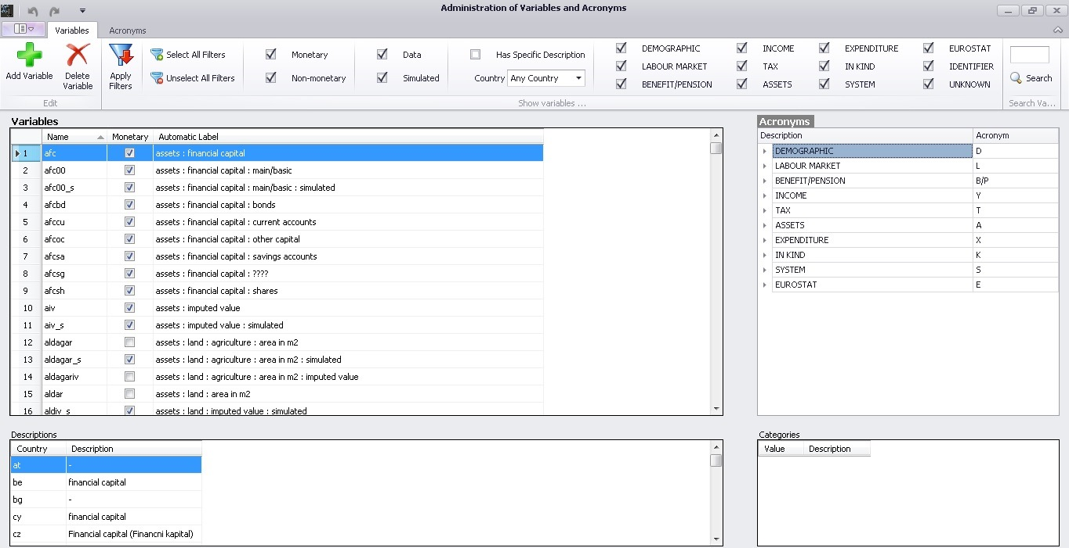
UKMOD: Adding variables & System function DefVar

Slide 55
What are variables
Variables define the results of model calculations for individual observations described by the input data
Variables are saved to the output data generated by the model by default
Useful for:
Checking whether new model code is working as intended
Analysing model output of special interest
Adding to other variables and income lists for secondary analysis

Slide 56
Variable types
“Standard” – following EUROMOD naming convention
Household and individual characteristics
Incomes: market incomes, simulated and non-simulated benefits and taxes
Assets and expenditures
“Intermediate”
Used to save the result of an intermediate calculation e.g. an eligibility condition, number of twins in the tax unit
i_<name>

Slide 57
Variable naming convention
“Standard” variables defined in the EUROMOD input micro-data and used by EUROMOD for policy simulations
The goal is to achieve:
more intuitive variable names
harmonised variable names to allow for consistent cross-county comparisons
Names are combinations of acronyms take the form: abbcc
a – type of information (e.g., y: income, x: expenditure)
bb – specific for each type a (e.g., y | em: employment, se: self-employment):
yem: employment income
yse: self-employment income
cc further bb’s for additional information/detail, e.g.
ysebs: business self-employment income
exception id*, eg. idperson, idmother
Variables administered via a built-in library

Slide 58
Variables Library

Slide 59
Variables Library
acronyms used for names
list of all variables defined in the variables file in alphabetical order
name
variable is monetary or non-monetary
automatic label
description of variable for countries where it is used

Slide 60
Adding a variable
new empty row;
fill in name and monetary

Slide 61
Naming a variable
acronyms
UI checks validity of name and existence of the variable

Slide 62
Filtering variables
select filters

Slide 63
System Function: DefVar
To define intermediate (temporary) variables not included in the Variables library

Slide 64
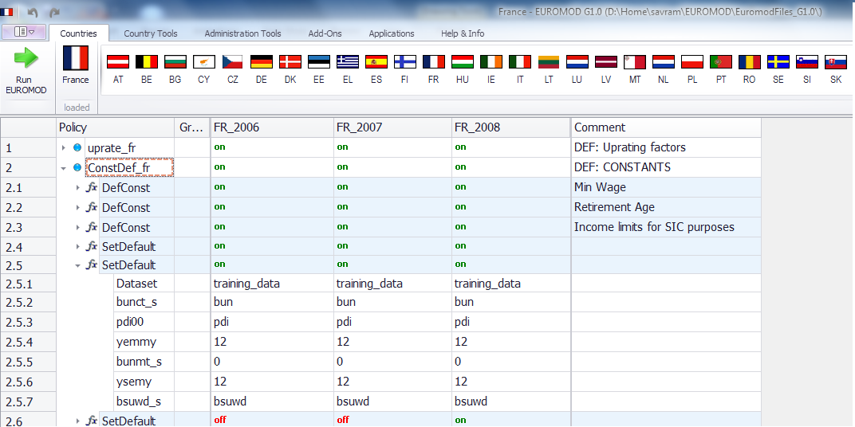
System Functions: SetDefault
sets default values for variables if the variable is not reported by a dataset
Notes:
Set default is not into constdef_cc anymore

Slide 65
UKMOD: Uprating Indices & system function uprate
Notes:
H12.40

Slide 66
Forward projected systems
Current release of UKMOD includes system years for four future years that reflect:
Enacted reforms, including announcements in the Spring Budget and Autumn Statement
Indexing of policy parameters reflecting existing legislation and historical norms
Forward projections obtained from OBR reports
Generally do not reflect plans for reform, including those set out in White Papers
Uprating administered via:
ConstDef_uk for policy parameters
Uprate_uk for input data

Slide 67
Why uprate input data?
When the sample period of input micro-data and the policy system do not match
e.g. use data from 2018 to analyse a tax and benefit system reflecting 2026
Accounts for nominal growth of incomes
We uprate incomes by source
define uprating indices in the Uprating Indices table
apply uprating indices for specific income variables described by the input data in the Uprate_uk policy
Only financial values are uprated – input data are not adjusted to reflect anticipated or observed demographic or labour market trends:
Unemployment rates, fertility, mortality, incidence of cohabitation, health and disability, etc.

Slide 68
Uprating Indices table
Time-series information for the uprating indices (table: Raw Indices)
EUROMOD calculates implicit uprating factors (table: Factors per Data)

Slide 69
Raw indices (time series)
policy years
the index description
source of information
user-defined index name($f_)

Slide 70
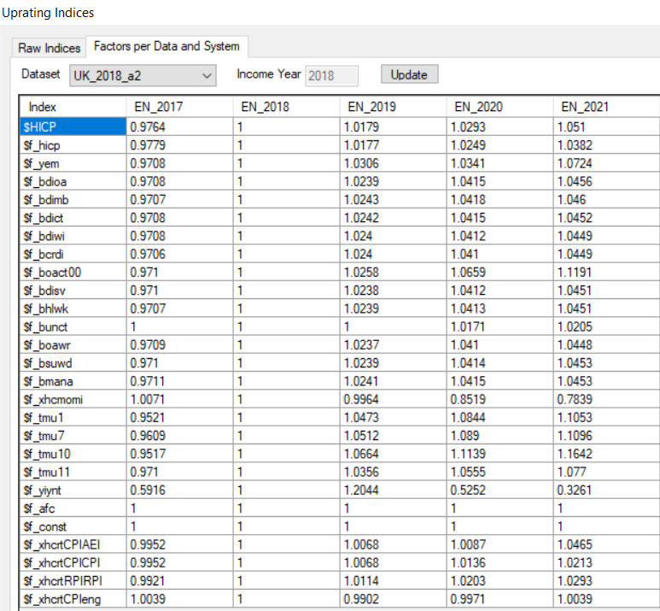
Uprating Indices per Data and System
You can see the implicit uprating factors:
Select the dataset you want to view
Example:
Dataset UK_2018_a2 → income referring to 2018
Prices (see CPI) increased by 2.9 between 2018 & 2020

Slide 71
System Function: Uprate
71
Defines which indices to apply on which income variables from the input micro-data
input data sets to which uprating applies
variables that are uprated
name of uprating factor

Slide 72
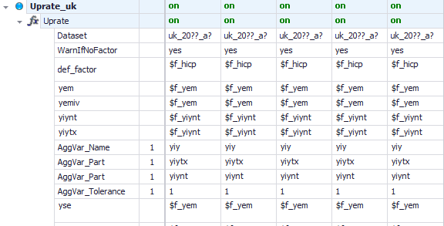
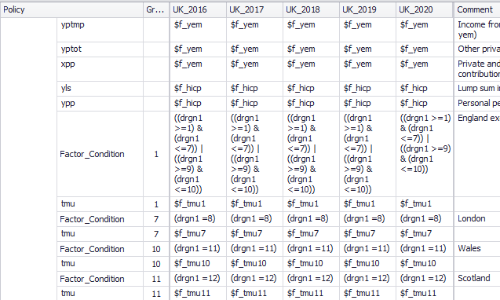
Using Uprate
Uprating the components of an aggregate variable
Using different uprating indices for different groups

Slide 73
UKMOD: System functions DefOutput and SetDefault

Slide 74
UKMOD output micro-data
Content manipulated in policy output_std_uk
Controls level at which info is outputted (e.g. individual, family or household)
The variables included in the output data generated by the model
Usually included:
All variables present in the input micro-data file
Simulated variables (i.e. simulated taxes and benefits)
Standard income lists (ils_<name>; all benefits, all taxes)
(optional) non-standard income lists (il_<name>)
(optional) temporary variables (i_<name>)
(optional) tax/assessment unit identification info

Slide 75
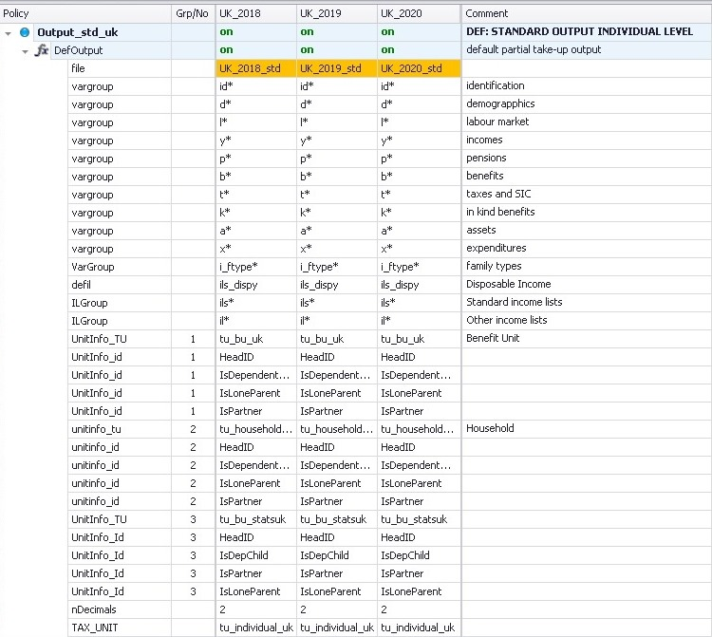
System Functions: DefOutput
75
name of output file: UK_<YYYY>_std
variables included in the output file
TAX_UNIT: level of aggregation

Slide 76
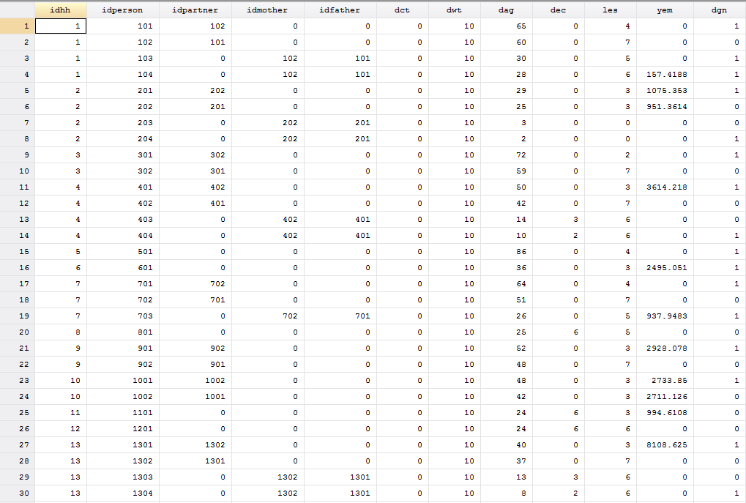

Slide 77
End of Day 2
Notes:
2021 – revision stopped here

Slide 78
Extra slides

Slide 79
UKMOD: ADDITIONAL USER INTERFACE ELEMENTS
Notes:
H12.40

Slide 80
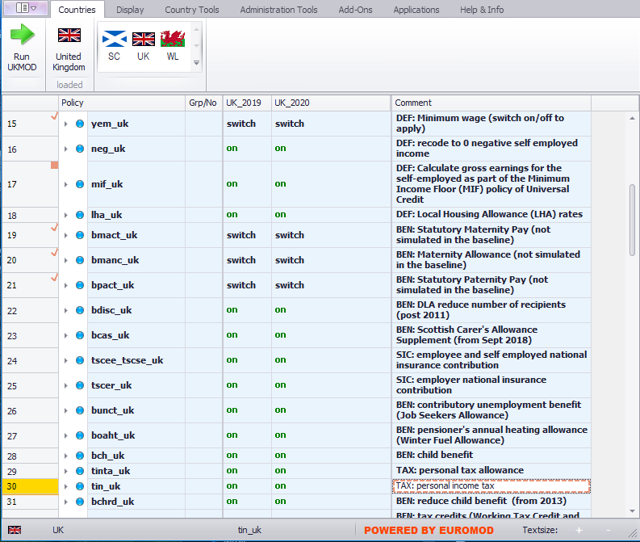
User Interface

Slide 81
User Interface (UI)
Single stand-alone piece of software (based on .NET framework)
Mostly point and click but some hot keys are available
In-built features that allow for improved user control and guidance
Intuitive!!
Features:
Ribbon bar with tabs, Context menus
IntelliSense (suggestion of parameter values)
Drag and drop, Built-in help
Display customization, …much more
Active development: New features and capabilities added over time!

Slide 82
Tax Benefit Policy Rules and Parameters (1)
coded using the EUROMOD ‘language’
set of (7-8) custom functions (and associated parameters)
standardised ‘microsimulation language’
allow for both flexibility (parametrisation) and harmonised approach
stored in xml files – ‘content’ files
manipulated via the EUROMOD User Interface (UI)

Slide 83
Policies simulated
National insurance contributions
paid by employees, self-employed and employers
Contributory JSA
Winter Fuel Allowance
Child Benefit
Personal income tax
Tax credits (Working Tax Credit & Child Tax Credit)
Universal Credit
Scottish Child Payment and Winter Heating Allowance
Income based JSA
Income support
Pension Credit
Income based ESA
Housing Benefit & Local Housing Allowance
Council tax benefit/CT support
Universal Credit
Total benefit cap
Minimum wage and National Living wage
Parental Benefits
Coronavirus Job Retention Scheme & Self-employment Income Support Scheme

Slide 84
Scope of policy simulations
Social/national insurance contributions
Income tax
Non-contributory benefits (means-tested or not)
Contributory unemployment benefits (approximation)
Min wage
additional country-specific policies specific to the UK:
benefit non-take-up of means-tested benefits using estimates by DWP and HMT
increases to the statutory retirement age

Slide 85
How to install EM software
Download latest version from
https://www.microsimulation.ac.uk/euromod/access/
Run the installation wizard
Set the path to your EUROMOD files
project path
(if necessary) separate input data and output data paths
Note: you need only one copy of the UI but can use multiple ‘content’ files:
but content files must have set structure of folders
think of working with Stata and multiple do-files, specific to different projects

Slide 86
Ribbon bar – country tools
Open country to activate buttons
Contains options that manipulate the general parameters of a country file
name and acronym
available policy systems and their characteristics
available datasets and their characteristics
Adding and deleting systems
Viewing options:
search and replace
formatting
bookmarks
Comparing versions
More advanced (import/ export systems, add-ons etc.)

Slide 87
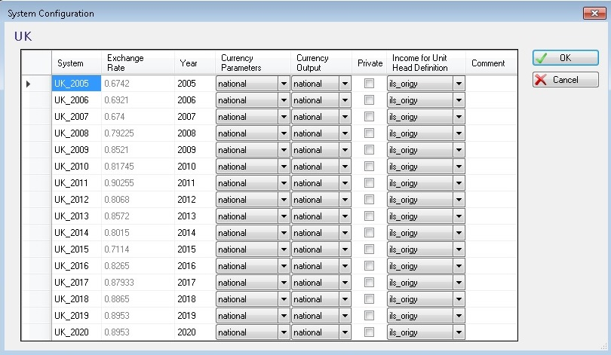
Policy system settings
all policy years/systems
income used to define the head of the unit
exchange rate national to euro
parameters currency
output currency

Slide 88
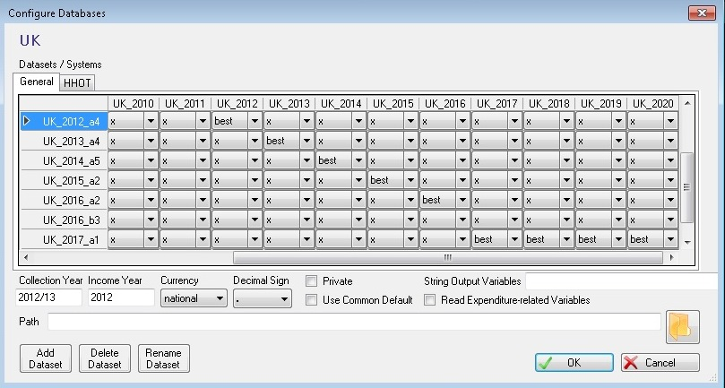
Data settings
all policy systems
all input data sets
characteristics of the input
data set
add/delete input data sets

Slide 89
Ribbon bar - control display and formatting
Control display and formatting
View full spine vs. single policy
Conditional formatting (similar idea to EXCEL)
Bookmarks
Matrix view of income lists
Visualising/ hiding key parameters

Slide 90
Ribbon bar – administration tools
Adding and deleting countries
Accessing and administering the variables file
Updating progress: overview of available policy systems and datasets
Merging versions
Administrating switches
Administrating exchange rates and HICP series

Slide 91
EUROMOD software Help
browse
search

Slide 92
Context Menus
Activated by right-clicking
column headings
row headings
function headings/ parameter names
comments
Intuitive options controlling the respective elements
Description available

Slide 93
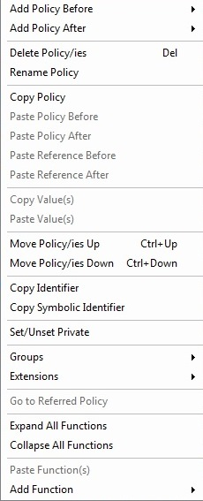
Context Menus
right-click on
a policy, function or parameter

Slide 94
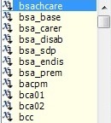
IntelliSense

Slide 95
UKMOD: more on functions and parameters
Notes:
H12.40

Slide 96
Interactions between functions (1)
Functions interact in three ways (+ replacement):
Condition: one function (usually function Elig) evaluates a parameter and a subsequent function operates on the basis of the result of this evaluation
Notes:
AP: too early to have this?

Slide 97
Interactions between functions (2)
Input: one function calculates a variable, which is used as an input by a subsequent function.

Slide 98
Interactions between functions (3)
Addition: one function calculates a part of a policy and a subsequent function calculates another part of the policy and then needs to add its calculation to the first part.

Slide 99
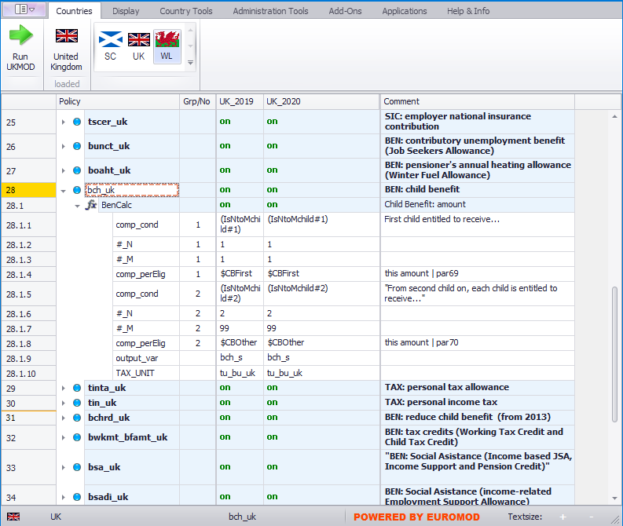
Manipulating policies
right-click on a policy to activate menu

Slide 100
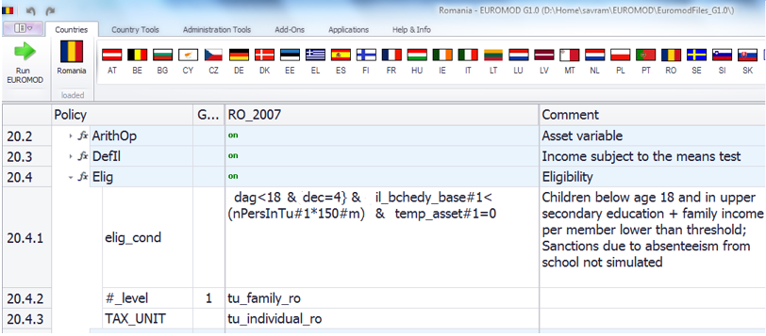
Condition parameters
logical and comparison operations to evaluate a condition with a yes/no result.
Conditions can be grouped by parenthesis ()
Negative condition (i.e. !) can be used with a single condition only

Slide 101
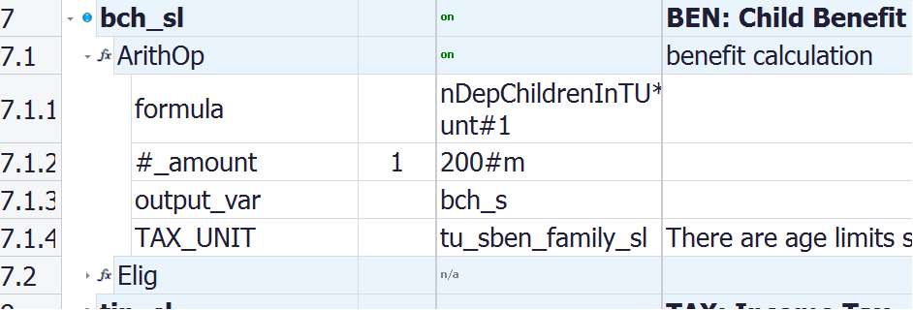
Parameters: Assessment Unit (TAX_UNIT)
TAX_UNIT defines the assessment unit a function refers to:
Individual (tu_individual_xx)
Household (tu_household_xx)
Various definitions of family units (various names, e.g. tu_family_xx, tu_bu_xx)
Compulsory for most policy functions!

Slide 102
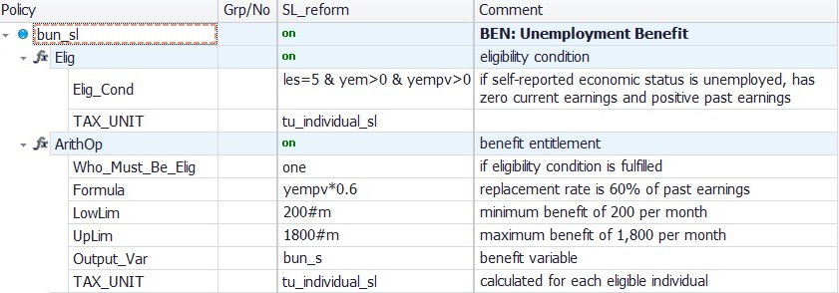
Parameters: Limits (LowLim; UpLim)
LowLim: lower limit
UpLim: upper limit

Slide 103
Updating assessment units
103
The tax unit is defined/ calculated the first time it is used by the model: household members are assigned to respective units once an assessment unit is first used.
This assignment is not changed with subsequent uses, even if circumstances change.
However, the reassessment of the units can be enforced by using the function UpdateTU.

Slide 104
UKMOD: Special functions
Notes:
H12.40

Slide 105
(More) Special functions
AddOn_xxx (implement extended functionalities not part of the standard tax-benefit calculations, such as Effective Marginal Tax Rates, different budget sets)
Loop and UnitLoop (repeat part (or all) of the tax-benefit calculations)
Store and Restore (set a variable to the initial (or other previous) value
ChangeParam (modify parameters during the model run)
Totals (calculates aggregates over groups of persons/households)
DropUnit and KeepUnit (drops certain persons/households from the calculations)
ILVarOp (performs operations on variables that are part of an income list)
RandSeed (generates random numbers)
CallProgramme (calls another programme, e.g., Stata)

