Slide 1
UKMOD Advanced Training Course: TCO add-on (indirect taxes)
Justin van de Ven, Matteo Richiardi, Daria Popova
University of Essex

Slide 2
Course outline
Add-ons - the basics
Analytical approach of the UKMOD indirect tax add-on
Model implementation
Practical use and example

Slide 3
Add-ons – the basics
A way to “inject” code into existing policy spine
Difference between a model “add-on” and “extension”
Use cases for each
Structure of an add-on
Similar to standard EUROMOD model:
Systems > policies > functions > parameters
Special features of add-ons
Functions
Use

Slide 4
Add-ons – special functions
AddOn_Applic
Specifies the systems that the add-on can be used for
AddOn_Pol
Specifies an add-on policy name and insertion point
AddOn_Func
Specifies a function to add and insertion point
AddOn_Par
Specifies a parameter to insert and insertion point
AddOn_ExtensionSwitch
Specifies the state of an extension switch to assume

Slide 5
Add-ons - use

Slide 6
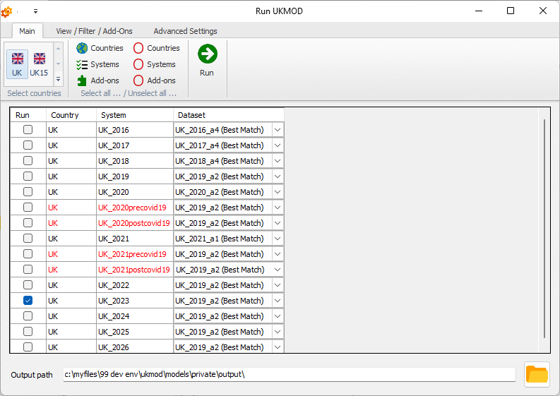
Add-ons - use

Slide 7
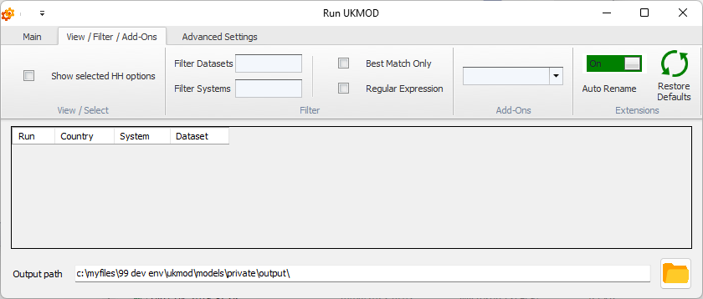
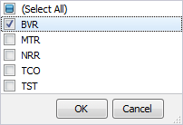
Add-ons - use

Slide 8
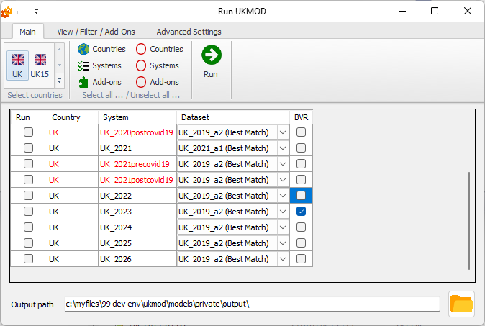
Add-ons - use

Slide 9
UKMOD’s Indirect taxes add-on: TCO
Define:
$x_{k,h}$ units consumed of commodity $k$ by benefit unit $h$
$q_{k}$ per unit price paid by consumers for commodity $k$
$e_{k,h}$ expenditure on commodity $k$ by benefit unit $h$
$p_{k}$ per unit price received by producers for commodity $k$
$v_{k}$ ad valorum excise rate on $q_{k}$
$a_{k}$ per unit specific excise for commodity $k$
$t_{k}$ VAT rate on commodity $k$
$$e_{k,h}=q_{k}x_{k,h}$$

Slide 10
TCO: Evaluation of indirect taxes
$T_{k,h}^{v}=v_{k}q_{k}x_{k,h}=v_{k}e_{k,h}$
$T_{k,h}^{s}=a_{k}x_{k,h}=\frac{a_{k}}{q_{k}}e_{k,h}$
$T_{k,h}^{t}=t_{k}\left(p_{k}x_{k}+T_{k,h}^{v}+T_{k,h}^{s}\right)$
$T_{k,h}=T_{k,h}^{t}+T_{k,h}^{v}+T_{k,h}^{s}=\left(q_{k}−p_{k}\right)x_{k}$
$q_{k}=\left(1+t_{k}\right)\left(p_{k}+a_{k}+v_{k}q_{k}\right)$
$T_{k,h}^{t}=\frac{t_{k}}{(1+t_{k})}e_{k,h}$

Slide 11
TCO: Three alternative behavioural assumptions
Constant income shares
$e_{k,h}=y_{h}{\hat{e}}_{k,h}/{\hat{y}}_{h}$
Constant expenditure shares
${\hat{s}}_{h}={\hat{y}}_{h}−\sum_{k}{{\hat{e}}_{k,h}}$ $e_{k,h}=\left(y_{h}−{\hat{s}}_{h}\right).{\hat{e}}_{k,h}/\sum_{j}{{\hat{e}}_{j,h}}$
Constant quantities
$e_{k,h}=q_{k}{\hat{e}}_{k,h}/{\hat{q}}_{k}$

Slide 12
TCO: Evaluation of indirect taxes
Given input data describing:
expenditures $\left({\hat{e}}_{k,h}\right)$, consumer prices $\left({\hat{q}}_{k}\right)$, and disposable income $\left({\hat{y}}_{h}\right)$
And given any one of three alternative behavioural scenarios:
constant income shares, expenditure shares, quantities
We can evaluate commodity specific expenditure in context of alternative transfer policies $(e_{k,h})$
Given indirect tax parameters $\left(a_{k},t_{k},v_{k}\right)$, producer prices $({\hat{p}}_{k})$, and producer price invariance to transfer policy
We can project VAT $(T_{k,h}^{v})$, specific excise $(T_{k,h}^{s})$, and ad valorum excise $(T_{k,h}^{v})$
The Default and Baseline/Reform templates of Statistics Presenter report statistics for indirect taxes if the associated variables are found in the
output data

Slide 13
TCO add-on policies
ao_control_tco: injection points of subsequent policies
tco_paraminit: initialises excise rates, consumer and producer prices
tco_calcprelim:
The indirect tax calculations account for many consumption categories.
These calculations are facilitated by the special EUROMOD function ilArithOp.
The ilArithOp function uses income lists to evaluate an arithmetic function over terms that share a common naming format.
The tco_calcprelim policy initialises income lists, and uses these to evaluate consumer prices under the considered policy for each commodity via:
$q_{k}=(1+t_{k})(p_{k}+a_{k})/[1−(1+t_{k})v_{k}]$

Slide 14
TCO add-on policies
tco_cy: projects per-commodity expenditure based on the assumption of constant income shares
tco_ce: projects per-commodity expenditure based on the assumption of constant expenditure shares
tco_cq: projects per-commodity expenditure based on the assumption of constant quantities
Only one of these three policies should be implemented for any simulation
tco_calc: evaluates indirect taxes

Slide 15
TCO – Practical Example
Use the TCO add-on to simulate the effects of a 5-percentage point increase in the standard rate of VAT in 2026.
Directions:
Open UKMOD and access the UK policy descriptions
Run a base-line simulation of the TCO add-on for the UK_2026 system and the training_data input
Copy the UK_2026 system and name the copy UK_2026_ex2
Implement a 5-percentage point increase in the basic rate of tax by adjusting parameter $tco_t_std in system UK_2026_ex2
Save the model changes
Run the TCO add-on for the UK_2026_ex2 system and training_data
Use the Statistics Presenter’s Baseline/Reform template to analyse effects of the reform

