Slide 1
UKMOD Advanced Training Course: BVR add-on (behavioural responses)
Justin van de Ven, Matteo Richiardi, Daria Popova
University of Essex

Slide 2
Course outline
Add-ons, the basics
Analytical approach of the UKMOD behavioural add-on
Model implementation
Practical use and example

Slide 3
Add-ons – the basics
A way to “inject” code into existing policy spine
Difference between a model “add-on” and “extension”
Use cases for each
Structure of an add-on
Similar to standard EUROMOD model:
Systems > policies > functions > parameters
Special features of add-ons
Functions
Use

Slide 4
Add-ons – special functions
AddOn_Applic
Specifies the systems that the add-on can be used for
AddOn_Pol
Specifies an add-on policy name and insertion point
AddOn_Func
Specifies a function to add and insertion point
AddOn_Par
Specifies a parameter to insert and insertion point
AddOn_ExtensionSwitch
Specifies the state of an extension switch to assume

Slide 5
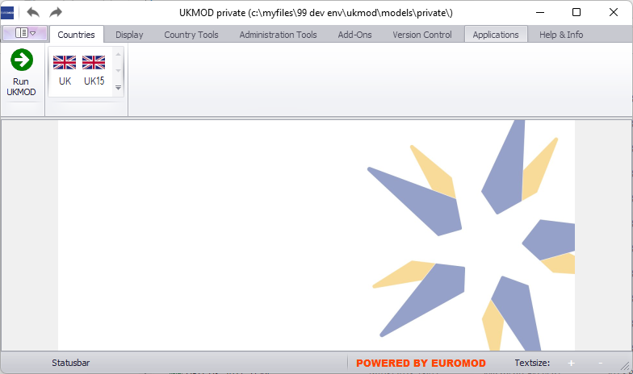
Add-ons - use

Slide 6
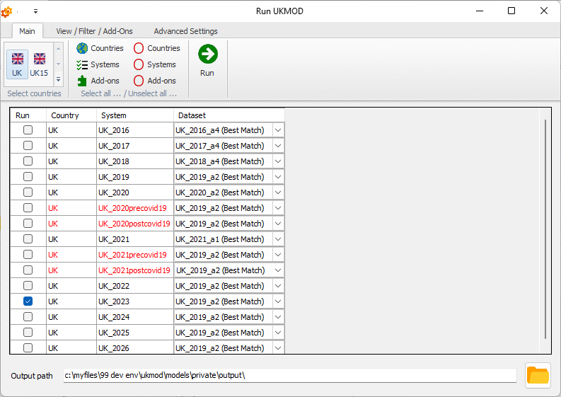
Add-ons - use

Slide 7
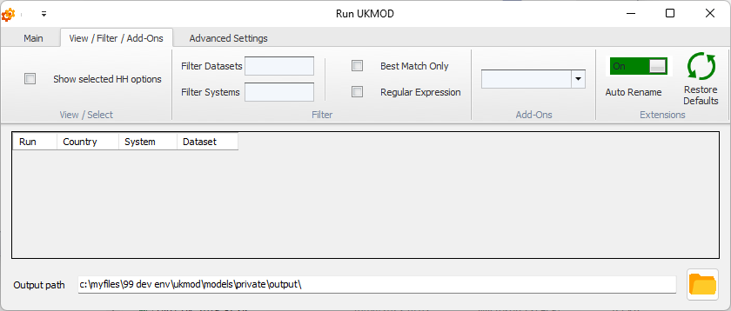
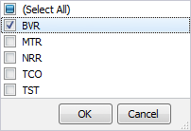
Add-ons - use

Slide 8
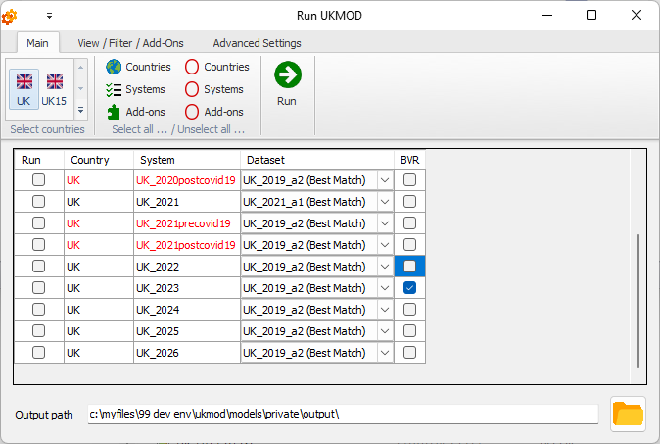
Add-ons - use

Slide 9
UKMOD’s Behavioural Add-on: BVR
Seek to distinguish between “impact” and “behavioural” effects
Impact effects are standard in UKMOD
Behavioural effects consider likely responses to policy reform
Reduced form versus structural
In UK Government analysis, common to focus on reduced form methods reflecting “elasticities” reported in empirical literature
HM Treasury, DWP: Adams and Phillips, (2013), Meghir and Phillips, (2008)
Scottish Fiscal Commission (2018, 2021), Scottish Government (2020)
UKMOD implements elasticity approach
Follows the approach documented by the Scottish Fiscal Commission (2021)

Slide 10
BVR: Responses to marginal effective tax rates
Taxable Income Elasticity (TIE)
% change in taxable income due to a 1% change in net-of-tax rate
Example:
Earnings: £200,000 per year
TIE: 0.5
Increase in marginal tax rate from 40% to 45%
8.33% reduction in net of tax rate = (0.55 – 0.60)/(0.60)
4.17% reduction in taxable income = 0.5 x 8.33
£8,333 per year reduction in earnings = 0.0417 x 200,000

Slide 11
BVR: Responses to marginal effective tax rates
Scottish Fiscal Commission’s assumed taxable income elasticities for 2020/21 budget forecasts
Taxable income start (£) | Taxable income end (£) | Taxable income elasticity
Low | Basic rate limit | 0.015
Basic rate limit | 80,000 | 0.10
80,001 | 150,000 | 0.20
150,001 | 300,000 | 0.35
300,001 | 500,000 | 0.55
500,001 | High | 0.75
Included in policy ConstDef – see parameters $TIERate and $TIEThresh

Slide 12
BVR: Responses to average effective tax rates
Responses to change in average effective tax rates based on assumed “average effective tax rate factors”
Example:
Increase in tax liability of individual under proposed reform = £500
Effective tax rate factor of individual = 0.2
Projected increase in tax liability following behavioural response: £400 = 500 x (1.0 – 0.2)
Less evidence to support behavioural responses to changes in average effective tax rates than for changes to marginal rates
Responses projected based on marginal rates in preference to average rates

Slide 13
BVR: Responses to average effective tax rates
Scottish Fiscal Commission’s assumed average effective tax rate factors for 2020/21 budget forecasts
Taxable income start (£) | Taxable income end (£) | Extensive AETR factors
Low | Basic rate limit | 0
Basic rate limit | 80,000 | 0.06
80,001 | 150,000 | 0.06
150,001 | 300,000 | 0.25
300,001 | 500,000 | 0.25
500,001 | High | 0.25
Included in policy ConstDef – see parameters $AETRFactor and $AETRThresh

Slide 14
BVR implementation
Required information
The parameters for TIEs and AETR Factors are included in the model spine
Model checks input data for information concerning individual specific marginal effective tax rates and net tax burden under assumed baseline
The input data need to be augmented to include this information
The “Behavioural Responses” (BVR) add-on uses the above information to evaluate responses to a policy counterfactual
The “Behavioural Responses” Statistics Presenter template is designed to assist post simulation analysis

Slide 15
BVR add-on policies
ao_control_bvr: injection points of subsequent policies
prep_bvr: manages loops used to conduct analysis
init_bvr: defines loop-specific adjustments, comprising income variation and behavioural responses
store_bvr: identifies outputs to store following completion of each loop
calc_bvr: evaluates the net tax burden of the considered system
earns_bvr: evaluates marginal effective tax rates on earnings and associated behavioural responses

Slide 16
BVR add-on policies (cont.)
ypp_bvr: evaluates statistics for private pensions
yprtx_bvr: evaluates statistics for taxable property income
yiytx_bvr: evaluates statistics for taxable investment income
other_bvr: evaluates statistics for “other” income
dummy_bvr: is a policy added to ensure that variables of interest are reported by EUROMOD software

Slide 17
BVR – Practical Example
Use the BVR add-on to simulate behavioural responses to a 5-percentage point increase in the basic rate of tax for people residing in England and Northern Ireland in 2026.
Directions:
Open UKMOD and access the UK policy descriptions
Run a base-line simulation of the UK_2026 system using the training_data input
Use the BVR add-on to generate working statistics for the base-line simulation
Copy the working statistics to the training_data input
mntr_earns_s, mntr_ypp_s, mntr_yprtx_s, mntr_yiytx_s, mntr_other_s, ntax_s (omit “_s” from variable name in training_data)
Copy the UK_2026 system and name the copy UK_2026_ex1
Implement a 5% increase in parameter $ITRate1 in system UK_2026_ex1
Save the model changes
Run the UK_2026_ex1 system
Use the Statistics Presenter to analyse effects

