Slide 1
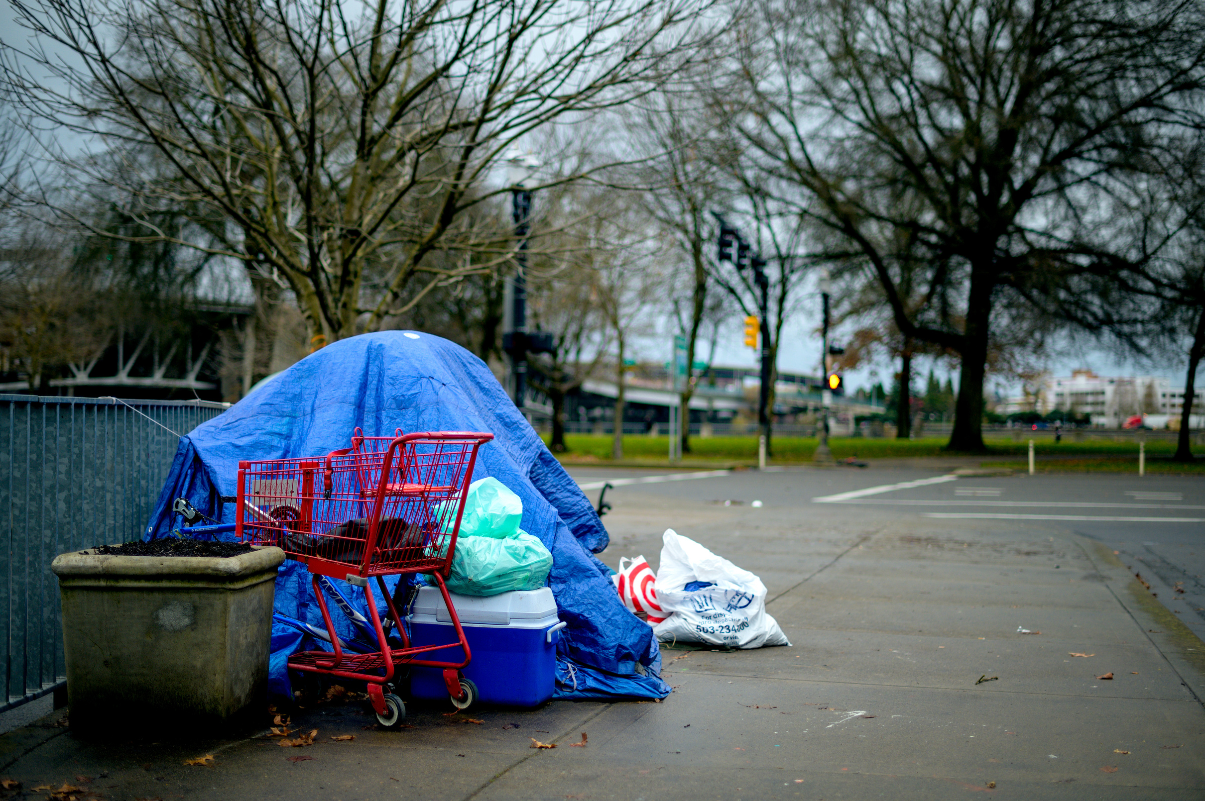
Leadership in provision of Musculoskeletal(MSK) physiotherapy services to the homeless community.
Going above and beyond
Presented by
Rajesh Kumar

Slide 2
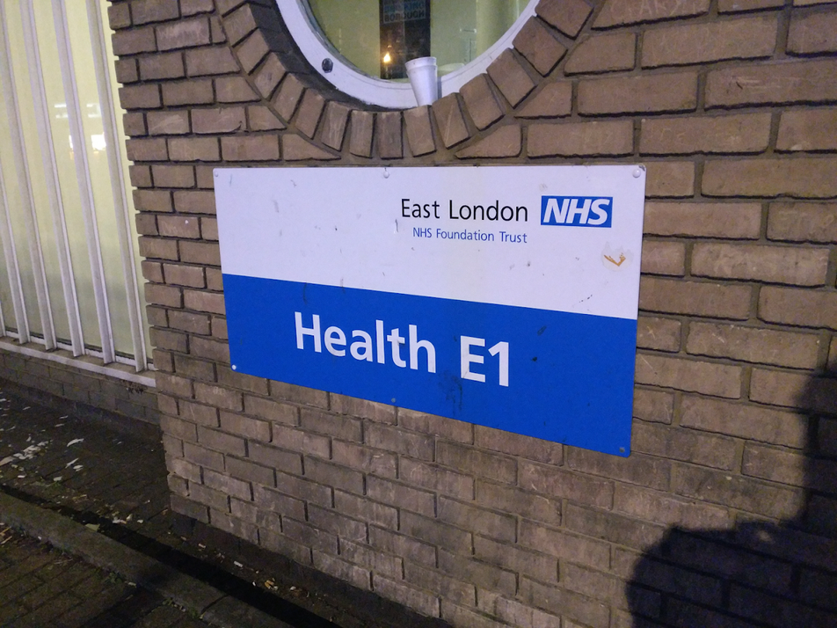
About me
Mr Rajesh Kumar
Advanced Physiotherapy Practitioner/First Contact Physiotherapist
at East End Health Network, East London

Slide 3


Overview
Integrated Care model for the homeless patients with MSK conditions in the primary care
Leadership challenges and strategies to improve health outcomes in homeless patients
Case studies
Success story
Recommendations

Slide 4




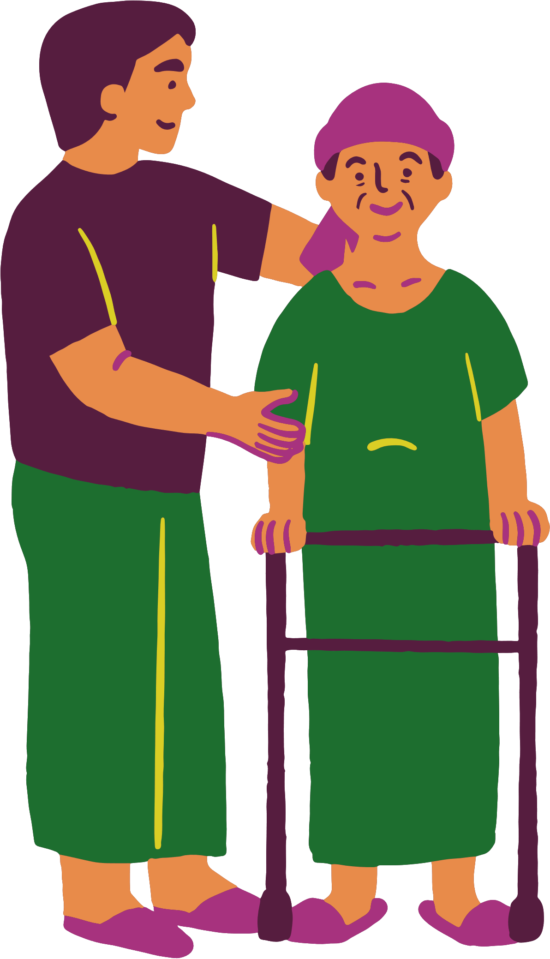
Patient Population
at Homeless Medical Centre
Vulnerable groups such as migrants, refugees, experienced severe trauma, domestic violence or abuse.
Prisoners and those with no recourse to public funds.
Substance misuse (alcohol and drug dependency)
Street Homeless
Temporary accommodation (hostels, B&Bs).
"sofa-surfers," and those with no fixed abode
Patients with mental health problems, including schizophrenia, bipolar disorder, depression and post traumatic stress disorder.

Slide 5
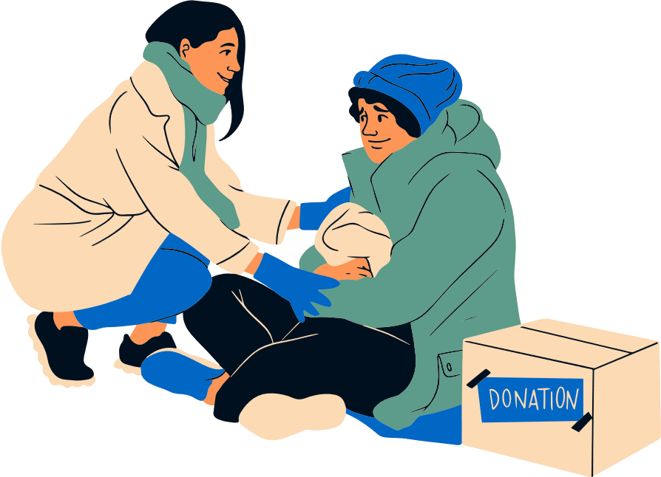
382,000 people are homeless in England
(Shelter 2025, the National Campaign for Homeless People Organization)
Homeless people face extreme health inequalities in the UK
(Bowen et al., 2019)
Among 3355 homeless people in the UK,
2452 (78%) have physical health problems of which
1371 (41%) have MSK issues (A National study on homeless health needs audit UK, 2022)
Homeless people have a ‘tri-morbidity’ health issues like mental health, physical health, drug abuse or alcoholism (Hawett et al., 2012)

Slide 6
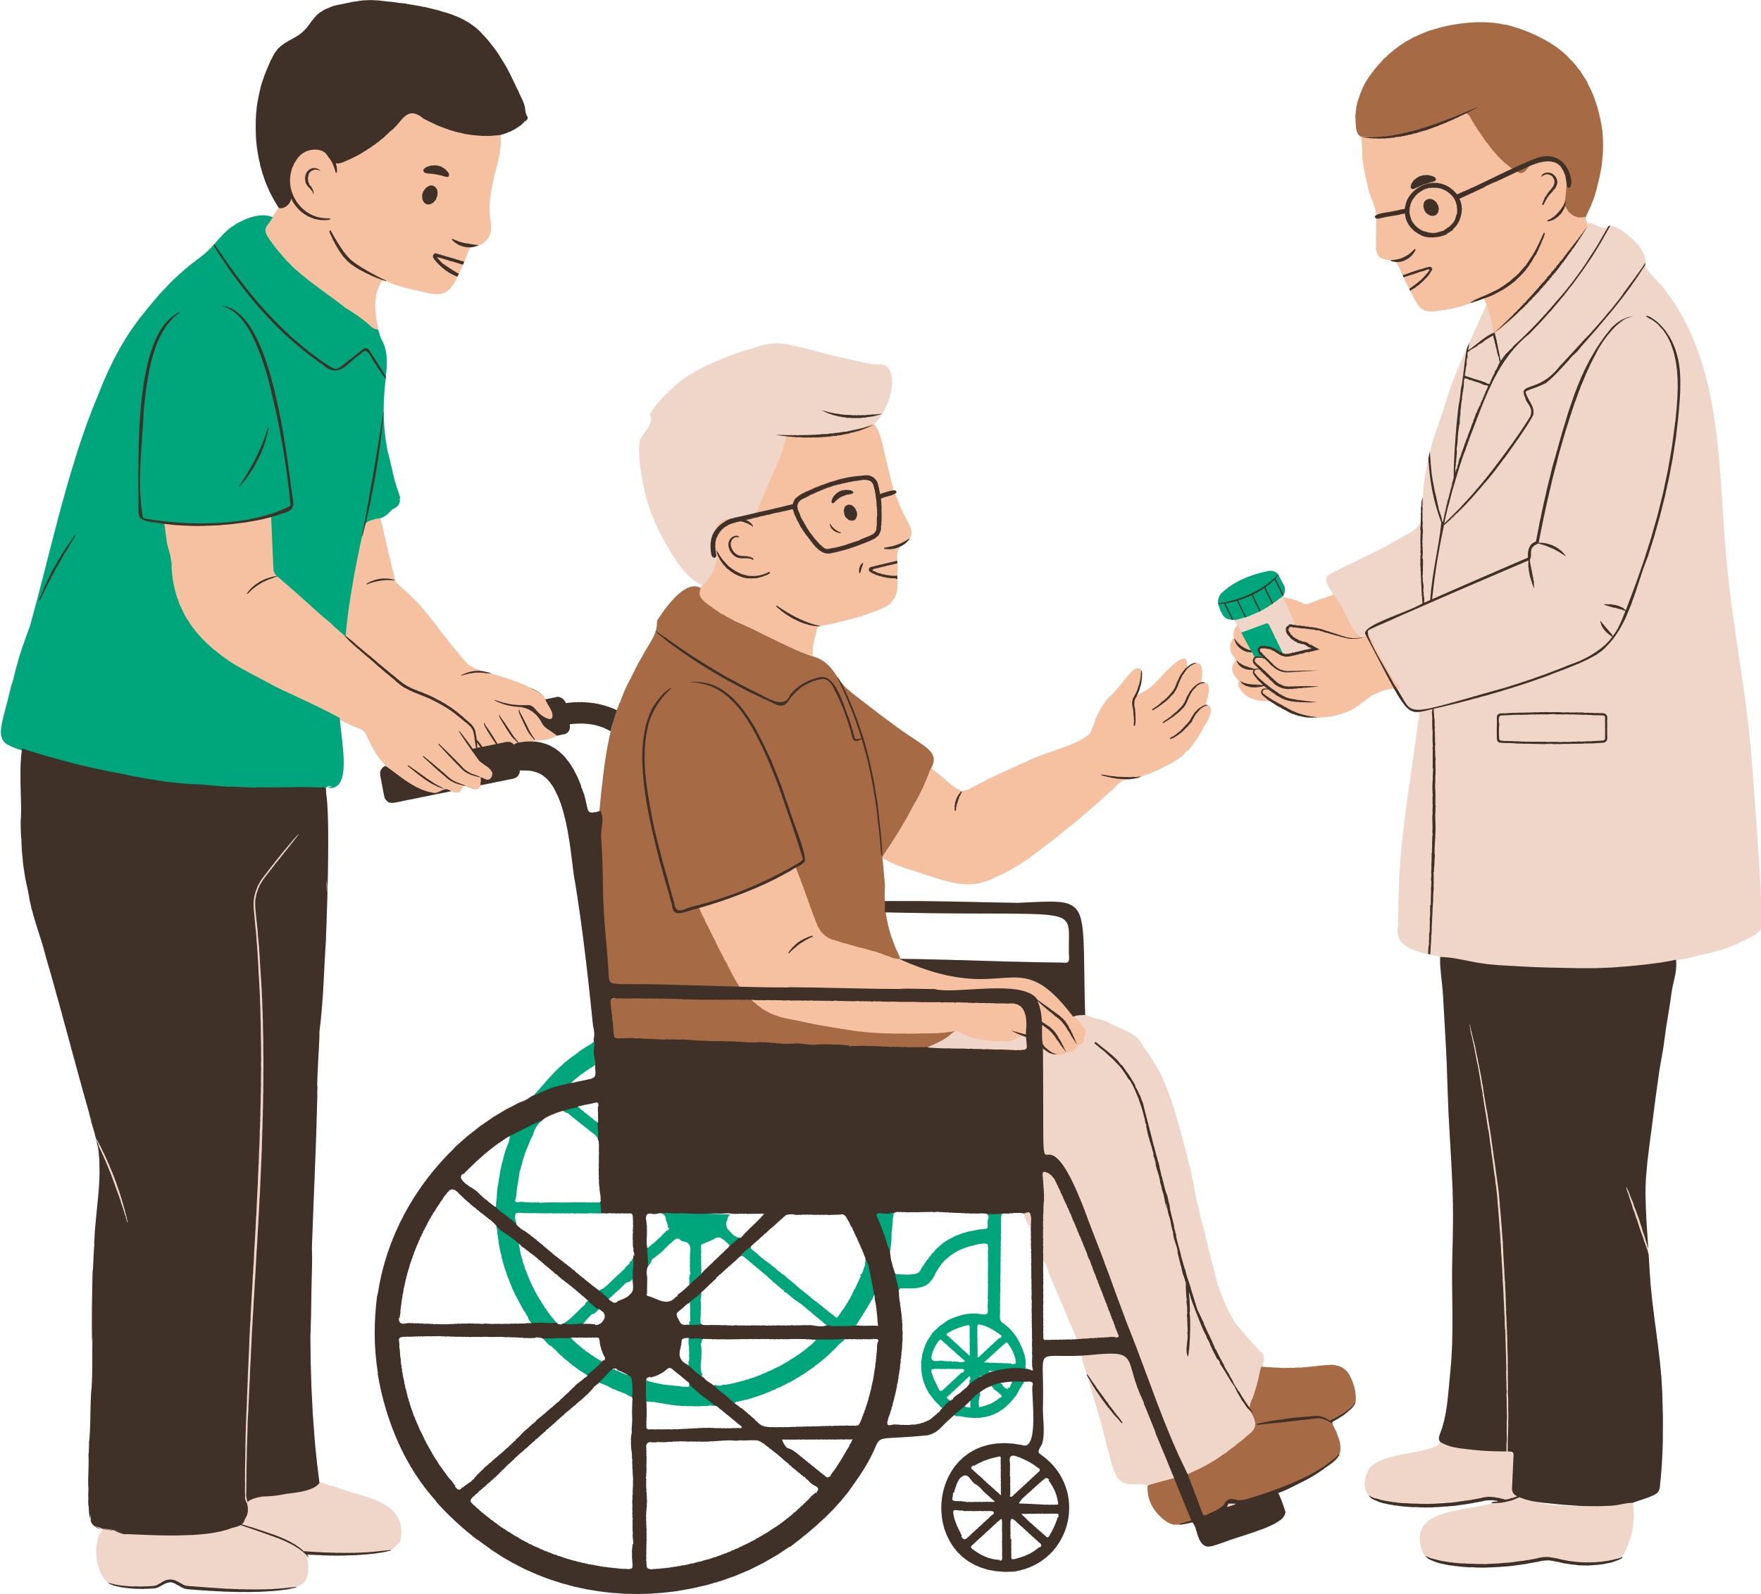
The most common physical pain due to broken bones (39%), arthritis (23%), migraine (22%), pain after surgery (22%), sciatica (14%) and cluster headaches (12%)
(Groundswell charity, 2018)
Quick access to physiotherapy is vital to prevent new acute MSK problems from becoming chronic (Dept. of Health,2016)
The mortality and multi-morbidity rates in homeless people are 12 times higher compared to the general population (Aldridge et al., 2017)

Slide 7
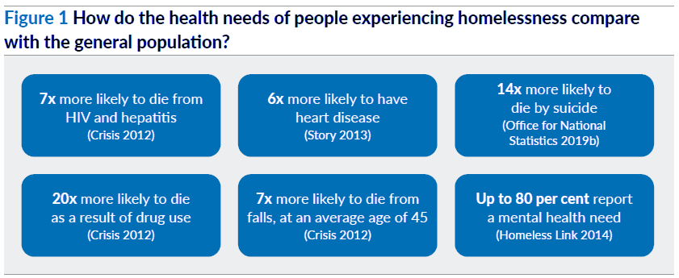
Cream et al., 2020

Slide 8
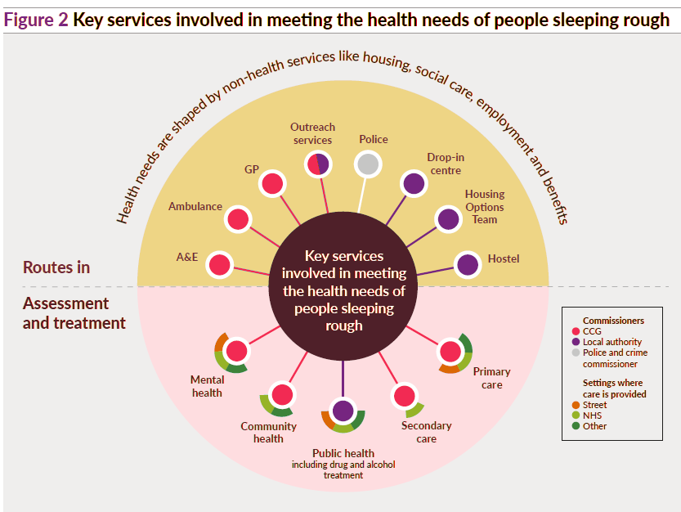
Cream et al., 2020

Slide 9
The Practice Multidisciplinary Team
Practice manager and Admin team
Care coordinators
GP’s
Practice Nurse
Clinical Pharmacist
Health care Assistant
Psychologist
Advanced Mental Health Practitioner
Advanced clinical Practitioner (ACP)
FCP/APP
Social Prescriber
Podiatrist
Dentist

Slide 10


Coordinated Care Model
Traditional Care Model
Integrated Care Model
Require appoinments/rigid registration
Telephone consultation/ 10-20 min consultation
2-4 weeks waiting time/ no multiple appointments available
Referral to secondary care MSK and other services - waiting time is 5-6 months
May lack specific training or resources to manage the complex, multi-morbidities.
Walk in service/no identification required
F2F/30-60 min. consultation
same day/ sameweek appt/multiple appt
First point of contact for MSK issues/afor any referrals
Highly experienced in treating complex, combined physical/mental health, and substance use issues and deliver shared decision towards patient centered care.

Slide 11
Case study 1
A 35 years old male asylum seeker presented with hip pain due to gun shot injury in Libya 5 years ago,
He was removed or deregistered from the previous practice due to his aggressive behavior. However, pt reported previous practice staffs were biased and had language issues.
This pt registered in our homeless practice recently without any ID check and now uses the practice address as permanent address
Practice provided the Phone SIM to receive messages or call from the practice as patient has no money to top up.
Speaks Arabic language- during consultation I have arranged an interpreter for an hour session.
I use Ideas, Concerns and Expectation (ICE) , patient centered communication tool for the assessment.
MH: PTSD and depression
Thorough MSK examination was done
Plan: Agreed shared decision on hip self-management
Meantime, d/w gp for the blood test and hip x-ray referral
Booked appt to see mental health nurse in the same week.
Referred to ESOL and home office assistance for asylum support

Slide 12

Leadership Challenges and Strategies in Homeless patient care
Challenges
Administrative hurdles: e.g., lack of fixed address
High missed appointments/DNA’s- may be due to time keeping.
Service design flaw: rigid appt times, intolerance to missed appt, long waiting list
Strategies
Flexibility and adaptability:
No identification requirements at Homeless medical centre e.g., Providing practice address as fixed address.
Adapt communication method e.g.,phoning, texting, multiple reminders
afternoon appointments/flexible appt- patient choice e.g., booking multiple appt same day to see MDT clinicians

Slide 13
Case study 2
A 52 years old female presented with b/l knee pain for more than 6 months
Speaks Arabic and Hindi language- pt comfortable to speak in Hindi language with me. Chaperon provided for an hour session
h/o domestic abuse and pt is now under safe guarding team at the practice. Seen gp for other issues and pt is under the care of mental health nurse
Assessed the knee and on agreed shared decision -reassurance, education and self-management given.
Plan: advised to r/v physio in 6-8 weeks.
On agreed shared decision referred the pt o social prescriber to discuss weight management options and swimming and physical activities classes.
Referred the pt for ESOL English language classes, and job center assistance.
Good news is that patient now runs her own cooking class in the leisure center.

Slide 14

Leadership Challenges and Strategies in Homeless patient care
Challenges
Trauma/ Mistrust in the system
Discriminatory attitudes
past negative experiences
Cultural insensitivity/LGBTQ communities- staff may not be familiar with gender affirming care and terminology.
Strategies
Communication and trust building:
Active listening
Empathy
building trust and rapport
Providing bilingual advocate/interpreter
allowing for more open dialogue
offer services free of cost e.g., ESOL, job center application, home office assistance

Slide 15
Case study 3
A 47 years old homeless male with HIV +ve who attended A&E 10 times in a month following chest pain, abdominal pain, diarrhea.
According to A&E report pt was intoxicated due to alcohol and substance abuse.
left the A&E in all 10 occasions without seeing any healthcare professionals due to long waiting hours.
h/o selling medicine for money. pt unable to attend clinic as no money to travel.
MH: anxiety and depression -seeing mental health practitioner for mental health support with CBT, Talk therapy
Seen gp in the practice who advised to see FCP for low back pain.
Arranged double appt
Assessed him. No CES symptoms.
Plan: Biopsychosocial approach along with self-management
Given education about functioning of primary care, A&E, secondary care.
Referred to social prescriber to assist with swimming and physical activities classes.
Provided food bank details and assistance to apply freedom pass for travel
Referred back to GP’s care as pt now willing to talk to gp to stop substance misuse and for alcohol addiction support

Slide 16
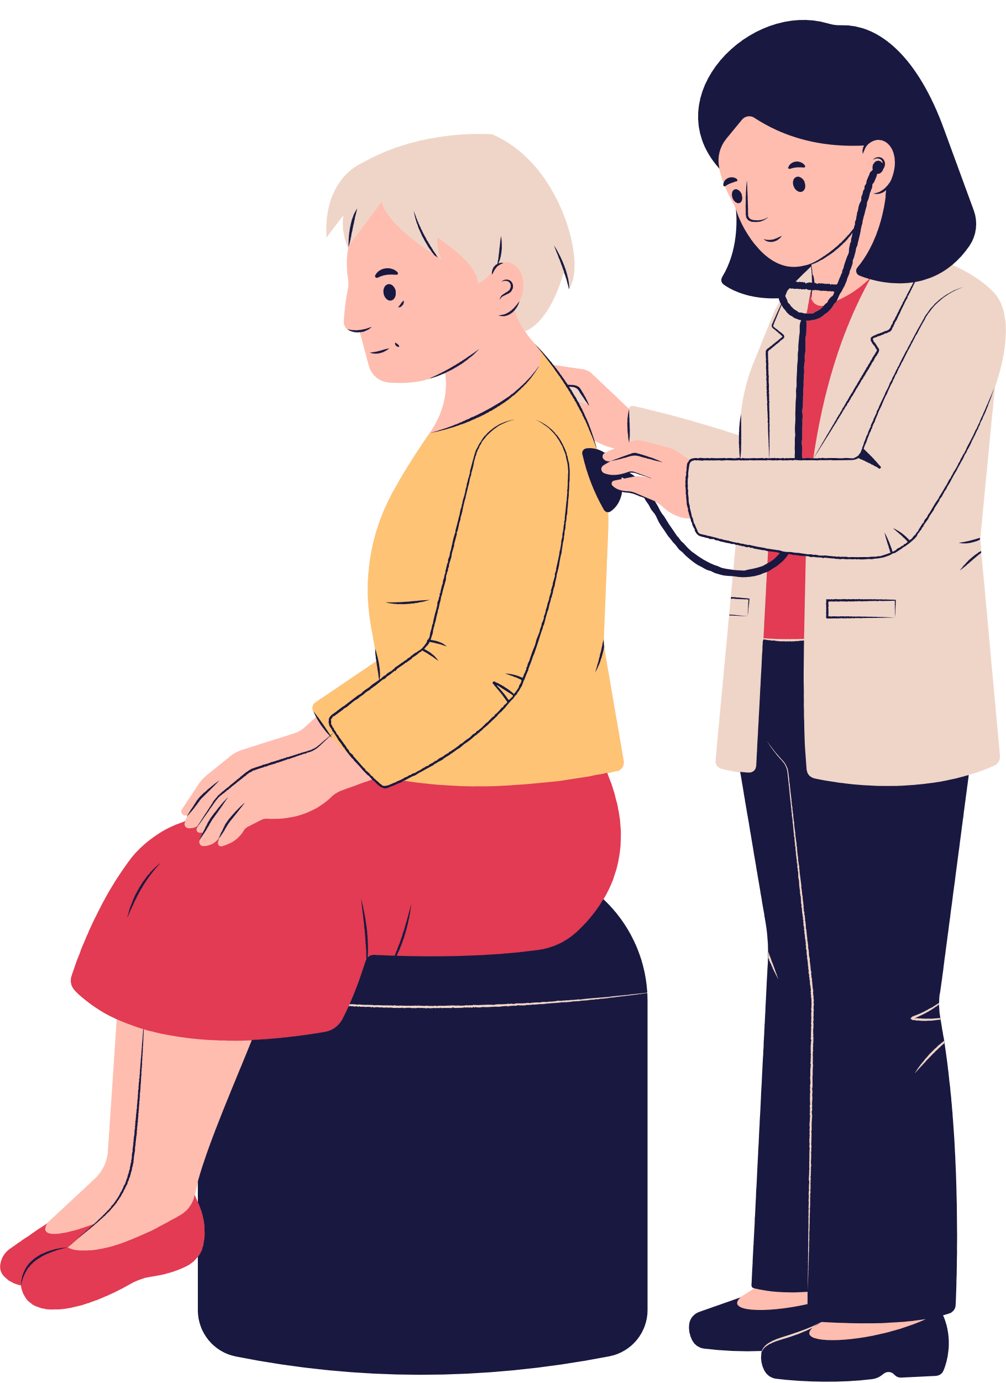
Leadership Challenges and Strategies in Homeless patient care
Challenges
Socioeconomic status, shelter, food, chronic health issues
MSK pain often linked to mental health, physical health, substance use- trimorbidity challenges
Strategies
Holistic Problem-Solving:
supported self- management with information and advice
Biopsychosocial approach
Integrating pain management with mental well-being, connecting patients to broader services e.g., housing, food bank- acting as a bridge between the care.
prevent from drug dependency
referral to mental health nurse, talk therapy.

Slide 17

Leadership Challenges and Strategies in Homeless patient care
Challenges
disrupted continuity of care- released from Prison/ from other surgery
complex systems
lack of patient voice.
Strategies
Advocacy and Empowerment:
ICE (Ideas, Concerns, and Expectations)
Trauma Informed care/emotional support
motivation, reassurance and shared decision making
Advocating for their needs within the primary care team- e.g., patient feedback, patient participation group meetings.

Slide 18

Leadership Challenges and Strategies in Homeless patient care
Challenges
Fragmented care
Prejudice from health care staff
Service gaps and delays
Strategies
Team Collaboration:
Addressing Multifaceted needs along with MSK issues
Building collaborative networks across health and social care
Prioritizing patient-centered care.
new staff training/further training,

Slide 19

Leadership Challenges and Strategies in Homeless patient care
Challenges
Time constraints
Patient adherence to Physio treatment
limited or no access to physio equipment e.g., splints, walking aids
5 months waiting time for MSK physio in secondary care
Strategies
Resourcefulness and Innovation:
providing double appointments
Created self-management strategies by prioritizing essential movement.Self-management booklets, digital tool
Providing charity link to support to purchase equipment e.g., hot packs
Currently pioneering US image and guided injection in the practice

Slide 20

Success story
A 40% increase in treatment adherence
Reduced DNA rates and reduction secondary care reliance
My consultation duration extended from a afternoon session to 2 days.
Success in organizing summer and winter fair activities for homeless.
The practice team received several awards

Slide 21
Success story
2025/2026 Awards: won the 'Greener Health Award' at the ELFT Staff Awards for sustainability.
2023 Nominations: Shortlisted for the "Award for Above and Beyond General Practice" at the NEL Workforce Awards.
2019 National Award: The Pathway Homeless team at Health E1 won the Excellence in Urgent and Emergency Care Award at the national NHS Parliamentary Awards.
2022 Regional Award: The Homeless and Vulnerable Person Outreach Service (operating from Health E1 won a London regional NHS Parliamentary Award.

Slide 22
Recommendations
Fix the service design flaws
Embed evaluation
Foster the growth
Promote a partnership

Slide 23
Case study to discuss
A 38 years old male who came to UK 10 years ago on student visa and overstayed.
he is on dialysis. Lost his job and accommodation.
Has right foot pain for 2 months.
Pt recently received deportation notice and awaiting fit note to fly.
You still see him? What is your pt management strategies.

Slide 24

Summary and Takeaways
Homeless people have a ‘tri-morbidity’ health issues like mental health, physical health, drug abuse or alcoholism.
Integrated care model and effective leadership is essential for addressing the complex musculoskeletal needs with shared decision and patient centered care to improve health outcomes in homeless patients.
Leadership in physiotherapy services for the homeless community requires flexibility and adaptability, communication and trust building, advocacy and empowerment, holistic problem solving, team collaboration, resourcefulness and innovation strategies to overcome significant barriers to care.

Slide 25
References
Shelter & Shelter 2019, "280,000 people in England are homeless, with thousands more at risk", Press Release.
Bowen, M., Marwick, S., Marshall, T., Saunders, K., Burwood, S., Yahyouche, A., Stewart, D. & Paudyal, V. 2019, "Multimorbidity and emergency department visits by a homeless population: a database study in specialist general practice", British Journal of General Practice, vol. 69, no. 685, pp. e515–e525.
Hewett, N., Halligan, A. & Boyce, T. 2012, "A general practitioner and nurse led approach to improving hospital care for homeless people", BMJ, vol. 345.
A National study on homeless health needs audit UK, 2022
Groundswell charity, 2018
Aldridge, R.W., Story, A., Hwang, S.W., Nordentoft, M., Luchenski, S.A., Hartwell, G., Tweed, E.J., Lewer, D., Katikireddi, S.V. & Hayward, A.C. 2018, "Morbidity and mortality in homeless individuals, prisoners, sex workers, and individuals with substance use disorders in high-income countries: a systematic review and meta-analysis", The Lancet, vol. 391, no. 10117, pp. 241–250.
Department of Health,2016.
Cream, J., Fenney, D., Williams, E., Baylis, A., Dahir, S. & Wyatt, H. 2020. Delivering health and care for people who sleep rough, Going above and beyond. The Kings Fund.

Slide 26
Thank you

Slide 27
Questions & Discussion

