Slide 1
SelfBack at AHPS
Feb 2026

Slide 2
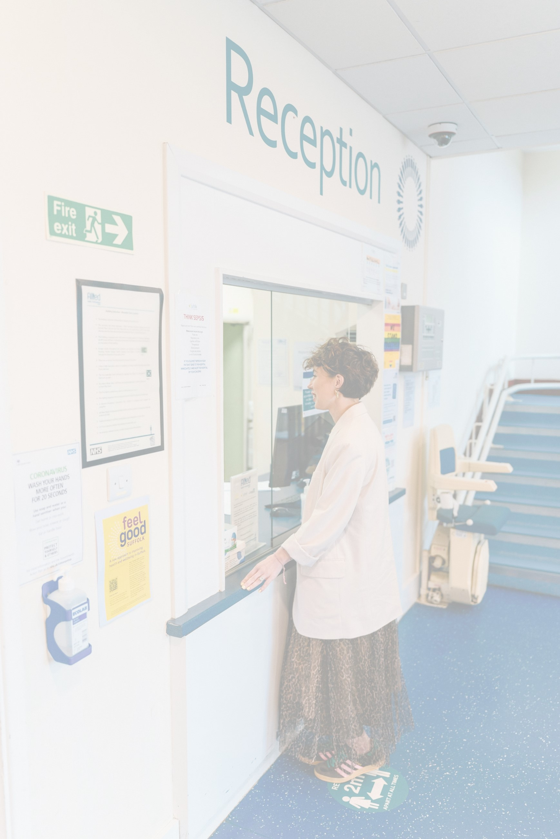


Activity & Growth 24/25
129,632
patient contacts
95,659
referrals received
4.8%
MSK & PH
15,455
GP appointments saved
14.3%
PH
92.8%
NHS Friends
& Family
-8.2%
BANS
22 seconds avg. calls answer

Slide 3

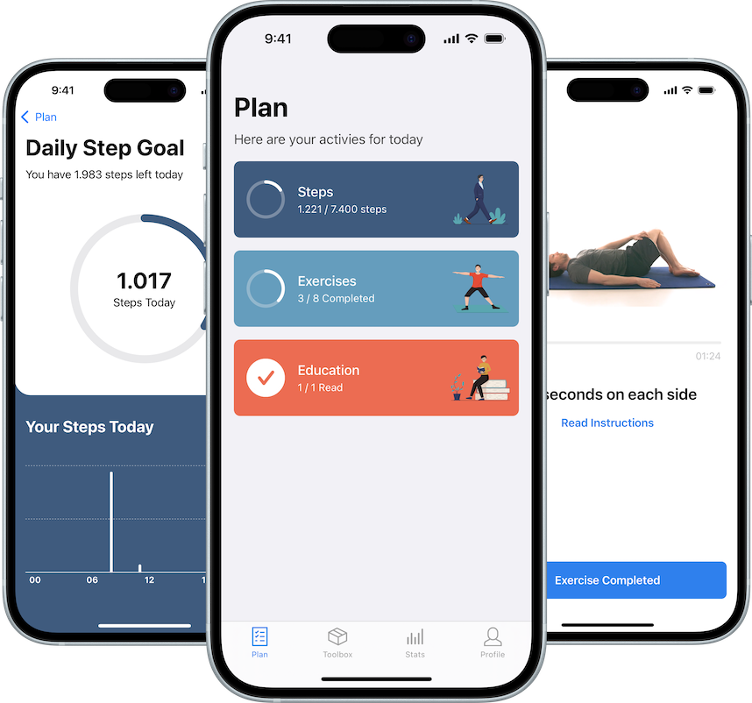
SelfBack
Personalised treatment plan using machine learning
Similar outcomes to traditional care
Immediate access to the app
Approx £21 saving per episode of care
Lower cost than on F2F physiotherapy appointment
Aim: reduce the number of back pain patients needing appointments

Slide 4
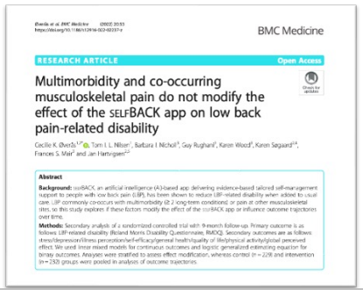
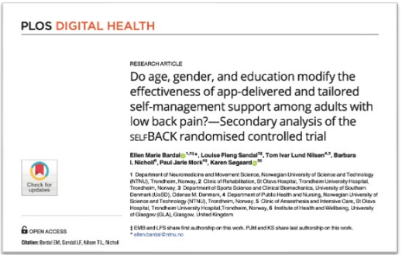
Be aware of your bias
SelfBack is not just for young patients
SelfBack has been shown to work for patients up to 85 years old
SelfBack is not just for tech savy men
SelfBack has proven effects on all patients and is easy to use
SelfBack is not just for the simple cases
SelfBack has proven effective for multidiagnosed with stress and depression!

Slide 5
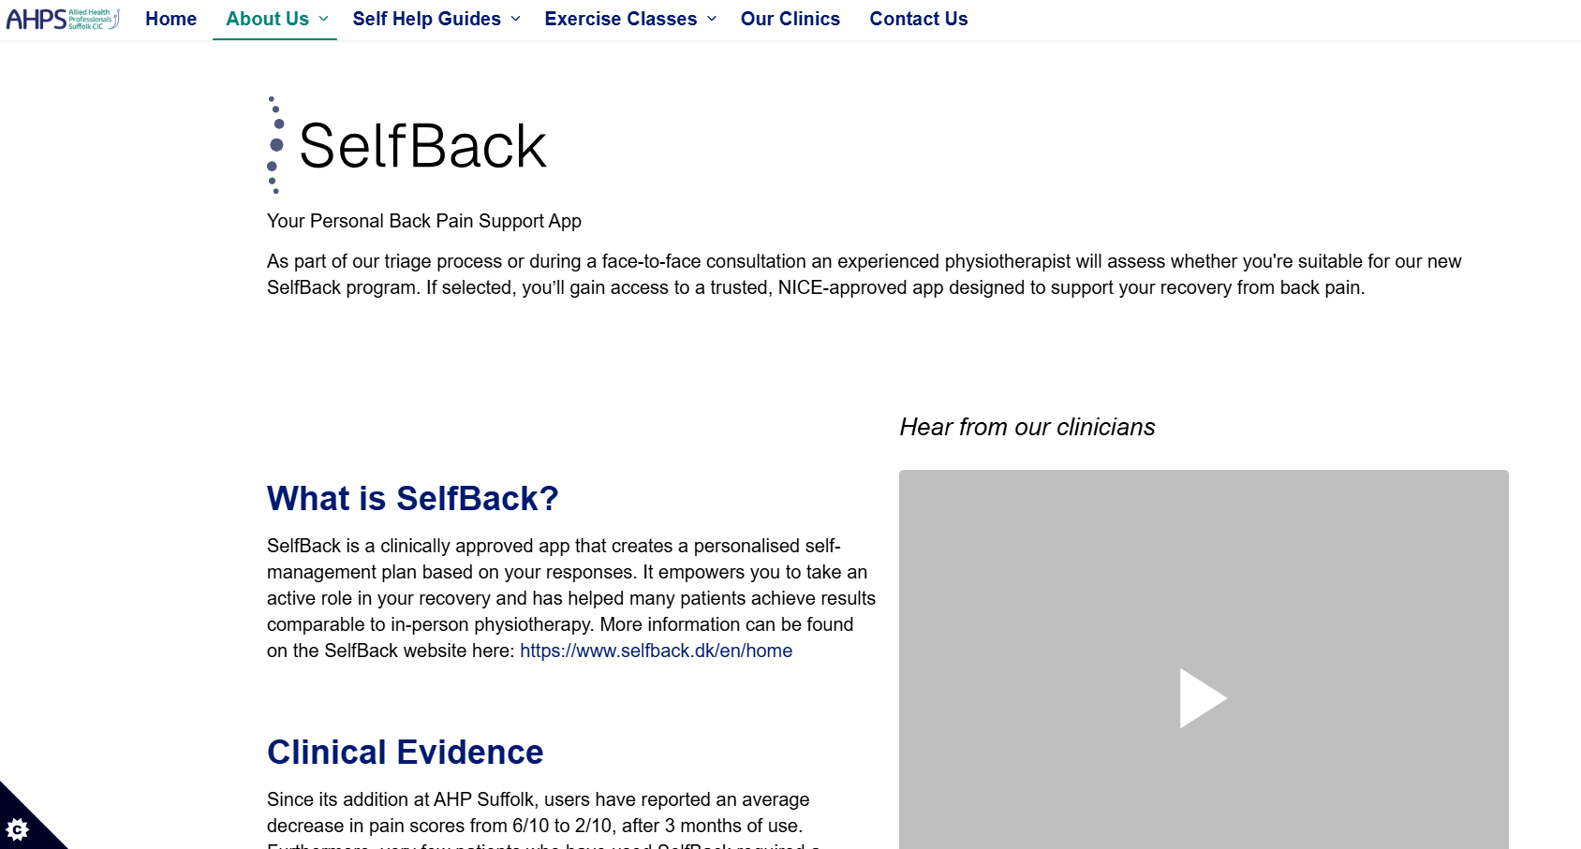
Implementation
Project T&F group
Staff from all groups
Clinician led implementation
Staff training
Multi-modal
Patient facing materials
Website
Video
Email communication
SMS communication
Data collection from day one

Slide 6
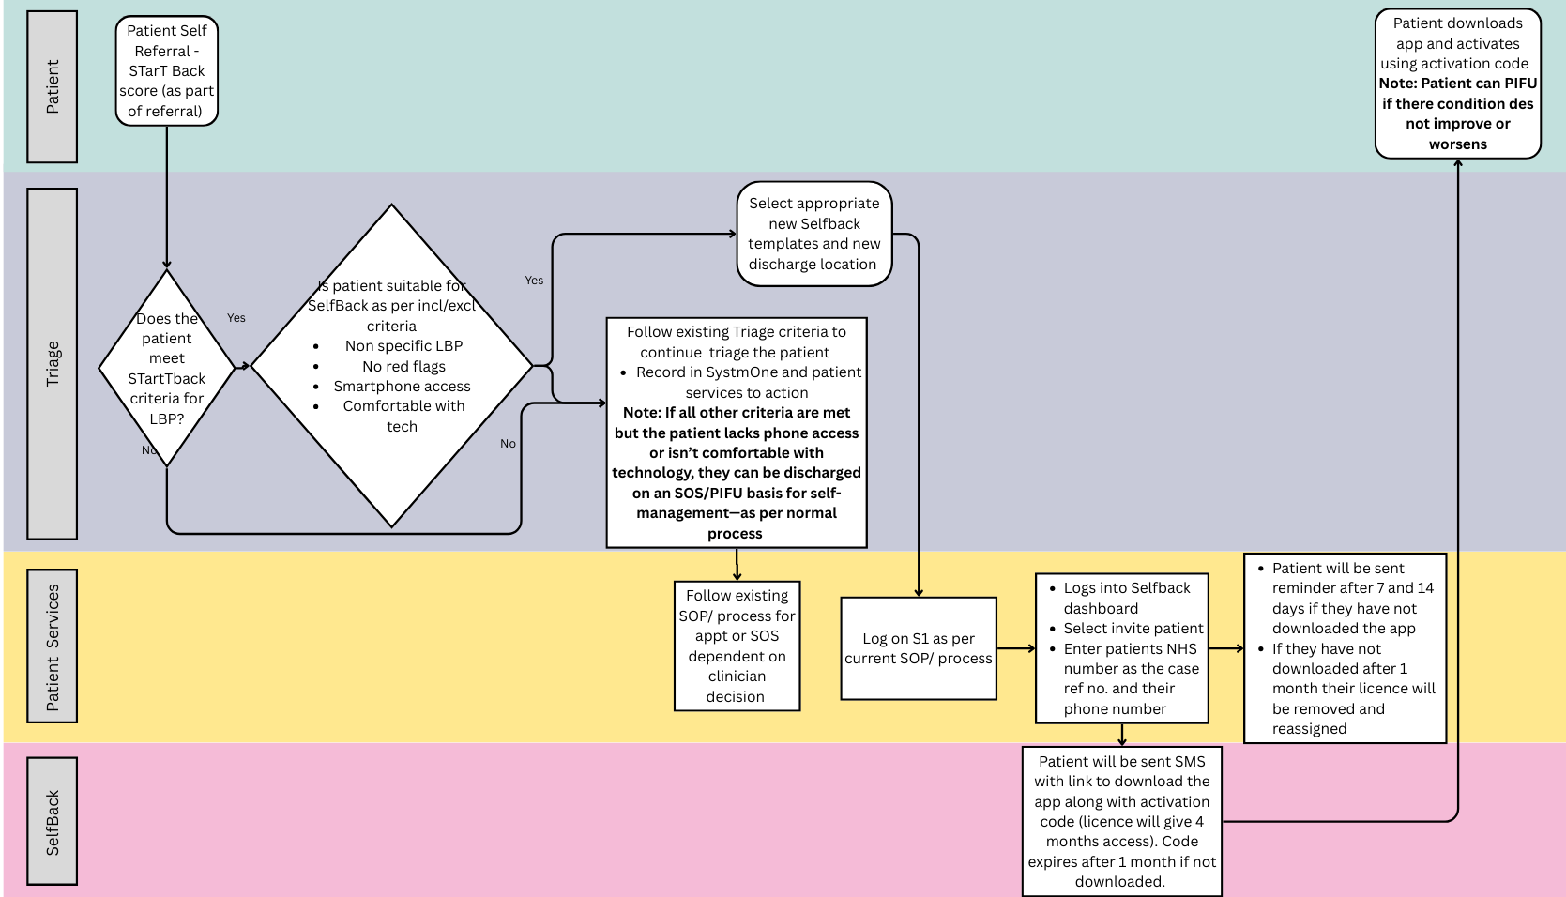
If eligible, patient can be added to Selfback from Triage or first appointment.
Patient Services will process the Selfback invite and reminders.
Patient can PIFU if condition does not improve or worsens

Slide 7
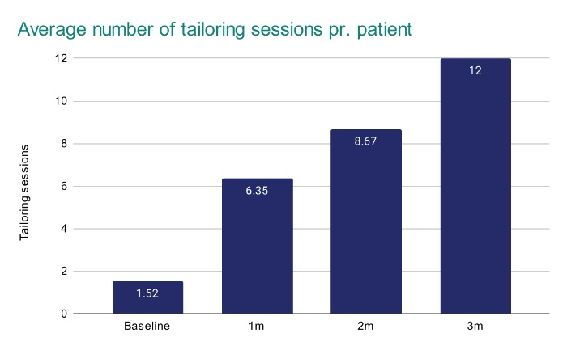
Uptake
Over 200 patients invited (Oct 25 – Dec 25)
Primarily from online triage
65% - 70% redemption of invites
Most users using SelfBack for 3 months
Within this time having 12 tailoring sessions

Slide 8
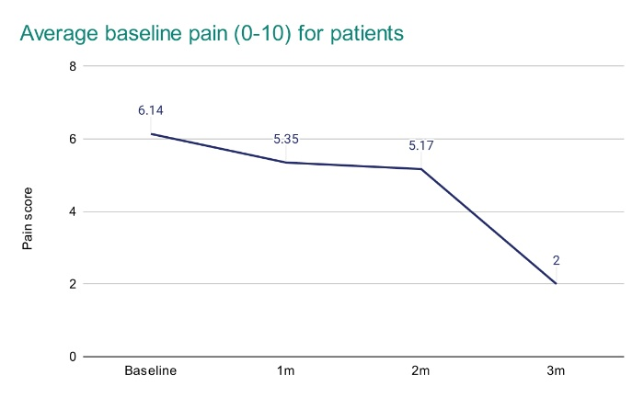
Outcomes
Very low PIFU (<5%)
1 negative patient feedback since start
Demonstrating lower VAS over 3 months
Awaiting data on MSK-HQ and NHS FFT

