Slide 1
KSB’s
A Workplace Mentors Perspective
By Ella Collard
l

Slide 3
When first starting mentoring we were presented with the KSB’s
Physiotherapy Practice - 27
Physiotherapy Values and Behaviours – 8
Development of self and others – 8
Professional Engagement – 9
Total KSB’s - 52

Slide 4

Daunting !!

Slide 5
Mentoring sessions
Picked our agenda items
Would complete our session and work through discussion and learning summary
Related everything to KSB’s
But we were randomly working on the KSB’s !!
Some were being recorded/related to frequently
Others not at all

Slide 6
Pre-agreed agenda items | Mapping to apprenticeship standard | Discussion and learning summary | Ongoing actions and for whom
Patient with low tone shoulder | S14,S19,K1,K3 | Active assisted exs of shoulder facilitating recruitment by patient Standing work with patient who is not actively engaging in rehab, discussion as to why | Review exs with patient at next appoint
Hypotonia | S10 S11, S19, K1,K3 | Discussed in a session and then saw patient. Patient who has had a stroke discussion on effects of low tone, knee hyperextends and unable to actively produce hip knee flexion for step through. Lack of hip extension and stability of leg Lack of sensation and proprioception of leg therefore patient does not trust the leg to weight bear | Review appoint with patient

Slide 7


Slide 8
Tripartite Meetings
Good time to reflect on how the development/learning process is going
Suggested we start using Skills mapping in mentoring sessions to cover KSB’s

Slide 9
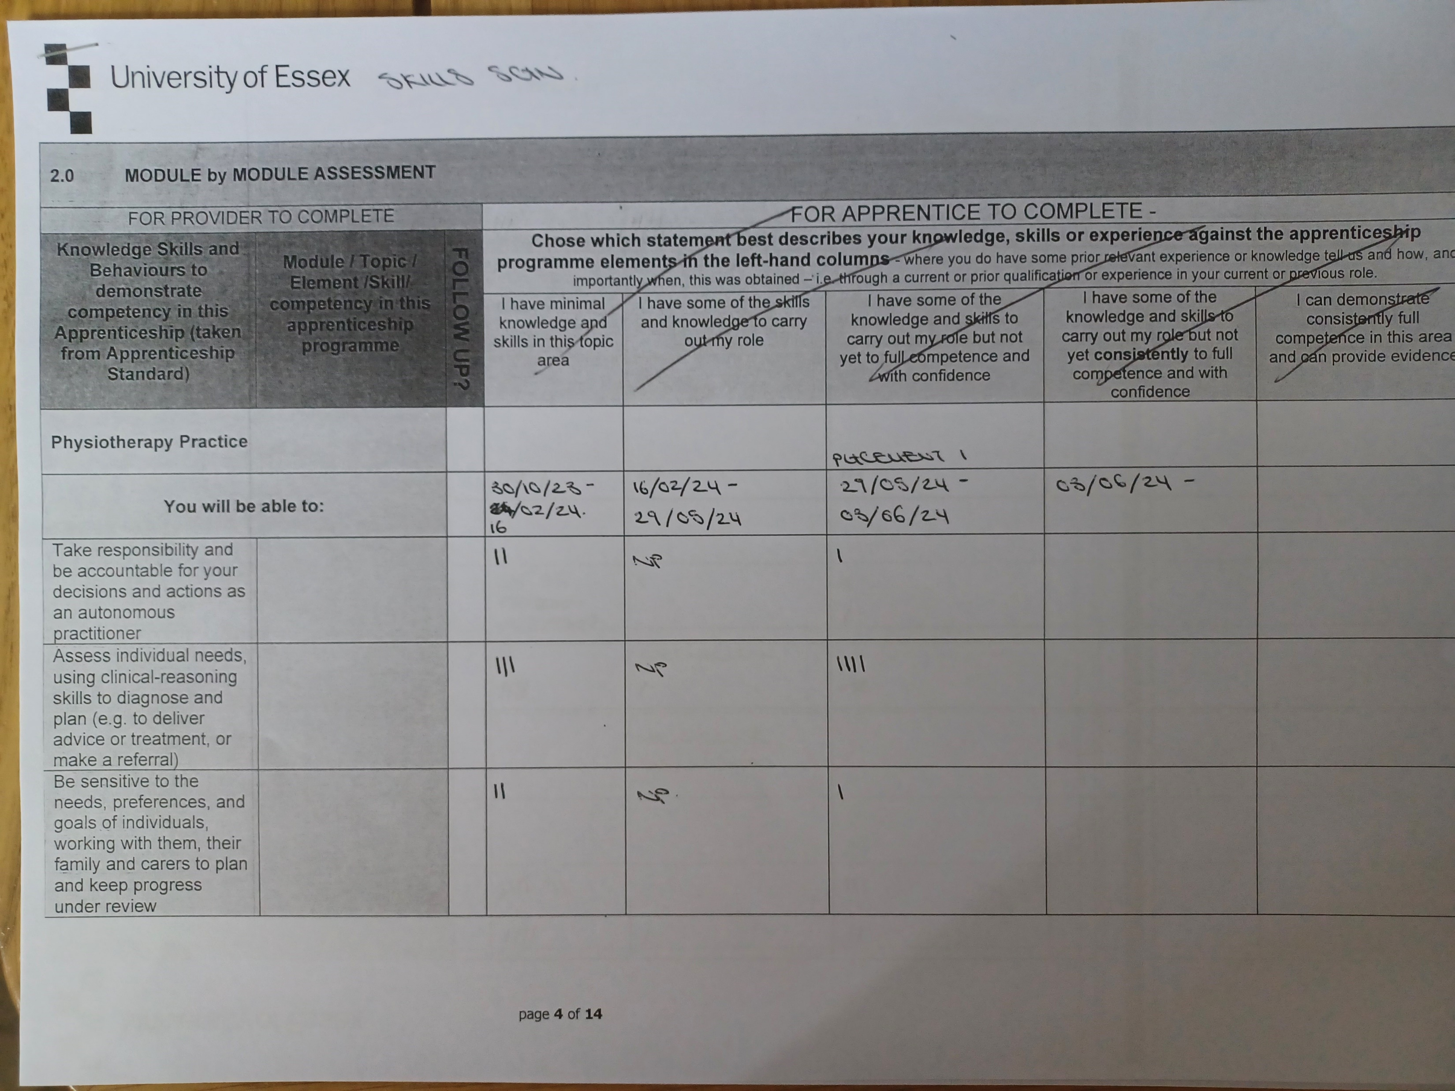
Skills map

Slide 10
Discussion and learning summary
Bilateral amputee
Visit and followed through with sarasteady, working on lifting of body weight whilst wearing one prosthesis to alleviate pressure. Discussion on positioning for safety with a view of only having one prosthesis
Analysis of limited shoulder ROM
Discussion of overall benefits of using sarasteady of UL ROM and strength and pressure relief
Complex NP assessment, patient with numbness of hands and struggling with loss of function
Good thorough assessment made including progression to appropriate assessment of sensation and discussions on proprioception
Aims and goals of therapy discussed and appropriateness for patient as she will not be further investigated as to cause

Slide 11

But where are we now recording KSB’s ?

Slide 12
Discussion on pathology of MS and Full assessment of patient in their home
Linked session to KSB's
S2 – Assess individuals needs, using clinical reasoning skills to diagnose and plan
Reviewing of handling to avoid both injury and pain for patient and husband
Looking at alignment of hips, knees, ankles to engage more stability, prevent mm and tissue tightening shortening , which in turn would limit standing position
Maintaining safety of patient
Importance of good BOS
Looking at fatigue and pacing and incorporating into exs
Recognised need for core strength

Slide 13
S3 – Be sensitive to the needs, preferences and goals of individuals, working with them, their family and carers to plan and keep progress under review
Recognising importance of husband requesting feedback and advice on progression/improvement
Being positive and sensitive to patient needs
Making both patient and husband aware of safety
Importance of building rapport with both patient and husband
Being sensitive as to how giving advice and using explanation and reasoning
Acknowledging impact of fatigue

Slide 14
K4 – Theories and approaches underpinning holistic assessment, rehabilitation, reablement, self management and behaviour change
Already has a good ex programme which was demonstrated
Providing encouragement and reassurance
Managing fatigue
Agreed on trialling a handling belt to make self management easier/safer

Slide 15
How do you Work?

