Slide 1
Physiotherapy KSB’s
The Curriculum Perspective
Jo Etherton
jethera@essex.ac.uk

Slide 2
Knowledge, Skills & Behaviours (KSBs)
The core attributes an apprentice must have to be competent in the occupation they are working in.
They must demonstrate competence in all KSB’s at
The End-point Assessment (EPA) to successful complete apprenticeship.
What the levy pays for & therefore needs to be central and visible throughout the curriculum
KSB’s are set out in the apprenticeship standard ST0519
Notes:
Onboarding and recruitment – skilsl scanning
Taught content and workplace tasks
Assessment
Progress reviews
supervision

Slide 3
Mentor Roles and Responsibilities
Familiarise themselves with the apprenticeship standard, British Values, safeguarding (e.g., knowledge of ‘Prevent’ and how to raise a concern) and the associated knowledge, skills, and behaviours which the apprentice will need to demonstrate to them.
Contribute to the decision as to whether the apprentice is ready to go through the gateway review to End-Point Assessment
Ensure there are clear, timely communications with the university, the employer and the apprentices’ colleagues about their developing scope of practice. And take steps to mitigate and identify challenges early, communicate promptly and ensure an action plan is put in place to provide enhanced support where required.

Slide 4
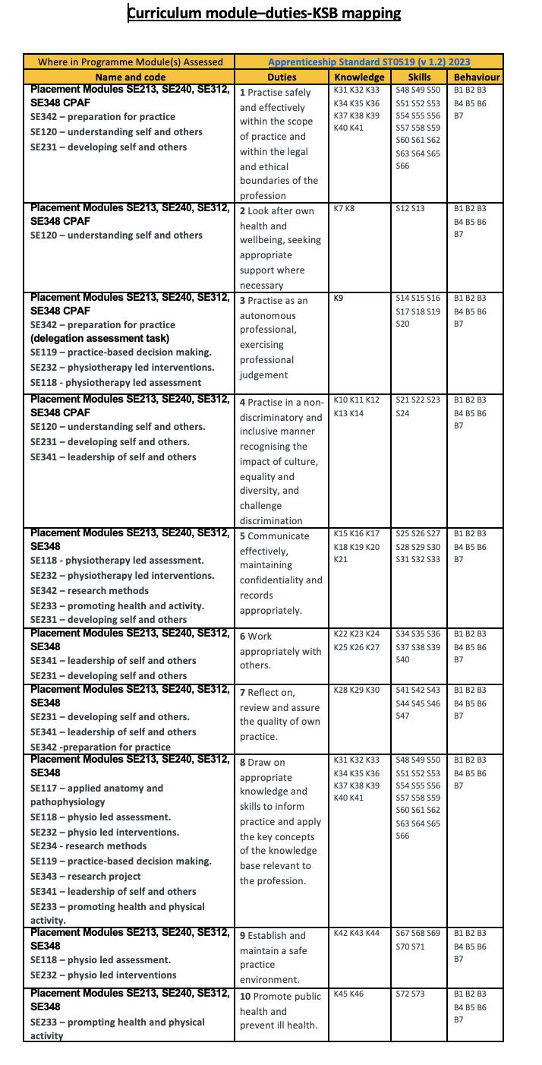
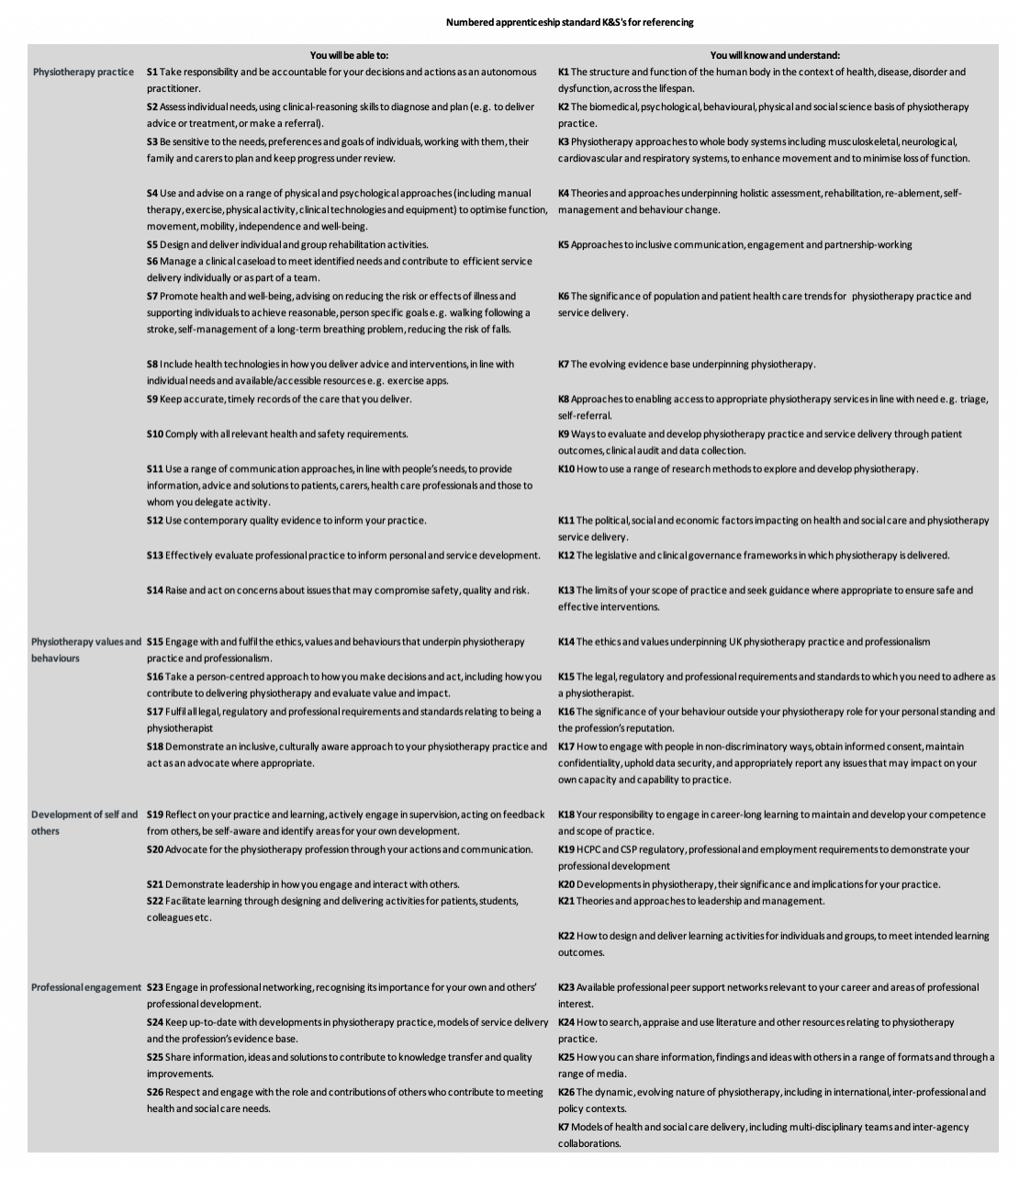

Slide 5
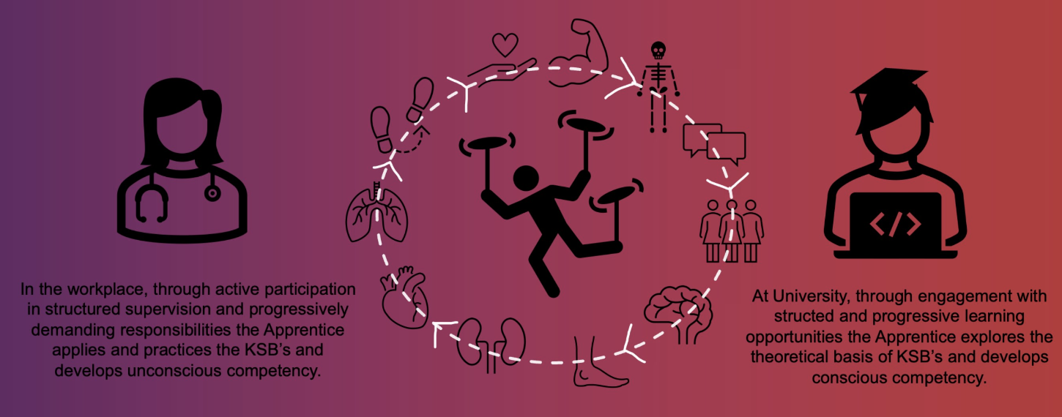
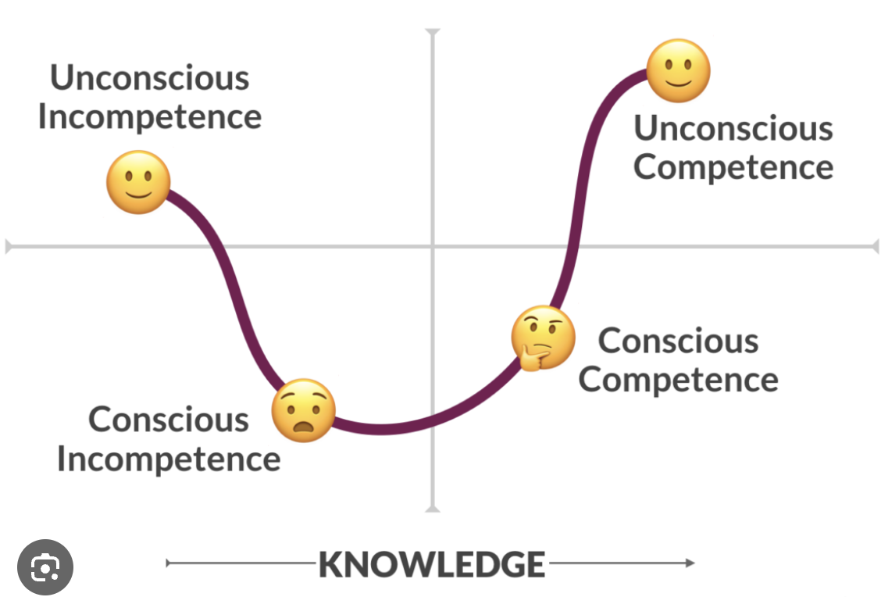
Notes:
Capturing evidence of these satges to inform decisiona nd communicatioins about developing socep fo practice and make informed gate way progression decisions.

Slide 6
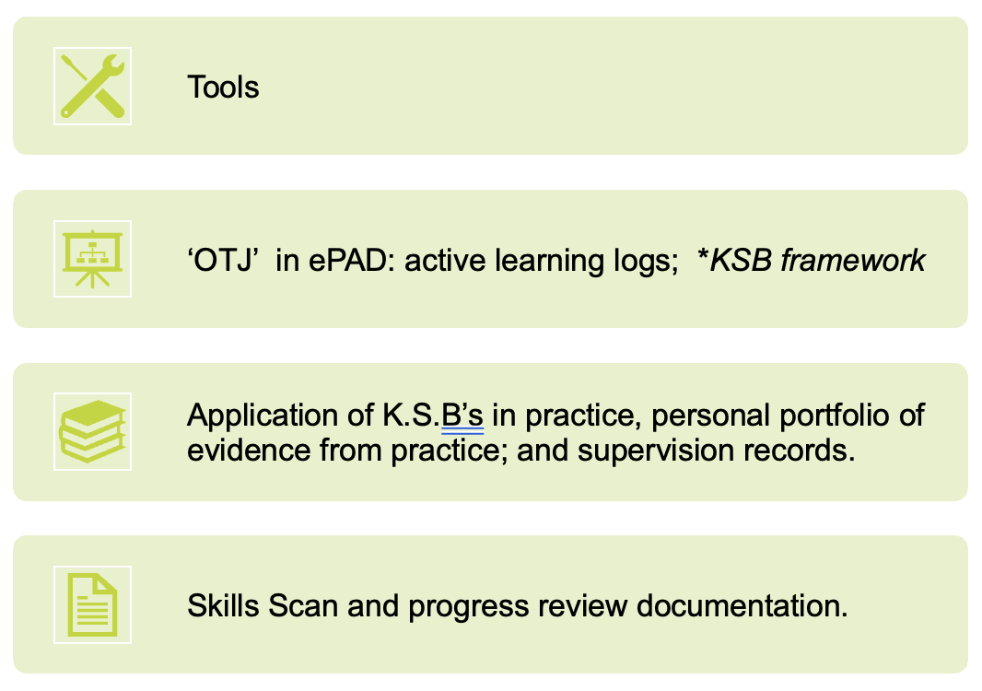
Evidencing developing conscious and unconscious competence of KSB’s
Evidencing monitoring, plans and steps to support the apprentice successfully achieve the required standard

