Slide 1
Welcome to your apprenticeship @Essex
Apprenticeship Hub & HSC Apprenticeships
Daniel King – Apprenticeships Business Engagement Manager
Samantha Williams & Jordan Flint– Apprenticeship Officers
Nikki Williamson, HSC Apprenticeship Lead and Senior Lecturer

Slide 2
The Apprenticeship Team
Supporting employers from the application stages through to apprenticeship completion
Supporting academic departments in developing and delivering Higher & Degree apprenticeships
Completing and updating Individualised Learner Record (ILR) for apprentices
Liaison with End Point Assessment Organisations (EPAO) on behalf of employers
Ensuring compliance with the Education and Skills Funding Agency (ESFA) requirements
Facilitating Learning Support for apprentices with additional learning needs

Slide 3
Apprenticeship responsibilities
Regular communication with Programme Lead, Personal Tutor, and Module Leads
Consistent attendance (both at teaching events and in post)
Engaging with Tripartite Reviews and meeting EPA requirements (including timesheet submission)
Completing assignments and taking feedback on board
Any changes in circumstances including; breaks in learning, change of employer/line manager/work-based mentor or supervisor
Raising any issues in a timely manner with the programme team
Nursing apprentice being assessed

Slide 4
Feedback opportunities
Student mid and end of Module Feedback
Tripartite Reviews
Apprenticeship Hub Survey
Student Voice Groups
National Apprenticeship Survey
Students sitting in a pod space in EBS

Slide 5
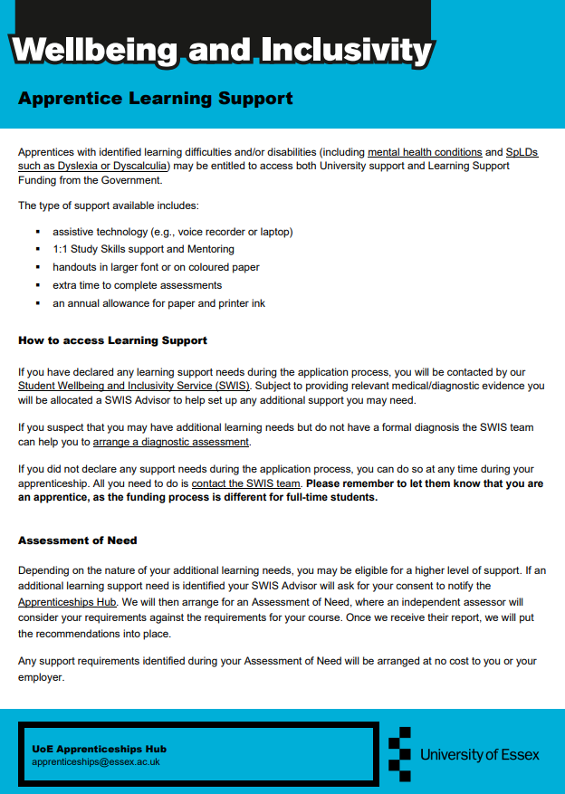
Apprentice learning support
Eligible apprentices with identified learning difficulties and/or disabilities are able to access Learning Support Funding for support such as:
Assistive Technologies
Study skills support
Mentoring
Extra time in assessments
How to access learning support - Contact our Student Wellbeing and Inclusivity Services (SWIS) for further information (include@essex.ac.uk)
Please ensure you inform the SWIS team you are an apprentice to avoid any unnecessary costs to you
Assessment of need

Slide 6
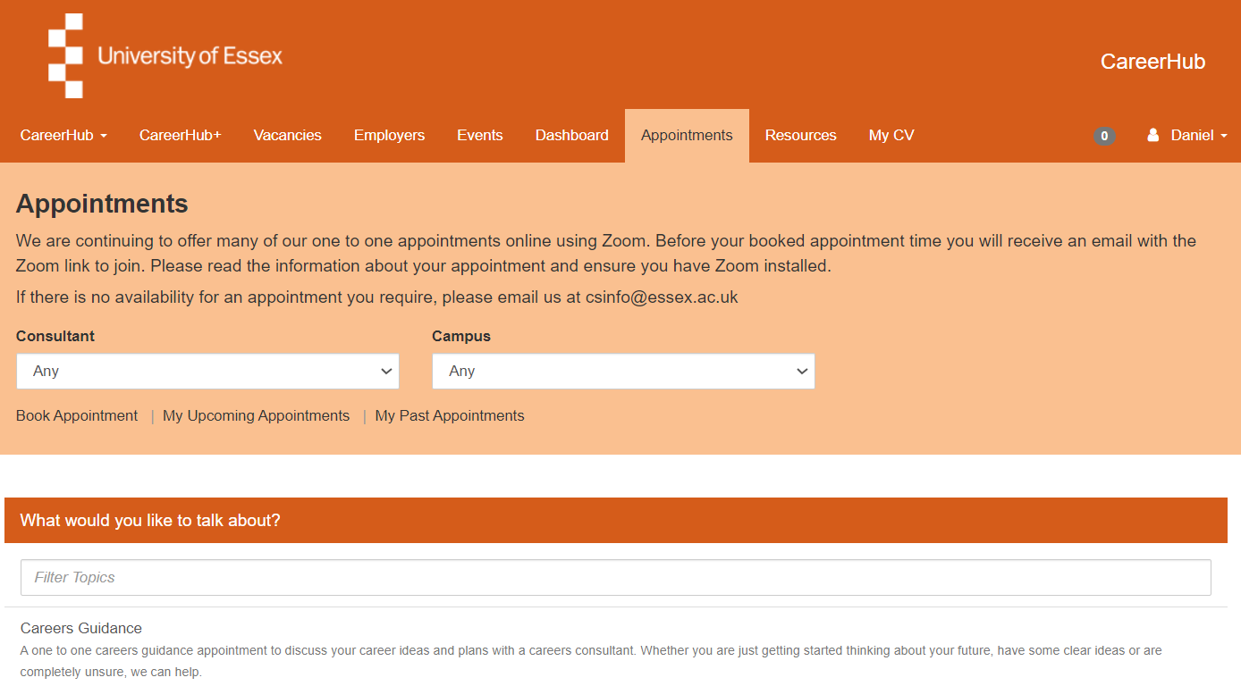
Career Hub
https://careerhub.essex.ac.uk/students/appointments/app/?siteId=1

Slide 7
HSC Apprenticeships at Essex
Delivering apprenticeships at Essex and in the school since 2016
Work collaboratively across HSC teams and with the central apprenticeship hub
Committed to delivering transformational education and excellence in teaching and research
Forefront of health and social care provision to support widening of social participation to develop skills for life
Ongoing engagement with our local and regional partners/employers
Consistent approach to meeting mandatory requirements for placements
Support apprentices and employers with the end-to-end processes of apprenticeships (from application to completion)
And beyond…
Interior view – Ivor Crewe

Slide 8
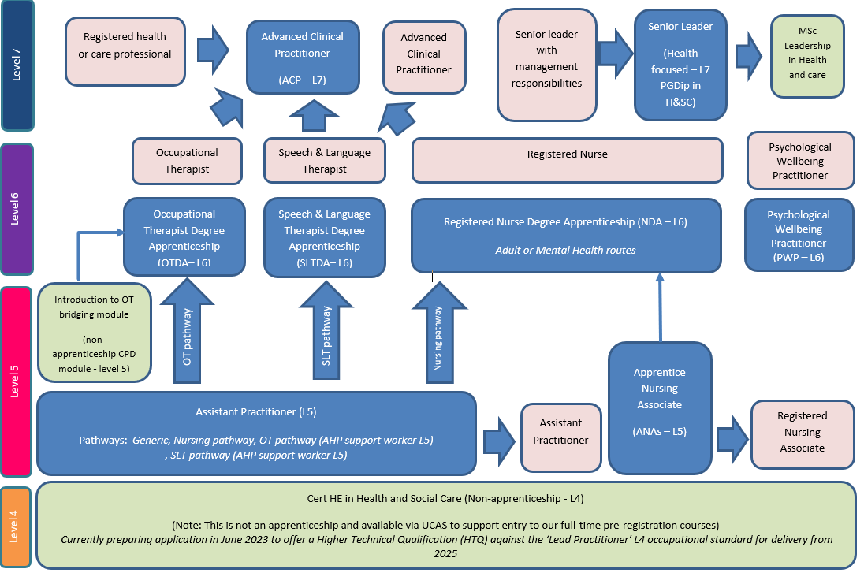
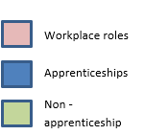
School of Health and Social Care Apprenticeship Provision & progress routes

Slide 9
Embrace new challenges and learning opportunities

Slide 10
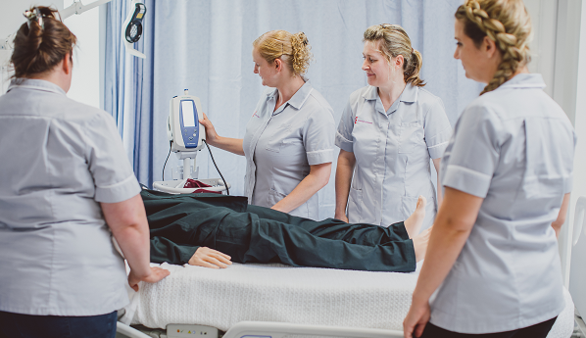
Contact details
Contact details
Apprenticeship Hub
apprenticeships@essex.ac.uk
Nikki Williamson - Apprenticeship lead for the School of Health and Social Care
hscapprenticeships@essex.ac.uk
HSC Colchester apprenticeships
hsccolapp@essex.ac.uk
For further information see our website:
https://www.essex.ac.uk/apprenticeships/health-and-social-care-apprenticeships
AP Apprentice skills-based session
HAP Apprentice skills-based session

