Slide 1
Use of UKHLS-Understanding Society data in UKMOD
Matteo Richiardi, Daria Popova and Justin van de Ven
University of Essex

Slide 2
Overview
Main characteristics of UKHLS input data
UKHLS vs FRS input data
Research uses
How to run UKMOD with UKHLS data
Example of a policy simulation

Slide 3

UKHLS as UKMOD input data
The UK Household Longitudinal Study (UKHLS) is a large panel survey with a sample of approximately 40,000 households in its first wave. It is the primary survey of interest in the UK for those interested in longitudinal analysis.
UKMOD-UKHLS input data released for policy years 2010-2019
  UK_Year_c1, where “Year” refers to the year of the dataset, “c” – signifies that the input data files are derived from UKHLS data and “1” is the version of the input data release.
  DRDs are available for each dataset.
  Derived from the UKHLS Special licence dataset.
  UKMOD UKHLS input datasets can be accessed via UKDS: https://beta.ukdataservice.ac.uk/datacatalogue/studies/study?id=9147.
  UKMOD input/output can be merged with the original UKHLS dataset (idperson=pidp in UKHLS)
  UKMOD-UKHLS benefits from all existing tools, add-ons, and flexibility of UKMOD.

Slide 4
UKHLS sample and weights
  Technical challenges:
  Some (limited) data gaps compared with requirement
  Missing data issues, especially incomplete households
  Two-year fieldwork period – requires aligning with policy years
  Sample: Only complete households included (i.e., all eligible adults have been interviewed).
  Weights are adjusted to account for the use of complete households only and then scaled to match population totals provided by the FRS.
  UKHLS sample is divided into fiscal years, from the beginning of April of Year 1 to the end of March of Year 2 ➔ e.g. 2019 input data contains interviews conducted from April 2019 to March 2020.

Slide 5
UKHLS regional samples
 | 2010 | 2011 | 2012 | 2013 | 2014 | 2015 | 2016 | 2017 | 2018 | 2019 | Total
England incl London | 25,746 | 36,631 | 34,205 | 33,006 | 30,157 | 28,079 | 27,121 | 25,848 | 24,495 | 21,569 | 286,857
London | 3,543 | 5,692 | 4,960 | 4,638 | 4,346 | 3,820 | 3,713 | 3,488 | 3,154 | 2,736 | 40,090
Wales | 3,207 | 3,468 | 3,359 | 3,119 | 2,708 | 2,472 | 2,306 | 2,146 | 2,050 | 1,821 | 26,656
Scotland | 3,710 | 4,207 | 3,998 | 3,777 | 3,437 | 3,232 | 3,061 | 2,846 | 2,754 | 2,293 | 33,315
Northern Ireland | 3,679 | 3,302 | 3,136 | 2,742 | 2,462 | 2,308 | 2,331 | 2,248 | 2,162 | 1,731 | 26,101
Total | 36,342 | 47,608 | 44,698 | 42,644 | 38,764 | 36,091 | 34,819 | 33,088 | 31,461 | 27,414 | 372,929

Slide 6
UKHLS vs FRS input data

Slide 7
UKHLS vs FRS input data
We aimed to re-create as closely as possible UKMOD FRS input data variables.
For validation, we have done some comparison with FRS-based UKMOD and Administrative statistics
The aggregate estimates of the main income concepts (market income, disposable income before and after housing costs, direct taxes and NIC, and all benefits) are very close in the two versions of UKMOD based on UKHLS and FRS.
The validation exercises conducted so far point to some puzzles that require further work to fully understand their drivers.
  See: Bronka P., D. Popova and M. Richiardi (2023) UK Household Longitudinal Study (UKHLS) - Understanding Society. CEMPA Working Paper7/23 https://www.microsimulation.ac.uk/publications/publication-557747/

Slide 8
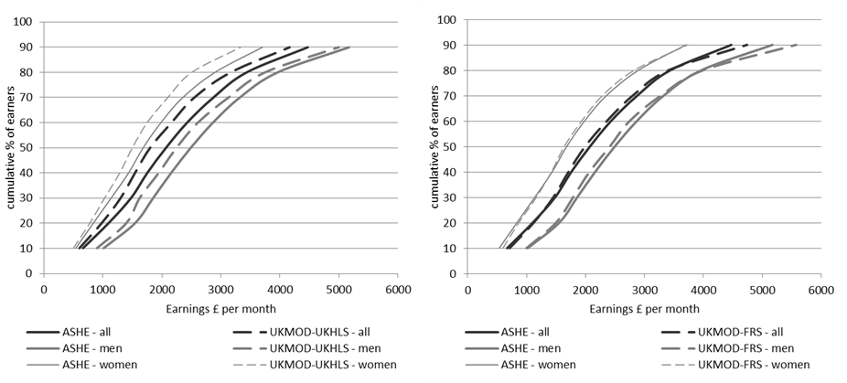
Cumulative earnings distributions in 2019: UKHLS and FRS vs ASHE
Notes:
Figure xx compares the cumulative earnings distribution from ASHE and the UKMOD input data based on UKHLS and FRS for 2019 for all employees and for men and women (plotting decile points cumulatively).
In the UKMOD-FRS data average earnings and males earnings are slightly overestimated at the top of the earnings distribution compared to ASHE data, and underestimated in the middle.
Earnings based on UKMOD-UKHLS are slightly underestimated across all the distribution.

Slide 9
Selected benefits simulated by UKMOD-UKHLS vs UKMOD-FRS and external data, 2019 (assuming partial take-up). Expenditure/revenue (£million/year).

Slide 10
Main differences between UKHLS and FRS input data
High-income individuals are generally underrepresented in the UKHLS sample, possibly due to their higher survey non-response ➔ Lower aggregate inequality estimates in UKMOD compared to HBAI.
Over-simulation of some means-tested benefits ➔ lower poverty threshold and poverty estimates in UKMOD using UKHLS data, compared to HBAI.
Older people are over-represented in the UKHLS sample which is typical of longitudinal surveys ➔ pension income and allowances typically received by the elderly are over-estimated in UKHLS.
Some income sources appear to be better captured in UKHLS than in the FRS: e.g. investment and property income, income from odd jobs and private pension.

Slide 11
Research uses.

Slide 12
Research uses: Using UKMOD to enhance UKHLS
  To improve accuracy of income measures at the bottom of the income distribution, by simulating entitlement to means-tested benefits according to the statutory rules.
  To simulate benefit entitlement and tax liability at the individual level, whenever information is available only at the household/benefit unit level in the survey.
  To measure fiscal / tax advantages that are not directly observed in UKHLS, such as tax allowances or tax credits.
  To produce harmonised outputs based on UKHLS and FRS, and cross-validate estimates based on different sources.

Slide 13
Research uses: Using UKHLS to enhance UKMOD
  To increase the precision of simulation of certain benefits, which require information about individuals’ past, such as unemployment benefits and pensions.
  To use additional detailed information contained in the UKHLS to improve simulation of benefits. For example, detailed health information can be used to simulate disability benefits.

Slide 14
Research uses: Expanding the scope of analyses conducted using UKMOD
  To analyse the effects of taxes and benefits on life course domains not covered in detail in the FRS data, such as employment history, partnership history, private transfers, health, and well-being.
  To analyse the tax-benefits system and policy reforms among immigrant and ethnic minority groups, well represented in the UKHLS thanks to boost samples.
  To conduct research requiring longitudinal data, such as studies of longitudinal inequality, persistent poverty, inter-generational redistribution, income dynamics and social mobility.

Slide 15
Running UKMOD with the UKHLS dataset

Slide 16
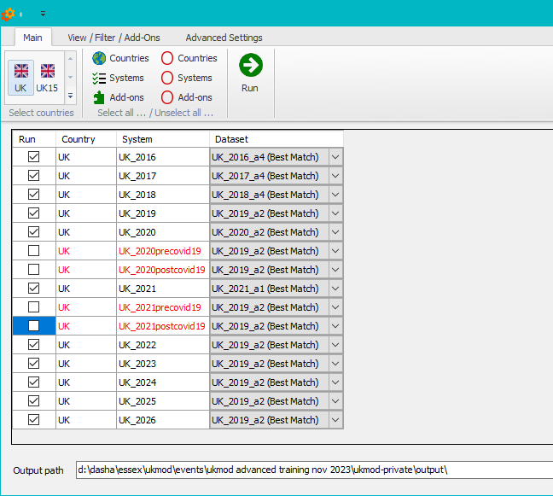
Running UKMOD with the UKHLS dataset.
Standard UKMOD run will use the FRS input data by default
Note that all the standard output will be saved in this folder by default

Slide 17
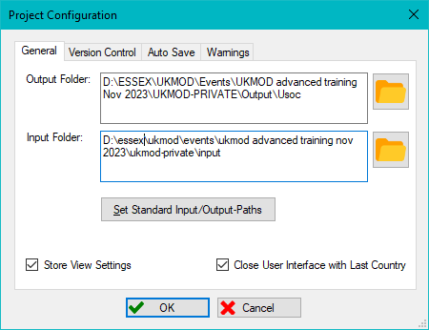
Running UKMOD with the UKHLS dataset.
Create a different output folder for the Usoc output files if you don’t want to rewrite the standard FRS output.
The folder has to be created manually before changing “Project Configuration” in UKMOD

Slide 18
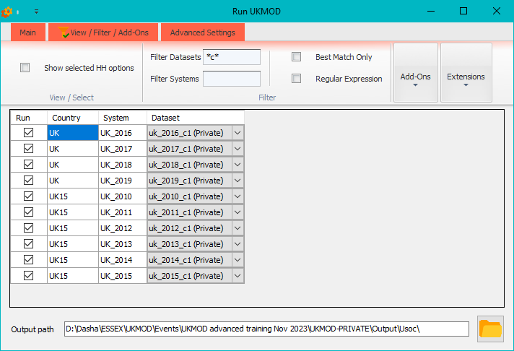
Running UKMOD with the UKHLS dataset.
To run UKMOD with UKHLS input data, go to “Run UKMOD” and click on tab “View/Filter/Add-ons”
Filter out “c” datasets
Go back to “Main” tab and click “Run”
UKHLS output will be saved here

Slide 19
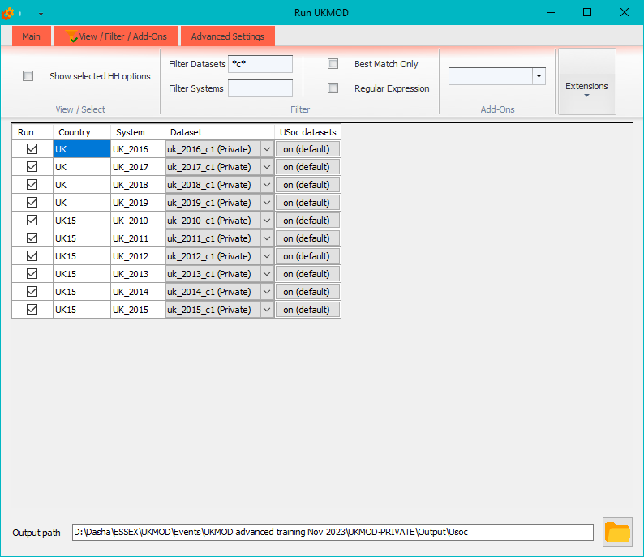
Running UKMOD with the UKHLS dataset.
If you press on “Extensions” and select “USOC” you will see that there is an extension set to “On by default” when the UKHLS data is selected. You don’t need to change the default settings!

Slide 20
Example of a policy simulation

Slide 21

Example of policy simulation
The benefit cap was introduced in the UK in April 2013 as a measure aimed at limiting the total amount of benefits that most people aged 16 to 64 can receive. The cap applies to the combined total from a range of benefits including: Jobseeker's Allowance, Child Benefit, Child Tax Credit, Housing Benefit, and others.
Implementation in UKMOD: The variables brd_s (amount of benefit cap on HB) and brduc_s (amount of benefit cap on UC) are subtracted from the means-tested income list (ils_benmt).
We will:
  Remove the benefit cap in 2013-2019
  Run reformed systems and analyse impact on cross-sectional poverty
  Analyse the impact of this reform on persistent poverty (being in relative low income in the current year and at least two out of the three preceding years)
  Analyse the results by subgroups of interest

Slide 22
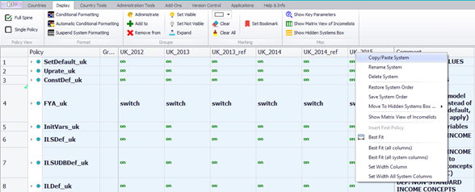
Step 1: Create reform systems in 2013-2019
To create a reform system right-click on a policy column, press “Copy/paste”

Slide 23
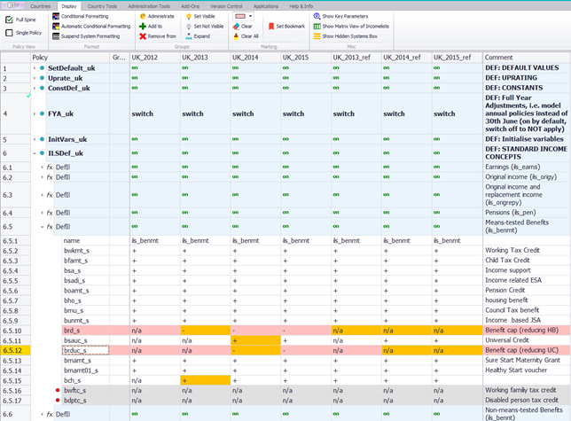
Step 2: Remove benefit cap in 2013-2019
set brd_s and brduc_s to n/a in ils_benmt (income list for means-tested benefits)

Slide 24
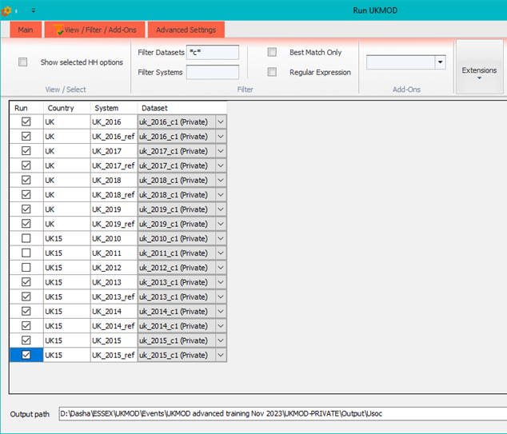
Step 3: Produce outputs for baseline and reform systems 2013-2019
Select UKHLS data

Slide 25
Step 4: Create a pooled dataset with baseline and reform indicators
Utilize Stata or any other statistical software to merge the baseline and reform output datasets for each year based on idperson. Calculate baseline and reform poverty headcounts using the baseline poverty line—this mirrors the actions of the Statistics presenter!
Append all datasets to generate a pooled dataset spanning all years. Subsequently, employ panel data commands with idperson as the panel variable and year as the time variable (for instance, the xtset command informs Stata that your data is in panel format).
Compute persistent poverty headcounts for both baseline and reform scenarios, identifying individuals in poverty in the current year and for at least two out of the three preceding years.
Conduct an analysis of the results, considering various population subgroups.

Slide 26
Persistent poverty measure (example of the Stata code)
*baseline persistent poverty
local poverty_status "pov_base"
cap gen lag1_`poverty_status' = l.`poverty_status'
cap gen lag2_`poverty_status' = l2.`poverty_status'
cap gen lag3_`poverty_status' = l3.`poverty_status'
cap gen pers_`poverty_status' = (`poverty_status' == 1) & (lag1_`poverty_status' + lag2_`poverty_status' + lag3_`poverty_status' >= 2)
replace pers_`poverty_status' = . if missing(`poverty_status', lag1_`poverty_status', lag2_`poverty_status', lag3_`poverty_status')
cap label define persistent_poverty_label 0 "Not Persistent" 1 "Persistent"
label values pers_`poverty_status' persistent_poverty_label
tab2 year pers_`poverty_status'

Slide 27
Results: Cross-sectional vs persistent poverty

Slide 28
Results: Cross-sectional vs persistent poverty

Slide 29
Results: Cross-sectional vs persistent poverty

Slide 30
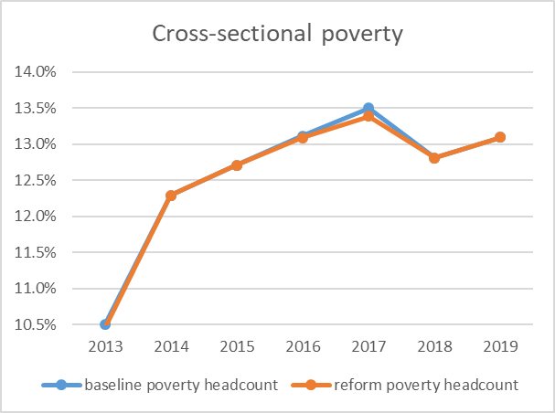
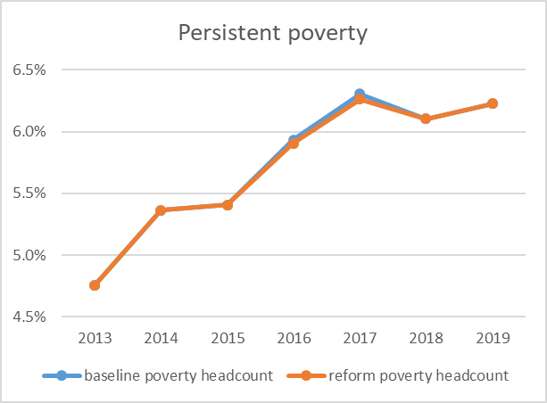
Results: Effects of removing benefit cap on cross-sectional and persistent poverty, all population

Slide 31
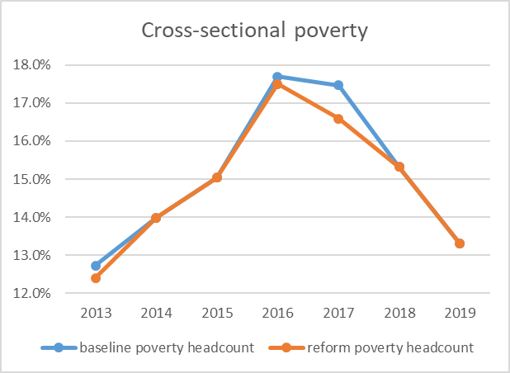
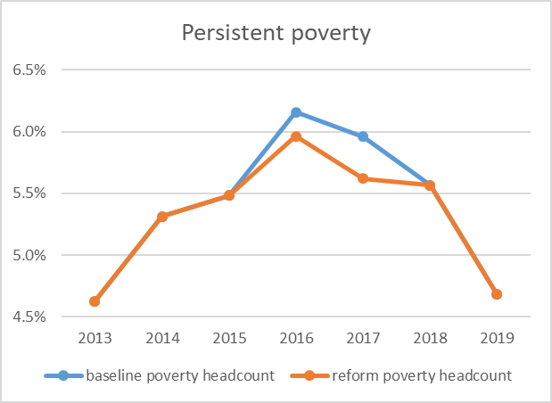
Results: Effects of removing benefit cap on cross-sectional and persistent poverty, single parents

Slide 32
Future developments planned
  Update to more recent waves of UKHLS (if there is enough interest in using these data)
  Creating Statistics Presenter templates for longitudinal indicators, i.e. income mobility, persistent poverty, etc.
  Adjusting UKHLS longitudinal weights for UKMOD

Slide 33

Questions

