Slide 1
UKMOD training course
Daria Popova, Matteo Richiardi & Justin van de Ven
ISER, University of Essex
November 2022
Course based on UKMOD_A3.23+

Slide 2
Welcome!
Day 3:
  UKMOD system functions DefConst and DefIl
  Exercise using functions SchedCalc and DefConst
  UKMOD policy function Allocate
  UKMOD system function DefTU
  Exercise using function DefTU
  UKMOD system functions Uprate and DefVar
Notes:
DefVar in supplemental matieral
What about DefOutput?

Slide 3
Re-cap of Day 2
We learned about:
  How to use Elig and ArithOp
    How to link them via the parameter Who_must_be_elig
    The parameter output_add_var
  Handling errors
  How to use BenCalc
    Parameters Comp_perTU/Comp_perElig and Comp_Cond
    How to combine/group together parameters via column Grp/No
  We continue today with function SchedCalc

Slide 4
functions:
SchedCalc, DefConst, DefIL, Allocate, DefTU

Slide 5
Types of functions
Policy
Function
Parameter
Parameter
Parameter
System functions
functions used to define some general settings
e.g. to define income lists and tax units
Policy functions
functions used to implement tax-benefit policies
e.g. define eligibility, calculate amount etc
Special functions
more advanced functions that perform more complicated tasks
e.g. loops, change parameters at run-time etc.
we already learned about Elig , ArithOp, and BenCalc
we will learn today about SchedCalc and Allocate
we will learn today about DefIL, DefConst, DefTU, DefVar, DefOutput, Uprate
not covered in this course

Slide 6
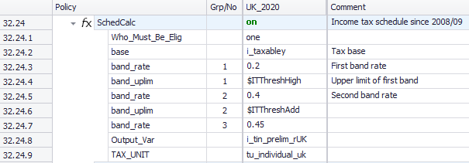
UKMOD: the policy FUNCTION SchedCalc &
SYSTEM FUNCTIONS DefConst, DefIL

Slide 7
Function SchedCalc
Used (mainly) for progressive taxes
Tax schedule
  Tax bands: Band_UpLim / Band_LowLim
  Tax rate: Band_Rate
  Tax base: Base
“group” together Band_Rate and Band_UpLim/Band_LowLim
Instead of rates, for fixed amounts use Band_Amount
Policy |  | Grp/No | System Name | Comment
SchedCalc |  |  | on | Made-up example: income tax
 | Base |  | tintb_s | income tax calculated based on taxable income (t: tax, in: income, tb: tax base, _s: simulated)
 | Band_Rate | 1 | 0.2 | first band rate: 20%
 | Band_LowLim | 1 | 12500#y | first band rate applies on income above £12.5k per year…
 | Band_UpLim | 1 | 50000#y | …and up to £50k per year
 | Band_Rate | 2 | 0.4 | second band rate: 40%
 | Band_UpLim | 2 | 150000#y | second band rate applies on income above £50k and up to £150k per year
 | Band_Rate | 3 | 0.45 | third band rate: 45%; applies on income above £150k per year
 | output_var |  | tin_s | result saved in variable tin_s (t: tax, in: income, _s: simulated)
 | TAX_UNIT |  | tu_individual_uk | assessment unit used for the calculations

Slide 8
Functions: DefConst (1)
Allows to define tax-benefit policy parameters as constants
  e.g. monthly amounts, income thresholds, maximum amounts, tax rates
  notated as $<var> where <var> is replaced by the variable name
Advantage:
  over-time changes to tax-benefit parameters are visible at one glance
  updating of tax-benefit parameters is easier
  the same constant can be used in several policies (e.g. pension age)
Constants are defined in the policy ConstDef_xx

Slide 9
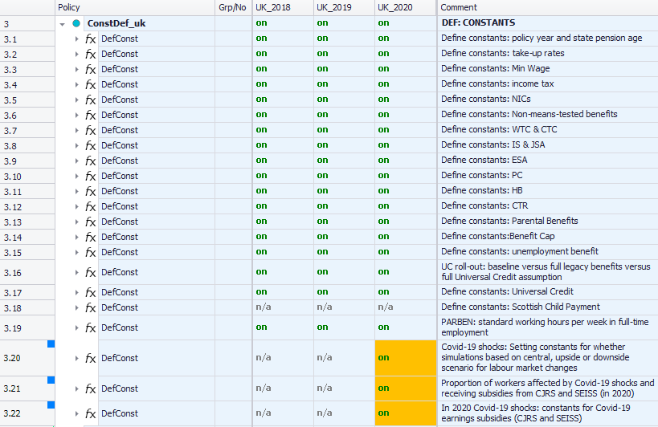
Functions: DefConst (2)

Slide 10
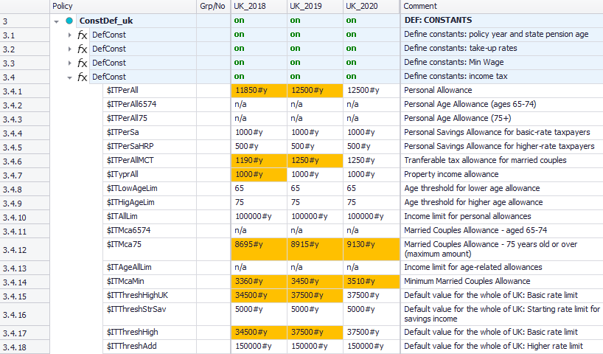
Functions: DefConst (3)
user-defined constant names $ITx in “policy” column
changes to constant values highlighted
Notes:
The naming convention here is inconsistent with EUROMOD conventions…

Slide 11
The parameter “condition” in DefConst
Allows for multiple definitions of the same constant with conditions
  Similar to an “if” statement in most programming languages
A base/default value needs to be defined
If more than one condition is true, the matching condition with the largest group number determines the final constant value
Policy |  | Grp/No | System Name | Comment
DefConst |  |  | on | Made-up example: Defining income tax parameters as constants
 | $ITThreshHigh |  | 37500#y | Income tax threshold - base/default value needs to be defined first before conditions can be used
 | Condition | 1 | drgn1=12 | if region (drgn1) is Scotland…
 | $ITThreshHigh | 1 | 30930#y | …this value applies (overwrites default value)
 | Condition | 2 | drgn1=11 | if region is Wales...
 | $ITThreshHigh | 2 | 37500#y | … this value applies (overwrites default value)
Default value applies on England and Northern Ireland, as no separate conditions for these regions

Slide 12
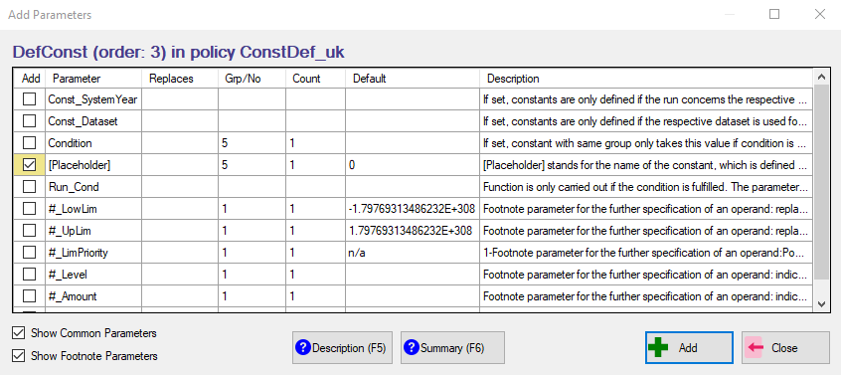
How to add a new constant
right-click on DefConst function
select “Add Parameter Form”
select parameter “[Placeholder]”
type in constant name in place of [Placeholder]
Notes:
Can only add one parameter at a time

Slide 13
Functions: DefIL (1)
Income lists are aggregates of several income sources
  “Standard”, used for distributional analysis (e.g. household net income) or fiscal overview (e.g. income taxes)
  “Non-standard”, used for policy implementation (e.g. taxable income)
System function DefIL allows to define income lists
  naming convention:
    prefix ils_ for “standard”
    prefix il_ for “non-standard”
  “standard”, defined in the policy IlsDef_xx
    Used by the Statistics Presenter
  “non-standard”, usually defined in the policy IlDef_xx

Slide 14
Functions: DefIL (2)
Aggregates of variables, pre-defined income lists, fixed amounts, constants
Operations: +, -, fractions can be used, n/a (not used)
Use
  once defined, available for all subsequent functions and policies
  behave like monetary variables

Slide 15
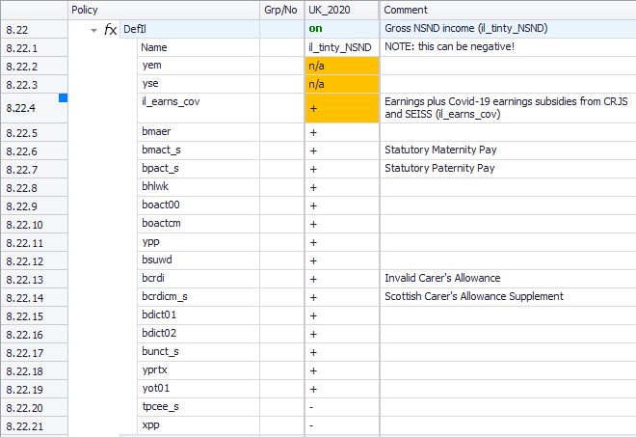
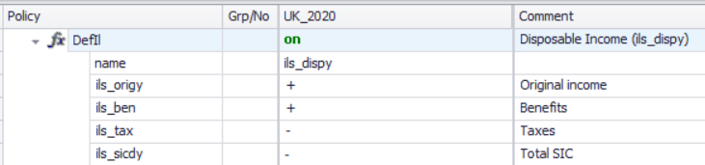
Functions: DefIL (3)
user-defined income list name in “system” column
- components of the income list
- some are being added, other subtracted
income lists used to define another income list

Slide 16
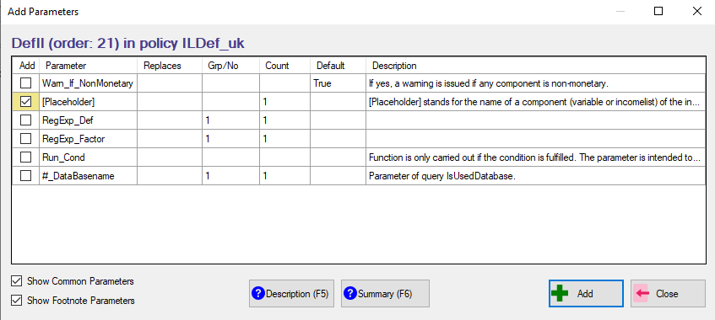
How to add a new component to an income list
right-click on DefIL function
select “Add Parameter Form”
select parameter “[Placeholder]”
type in component name in place of [Placeholder]

Slide 17
Standard income lists
Defined in every country
Built in a comparable way to facilitate cross-national analysis
  ils_earns: earnings
  ils_origy: market incomes
  ils_pen: public pensions
  ils_bennt: non-means-tested benefits
  ils_benmt: means-tested benefits
  ils_ben: all benefits and public pensions
  ils_tax: taxes
  ils_sicee: employee SICs
  ils_sicse: self-employed SICs
  ils_sicer: employer SICs
  ils_sicdy: total SICs
  ils_dispy: disposable income
  ils_bensim: simulated benefits
  ils_taxsim: simulated taxes
Remember:
If you add a new policy that simulates a new benefit/tax, then you need to add the benefit/tax to the right income list!

Slide 18
Structure of standard income lists
Ils_origy
Ils_pen
Alternative categorisation of benefit types:
Ils_b1_bun
Ils_b2_bsaho
Ils_b1_bho
Ils_b2_bfaed
Ils_b1_bed
Ils_b1_bfa
Ils_b1_bcb
Ils_b2_penhl
Ils_b1_boa
Ils_b1_bsu
Ils_b1_bdi
Ils_b1_bhl
Ils_b1_bsa
Ils_ben
Ils_benmt
Ils_bent
Ils_dispy
Ils_tax
Ils_taxsim
Ils_earns
Ils_sicee
Ils_sicer
Ils_sicdy
Ils_sicse
Ils_sicct
Ils_sicot
Ils_origyrepy
Ils_bensim
Plus country specific income lists to calculate implicit tax rates

Slide 19
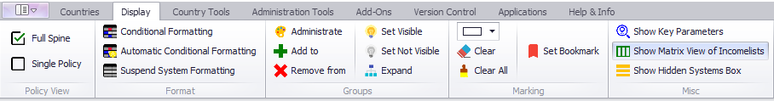
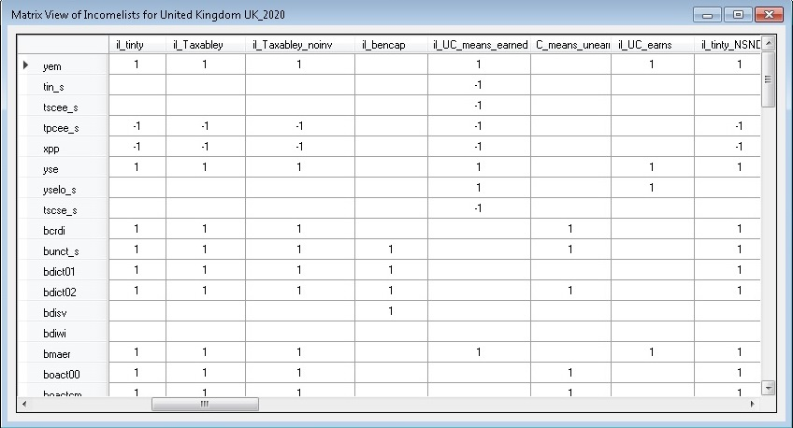
Income lists – Matrix view
Summary of income list components

Slide 20
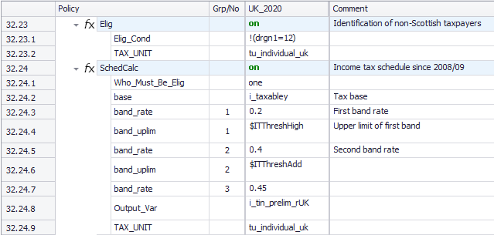
Understanding SchedCalc & constants
We can now read and understand the code written in the SchedCalc function

Slide 21

Exercise 5
You will:
  Implement a reform to the personal income tax (tin_uk) by adding/modifying parameters in SchedCalc function
  define custom income tax bands/thresholds using constants
  Run reformed system and analyse its distributional impact using the Statistics Presenter

Slide 22

Summary: Exercise 5
You learned how to use SchedCalc to reform the income tax policy
  Adding and modifying Band_Rate, Band_UpLim
  Adding or changing values to income tax band thresholds using constants defined in the DefConst policy

Slide 23

Questions

Slide 24
Exercise 6
You will:
  Reform the benefit cap (bcap_uk) policy, based on the UK 2021 system
    Understand how the benefit cap policy works in UKMOD
    Understand how exemptions to the policy are defined
    Understand which benefits are capped
    How to exclude child benefit from the cap
  Run reformed system and analyse impact on child poverty using the Statistics Presenter

Slide 25
Summary: Exercise 6
You learned:
  how the benefit cap policy works in UKMOD
  how exemptions from the benefit cap are taken into account (e.g. il_bcap_exempt)
  which benefits are subject to the cap and how they are taken into account by UKMOD (e.g. il_bencap)
  there are separate calculations of the benefit cap when it applies to HB (brd_s) and when it applies to UC (brduc_s)
  benefit cap affect net disposable income by reducing means-tested benefit (ils_benmt)

Slide 26
Questions

Slide 27
UKMOD: POLICY FUNCTION Allocate
Policy |  | System Name | Comment
Allocate |  | on | Made-up example: Allocate Housing Benefit to the person responsible for housing costs and council tax
 | Share | bho_s | Housing Benefit to be reallocated between the members of the assessment unit (b: benefit, ho: housing, _s: simulated)
 | Share_Between | dhr=1 | share the benefit between those responsible for the housing (dhr=1)
 | Share_All_IfNoElig | yes | if noone is responsible for the housing, share among all members
 | output_var | bho_s | save result in bho_s: result of Allocate function overwrites the current value of the variable
 | TAX_UNIT | tu_bu_uk | assessment unit used for the calculations

Slide 28
Result of a function
It is always assigned to the head of the assessment unit
For all other members of the unit and for those in not eligible units (defined by who_must_be_elig):
  output_var is set to zero
  output_add_var not changed (or set to 0 if undefined before)
  result_var is set to zero.

Slide 29
Function Allocate (1)
Default: result is assigned to the head of the assessment unit
Function Allocate is used to share/allocate the amount of a variable among specific members of the assessment unit
  E.g. share the income tax from a joint income taxation among the partners in a couple → important for the simulation of benefits which depend on individual after-tax income
Parameters of function Allocate
  Share: which variable to split
    amount to split first summed up across assessment unit members
  Share_Between: condition parameter; who are the members ‘participating’ in the split
    default is all members of the assessment unit
  Share_Prop: in what proportion to split between the various qualifying members (i.e. those satisfying the Share_Between condition)
    default is sharing in equal proportions

Slide 30
Function Allocate (2)
Allocate reallocates amounts between members of assessment units (subject to conditions)
Policy |  | System Name | Comment
Allocate |  | on | Made-up example: Allocate Housing Benefit to the person responsible for housing costs and council tax
 | Share | bho_s | Housing Benefit to be reallocated between the members of the assessment unit (b: benefit, ho: housing, _s: simulated)
 | Share_Between | dhr=1 | share the benefit between those responsible for the housing (dhr=1)
 | Share_All_IfNoElig | yes | if no one is responsible for the housing, share among all members
 | output_var | bho_s | save result in bho_s: result of Allocate function overwrites the current value of the variable
 | TAX_UNIT | tu_bu_uk | assessment unit used for the calculations

Slide 31
Function Allocate (3)
Allocate reallocates amounts between members of assessment units (subject to conditions)
Policy |  | System Name | Comment
Allocate |  | on | Made-up example: Allocate the income tax - based on joint taxation - between the couple's partners
 | Share | tin_s | Income Tax to be reallocated between the partners of the couple (t: tax, in: income, _s: simulated)
 | Share_Prop | yem | share the income tax in proportion to the persons' earnings
 | Share_equ_Ifzero | yes | if no one has earnings, then income tax is shared equally between the couple's partners
 | Ignore_neg_prop | yes | if someome's earnings are negative, they are ignored (i.e. considered to be zero)
 | output_var | tin_s | save result in tin_s: result of Allocate function overwrites the current value of the variable
 | TAX_UNIT | tu_couple_uk | assessment unit used for the calculations

Slide 32
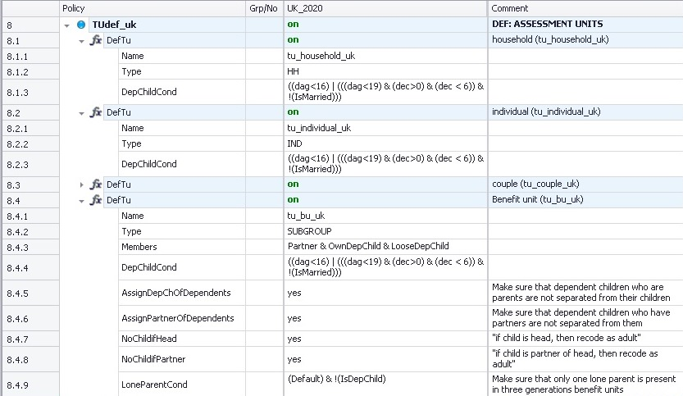
UKMOD: Assessment (Tax) Unit & the system function DefTU

Slide 33
In this lecture, you will learn about:
What assessment (tax) units are and how they work
  How the head and other members of the assessment unit is defined in UKMOD
  How to avoid splitting up families
  Footnote parameters
how they are implemented in UKMOD, using the system function DefTU

Slide 34
Assessment/Tax Unit
Unit: group of household members to be considered together
Defined with System function DefTU usually in policy TUDef_xx
Defined the first time used by the model
  (although can be updated – see UpdateTU in extra slides)
Naming convention: tu_yyyy_xx
Parameter Type in DefTU defines the composition of the tax unit
  HH: all individuals of the household are in the same unit.
  IND: each individual of the household forms its own unit.
  SUBGROUP: individuals determined by parameter Members form a unit. The household may be split into several units of different size.
Notes:
H 9.37

Slide 35
Type of assessment/tax unit
Policy |  | System Name | Comment
DefTu |  | on | Made-up example: individual
 | Name | tu_individual_uk
 | Type | IND
 | DepChildCond | dag<16 | (dag<19 & IsInEducation & !IsMarried) | aged less than 16; or less than 19, in education and not married
DefTu |  | on | Made-up example: household
 | Name | tu_household_uk
 | Type | HH
 | DepChildCond | dag<16 | (dag<19 & IsInEducation & !IsMarried) | aged less than 16; or less than 19, in education and not married
DefTu |  | on | Made-up example: nuclear family
 | Name | tu_family_uk
 | Type | SUBGROUP
 | Members | Partner & OwnDepChild | head, head's partner, own dependent children
 | DepChildCond | dag<16 | (dag<19 & IsInEducation & !IsMarried) | aged less than 16; or less than 19, in education and not married
Notes:
H 9.37

Slide 36
Assessment/tax units: examples
description | idhh | idperson | idpartner | idmother | idfather | dag | Household | Individual | Family (i.e. Subgroup)
typical family | 1 | 101 | 102 | 0 | 0 | 30 | A1 | A1 | A1
 | 1 | 102 | 101 | 0 | 0 | 28 | A1 | B1 | A1
 | 1 | 103 | 0 | 102 | 101 | 3 | A1 | C1 | A1
 | 1 | 104 | 0 | 102 | 101 | 1 | A1 | D1 | A1
couple.without children | 2 | 201 | 202 | 0 | 0 | 56 | A2 | A2 | A2
 | 2 | 202 | 201 | 0 | 0 | 55 | A2 | B2 | A2
lone parent | 3 | 301 | 0 | 0 | 0 | 35 | A3 | A3 | A3
 | 3 | 302 | 0 | 301 | 0 | 6 | A3 | B3 | A3
single | 4 | 401 | 0 | 0 | 0 | 25 | A4 | A4 | A4
two singles living together | 5 | 501 | 0 | 0 | 0 | 22 | A5 | A5 | A5
 | 5 | 502 | 0 | 0 | 0 | 23 | A5 | B5 | B5
large family | 6 | 601 | 602 | 606 | 0 | 48 | A6 | A6 | A6
 | 6 | 602 | 601 | 0 | 0 | 45 | A6 | B6 | A6
 | 6 | 603 | 0 | 602 | 601 | 20 | A6 | C6 | B6
 | 6 | 604 | 0 | 602 | 601 | 15 | A6 | D6 | A6
 | 6 | 605 | 0 | 602 | 601 | 10 | A6 | E6 | A6
 | 6 | 606 | 0 | 0 | 0 | 70 | A6 | F6 | C6

Slide 37
Head of the tax unit
The head of a tax unit is by default
  the highest income member
    System Configuration: Income for Head Definition
  the oldest
    with the smallest personal id (i.e. idperson)
Additional, optional specifications for the head:
Query | Value type | Default | Description
HeadDefInc | variable or incomelist | ils_origy | Incomelist used for determining who has highest income in the assessment unit, see parameter ExtHeadCond.
ExtHeadCond | condition | !IsDepChild | Condition further defining the head of the assessment unit.
StopIfNoHeadFound | yes/no | no | If set to yes: an error is issued if ExtHeadCond rules out all household members. If set to no: no error issued, instead ExtHeadCond is dropped for affected households.
NoChildIfHead | yes/no | no | If set to yes (possible) child status is removed if person is the Head of the assessment unit.
NoChildIfPartner | yes/no | no | If set to yes (possible) child status is removed if person is Partner as defined by parameter PartnerCond.

Slide 38
Members of the tax unit (1)
If tax unit type is SUBGROUP, parameter Members defines which hh members form a unit
Relations are often defined with respect to the head of the unit
  e.g. Partner, OwnChild, DepParent
The status of each member is defined by an xCond parameter
  e.g. PartnerCond, OwnChildCond, DepParentCond

Slide 39
Members of the tax unit (2)
Query | Default | Description
Members | n/a | Specifies which members of the household form a unit, if parameter Type is set to SUBGROUP, e.g. Partner & OwnChild.
PartnerCond | head:idperson=idpartner | Condition defining who is a partner, i.e. the partner of the head.
DepChildCond | 0, i.e. nobody is a child | Condition defining who is a dependent child. The parameter equals 0, i.e. nobody is child, if not defined or set to n/a. However, setting the parameter to Default is the same as typing !IsParent & idpartner=0.
OwnChildCond | head:idperson=idmother | head:idperson=idfather | partner:idperson=idmother | partner:idperson=idfather | Condition defining who is an own child: either the head or the head's partner is the mother/father of the child.
OwnDepChildCond | IsOwnChild & IsDepChild | Condition defining who is an own dependent child.
LooseDepChildCond | idmother=0 & idfather=0 & IsDepChild | Condition defining who is a loose dependent child.
DepParentCond | head:idmother=idperson | head:idfather=idperson | partner:idmother=idperson | partner:idfather=idperson | Condition defining who is a dependent parent, i.e. the parent of the head or the head's partner.
DepRelativeCond | 0, i.e. nobody is a dependent relative | Condition defining who is a dependent relative.
LoneParentCond | IsParentOfDepChild & idpartner=0 | Condition defining who is a lone parent.

Slide 40
Examples: Members of the tax unit (1)
head: subsequent variable refers to the head
partner: subsequent variable refers to the partner of the head
Default setting can be overwritten or combined with further specifications
Policy |  | System Name | Comment
DefTu |  | on | Made-up example: couple with dependent parents
 | Name | tu_couple1_uk
 | Type | SUBGROUP
 | Members | Partner & DepParent | head, head's partner and dependent parents
 | DepParentCond | head:idmother=idperson | head:idfather=idperson | overwriting the default condition: only include parents of the head
DefTu |  | on | Made-up example: couple
 | Name | tu_couple2_uk
 | Type | SUBGROUP
 | Members | Partner | head and head's partner
 | PartnerCond | Default & IsMarried | default condition (i.e. head's partner) + partner is married

Slide 41
Examples: Members of the tax unit (2)
DepChildCond: determines who is the dependent child
OwnDepChild: “a son or daughter” (see OwnChildCond), who is a dependent child
LooseDepChild: “someone, who is a dependent child, but doesn’t cohabit with parent/s”
Policy |  | System Name | Comment
DefTu |  | on | Made-up example: nuclear family
 | Name | tu_family1_uk
 | Type | SUBGROUP
 | Members | Partner & OwnDepChild | head, head's partner and own dependent children
 | DepChildCond | dag<=15 | definition of the dependent child: aged 15 or less
idhh | idperson | idpartner | idmother | idfather | dag | ils_origy | IsHead | IsPartner | IsDepChild | IsOwnDepChild | IsLooseDepChild | tax unit
1 | 101 | 102 | 0 | 0 | 44 | 2000 | no | yes | no | no | no | A
1 | 102 | 101 | 0 | 0 | 45 | 2100 | yes | no | no | no | no | A
1 | 103 | 0 | 102 | 101 | 14 | 400 | no | no | yes | yes | no | A
1 | 104 | 0 | 0 | 0 | 12 | 0 | yes | no | yes | no | yes | B

Slide 42
Examples: Members of the tax unit (3)
DepChildCond: determines who is the dependent child
OwnDepChild: “a son or daughter” (see OwnChildCond), who is a dependent child
LooseDepChild: “someone, who is a dependent child, but doesn’t cohabit with parent/s”
Policy |  | System Name | Comment
DefTu |  | on | Made-up example: nuclear family
 | Name | tu_family2_uk
 | Type | SUBGROUP
 | Members | Partner & OwnDepChild & LooseDepChild | head, head's partner, own and loose dependent children
 | DepChildCond | dag<=15 | definition of the dependent child: aged 15 or less
idhh | idperson | idpartner | idmother | idfather | dag | ils_origy | IsHead | IsPartner | IsDepChild | IsOwnDepChild | IsLooseDepChild | tax unit
1 | 101 | 102 | 0 | 0 | 44 | 2000 | no | yes | no | no | no | A
1 | 102 | 101 | 0 | 0 | 45 | 2100 | yes | no | no | no | no | A
1 | 103 | 0 | 102 | 101 | 14 | 400 | no | no | yes | yes | no | A
1 | 104 | 0 | 0 | 0 | 12 | 0 | no | no | yes | no | yes | A

Slide 43
Avoiding splitting up families
Query | Value type | Default | Description
AssignDepChOfDependents | yes/no | no | If set to yes dependent children of dependent unit members (i.e. persons who are not Head or Partner of the head) are assigned to the unit.
AssignPartnerOfDependents | yes/no | no | If set to yes partners of dependent unit members (i.e. persons who are not Head or Partner of the head) are assigned to the unit.

Slide 44
Using conditions which refer to income
If the assessment unit is bigger than the individual, monetary variables or income lists are assessed at the level of the whole unit
Use footnote parameters to specify an alternative assessment unit
Now let’s have a look at footnote parameters
Policy |  | Grp/No | System Name | Comment
DefTu |  |  | on | Made-up example: family
 | Name |  | tu_family_uk
 | Type |  | SUBGROUP
 | Members |  | Partner & OwnDepChild & LooseDepChild
 | DepChildCond |  | dag<25 & yem#1 < 1000#m | aged less than 25 and with (individual) earnings of less than GBP 1,000 per month
 | #_Level | 1 | tu_individual_uk | earnings are assessed at the individual level

Slide 45
Parameters: Footnotes
They serve the further specification of other parameters.
Identified by #i (i=number from 1 to....)
  Limits
  Amounts
  Assessment units
  Specification of queries
Policy |  | Grp/No | System Name | Comment
ArithOp |  |  | on | Made-up example: tax allowance for pensions
 | Formula |  | il_pensions#1 + (ils_earns#2 + GetPartnerIncome#3)*0.3 | the person's pensions - up to 1,000 per month - plus 30% of the sum of the couple's earned income and the pension of the partner
 | #_UpLim | 1 | 1000#m | upper limit on the person's pensions
 | #_Level | 2 | tu_couple_uk | alternative assessment unit
 | #_Income | 3 | poa | get the pension of the partner
 | output_var |  | tintape_s
 | TAX_UNIT |  | tu_individual_uk

Slide 46
The tax unit in the output file
idhh | idperson | idpartner | idmother | idfather | dag | ils_origy | yem | tu_family_uk_HeadId | tu_family_uk_IsPartner | tu_family_uk_IsDepchild | tu_family_uk_IsDePparent | tu_family_uk_IslLoneParent
1 | 101 | 102 | 0 | 0 | 65 | 0 | 0 | 101 | 0 | 0 | 0 | 0
1 | 102 | 101 | 0 | 0 | 60 | 0 | 0 | 101 | 1 | 0 | 0 | 0
1 | 103 | 0 | 102 | 101 | 30 | 0 | 0 | 103 | 0 | 0 | 0 | 0
1 | 104 | 0 | 102 | 101 | 28 | 166 | 147 | 104 | 0 | 0 | 0 | 0
2 | 201 | 202 | 0 | 0 | 29 | 1,085 | 1,007 | 201 | 0 | 0 | 0 | 0
2 | 202 | 201 | 0 | 0 | 25 | 953 | 891 | 201 | 1 | 0 | 0 | 0
2 | 203 | 0 | 202 | 201 | 3 | 0 | 0 | 201 | 0 | 1 | 0 | 0
2 | 204 | 0 | 202 | 201 | 2 | 0 | 0 | 201 | 0 | 1 | 0 | 0
52 | 5,201 | 5,202 | 5,206 | 5,205 | 40 | 1,954 | 1,831 | 5,201 | 0 | 0 | 0 | 0
52 | 5,202 | 5,201 | 0 | 0 | 38 | 0 | 0 | 5,201 | 1 | 0 | 0 | 0
52 | 5,203 | 0 | 5,202 | 5,201 | 10 | 0 | 0 | 5,201 | 0 | 1 | 0 | 0
52 | 5,204 | 0 | 5,202 | 5,201 | 15 | 0 | 0 | 5,201 | 0 | 1 | 0 | 0
52 | 5,205 | 5,206 | 0 | 0 | 70 | 0 | 0 | 5,201 | 0 | 0 | 1 | 0
52 | 5,206 | 5,205 | 0 | 0 | 70 | 0 | 0 | 5,201 | 0 | 0 | 1 | 0
92 | 9,201 | 0 | 0 | 0 | 80 | 0 | 0 | 9,202 | 0 | 0 | 1 | 0
92 | 9,202 | 0 | 0 | 9,201 | 38 | 3,740 | 3,502 | 9,202 | 0 | 0 | 0 | 1
92 | 9,203 | 0 | 0 | 9,201 | 34 | 2,483 | 2,324 | 9,203 | 0 | 0 | 0 | 0
92 | 9,204 | 0 | 0 | 9,202 | 11 | 0 | 0 | 9,202 | 0 | 1 | 0 | 0
Policy |  | Grp/No | System Name
DefTu |  |  | on
 | Name |  | tu_family_uk
 | Type |  | SUBGROUP
 | Members |  | Partner & OwnDepChild & LooseDepChild & DepParent
 | DepChildCond |  | dag<25 & yem#1<8000#y
 | DepParentCond |  | Default & dag>65 & yem#1<8000#y
 | #_Level | 1 | tu_individual_uk
 | AssignDepChOfDependents |  | yes
 | AssignPartnerOfDependents |  | yes
 | LoneParentCond |  | Default & !IsMarried
Notes:
H10.20am

Slide 47
In this lecture, you learnt about:
What assessment (tax) units are and how they work
  How the head and other members of the assessment unit is defined in UKMOD
  How to avoid splitting up families
  Footnote parameters
how they are implemented in UKMOD, using the system function DefTU

Slide 48
Exercise 7
You will:
  Create a new tax unit
    You can copy/paste an existing one (tu_bu_uk) and modify it
  Use the function DefTU to create a new assessment unit where you change the age condition for being a dependent child
    Make a copy of UK 2021 system and call it e.g. UK_2021ben_ref
    Reform the Child Benefit so that families with children aged 14+ no longer receive this benefit;
  Run reform system and analyse impact on household incomes of the reform using the Statistics Presenter

Slide 49
Summary: Exercise 7
You learned how to
  Create a new assessment unit
  Manipulate those assessment units that are already defined in the model

Slide 50
Questions

Slide 51
UKMOD: Uprating Indices & system function uprate
Notes:
H12.40

Slide 52
Projected 2022-2025 systems
UKMOD A3.23+ includes 2022-2025 based on:
  Announcements or statutory indexation rates (underlying data to calculate these are from OBR’s July forecasts)
    Data uprating (function Uprate)
    Parameters projections (see policy ConstDef_uk)

Slide 53
Updating the 2022-2025 systems
Include new policy reforms
  Structural (i.e. introduction of a new benefit)
  Parametrical (i.e. change of existing “projected” benefit amount)
Update uprating indexes
  To take into account new OBR projections

Slide 54
Why uprate incomes?
Income reference period of input micro-data and policy system may not match
  E.g. data availability issue – survey data become available usually with several years lag
We need to adjust – i.e. uprate – the incomes in the input micro-data to match the policy year
  E.g. uprate 2019 input incomes to 2022 policy year
We uprate incomes by source
  define uprating indices in the Uprating Indices table
  apply the uprating indices on the specific income variables from the input micro-data
  NB we do not account for population changes by input data and policy year e.g. changes to the labour market

Slide 55
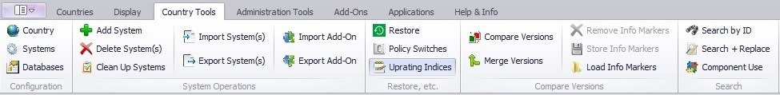
Uprating Indices table
Time-series information for the uprating indices (tab Raw Indices)
EUROMOD calculates implicit uprating factors (tab Factors per Data)

Slide 56
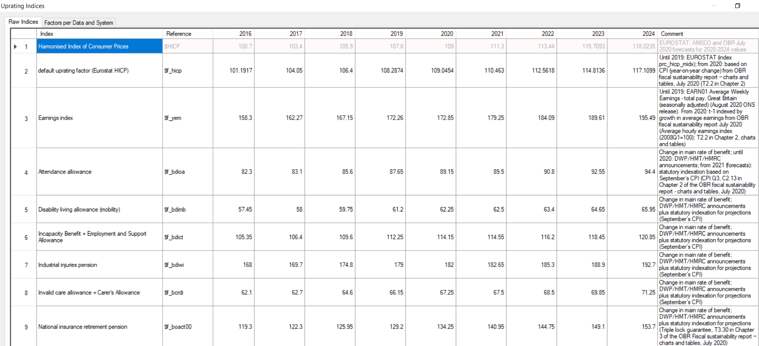
Raw indices (time series)
policy years
the index description
source of information
user-defined index name($f_)

Slide 57
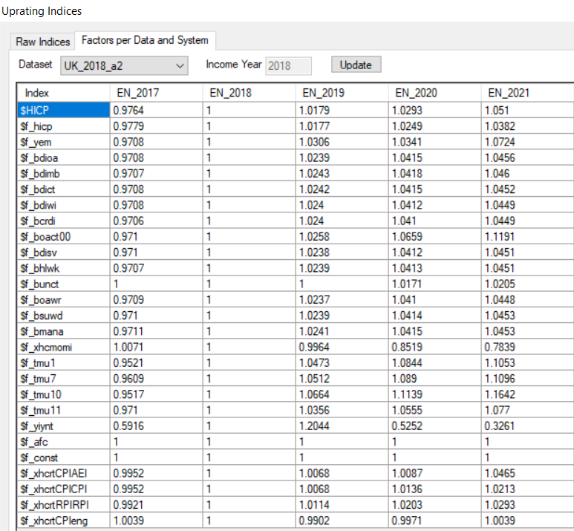
Uprating Indices per Data and System
You can see the implicit uprating factors:
Select the dataset you want to view
Example:
Dataset UK_2018_a2 → income referring to 2018
Prices (see CPI) increased by 2.9 between 2018 & 2020

Slide 58
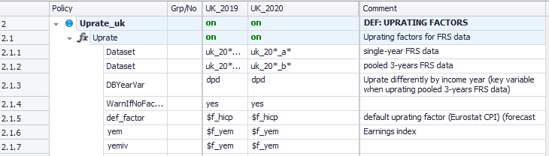
System Function: Uprate
58
Defines which indices to apply on which income variables from the input micro-data
input data sets to which uprating applies
variables that are uprated
name of uprating factor

Slide 59
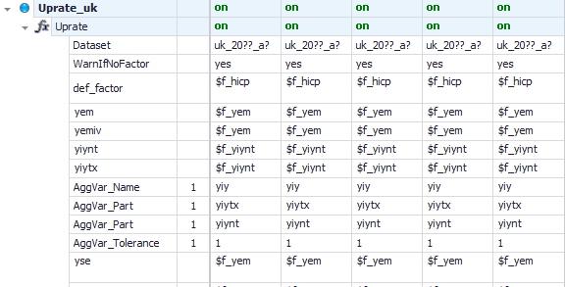
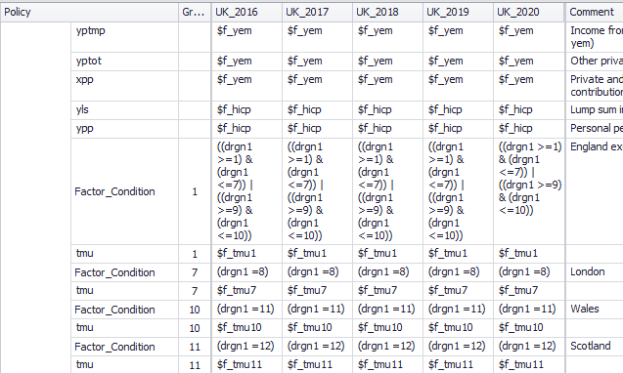
Using Uprate
Uprating the components of an aggregate variable
Using different uprating indices for different groups

Slide 60
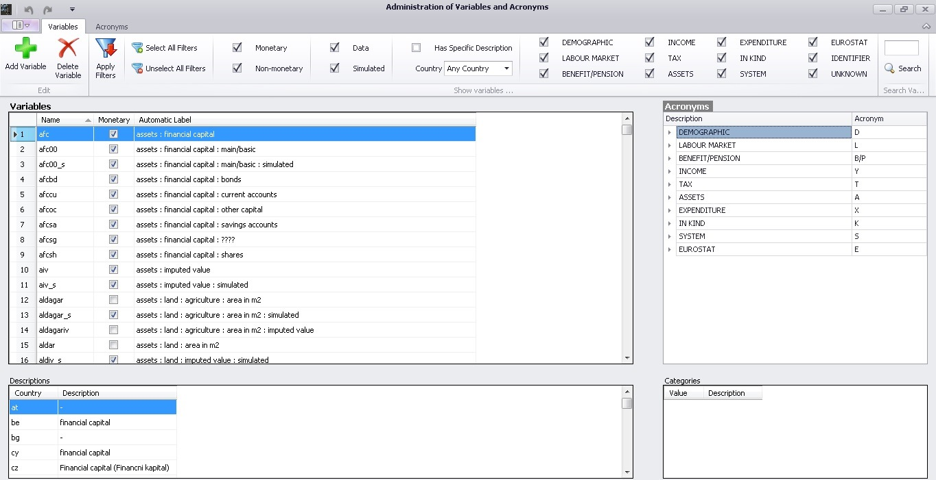
UKMOD: variable types & System function DefVar

Slide 61
Variable types
“Standard” – following EUROMOD naming convention
  Household and individual characteristics
  Incomes: market incomes, simulated and non-simulated benefits and taxes
  Assets and expenditures
“Intermediate”
  Used to save the result of an intermediate calculation e.g. an eligibility condition, number of twins in the tax unit

Slide 62
Variable naming convention
“Standard” variables defined in the EUROMOD input micro-data and used by EUROMOD for policy simulations
The goal is to achieve:
  more intuitive variable names
  harmonised variable names to allow for consistent cross-county comparisons
Names are combination of acronyms: abb**
  a – type of information (e.g., y: income, x: expenditure)
  bb – specific for each type a (e.g., y| em: employment, se: self employment), e.g.
    yem: employment income
    yse: self-employment income
  ** further bb’s for additional information/detail, e.g.
    ysebs: business self-employment income
  exception id*, eg. idperson, idmother
Acronyms and list of variables stored in a common Variables file (VarConfig.xml)

Slide 63
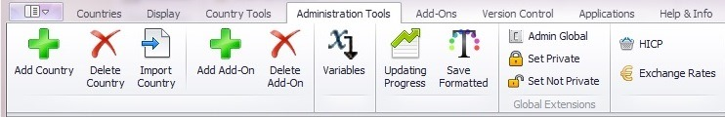
Variables Library (1)

Slide 64
Variables Library (2)
acronyms used for names
list of all variables defined in the variables file in alphabetical order
name
variable is monetary or non-monetary
automatic label
description of variable for countries where it is used

Slide 65
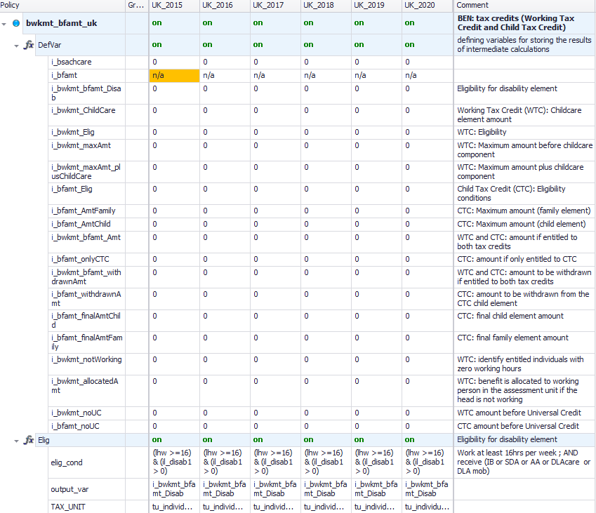
System Function: DefVar
To define intermediate (temporary) variables not included in the Variables library

Slide 66

End of Day 3
Notes:
2021 – revision stopped here

Slide 67

Extra slides

Slide 68
UKMOD: ADDITIONAL USER INTERFACE ELEMENTS
Notes:
H12.40

Slide 69
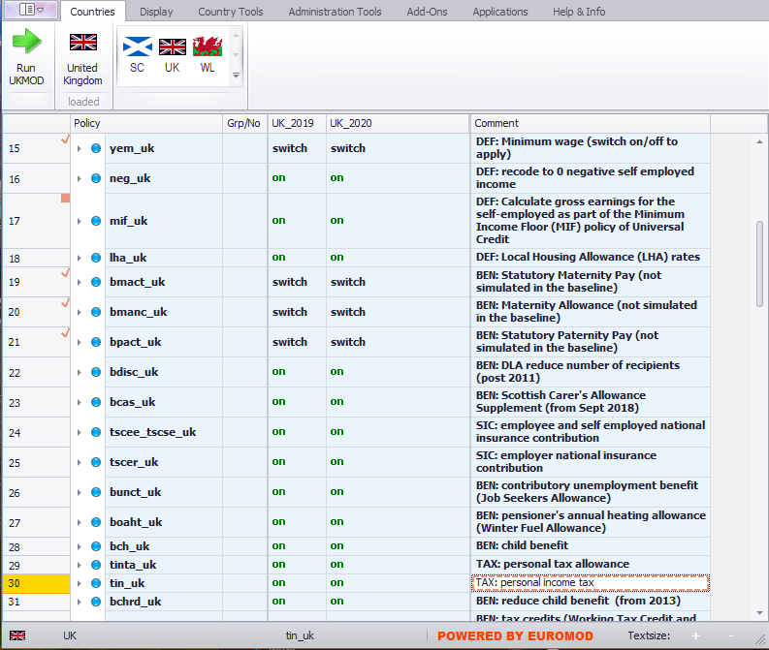
User Interface

Slide 70
User Interface (UI)
Single stand-alone piece of software (based on .NET framework)
Mostly point and click but some hot keys are available
In-built features that allow for improved user control and guidance
Intuitive!!
Features:
  Ribbon bar with tabs, Context menus
  IntelliSense (suggestion of parameter values)
  Drag and drop, Built-in help
  Display customization, …much more
Active development: New features and capabilities added over time!

Slide 71
Tax Benefit Policy Rules and Parameters (1)
coded using the EUROMOD ‘language’
  set of (7-8) custom functions (and associated parameters)
  standardised ‘microsimulation language’
  allow for both flexibility (parametrisation) and harmonised approach
  stored in xml files – ‘content’ files
manipulated via the EUROMOD User Interface (UI)

Slide 72
Policies simulated
National insurance contributions
  paid by employees, self-employed and employers
Contributory JSA
Winter Fuel Allowance
Child Benefit
Personal income tax
Tax credits (Working Tax Credit & Child Tax Credit)
Universal Credit
Scottish Child Payment and Winter Heating Allowance
Income based JSA
Income support
Pension Credit
Income based ESA
Housing Benefit & Local Housing Allowance
Council tax benefit/CT support
Universal Credit
Total benefit cap
Minimum wage and National Living wage
Parental Benefits
Coronavirus Job Retention Scheme & Self-employment Income Support Scheme

Slide 73
Scope of policy simulations
Social/national insurance contributions
Income tax
Non-contributory benefits (means-tested or not)
Contributory unemployment benefits (approximation)
Min wage
additional country-specific policies specific to the UK:
  benefit non-take-up of means-tested benefits using estimates by DWP and HMT
  increases to the statutory retirement age

Slide 74
How to install EM software
Download latest version from
https://www.microsimulation.ac.uk/euromod/access/
Run the installation wizard
Set the path to your EUROMOD files
  project path
  (if necessary) separate input data and output data paths
Note: you need only one copy of the UI but can use multiple ‘content’ files:
  but content files must have set structure of folders
  think of working with Stata and multiple do-files, specific to different projects

Slide 75
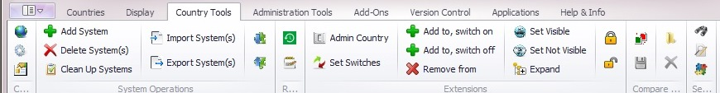
Ribbon bar – country tools
Open country to activate buttons
Contains options that manipulate the general parameters of a country file
  name and acronym
  available policy systems and their characteristics
  available datasets and their characteristics
Adding and deleting systems
Viewing options:
  search and replace
  formatting
  bookmarks
Comparing versions
More advanced (import/ export systems, add-ons etc.)

Slide 76
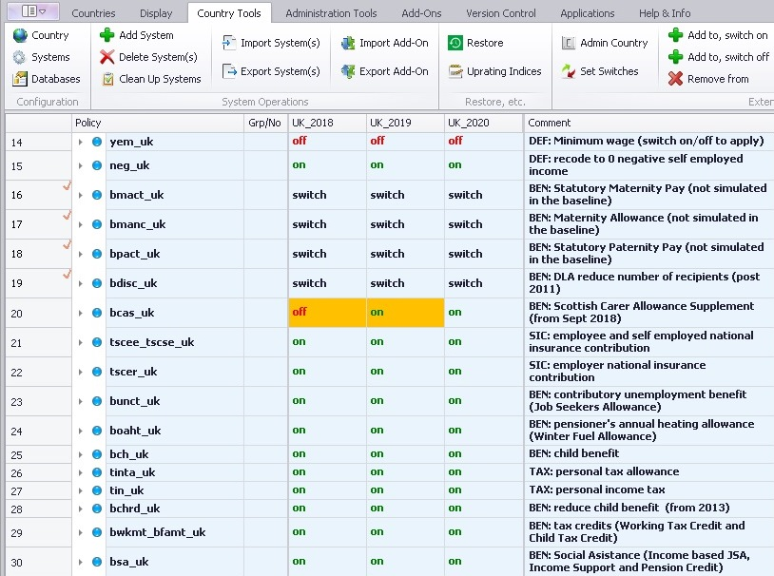
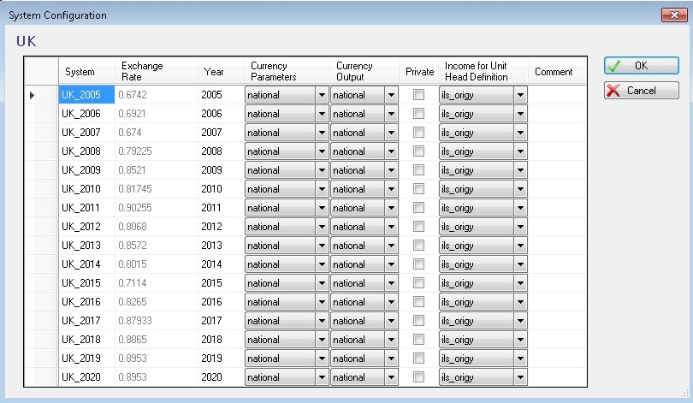
Policy system settings
all policy years/systems
income used to define the head of the unit
exchange rate national to euro
parameters currency
output currency

Slide 77
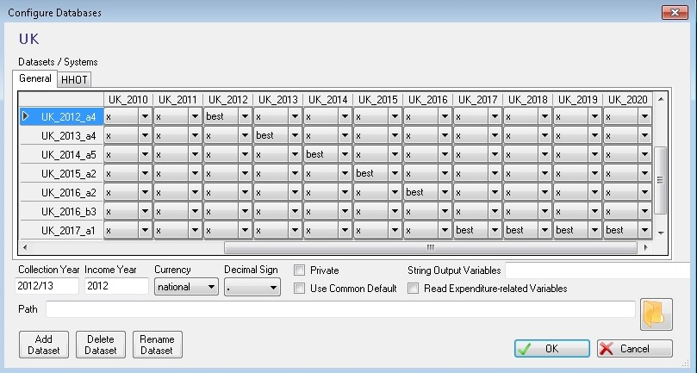
Data settings
all policy systems
all input data sets
characteristics of the input
data set
add/delete input data sets

Slide 78
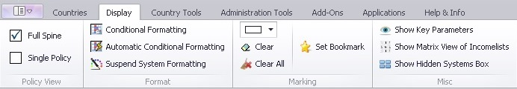
Ribbon bar - control display and formatting
Control display and formatting
View full spine vs. single policy
Conditional formatting (similar idea to EXCEL)
Bookmarks
Matrix view of income lists
Visualising/ hiding key parameters

Slide 79
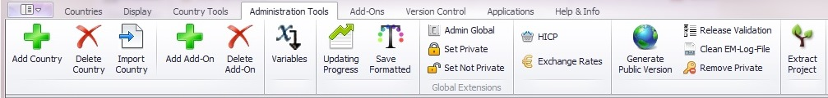
Ribbon bar – administration tools
Adding and deleting countries
Accessing and administering the variables file
Updating progress: overview of available policy systems and datasets
Merging versions
Administrating switches
Administrating exchange rates and HICP series

Slide 80
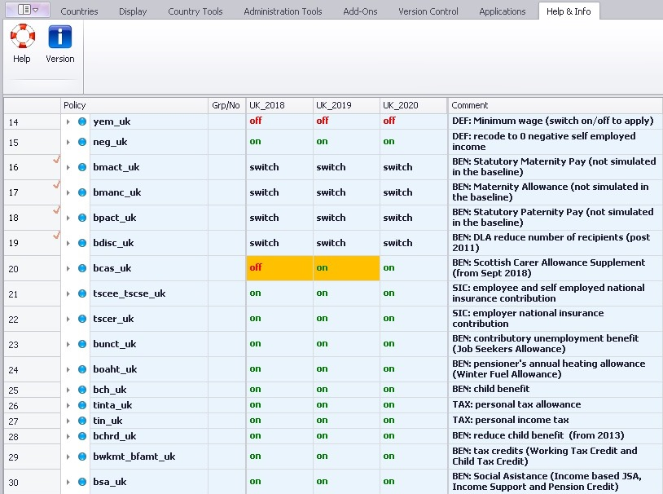
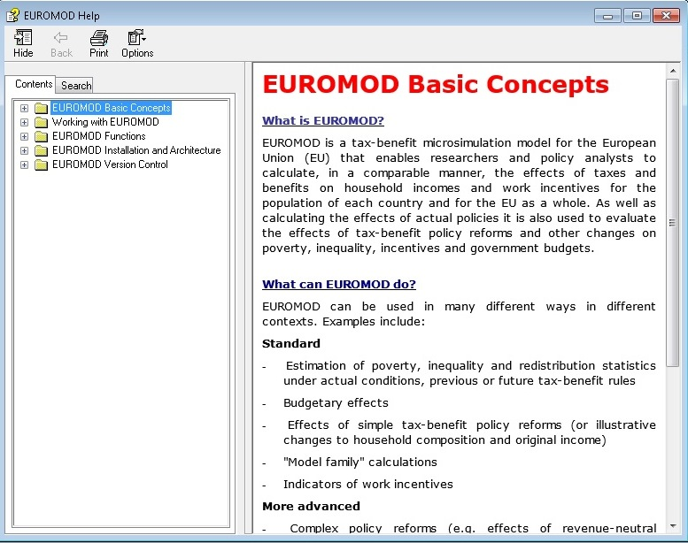
EUROMOD software Help
browse
search

Slide 81
Context Menus
Activated by right-clicking
  column headings
  row headings
  function headings/ parameter names
  comments
Intuitive options controlling the respective elements
Description available

Slide 82
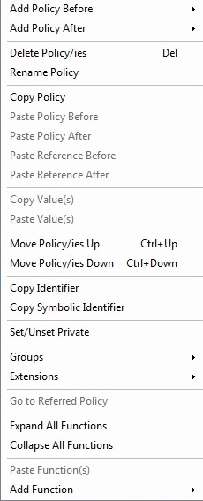
Context Menus
right-click on
a policy, function or parameter

Slide 83
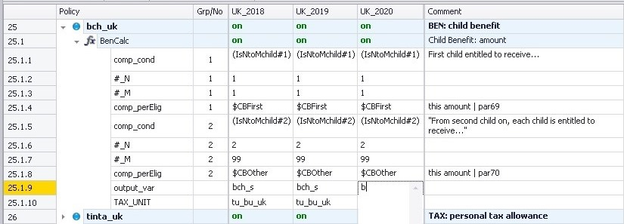
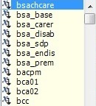
IntelliSense

Slide 84
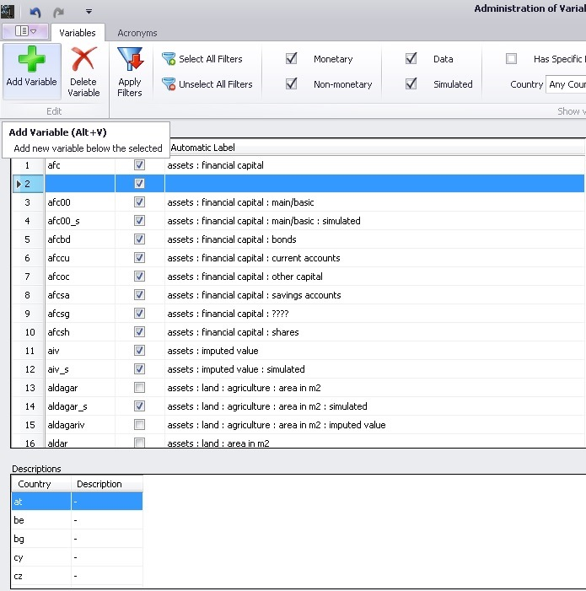
Adding a variable
new empty row;
fill in name and monetary

Slide 85
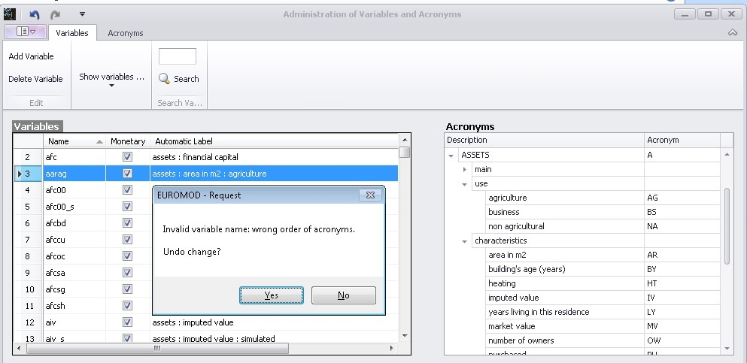
Naming a variable
acronyms
UI checks validity of name and existence of the variable

Slide 86
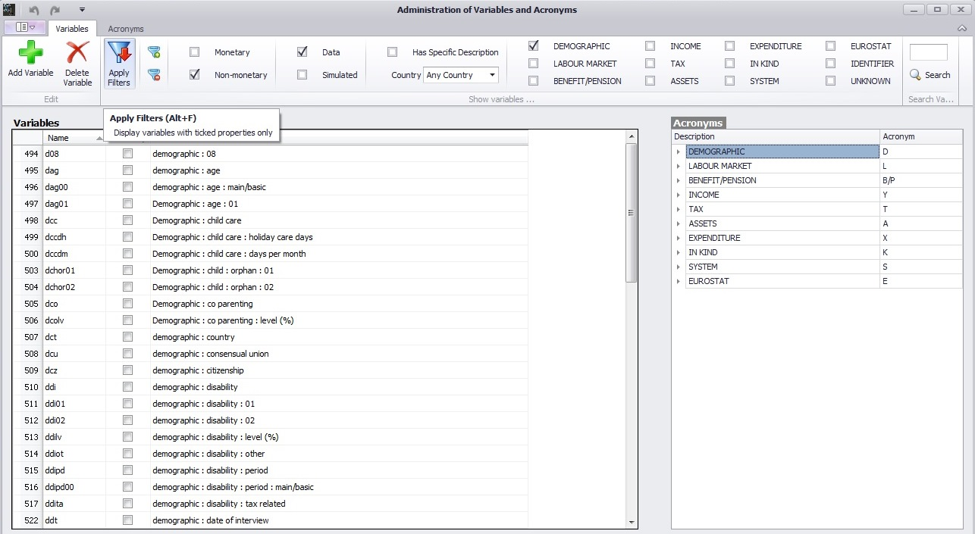
Filtering variables
select filters

Slide 87
UKMOD: System function DefOutput

Slide 88
UKMOD output micro-data
Content manipulated in policy output_std_cc
  Controls level at which info is outputted (e.g. individual, family or household)
  What variables to be included in the output
Usually included:
  All variables present in the input micro-data file
  Simulated variables (i.e. simulated taxes and benefits)
  Standardised income lists (e.g. all benefits, all taxes)
  (optional) non-standard income lists
  (optional) temporary variables
  (optional) tax/assessment unit identification info

Slide 89
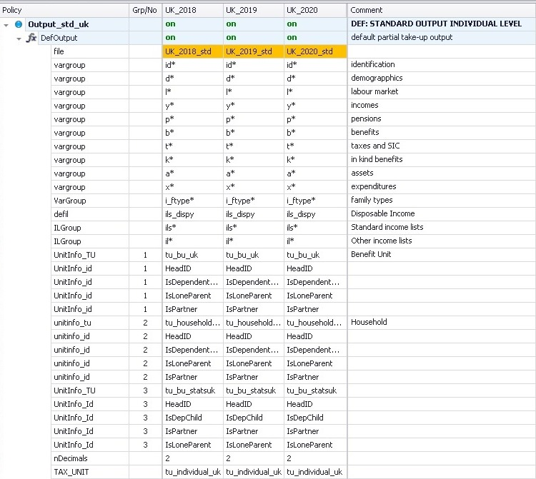
System Functions: DefOutput
89
Determines the content of the output file
name of output file: xx_year_std
variables included in the output file
TAX_UNIT: level of aggregation

Slide 90
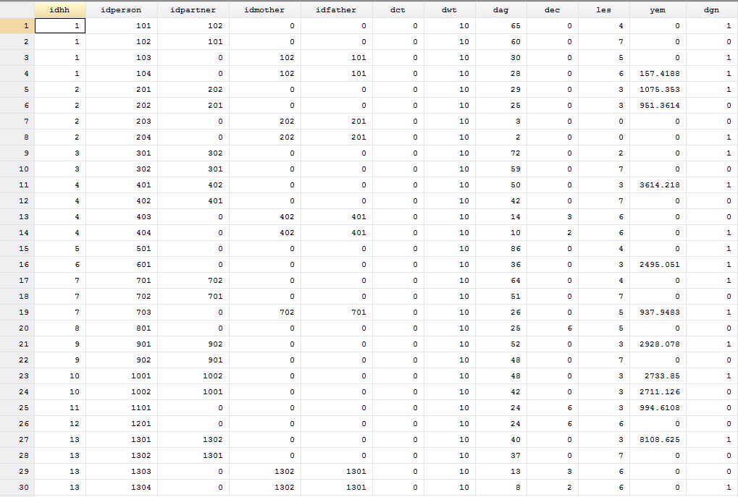

Slide 91
UKMOD: more on functions and parameters
Notes:
H12.40

Slide 92
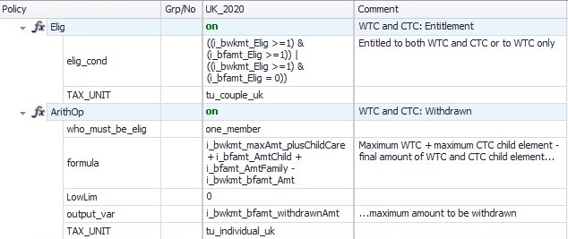
Interactions between functions (1)
Functions interact in three ways (+ replacement):
  Condition: one function (usually function Elig) evaluates a parameter and a subsequent function operates on the basis of the result of this evaluation
Notes:
AP: too early to have this?

Slide 93
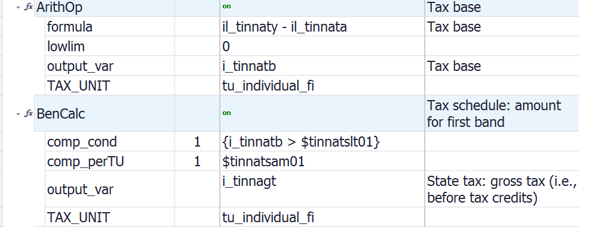
Interactions between functions (2)
  Input: one function calculates a variable, which is used as an input by a subsequent function.

Slide 94
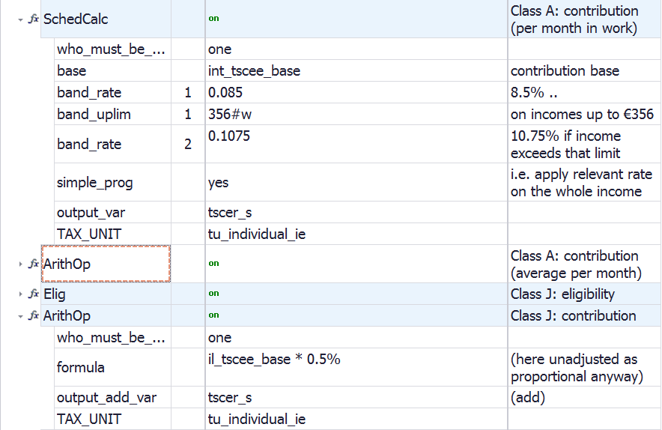
Interactions between functions (3)
  Addition: one function calculates a part of a policy and a subsequent function calculates another part of the policy and then needs to add its calculation to the first part.

Slide 95
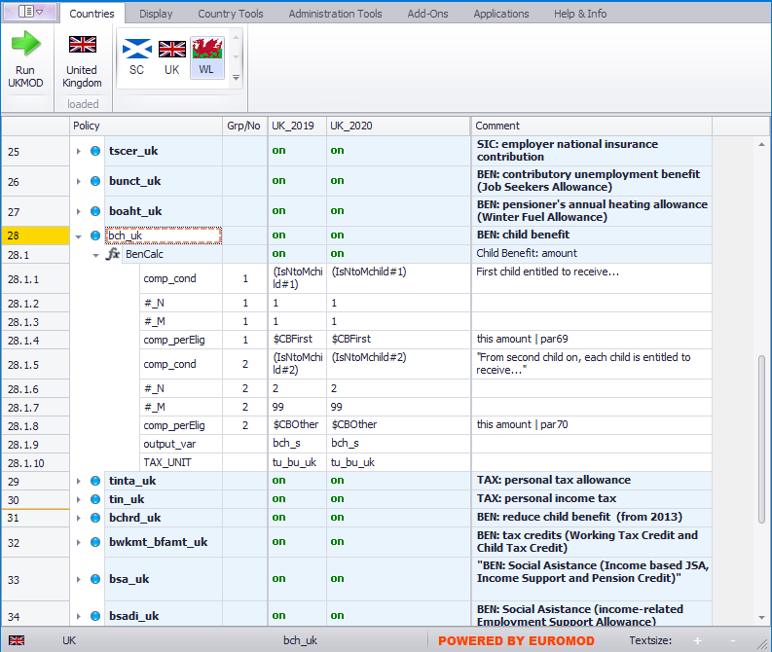

Manipulating policies
right-click on a policy to activate menu

Slide 96
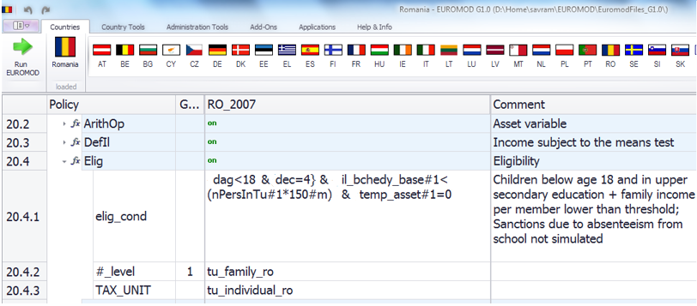
Condition parameters
logical and comparison operations to evaluate a condition with a yes/no result.
Conditions can be grouped by parenthesis ()
Negative condition (i.e. !) can be used with a single condition only

Slide 97
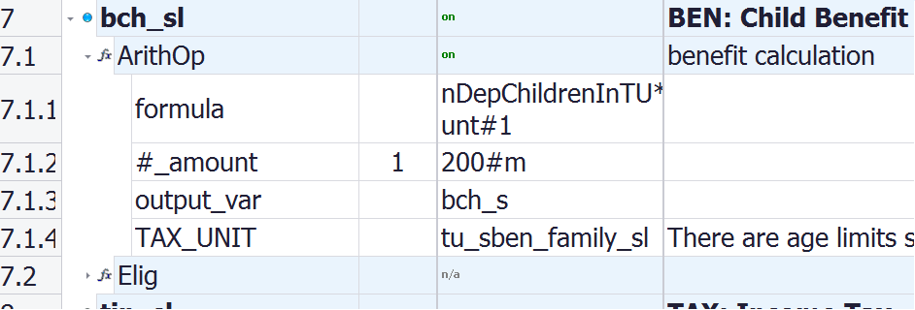
Parameters: Assessment Unit
(TAX_UNIT)
TAX_UNIT defines the assessment unit a function refers to:
  Individual (tu_individual_xx)
  Household (tu_household_xx)
  Various definitions of family units (various names, e.g. tu_family_xx, tu_bu_xx)
Compulsory for most policy functions!

Slide 98
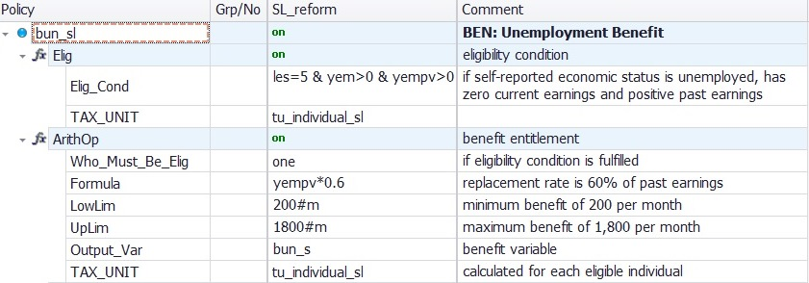
Parameters: Limits
(LowLim; UpLim)
LowLim: lower limit
UpLim: upper limit

Slide 99
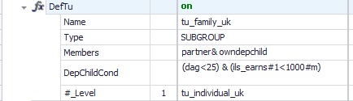
Updating assessment units
99
The tax unit is defined/ calculated the first time it is used by the model: household members are assigned to respective units once an assessment unit is first used.
This assignment is not changed with subsequent uses, even if circumstances change.
However, the reassessment of the units can be enforced by using the function UpdateTU.

Slide 100
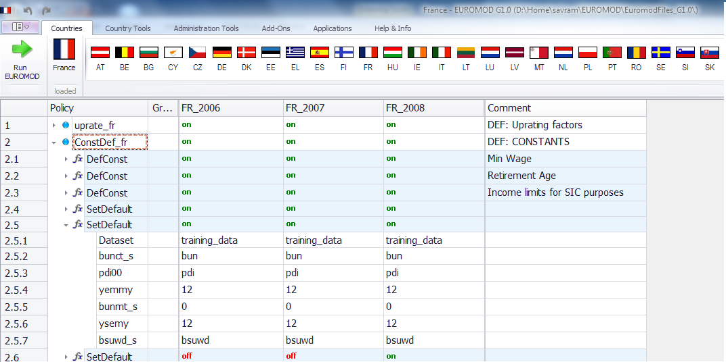
System Functions: SetDefault
sets alternative values or variables if a dataset variable is missing
Notes:
Set default is not into constdef_cc anymore

Slide 101
UKMOD: Special functions
Notes:
H12.40

Slide 102
(More) Special functions
AddOn_xxx (implement extended functionalities not part of the standard tax-benefit calculations, such as Effective Marginal Tax Rates, different budget sets)
Loop and UnitLoop (repeat part (or all) of the tax-benefit calculations)
Store and Restore (set a variable to the initial (or other previous) value
ChangeParam (modify parameters during the model run)
Totals (calculates aggregates over groups of persons/households)
DropUnit and KeepUnit (drops certain persons/households from the calculations)
ILVarOp (performs operations on variables that are part of an income list)
RandSeed (generates random numbers)
CallProgramme (calls another programme, e.g., Stata)

