Slide 1
UKMOD training course
Daria Popova, Matteo Richiardi & Justin van de Ven
ISER, University of Essex
November 2022
Course based on UKMOD_A3.23+

Slide 2
Welcome!
Day 2:
Exercise using functions Elig and ArithOp
Handling errors
UKMOD policy functions BenCalc and SchedCalc
Exercise using function BenCalc

Slide 3
Re-cap of Day 1
We learned about:
Statistics Presenter Tool
Adding a reform system → copy/paste baseline
Types of policy in the policy spine
Policy functions:
Elig – to implement conditions
ArithOp – for arithmetic calculations
Adding a new function/parameter → right-click

Slide 4
Functions: Elig & ArithOp
Policy |  | System Name | Comment
ArithOp |  | on | Made-up example: child benefit
 | formula | 25#w*nDepChildrenInTu | £25 per week for each dependent child in the assessment unit
 | output_var | bch_s | result saved in the variable bch_s (b: benefit, ch: child, _s: simulated)
 | TAX_UNIT | tu_bu_uk
Elig |  | on | Made-up example: eligibility condition
 | elig_cond | IsLoneParentOfDepChild | if a lone parent of a dependent child
 | TAX_UNIT | tu_bu_uk
ArithOp |  | on | Made-up example: child benefit supplement for lone parents
 | Who_Must_Be_Elig | one | at least one person in the benefit unit should be a lone parent
 | formula | 15#w | £15 per week for the assessment unit
 | output_add_var | bch_s | add answer to the result of the previous function, saved in the variable bch_s
 | TAX_UNIT | tu_bu_uk

Slide 5
Exercise 3
You will:
Implement a reform to the Child Benefit (bch_uk), based on UK 2022 system
Use the functions Elig and ArithOp to introduce a £30 p.w. supplement for families with 2+ children
Make a copy of UK 2022 system and call it e.g. UK_2022bch
Modify UK_2022bch
Add Elig and ArithOp functions after the BenCalc function
Run reform system and analyse impact on household incomes of the reform using the Statistics Presenter
This time you will do the exercise on your own!

Slide 6
Summary: Exercise 3
You learned how to use Elig and ArithOp to implement a benefit, using
Who_Must_Be_Elig to link Elig and ArithOp
Queries & amount parameters
Parameter output_add_var
You learned how to add a new function and a parameter

Slide 7
Questions

Slide 8
Handling Errors

Slide 9
In this lecture, you will learn:
How to handle errors in the model:
How to read/interpret the error message
How to find the location of the error in the model

Slide 10
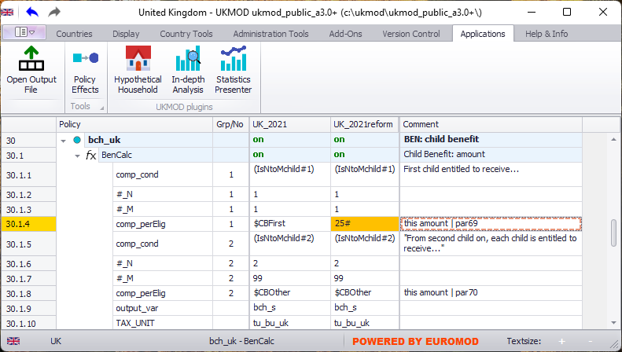
Handling errors (1)
typo in the syntax:
25# instead of 25#w

Slide 11
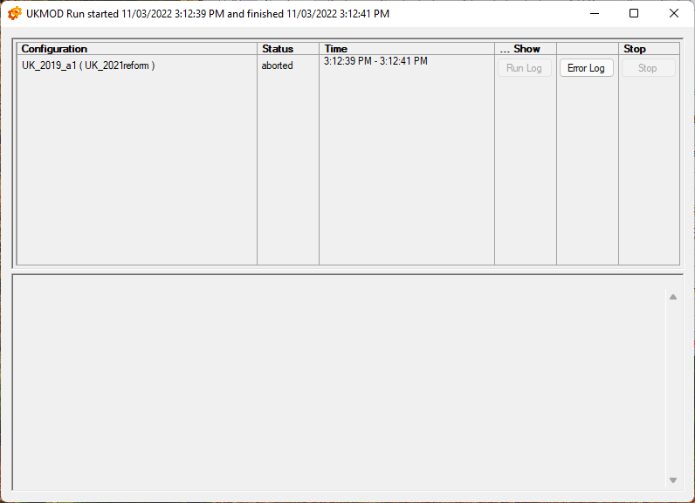
Handling errors (2)

Slide 12
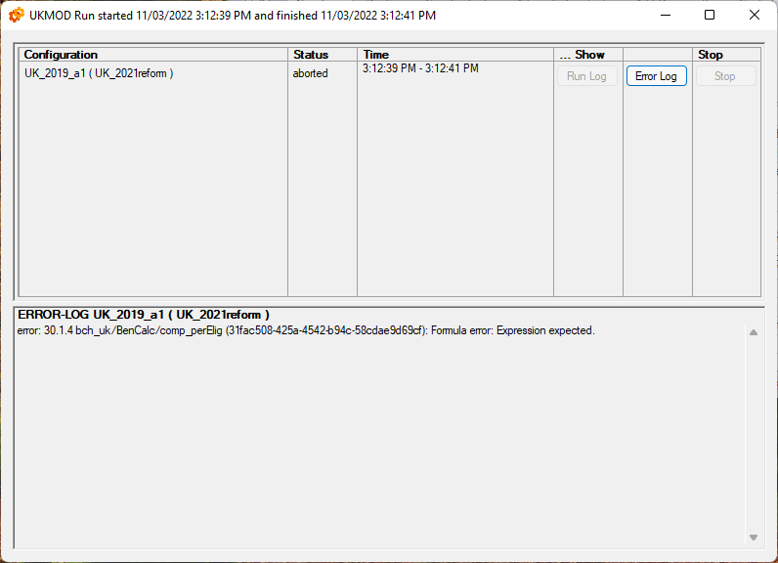
Handling errors (3)
location of the error: policy, function, parameter
unique identifier for the exact place of the error in the model

Slide 13
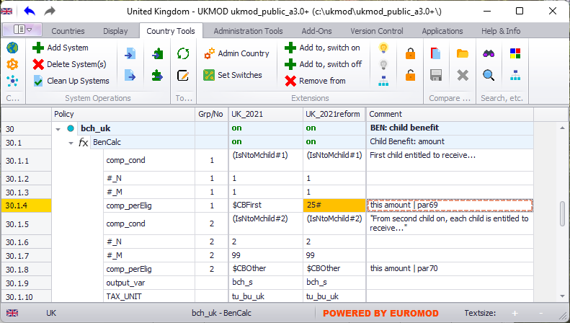
Handling errors (4)
search policies, functions or parameters by their identifier

Slide 14
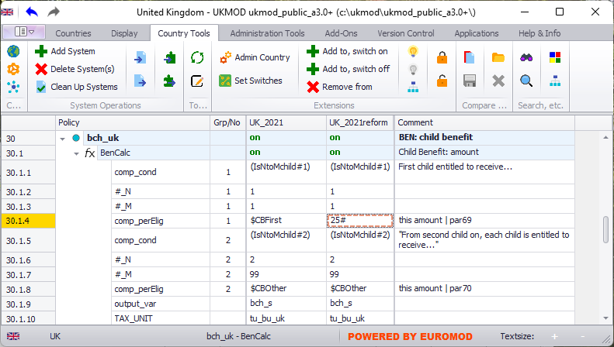
Handling errors (5)
copy unique identifier from error log and paste it here

Slide 15
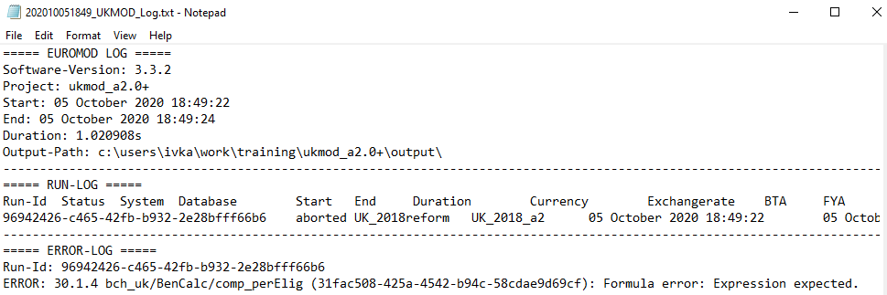
Handling errors (6)
Output folder: error log file (text format)
Same info as in the running dialogue box
Error logs contain time stamp of their creation
Info about EUROMOD version, policy system where error occurred and dataset used

Slide 16
Types of function
Policy
Function
Parameter
Parameter
Parameter
System functions
functions used to define some general settings
e.g. to define income lists and tax units
Policy functions
functions used to implement tax-benefit policies
e.g. define eligibility, calculate amount etc.
Special functions
more advanced functions that perform more complicated tasks
e.g. loops, change parameters at run-time etc.
we already learned about Elig and ArithOp
we will also learn about BenCalc, SchedCalc, Allocate
not covered in this course
we will learn about DefIL, DefConst, DefTU, DefVar, DefOutput, Uprate

Slide 17
UKMOD: THE POLICY FUNCTION bencalc
Policy |  | Grp/No | System Name | Comment
BenCalc |  |  | on | Made-up example: child benefit
 | Comp_Cond | 1 | nDepChildrenInTu>=1 & IsDepChild | if at least one dependent child in the assessment unit…
 | Comp_perElig | 1 | 20#w | …benefit amount is £20 per week per child
 | Comp_Cond | 2 | IsDepChild & IsDisabled | if a child with a disability in the assessment unit…
 | Comp_perElig | 2 | 10#w | …£10 per week for each child with a disability
 | Comp_Cond | 3 | IsLoneParentOfDepChild | if a lone parent in the assessment unit…
 | Comp_perTU | 3 | 5#w | …£5 per week for the assessment unit
 | output_var |  | bch_s
 | TAX_UNIT |  | tu_bu_uk | assessment unit used for the calculations

Slide 18
In this lecture, you will learn about:
The function BenCalc
Combines Elig and ArithOp functions
Used to implement benefits
Policy |  | Grp/No | System Name | Comment
BenCalc |  |  | on | Made-up example: child benefit
 | Comp_Cond | 1 | nDepChildrenInTu>=1 & IsDepChild | if at least one dependent child in the assessment unit…
 | Comp_perElig | 1 | 20#w | …benefit amount is £20 per week per child
 | Comp_Cond | 2 | IsDepChild & IsDisabled | if a child with a disability in the assessment unit…
 | Comp_perElig | 2 | 10#w | …£10 per week for each child with a disability
 | Comp_Cond | 3 | IsLoneParentOfDepChild | if a lone parent in the assessment unit…
 | Comp_perTU | 3 | 5#w | …£5 per week for the assessment unit
 | output_var |  | bch_s
 | TAX_UNIT |  | tu_bu_uk | assessment unit used for the calculations

Slide 19
Function BenCalc (1)
Benefit calculator – BenCalc – is a very powerful function that is typically used to implement means-tested benefits
Many benefits consist of several components, where a component is added if conditions are met by the assessment unit, and an income-test, where certain types of income reduce benefit entitlement
BenCalc allows these to be implemented/programmed easily
It combines the functionalities of the functions Elig and ArithOp
Compulsory parameters: Comp_Cond, Comp_PerTU/Comp_PerElig, output_var, TAX_UNIT

Slide 20
Function BenCalc (2)
Comp_Cond used to define a condition
as elig_cond in the function Elig
Comp_perTU or Comp_perElig used to calculate a formula
As formula in function ArithOp
Comp_perTU: amount is added once to the assessment unit
Comp_perElig: amount is added once for each individual, fulfilling the condition, in the assessment unit
“group” together Comp_Cond and Comp_perTU/Comp_perElig into one component
either Comp_perTU OR Comp_perElig in one component
can set upper and lower limits for each component
Comp_Lowlim
Comp_Uplim

Slide 21
Comp_perTU vs Comp_perElig
Policy |  | Grp/No | System Name | Comment
BenCalc |  |  | on | Made-up example: child benefit
 | Comp_Cond | 1 | nDepChildrenInTu>=1 & IsDepChild | if at least one dependent child in the assessment unit…
 | Comp_perTU | 1 | 20#w | …benefit amount is £20 per week
 | output_var |  | bch_s
 | TAX_UNIT |  | tu_bu_uk | assessment unit used for the calculations
Policy |  | Grp/No | System Name | Comment
BenCalc |  |  | on | Made-up example: child benefit
 | Comp_Cond | 1 | nDepChildrenInTu>=1 & IsDepChild | if at least one dependent child in the assessment unit…
 | Comp_perElig | 1 | 20#w | …benefit amount is £20 per week PER CHILD
 | output_var |  | bch_s
 | TAX_UNIT |  | tu_bu_uk | assessment unit used for the calculations

Slide 22
Function BenCalc (3)
Ex. A lone parent family with two children, one with a disability, will receive ?
£55#w
Policy |  | Grp/No | System Name | Comment
BenCalc |  |  | on | Made-up example: child benefit
 | Comp_Cond | 1 | nDepChildrenInTu>=1 & IsDepChild | if at least one dependent child in the assessment unit…
 | Comp_perElig | 1 | 20#w | …benefit amount is £20 per week per child
 | Comp_Cond | 2 | IsDepChild & IsDisabled | if a child with a disability in the assessment unit…
 | Comp_perElig | 2 | 10#w | …£10 per week for each child with a disability
 | Comp_Cond | 3 | IsLoneParentOfDepChild | if a lone parent in the assessment unit…
 | Comp_perTU | 3 | 5#w | …£5 per week for the assessment unit
 | output_var |  | bch_s
 | TAX_UNIT |  | tu_bu_uk | assessment unit used for the calculations

Slide 23
The query IsNtoMchild#x
IsNtoMchild#x is incredibly useful to implement child benefit which varies by n children
Returns 1 if a person belongs to the n to m oldest dependent children of the assessment unit, 0 otherwise. n and m are defined by footnote parameters #_N and #_M.
Policy |  | Grp/No | System Name | Comment
BenCalc |  |  | on | Made-up example: child benefit
 | Comp_Cond | 1 | IsNtoMchild#1 | if the dependent child is…
 | #_N | 1 | 1 | ...the first (oldest) child
 | #_M | 1 | 1
 | Comp_perElig | 1 | 20#w | benefit amount is £20 per week for the first (oldest) child
 | Comp_Cond | 2 | IsNtoMchild#2 | if the dependent child is…
 | #_N | 2 | 2 | …the second or any other child
 | #_M | 2 | 99
 | Comp_perElig | 2 | 10#w | benefit amount is £10 per week for any other child
 | output_var |  | bch_s
 | TAX_UNIT |  | tu_bu_uk | assessment unit used for the calculations
- footnote parameters are referred to by #
- they are grouped together with main parameter they refer to

Slide 24
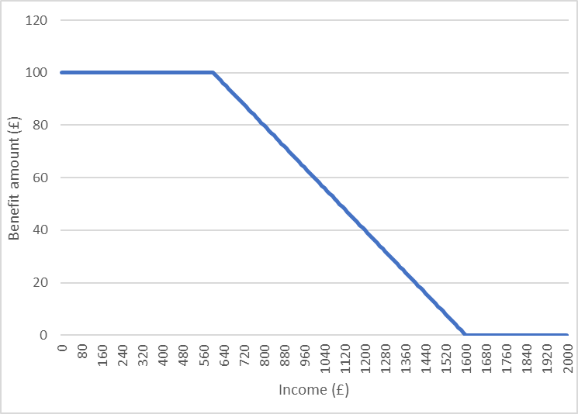
Function BenCalc (4)

Slide 25
Function BenCalc (4)
Withdraw parameters: subtract something from the calculated sum of components
Withdraw_Base: what is being subtracted (ex: variable, income list)
Withdraw_Rate: what percentage of the base is being subtracted
Withdraw_Start: level of the base where withdrawal starts
Withdraw_End: level of the base where sum of the components-base*rate is 0
Negative result automatically set to 0
Result=max(Sum of components-max(BASE-START, 0)*RATE, 0)
_Rate and _End cannot be used simultaneously
If Withdraw_End is specified:
RATE=(sum of components)/(END-START)

Slide 26
Function BenCalc (5)
Policy |  | Grp/No | System Name | Comment
BenCalc |  |  | on | Made-up example: child benefit
 | Comp_Cond | 1 | IsLoneParentOfDepChild | if there is a lone parent in the assessment unit…
 | Comp_perTu | 1 | 20#w | …benefit amount is £20 per week, if assessment unit has earnings up to £20,000 per year
 | Withdraw_Base |  | yem | withdraw benefit amount as earnings (yem) increase
 | Withdraw_Start |  | 20000#y | withdraw benefit amount if earnings equal or exceed £20,000 per year
 | Withdraw_Rate |  | 0.1 | 10% are withdrawn for each £1 earned above £20,000 per year
 | output_var |  | bch_s
 | TAX_UNIT |  | tu_bu_uk | assessment unit used for the calculations
the calculations done with the withdraw parameters apply to the sum of all components
withdraw parameters do not need to be grouped

Slide 27
Exercise 4
You will:
Implement a reform to the Child Benefit (bch_uk), based on UK 2022 system
Use the function BenCalc to introduce a means-tested supplement for families with 2+ children
Make a copy of UK 2022 system and call it UK_2022bch2
Modify UK_2022bch2
Add BenCalc function after the BenCalc function
Add parameters Withdraw_Base, Withdraw_Start, Withdraw_Rate
Run reform system and analyse impact on household incomes of the reform using the Statistics Presenter

Slide 28
Summary: Exercise 4
You learned how to use BenCalc to implement a benefit
Grouping together Comp_Cond and Comp_perTU
Using optional parameters Withdraw_Base, Withdraw_Start, Withdraw_Rate

Slide 29
Questions

Slide 30
What assessment unit do we use for eligibility vs other parameters? (1)
Assessing the result of a function

Slide 31
What assessment unit do we use for eligibility vs other parameters? (2)
Policy |  | System Name | Comment
Elig |  | on | Made-up example: condition to receive a housing benefit
 | elig_cond | yem<30000#y & nPersonsInTU<=2 & dag>=60 | household's earnings are less than £30k per year, there are max 2 persons in the household, and person's age is 60+
 | TAX_UNIT | tu_household_uk | assessment unit is the household
ArithOp |  | on | Made-up example: housing benefit
 | Who_Must_Be_Elig | all | calculations carried out if each member of assessment unit fulfills condition from last Elig function
 | formula | IsDisabled * xhc - yem | benefit funds expenditure for housing (xhc) if household head is disabled; benefit is reduced with household's earnings
 | lowlim | 0 | min benefit amount is 0
 | output_var | bho_s
 | TAX_UNIT | tu_household_uk | assessment unit is the household

Slide 32
Types of function
Policy
Function
Parameter
Parameter
Parameter
System functions
functions used to define some general settings
e.g. to define income lists and tax units
Policy functions
functions used to implement tax-benefit policies
e.g. define eligibility, calculate amount etc
Special functions
more advanced functions that perform more complicated tasks
e.g. loops, change parameters at run-time etc.
we already learned about Elig, ArithOp and BenCalc
we will also learn about SchedCalc and Allocate
not covered in this course
we will learn about DefIL, DefConst, DefTU, DefVar, DefOutput, Uprate

Slide 33
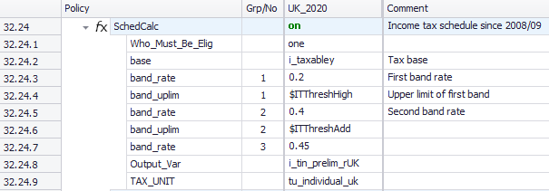
UKMOD: the policy FUNCTION SchedCalc

Slide 34
In this lecture, you will learn:
How to implement a tax using the function SchedCalc
Tomorrow: about two “system” functions which define
constants – DefConst
income lists – DefIL

Slide 35
Function SchedCalc (1)
Used (mainly) for progressive taxes
Tax schedule
Tax bands: Band_UpLim / Band_LowLim
Tax rate: Band_Rate
Tax base: Base
“group” together Band_Rate and Band_UpLim/Band_LowLim
Instead of rates, for fixed amounts use Band_Amount
Policy |  | Grp/No | System Name | Comment
SchedCalc |  |  | on | Made-up example: income tax
 | Base |  | tintb_s | income tax calculated based on taxable income (t: tax, in: income, tb: tax base, _s: simulated)
 | Band_Rate | 1 | 0.2 | first band rate: 20%
 | Band_LowLim | 1 | 12500#y | first band rate applies on income above £12.5k per year…
 | Band_UpLim | 1 | 50000#y | …and up to £50k per year
 | Band_Rate | 2 | 0.4 | second band rate: 40%
 | Band_UpLim | 2 | 150000#y | second band rate applies on income above £50k and up to £150k per year
 | Band_Rate | 3 | 0.45 | third band rate: 45%; applies on income above £150k per year
 | output_var |  | tin_s | result saved in variable tin_s (t: tax, in: income, _s: simulated)
 | TAX_UNIT |  | tu_individual_uk | assessment unit used for the calculations

Slide 36
Function SchedCalc (2)
36
With progressive tax-schedules this procedure is of advantage for couples where one partner has low (or no) and the other high income, as the average income falls into lower tax bands
Joint taxation: Quotient
Result = ((Base/Quotient)*Tax schedule)*Quotient
Policy |  | Grp/No | System Name | Comment
SchedCalc |  |  | on | Made-up example: income tax based on joint taxation
 | Base |  | tintb_s | income tax calculated based on taxable income (t: tax, in: income, tb: tax base, _s: simulated)
 | Band_Rate | 1 | 0.2 | first band rate: 20%
 | Band_LowLim | 1 | 12500#y | first band rate applies on income above £12.5k per year…
 | Band_UpLim | 1 | 50000#y | …and up to £50k per year
 | Band_Rate | 2 | 0.4 | second band rate: 40%
 | Band_UpLim | 2 | 150000#y | second band rate applies on income above £50k and up to £150k per year
 | Band_Rate | 3 | 0.45 | third band rate: 45%; applies on income above £150k per year
 | Quotient |  | 2 | Base is divided by the quotient before the schedule is applied. Afterwards the result is multiplied by the quotient.
 | output_var |  | tin_s | result saved in variable tin_s (t: tax, in: income, _s: simulated)
 | TAX_UNIT |  | tu_couple_uk | assessment unit used for the calculations
Notes:
Check EM help for simpler example

Slide 37
Function SchedCalc (3)
Simple_Prog: apply highest marginal tax rate reached by base on the whole income
Policy |  | Grp/No | System Name | Comment
SchedCalc |  |  | on | Made-up example: income tax
 | Base |  | tintb_s | income tax calculated based on taxable income (t: tax, in: income, tb: tax base, _s: simulated)
 | Band_Rate | 1 | 0.2 | first band rate: 20%
 | Band_LowLim | 1 | 12500#y | first band rate applies on the whole income if income is between £12.5k per year…
 | Band_UpLim | 1 | 50000#y | …and £50k per year
 | Band_Rate | 2 | 0.4 | second band rate: 40%
 | Band_UpLim | 2 | 150000#y | second band rate applies on the whole income if income is between £50k and up to £150k per year
 | Band_Rate | 3 | 0.45 | third band rate: 45%; applies on the whole income if income is above £150k per year
 | Simple_Prog |  | yes
 | output_var |  | tin_s | result saved in variable tin_s (t: tax, in: income, _s: simulated)
 | TAX_UNIT |  | tu_individual_uk | assessment unit used for the calculations

Slide 38
End of Day 2

