Slide 1
UKMOD training course
Daria Popova, Matteo Richiardi & Justin van de Ven
ISER, University of Essex
November 2022
Course based on UKMOD_A3.23+

Slide 2
Welcome!
Day 1:
  Introduction to static tax-benefit models and UKMOD
  UKMOD: how it works + exercises
  UKMOD policy functions Elig and ArithOp

Slide 3
Course structure
Mix of lecture and hands-on exercises
Extra exercises offered to do after the course
Please ask questions, and definitely interrupt if terminology is unclear
Tell us what you would like to do with the model

Slide 4

Quick round of introductions

Slide 5
Introduction: static tax-benefit models, distributional analysis and the UKMOD project

Slide 6
UKMOD is a static tax-benefit microsimulation model

Slide 7
What does “microsimulation” mean?
refer to a wide area of modelling techniques that:
operate at the level of individual units (persons, households, vehicles, firms, etc.)
apply rules to simulate changes in state or behavior of these units
estimate distributional outcomes after applying these rules at the micro level
application in different areas, e.g.:
traffic and transportation
demand for health care
spatial planning
tax-benefit policies

Slide 8
Types of tax-benefit microsimulation model
 | Static | Dynamic
Non-Behavioural | Individual characteristics are fixed Behaviour is fixed Short-term analysis (“morning after”) Focus on direct effects of policies
Behavioural | Individual characteristics are fixed Behaviour react to incentives Medium-term analysis (“a few months”) Focus on direct and indirect effects of policies | Individual characteristics change over time Behaviour explicitly modelled Longer-term analysis (“a few years/decades”) Focus on direct and indirect effects of policies and population change

Slide 9
Microsimulation: Why
To reconstruct things we do not observe:
  Missing variables
  (Future states)
  Counterfactuals
With respect to other modelling exercises:
  Focus on micro-units, and micro-rules
  Flexibility brought about by the computational approach: everything that can be algorithmically described can be simulated.

Slide 10
Static tax-benefit models
Units of analysis: households, benefit units, and persons
Rules: tax-benefit policies, mostly:
  Cash transfers
    Means-tested benefits
    Non-means-tested benefits
    Pensions
  Social insurance contributions (SIC)
  Direct taxes: Income tax, including tax allowances and tax credits, capital gains tax

Slide 11
Why use a tax-benefit microsimulation model?
Policy rules account for interactions between parts of tax and benefit system:
  basic state pension is taxable, so higher BSP means more income tax revenue
  Universal Credit depends on after-tax earnings, so a rise in income tax rate implies higher spend on UC

Slide 12
Why use a tax-benefit model?
Analyse the impact of policies (and policy changes) on:
  income distribution,
  measures of income inequality and poverty,
  (net) budgetary cost of policy changes,
  gainers and losers,
  work incentives...
  rather than:
  on the mean, as happens using regression techniques
  on individual cases, as happens using OECD-style standard family type calculations

Slide 13
Why use a tax-benefit model?
Added value to survey/register microdata
  information which is otherwise not (publicly) available
  e.g. tax deductions, benefit eligibility, net/gross values
More up-to-date results (as data collection and release take time)
Easy to “change the rules” and build counterfactuals

Slide 14

UKMOD
Microdata
on households (and individuals)
Tax-benefit policy rules
current or historical systems
representative of the population
hypothetical systems
Calculation of benefit entitlements & tax liabilities
for every household
under multiple tax-benefit systems
Analysis
household incomes
fiscal impact
work incentives
Accounts for:
interactions between policies
interactions between policies and household characteristics
heterogeneity of household characteristics

Slide 15
UKMOD
An open-access, flexible and transparent static tax-benefit microsimulation model:
  no hard-wiring; everything is parameterised
  (relatively) easy to simulate structural reforms
  extensive and growing documentation
  a growing community of users
  uses EUROMOD software, which provides a flexible user interface
  additional simplified interfaces and online models
  freely available!
Notes:
Open access: “the most used microsimulation model in the world”
Many users and stakeholders – quality assurance
Bridging the gap between academic research and policymaking
Increasingly recognised in the academic literature
Recent papers appeared in top economic and social policy journals
well embedded in the income distribution literature
(Input micro-data access handled separately)
2. Highly flexible, but organised, documented, validated and transparent
Purpose-built software: “tax-benefit modelling” language; user interface; “plug-ins” and “add-ons” for special purpose analysis
(Relatively) easy to simulate major reforms to policy structures (without programming skills); many types of application
(Spin-offs for non-EU countries; enhanced national models)

Slide 16
UKMOD’s origins
A spin-off from EUROMOD:
  EU-funded project that covered EU countries in a common framework, originally developed and coordinated by the University of Essex.
  The ownership of the EU-wide model has moved to the European Commission, but software is open-source
  EUROMOD provides a tax-benefit microsimulation programming language and a structure which can be used to produce a tax-benefit model for any country

Slide 17
UKMOD/EUROMOD: key users
Academic research in (e.g.) public economics & quantitative social policy
International policy organisations
European Commission policy Directorates
OECD, IMF, World Bank, UNICEF (hands-on & commissioned work)
National governments and public institutions
SK, MT, LT, LV, EE, EL ….
SPICe, Welsh Government, NHS Scotland
Civil society: UKMOD/EUROMOD are the engine for simplified web-based models
SORESI – run by Austrian Ministry of Social Affairs http://soresi.sozialministerium.at/soresi/#
Mefisto – for Flanders run by CES at KULeuven http://www.flemosi.be/easycms/mefisto
A platform for developing non-EU models
e.g. Africa (South Africa, Namibia, Mozambique, +4), Latin America (Ecuador, Colombia, +…), Russia, Serbia ...

Slide 18
Availability of static tax-benefit microsimulation models
models are built and maintained by researchers (for academic purposes) or ministries and civil service (for impact assessment of policies)
Models are often not accessible (model and/or documentation)
Some use non-publicly available data (e.g. administrative data)
All models are single country models
UKMOD
(EUROMOD)

Slide 19
UKMOD and related models (1)
Other models for the UK exist:
  UK government: HMT (IGOTM), DWP (PSM)
  IFS: TAXBEN
  IPPR: The “Institute of Public Policy Research Tax-Benefit Model”: https://www.mmuperu.co.uk
UKMOD is freely available; well-documented; flexible and transparent; goes back to 2005

Slide 20
UKMOD and related models (2)
UKMOD comes with data from Family Resources Survey
  Although it can in principle be run on other datasets…
    A version running on Understanding Society will be available next year
  It does not cover indirect taxes, nor wealth taxes
    Extension to indirect taxes is under development
Hard to compare with other models’ outputs as we don’t have access, and documentation not supplied
  Efforts to reconcile alternative model outputs underway
  UKMOD has been a trusted and well-used part of EUROMOD for 20 years

Slide 21
Ways of using UKMOD (1)
To analyse the impact of actual or hypothetical tax-benefit changes on the distribution of income, fiscal aggregates or work incentives:
  We have coded up some standard analysis into UKMOD (the “Statistics Presenter” and “In-depth analysis tool”)
  Or you can analyse the micro-data produced by UKMOD using your own statistical software (we are not covering this in this course)

Slide 22
Ways of using UKMOD (2)
You can use UKMOD as a tool in a more complicated piece of analysis, by:
  Doing further analysis on the output data
    What are the labour supply responses to a change in Universal Credit?
    How would increase higher spending on UC reduce poverty, as defined by the Social Mobility Commission?
  Adjusting the input data set
    How would a rise in earnings inequality affect the distribution of income?
    How does demographic change affect government revenues?
  Linking UKMOD to other models (e.g. dynamic models)

Slide 23
UKMOD: Uses
Simulate actual, proposed or illustrative changes to TB rules:
    distributive analysis, budgetary effects, work incentives
Complex reforms
    e.g. revenue-neutral packages, policy swaps
Counterfactual (“what if”) scenarios
    policy swaps
    stress test for unemployment shocks
    automatic stabilising effects
Design regional/national/EU-wide policy reforms
    single country, cross-country comparative, or European-level analysis

Slide 24
UKMOD: More uses
Extending policy scope with additional micro-data
    Indirect taxes (FRS + LCF data)
    Wealth and property taxes (HFCS data)
    Tax evasion and non-take-up simulation/calibration (special data)
Linkage to other models, providing a distributional/micro perspective within many other types of analysis (labour supply models; links with CGE etc.)
State-of-the-art Hypothetical Household Tool (HHoT)

Slide 25
Typical elements of distributional analysis of tax-benefit reforms
Common to look at the average change in income within income deciles
    Work out total net (disposable) income for each household (private income + benefits – taxes)
    Divide by that household’s equivalence scale
    Rank all individuals by their household’s net equivalised income, and form 10 income decile groups
    Calculate average (mean) change in income between baseline and reform systems within each decile group

Slide 26
Example: Hypothetical tax reform in Scotland
  Average change in tax by household and income decile, introducing a new zero rate band of £1,000 above personal allowance in Scotland
Source: Berthier & Hudson (2017), SPICe BriefingNotes: using EUROMOD and FRS for analysis for Scotland

Slide 27
Example: Distributional effects of Covid-19
Source: Brewer, M. & I. Tasseva (2020), “Did the UK Policy Response to Covid-19 Protect Household Incomes?”, EUROMODEUROMOD Working Paper 12/20
Notes: Own calculations using UKMOD, the Family Resources Survey and Understanding Society COVID-19 Study
Notes:
- households will lose a large proportion of their income due to the pandemic, with losses higher in the middle and top of the distribution than at the bottom.
- Subsidies from CJRS will play a crucial role in supporting household finances across the entire distribution. They will provide the main insurance mechanism during the crisis. Subsidies from SEISS will also provide income support across the distribution, with somewhat larger benefits at the bottom.
- Reductions in income taxes and NIC will provide additional income protection for households at the top, while increases to benefit entitlements will protect households at the bottom of the distribution.

Slide 28
Typical elements of distributional analysis of tax-benefit reforms
Compare two tax-benefit systems
    “How different would incomes be under the reform system compared to the baseline system”
    In this case, “baseline” = 2020 if Covid-9 did not happen & “reform” = 2020 with Covid-19 shocks + benefit emergency package + CJRS + SEISS
For a particular population (dataset)

Slide 29
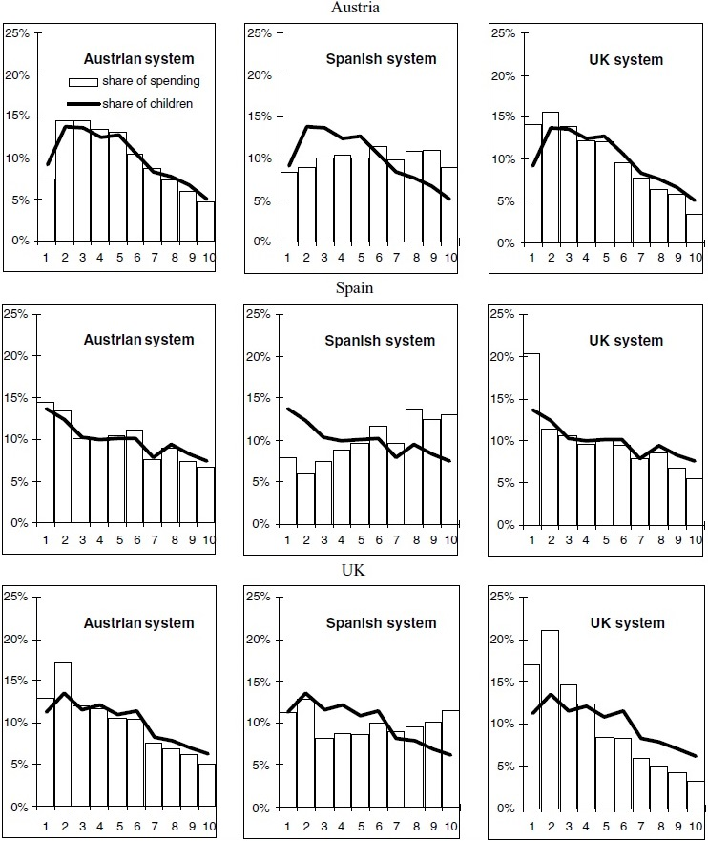
Example: policy swaps
Impact on household incomes of own and other countries’ child-related policies
Source: Levy et al. (2007), Journal of Social Policy
Notes: households are ranked in decile groups based on their actual net income in 2003

Slide 30
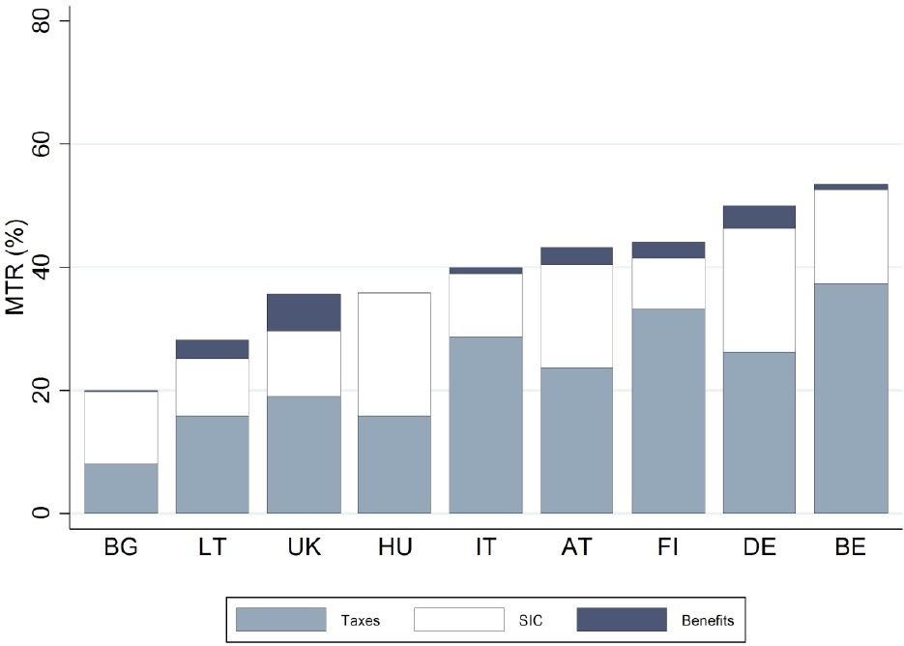
Example: work incentives
Decomposing the mean Marginal Effective Tax Rate by type of policy in 2015
Source: Jara, Gasior & Makovec (2017), EUROMOD Working Paper 3/17
Notes: METRs measure the incentive to work longer hours;
calculations with the Marginal Tax Rates tool in EUROMOD

Slide 31
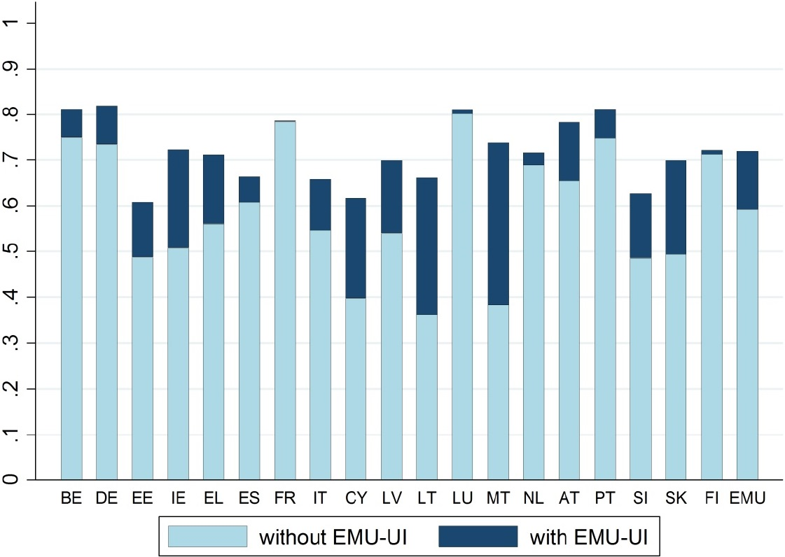
Example: EU-wide reforms
Income Stabilisation Coefficient with and without EMU Unemployment Insurance
Source: Jara, Sutherland & Tumino (2017), EUROMOD Working Paper 3/17
Notes: EMU-UI = European Monetary Union Unemployment Insurance benefit. ISC measures how much of the earnings loss is retained through tax-benefit policies

Slide 32
Example: Behavioural reactions
Calculating labour supply elasticities
Source: Bargain et al. (2013) Journal of Human Resources

Slide 33
UKMOD
What it covers

Slide 34
Taxes
Tax type | Tax name | Treatment in UKMOD
National Insurance Contributions (NICs) | Employees NICs | S
 | Self-employed NICs | S
 | Employers NICs | S
 | Credited (State) National Insurance Contributions | S (*)
Private pension contributions |  | PS
Direct Taxes | Income Tax | S
 | Council Tax | I
 | Capital Gains Tax | E
 | Inheritance Tax | E
 | Property and Stamp Duties | E
Indirect Taxes | Valued Added Tax (VAT) | E
 | Excises | E
Notes: “E”: excluded from the model as it is neither included in the micro-data nor simulated; “I”: included in the micro-data but not simulated; “PS” partially simulated as some of its relevant rules are not simulated; “S” simulated although some minor or very specific rules may not be simulated.
(*) Simulated only in 2020-21 with simulation of Covid-19 shocks.

Slide 35
Benefits
Contributory benefits are earnings-replacement benefits and pensions. Entitlement to these benefits depends on having met certain conditions regarding National Insurance contributions. Some contributory benefits are subject to specific tests on current income.
Non-contributory, non-means-tested benefits depend on certain contingencies such as disability or (lone) parenthood but do not require contributions to have been made and are not subject to an income test.
Non-contributory, means-tested benefits depend on a range of personal and family circumstances but also on family incomes – benefit entitlement is reduced if family incomes increase.
Tax credits have changed their name, format and administering authority over the past 15 years. In practice, despite being administered by the tax authorities, tax credits are like cash benefits and are treated as such in UKMOD.

Slide 36
Benefits: contributory
Benefit type | Benefit name | Treatment in UKMOD
Contributory (aka National Insurance Benefits) | Bereavement benefit | I
 | Employment and Support Allowance (ESA) | I
 | Incapacity Benefit | I
 | Jobseeker’s Allowance (JSA): | PS(*)
 | Maternity Allowance (MA) | I
 | State Pension | I
 | Winter Fuel Allowance | S
 | Self-Employed Income Support Scheme (SEISS) | S
Notes: “E”: excluded from the model as it is neither included in the micro-data nor simulated; “I”: included in the micro-data but not simulated; “PS” partially simulated as some of its relevant rules are not simulated; “S” simulated although some minor or very specific rules may not be simulated.
(*) Simulated only in 2020-21 with simulation of Covid-19 shocks.

Slide 37
Benefits: non-contributory, non-means-tested
Benefit type | Benefit name | Treatment in UKMOD
Non-contributory, non-means-tested | Attendance Allowance (AA) | I
 | Carer’s Allowance (CA) | I
 | Child Benefit (CB) | S
 | Disability Living Allowance (DLA) | I
 | Guardian’s Allowance | E
 | Industrial Injuries Disablement Benefit | I
 | Personal Independence Payment (PIP) | I
 | Scottish Carer’s Allowance Supplement (Scotland only) | PS
 | Scottish Child Winter Heating Assistance | S
 | Severe Disablement Allowance (SDA) | I
 | Sure Start Maternity Grant | S
 | War Pension | PS
 | Widow’s Pension | PS
 | Winter Fuel Allowance | S
Notes: “E”: excluded from the model as it is neither included in the micro-data nor simulated; “I”: included in the micro-data but not simulated; “PS” partially simulated as some of its relevant rules are not simulated; “S” simulated although some minor or very specific rules may not be simulated.
(*) Simulated only in 2020-21 with simulation of Covid-19 shocks.

Slide 38
Benefits: non-contributory, means-tested
Benefit type | Benefit name | Treatment in UKMOD
Means-tested | Best Start Grant | S
 | Child Tax Credit (CTC) | S
 | Council Tax Reduction (CTR) | S
 | Employment and Support Allowance (income-based) | S
 | Housing Benefit (HB) | S
 | Income Support (IS) | S
 | Jobseeker’s Allowance (income-based) | S
 | Local Housing Allowance (LHA) | PS
 | Pension Credit (PC) | S
 | Scottish Child Payment | S
 | Social Fund | E
 | Universal Credit (UC) | S
 | Working Tax Credit (WTC) | S
Notes: “E”: excluded from the model as it is neither included in the micro-data nor simulated; “I”: included in the micro-data but not simulated; “PS” partially simulated as some of its relevant rules are not simulated; “S” simulated although some minor or very specific rules may not be simulated.
(*) Simulated only in 2020 with simulation of Covid-19 shocks.

Slide 39
Benefits: others
Benefit type | Benefit name | Treatment in UKMOD
Other (not strictly) benefits | Child support | I
 | Foster Allowances | E
 | Occupational and approved personal pensions | E
 | Statutory Maternity Pay (SMP) | S (**)
 | Statutory Paternity Pay (SPP) | S(**)
 | Statutory Sick Pay (SSP) | S(**)
 | Student loans | I
 | Training allowances and Education Maintenance Allowance | I
Covid-19 Market income support schemes | Coronavirus Job Retention Scheme (CJRS) | S (*)
 | Self-Employed Income Support Scheme (SEISS) | S (*)
Notes: “E”: excluded from the model as it is neither included in the micro-data nor simulated; “I”: included in the micro-data but not simulated; “PS” partially simulated as some of its relevant rules are not simulated; “S” simulated although some minor or very specific rules may not be simulated.
(*) Simulated only in 2020-21 with simulation of Covid-19 shocks.
(**) Included in the data but not simulated in the baseline

Slide 40
UKMOD
How it works

Slide 41
Three components
UKMOD consists of three components:
Input micro-data
Tax-benefit policy code, i.e. the UKMOD model
EUROMOD software

Slide 42
How does UKMOD work?
Original micro-data
(FRS for the UK)
Model: Tax-benefit policy code
(via the EUROMOD User Interface)
Input micro-data
(FRS or hypothetical households data)
Policy simulations
(EUROMOD software)
Output micro-data =
input micro-data + additional simulated variables
Tools for analysis: Statistics Presenter, IDA
(or statistical software e.g. Stata)

Slide 43
UKMOD in this course
EUROMOD Software version: 3.4.10
Model (tax-benefit code):
  Version A3.23+
  Models for the UK, England, NI, Scotland and Wales
    policy years (systems) for 2005-2025
    Universal Credit included
    Scottish Budget, UK budget, Covid-19 measures
Input micro-data
  Family Resources Survey (UK) for 2019/2020 (UK_2019_a1)
Notes:
EUROMOD is continuously being developed and improved

Slide 44
UKMOD
INPUT data
Original micro-data
(FRS for the UK)
Model: Tax-benefit policy code
(via the EUROMOD User Interface)
Input micro-data
(FRS or hypothetical households data)
Policy simulations
(EUROMOD software)
Output micro-data =
input micro-data + additional simulated variables
Tools for analysis: Statistics Presenter
(or statistical software e.g. Stata)

Slide 45
UKMOD input micro-data
Based on household survey micro-data from the FRS
  Only a set of variables from the FRS end up in the UKMOD input micro-data
    those relevant to tax-benefit simulation + for distributional analysis
    if the user has access to both the original FRS and UKMOD micro-data, they can combine the two files
Hypothetical Household Tool (HHoT) in EUROMOD allows to generate an input file with model households
  Households with user-defined characteristics
  Abstracts from complexities of real data – focus on specific household types (Gasior & Recchia 2019)
Notes:
A. Based on survey household micro-data or administrative micro-data
Only a set of variables from the original micro-data end up in the EUROMOD input micro-data
those relevant for tax-benefit simulations plus some more relevant for distributional analysis
if the user has access to both the original and EUROMOD micro-data, they can combine the two files
B. Based on hypothetical households data
Hypothetical Household Tool in EUROMOD generates hypothetical households based on user-defined characteristics
Abstracts from complexities of real data – focus on specific household types

Slide 46
Variable characteristics
Characteristics of the UKMOD input micro-data
  Variables: demographic, labour, income, assets, expenditure
  Gross incomes, at the individual level
  Monetary variables recoded to (average) monthly basis
  No missing values

Slide 47

Exercise 1
You will learn:
  How UKMOD files are organised
  How to link the UKMOD model to the User Interface (UI)
  How to run the model and produce output micro-data
  How to analyse the output micro-data with the Statistics Presenter Tool
We will do the exercise together!
  Each step is described in the following slides to permit you to return to them later

Slide 48
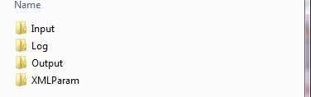
UKMOD files
Input data
Set structure
of folders
Output data
Country files
(=tax-benefit code)

Slide 49
UKMOD via the
User Interface (UI)
Original micro-data
(FRS for the UK)
Model: Tax-benefit policy code
(via the EUROMOD User Interface)
Input micro-data
(FRS or hypothetical households data)
Policy simulations
(EUROMOD software)
Output micro-data =
input micro-data + additional simulated variables
Tools for analysis: Statistics Presenter
(or statistical software e.g. Stata)

Slide 50
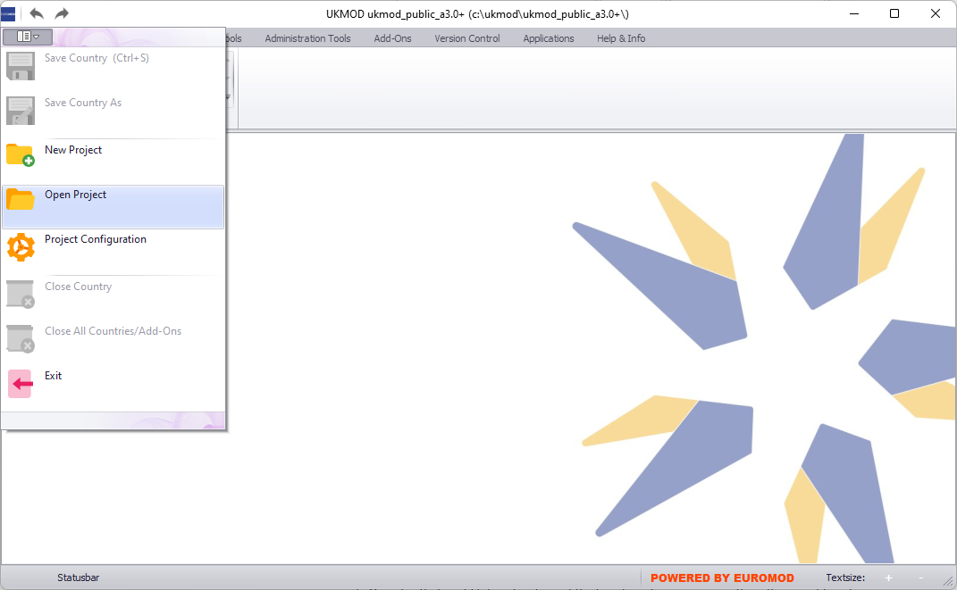
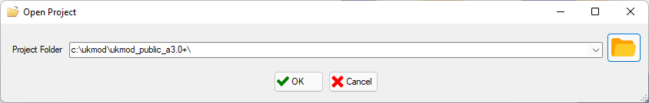
Linking the model to the UI (1)

Slide 51
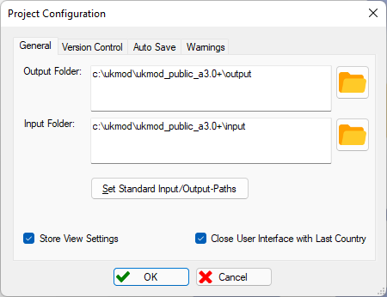
Linking the model to the UI (2)

Slide 52
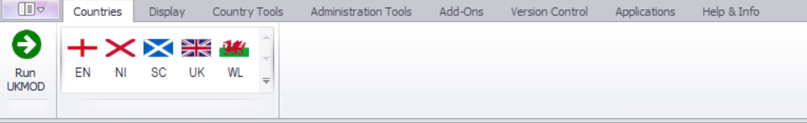
User Interface (UI)
Ribbon bar
Country models
Run button

Slide 53
Running UKMOD &
Producing output data
Original micro-data
(FRS for the UK)
Model: Tax-benefit policy code
(via the EUROMOD User Interface)
Input micro-data
(FRS or hypothetical households data)
Policy simulations
(EUROMOD software)
Output micro-data =
input micro-data + additional simulated variables
Tools for analysis: Statistics Presenter
(or statistical software e.g. Stata)

Slide 54
Running the model
54
Two ways of Running the model:
  by clicking on button Run UKMOD
  by clicking on a country flag and then clicking on the button Run UKMOD
We can run the model (simultaneously) for:
i) one country and
one or more systems
ii) several countries
(and systems)
iii) all countries and systems and for all data

Slide 55
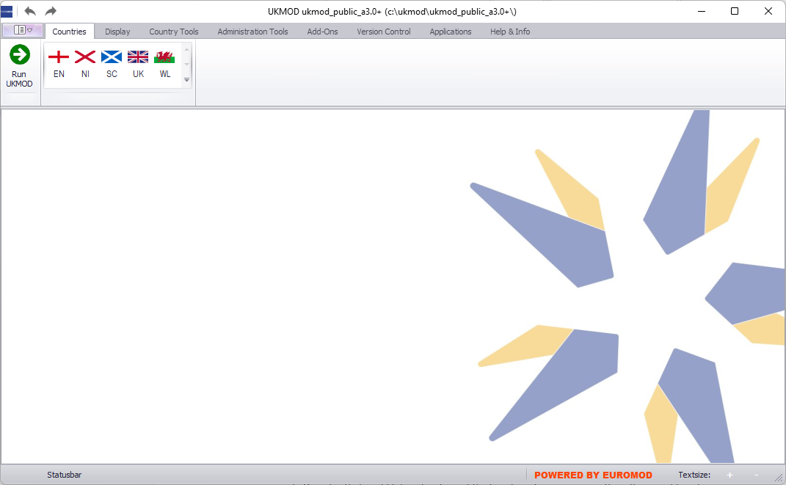
Running a single system (1)
Run button

Slide 56
Running a single system (2)
select countries by clicking on flags

Slide 57
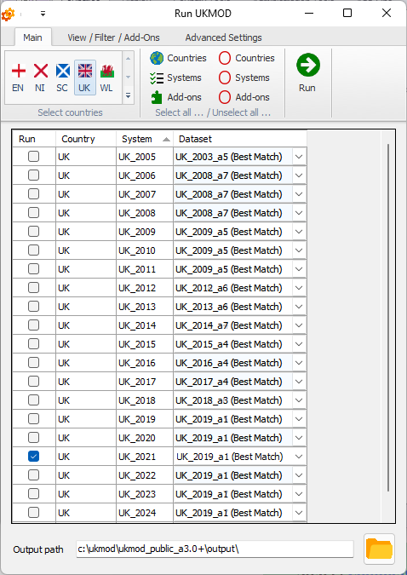
Running a single system (3)
57
select systems

Slide 58
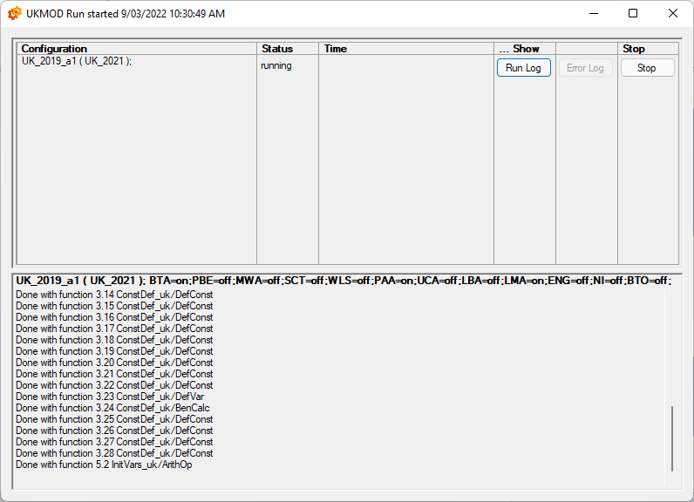
Running a single system (5)
58
data and systems running
some details about the calculations

Slide 59
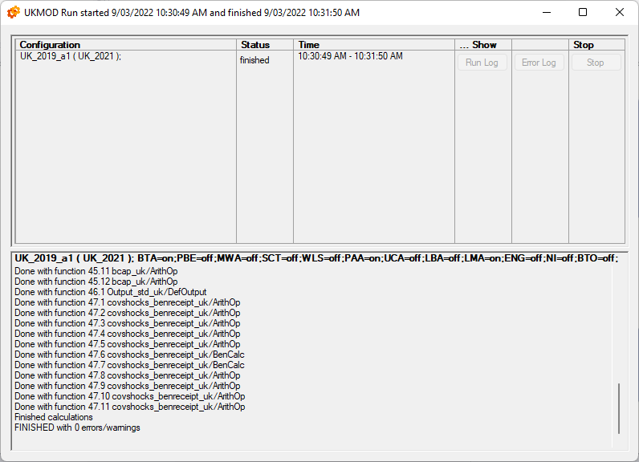
Running a single system (6)
59

Slide 60
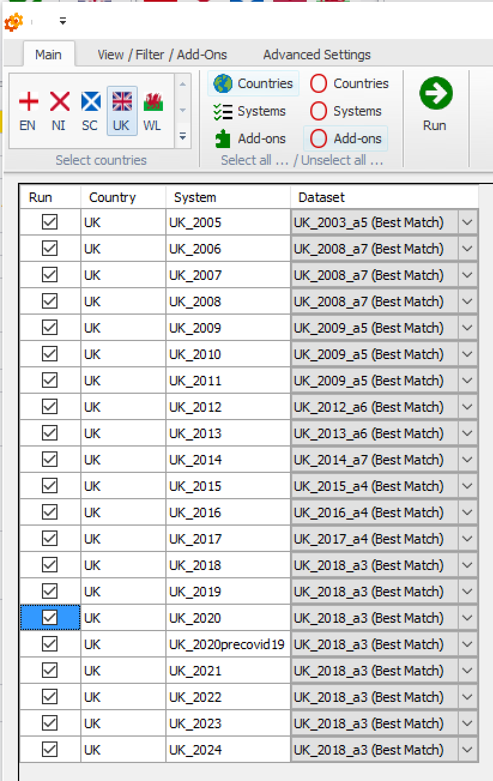
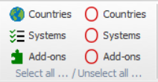
Running multiple systems (1)
60
select all countries/
all systems
unselect all countries/
all systems

Slide 61
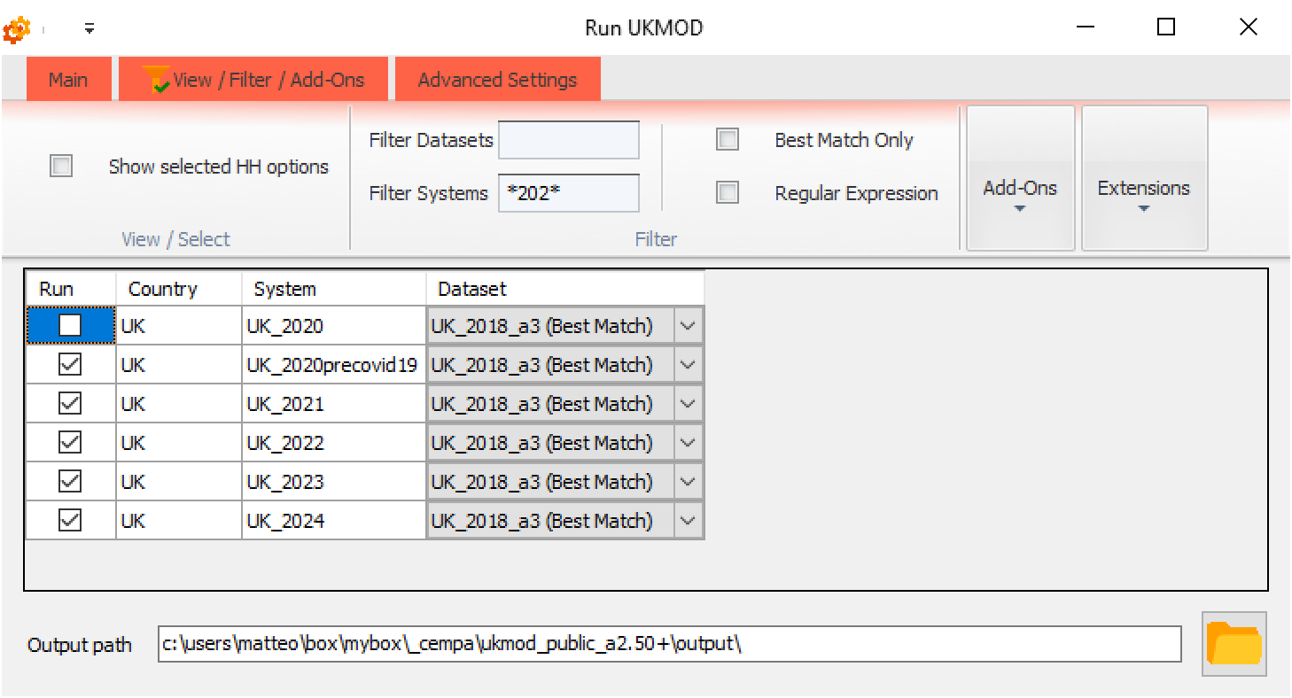
Running multiple systems (2)
61
red colour to remind us that filters are applied
filters

Slide 62

Statistics Presenter Tool
Original micro-data
(FRS for the UK)
Tax-benefit policy rules and parameters
(EUROMOD User Interface)
Input micro-data
(FRS or hypothetical households data)
Policy simulations
(EUROMOD software)
Output micro-data =
input micro-data + additional simulated variables
Tools for analysis: Statistics Presenter
(or statistical software e.g. Stata)

Slide 63
Statistics Presenter Tool (1)
The tool estimates:
  distributional measures of income (poverty rates, Gini, S80/20, income shares, decomposition of income sources, gainers and losers)
  fiscal costs (government revenues and expenditures)
Notes:
Euromod outputs are in effect microdata to be used with statistical software.
Use the Statistics presenter tool to create outputs to that purpose.

Slide 64
Statistics Presenter Tool (2)
The tool calculates income statistics for:
  a single country and policy system
  several countries/policy systems
  baseline and reform scenario and calculates difference in the income
  indicators
  a particular type of income (e.g. income taxes) if stronger focus on that income
Results can be exported in Excel tables
Notes:
Results can be exported in Excel and csv formats

Slide 65
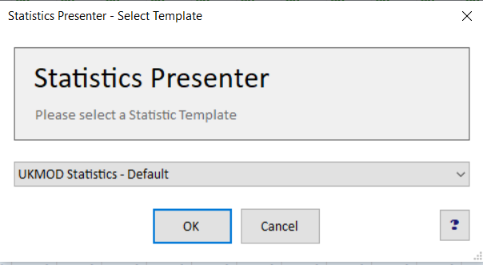
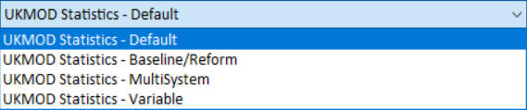
Statistics Presenter – Default (1)

Slide 66
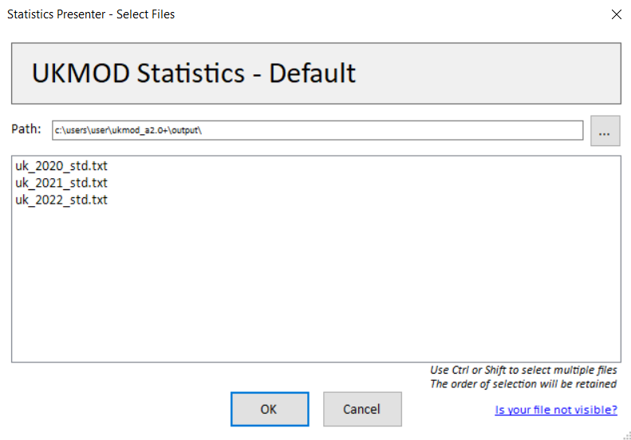
Statistics Presenter Tool – Default (2)
folder where output micro-data are stored
list of all output micro-data available in the output folder

Slide 67
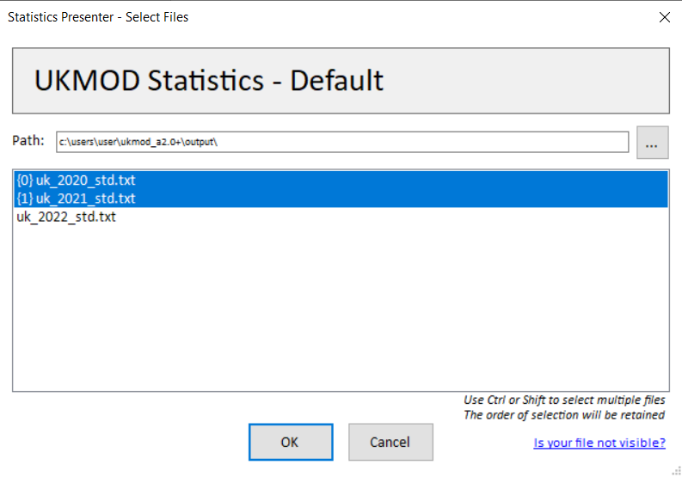
Statistics Presenter Tool – Default (3)
I have selected the 2020 output micro-data first and the 2021 data second

Slide 68
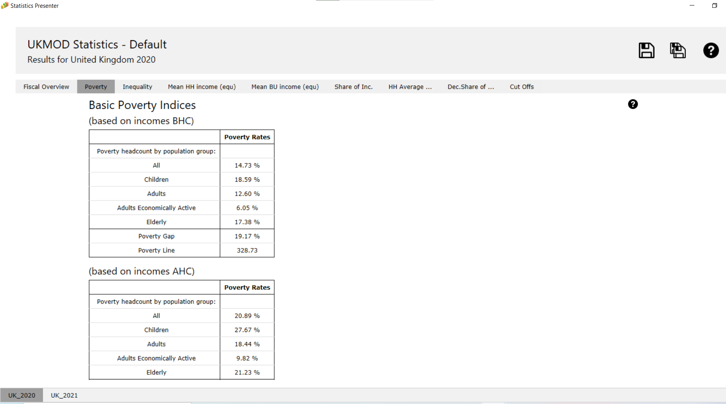
Statistics Presenter Tool – Default (4)
country and system for which results are produced
export results in excel
9 tables with results
table notes
one sheet per output micro-data file (2020 first, 2021 second)

Slide 69
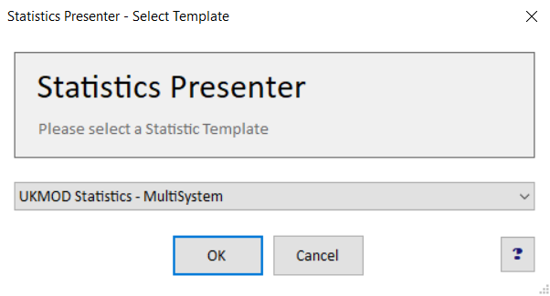
Statistics Presenter – MultiSystem (1)

Slide 70
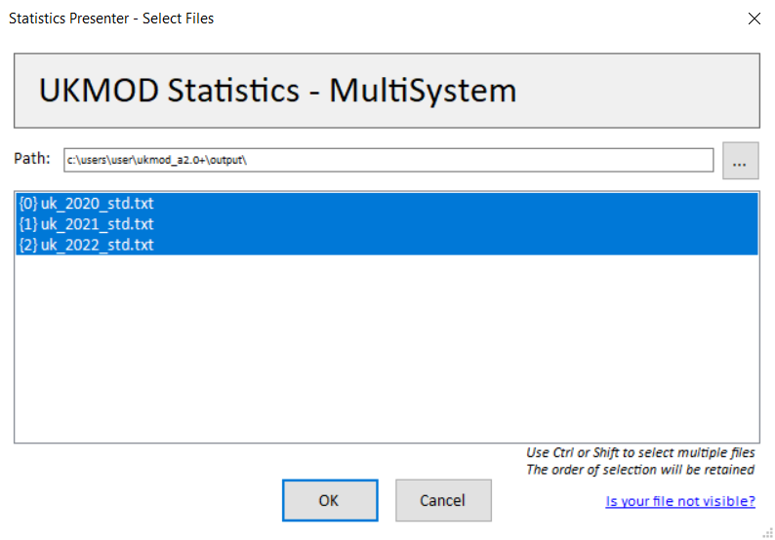
Statistics Presenter – MultiSystem (2)

Slide 71
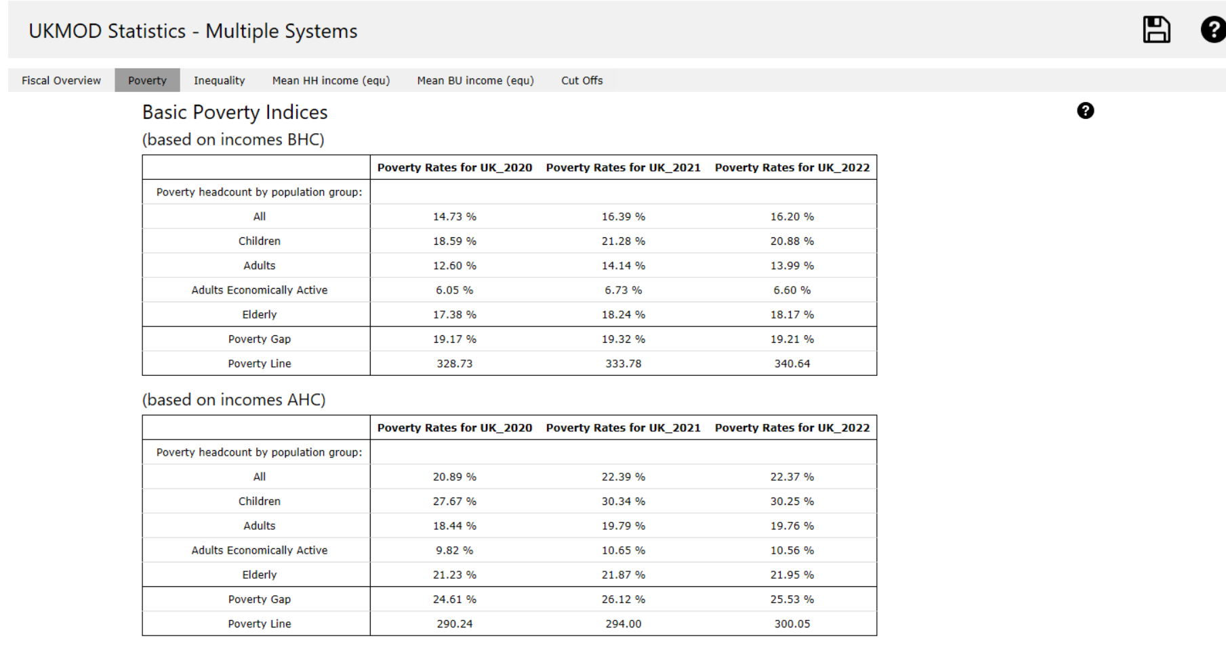
Statistics Presenter – MultiSystem (3)
one column per system

Slide 72

Summary: Exercise 1
You learned how to:
  Open the model
  Run a single system or several systems at the same time
  Analyse the output micro-data with the Statistics Presenter, using the:
    Default option
    MultiSystem option

Slide 73

Questions

Slide 74
UKMOD via the
User Interface (UI)
Original micro-data
(FRS for the UK)
Model: Tax-benefit policy code
(via the EUROMOD User Interface)
Input micro-data
(FRS or hypothetical households data)
Policy simulations
(EUROMOD software)
Output micro-data =
input micro-data + additional simulated variables
Tools for analysis: Statistics Presenter
(or statistical software e.g. Stata)

Slide 75
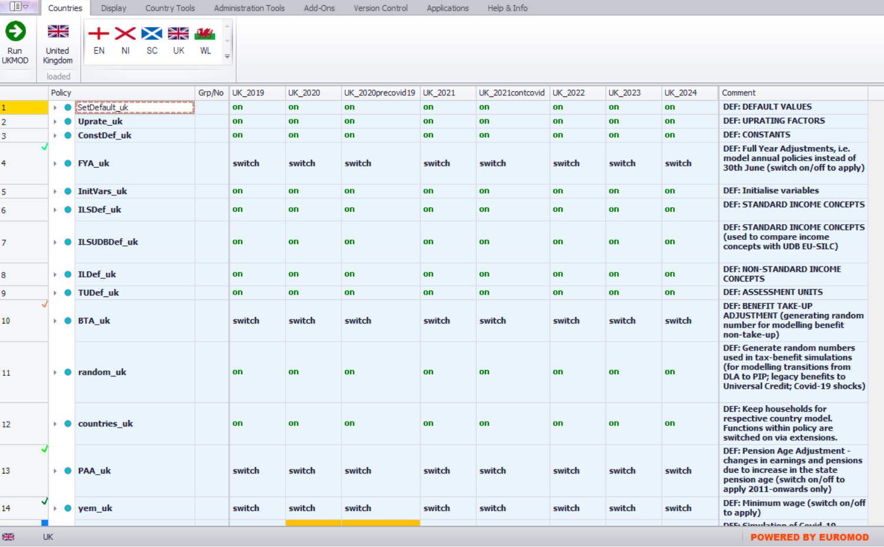
Working environment
policy systems
open country by clicking on a flag
comments
policies

Slide 76
In this lecture, you will learn about:
The building blocks of EUROMOD tax-benefit microsimulation language:
  Policies
  Functions
  Parameters

Slide 77
Policies
Policy
Function
Parameter
Parameter
Parameter
a block of functions completes a policy simulation
policy names end (usually) with the country acronym
  policies can have any name – but good to follow naming conventions
comments (in the comments column) explain what the policy intends to simulate
policies are run in the order they appear
  order of policies is called the ‘spine’
Notes:
Parameters stored in XML and manipulated via the UI
Calculation by the EUROMOD software

Slide 78
Structure of a policy
Policy column includes policy name, function and parameter names
    order of policies and functions reflects order of calculations
    groups (Grp/No) used to define conditional policy blocks
System columns include the values of the tax-benefit parameters by policy year
Comments column includes policy description

Slide 79
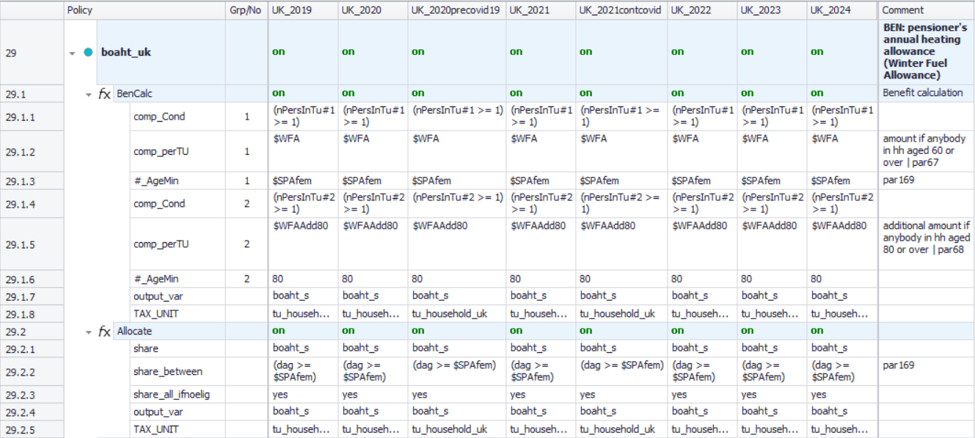
Example of a policy
policy column
group column
system columns
comments columns
Policy name
policy switch
function switch
function#1 and its parameters
function#2 and its parameters

Slide 80
Example of a policy
Function name
switch: on / off / n/a
parameter names
parameter values for each system

Slide 81
Example of a policy
Grp 1
Grp 2

Slide 82
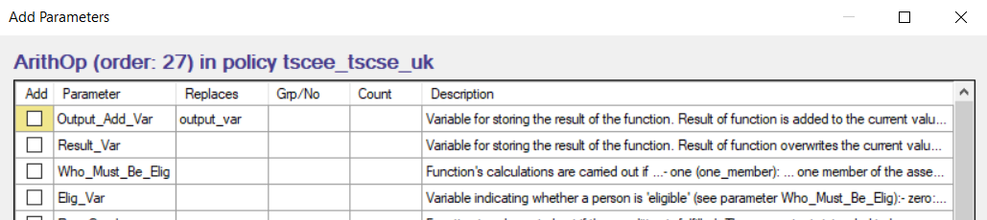
Parameters
Policy
Function
Parameter
Parameter
Parameter
Can be:
    common to several functions or specific to one function
    compulsory (i.e. error generated if not used) or optional
    which parameters are compulsory/optional depend on the function
Order of parameters in a function is not important
    but order of functions in a policy is!
Manipulated via context menu (right-click)
    only relevant parameters for the given function are shown
Drag & drop can be used

Slide 83
Exercise 2
You will learn to:
  Implement a reform, based on UK 2021 system
  Make a copy of UK 2021 system and call it e.g. UK_2021reform
  Modify UK_2021reform
    increase child benefit amount for the first child ($CBFirst) from £21.15 to £25 per week
  Run reform system and analyse impact on household incomes of the reform using the Statistics Presenter
We will do the exercise together!
  Each step is described in the following slides if you wanted to go back to them later

Slide 84
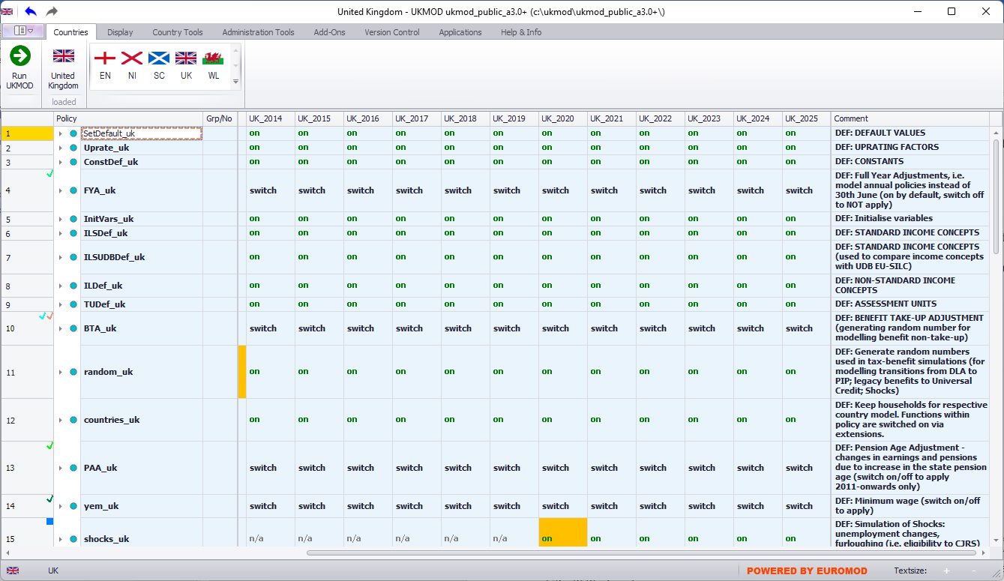
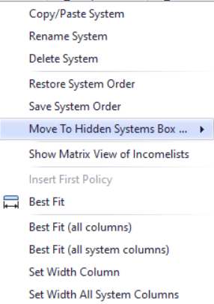
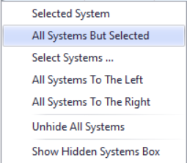
Hiding systems
right-click on system name

Slide 85
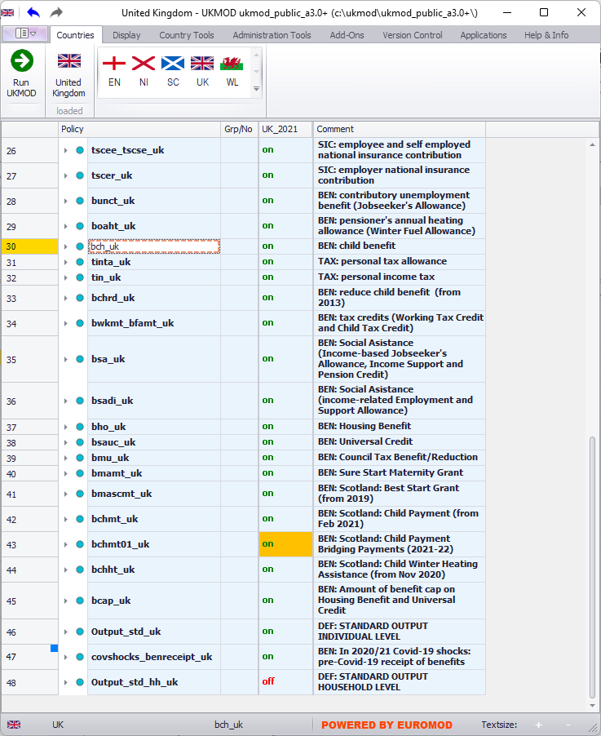
Expanding a policy (1)
click on triangle on the left of the policy name

Slide 86
Expanding a policy (2)
right-click on policy name to active context menu
context menu: select option “Expand All Functions”

Slide 87
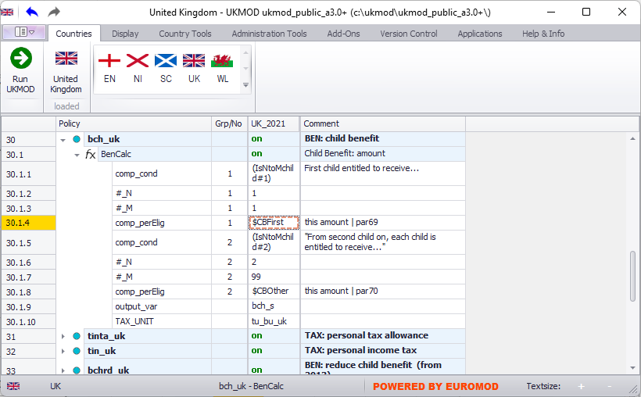
Implementing a reform (1)
The benefit amount for the first child is £21.15 per week

Slide 88
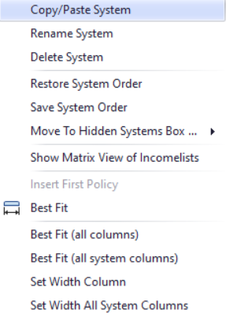
Implementing a reform (2)
right-click on system name

Slide 89
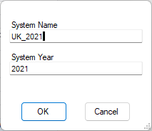
Implementing a reform (3)
type in a reform system name

Slide 90
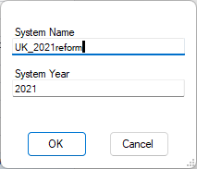
Implementing a reform (3)

Slide 91
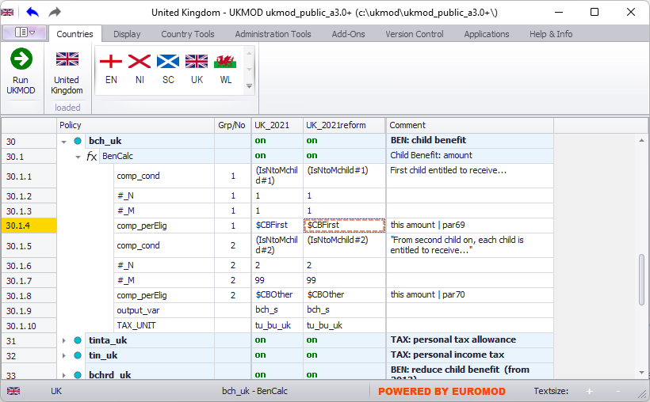
Implementing a reform (5)
reform is identical to the baseline

Slide 92
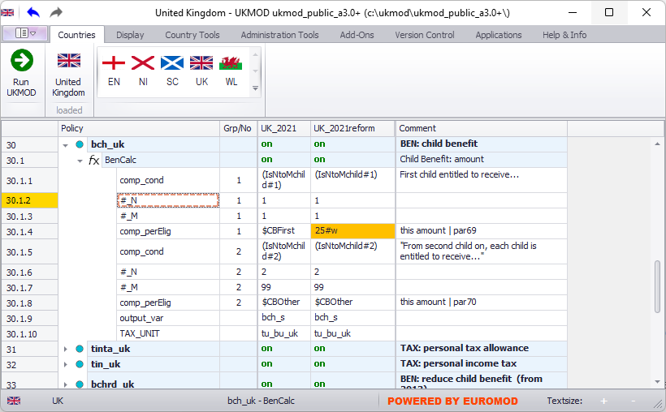
Implementing a reform (5)
new amount; difference compared to baseline is highlighted (“conditional formatting” option)

Slide 93
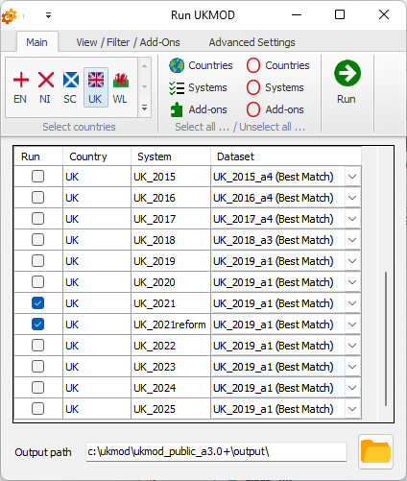
Producing output micro-data (1)
produce output for both the baseline and reform

Slide 94
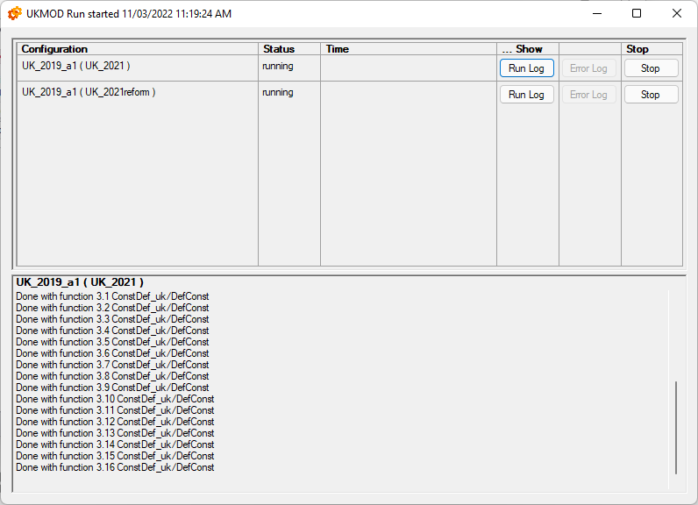
Producing output micro-data (2)
produce output for both the baseline and reform

Slide 95
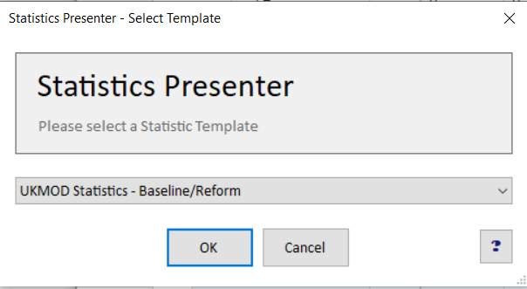
Statistics Presenter: Baseline/Reform (1)

Slide 96
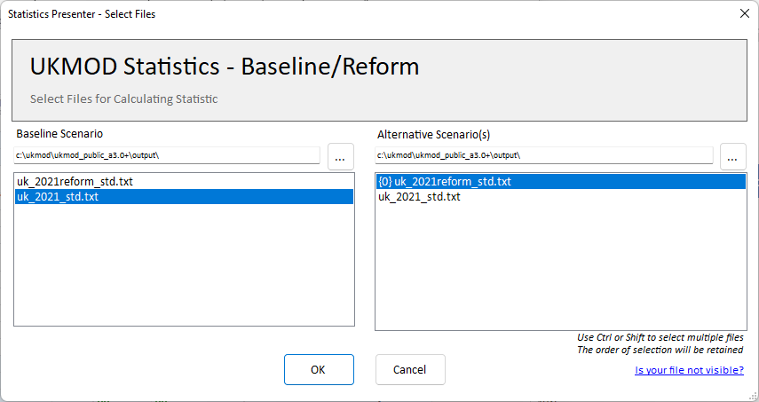
Implementing a reform (9)

Slide 97
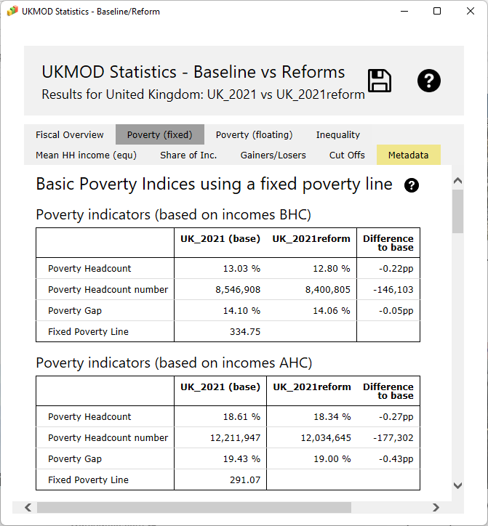
Statistics Presenter: Baseline
/Reform (2)

Slide 98
Summary: Exercise 2
You learned:
  how to add a reform system
  about basic options such as (un)hiding systems, expanding a policy and conditional formatting
  how to analyse the baseline and reform output micro-data with the Statistics Presenter, using:
    Baseline/Reform option

Slide 99
Questions

Slide 100
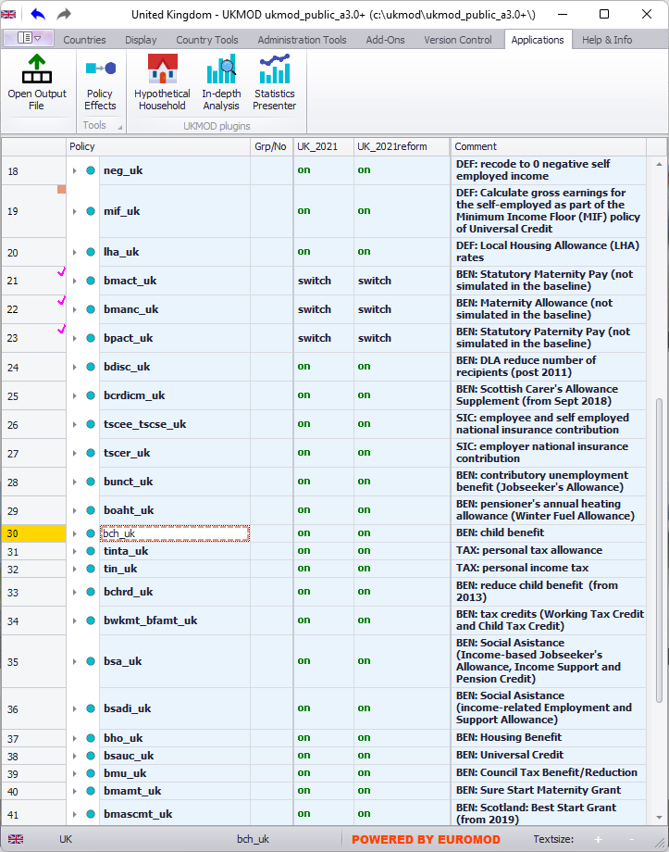
UKMOD: The policy Spine

Slide 101
In this lecture, you will learn about:
The policy spine:
  The order of policies is called the ‘spine’
  We will take a quick tour through the policies in the UK model
    the models for England, Northern Ireland, Scotland and Wales have the same policy spine
  See the UKMOD Country Report for more details

Slide 102
Policies in the spine
DEFINITIONS
define certain parameters or concepts; or do some pre-policy calculations
e.g. define assessment units; index (uprate) earnings if input micro-data year lags behind policy year
TAX AND BENEFIT CALCULATIONS
(almost) every tax and benefit implemented in a separate policy; policy name according to our naming convention
e.g. bch_uk (Child Benefit → b: benefit, ch: child)
OUTPUT
defines what variables to be included in the output micro-data and assessment unit for the results
e.g. include both simulated and non-simulated variables; output individual-level results

Slide 103
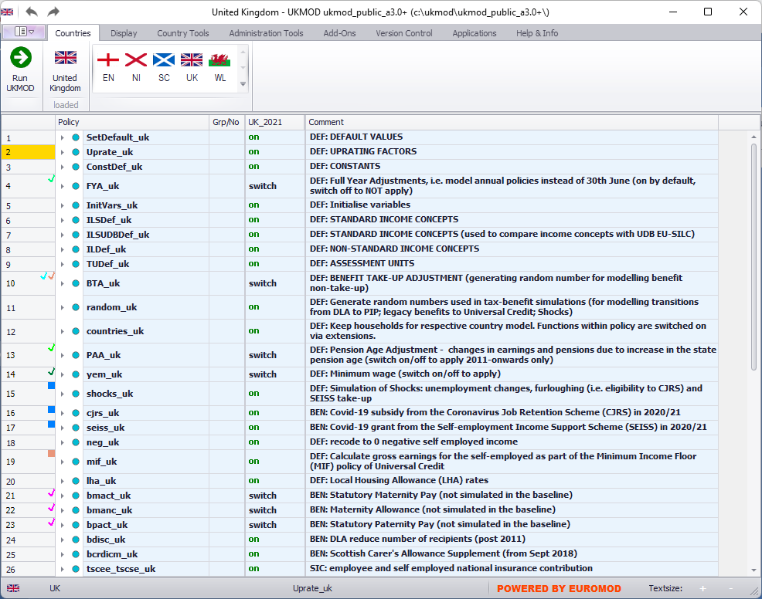
Definitions

Slide 104
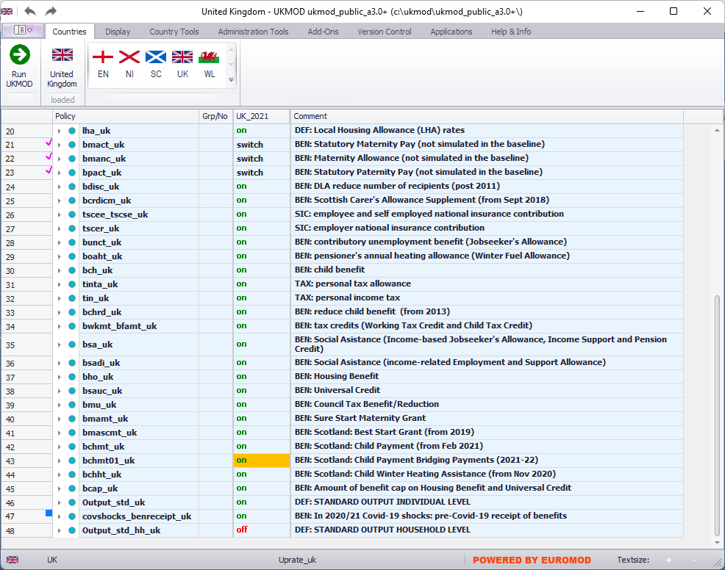
Tax and benefit calculations

Slide 105
Tax and benefit calculations
National Insurance contributions for employees and self-employed implemented in a single policy due to interactions
Working and Child Tax Credit implemented in a single policy due to interactions

Slide 106
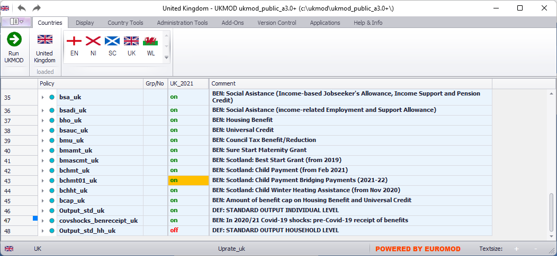
Output

Slide 107
UKMOD: THE POLICY functions elig & arithOp
Policy |  | System Name | Comment
Elig |  | on | Made-up example: condition to pay employee NI contributions
 | elig_cond | yem>0 & !IsCivilServant | with positive earnings (yem) and not a civil servant (!IsCivilServant)
 | TAX_UNIT | tu_individual_uk | assessment unit used for the calculations
ArithOp |  | on | Made-up example: pension contributions
 | Who_Must_Be_Elig | one | calculations carried out if at least one member of assessment unit fulfills condition from last Elig function
 | formula | yem*0.08 | 8% for Old-age Pension Fund
 | output_var | tsceepi_s | result saved in the variable tsceepi_s (t: tax, sc: social contributions, ee: employee, pi: pension insurance, _s: simulated)
 | TAX_UNIT | tu_individual_uk | assessment unit used for the calculations

Slide 108
Calculating a benefit/tax
What are the policy rules:
  Who is entitled to the benefit/liable to the tax, i.e. the assessment unit:
    e.g. the individual, family or household
  What is the criteria, i.e. the eligibility condition
    e.g. with earnings up to £800 per month and receives no pensions
  What is the benefit/tax amount:
    e.g. £20 per week or 20% of taxable income
Write down the policy rule
  Using EUROMOD tax-benefit language

Slide 109
In this lecture, you will learn about:
Assessment units
  basic idea
Eligibility condition
  using the Elig function
Benefit/tax amount:
  using the ArithOp function
Parameter types:
  amounts, formulas, queries

Slide 110
Assessment units
Main assessment units (TAX_UNIT) defined in UKMOD:
tu_household_xx: all individuals of the household are in the same unit.
tu_individual_xx: each individual of the household forms its own unit.
tu_bu_xx: the benefit unit, i.e. the nuclear family - the couple (cohabiting or married) or single adult plus any dependent children
  The household may be split into several units of different size.

Slide 111
Functions: ArithOp
Arithmetic Operator
Compulsory parameters: formula, output_var, TAX_UNIT
  The parameter formula contains some calculations
  The result is stored as output variable via parameter output_var
    To add the answer to the result of a previous function, use output_add_var
Now let’s have a look at some key parameter values we can use for formula
  amounts, formulas, queries
Policy |  | System Name | Comment
ArithOp |  | on | Made-up example: child benefit
 | formula | 25#w*nDepChildrenInTu | £25 per week for each dependent child in the assessment unit
 | output_var | bch_s | result saved in the variable bch_s (b: benefit, ch: child, _s: simulated)
 | TAX_UNIT | tu_bu_uk | assessment unit used for the calculations

Slide 112
Parameters: Amounts
Monetary (numbers; use . for decimal) followed by their time period:
  #m for monthly (no conversion)
  #y for yearly
  #q for quarterly
  #w for weekly
  #d for daily
  #l for labour day
  #s for six day labour week
  #c for capital (no conversion)
Default is #m (monthly)
Policy |  | System Name | Comment
ArithOp |  | on | Made-up example: child benefit
 | formula | 25#w*nDepChildrenInTu | £25 per week for each dependent child in the assessment unit
 | output_var | bch_s | result saved in the variable bch_s (b: benefit, ch: child, _s: simulated)
 | TAX_UNIT | tu_bu_uk | assessment unit used for the calculations

Slide 113
Parameters: Formula
Operations: *, /, +, -, ^, min(), max(), abs(), (), !(), %
Policy |  | System Name | Comment
ArithOp |  | on | Made-up example: child benefit
 | formula | (25#w + xed/2)*nDepChildrenInTu - bed_s | £25 per week plus half of educational expenses (xed), for each dependent child in the assessment unit; and deduct any education benefits (bed_s)
 | output_var | bch_s | result saved in the variable bch_s (b: benefit, ch: child, _s: simulated)
 | TAX_UNIT | tu_bu_uk | assessment unit used for the calculations

Slide 114
Parameters: Queries (1)
Frequently used ready-made calculations
The result of a query is:
  yes (=1) or no (=0) (e.g. IsDepChild)
  some (monetary or non-monetary) value (e.g. nDepChildrenInTu).
Well-documented in the Help file of the User Interface
Query | Description | Parameters
IsDepChild | Returns 1 if a person is a 'dependent child', i.e. fulfils the DepChildCond of the assessment unit specification, 0 otherwise.
nDepChildrenInTu#x | Returns the number of dependent children in the assessment unit who fulfil dag >= parameter #_AgeMin and dag <= parameter #_AgeMax. | #_AgeMin, #_AgeMax (optional)

Slide 115
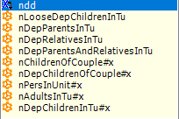
Parameters: Queries (2)
No need to learn the query names by heart
→ use “IntelliSense” feature to find and select the desired query
ArithOp |  | on | Made-up example: child benefit
 | formula | 25#w*n | £25 per week for each dependent child in the assessment unit
 | output_var | bch_s | result saved in the variable bch_s (b: benefit, ch: child, _s: simulated)
 | TAX_UNIT | tu_bu_uk | assessment unit used for the calculations

Slide 116
Functions: ArithOp (1)
ArithOp |  | on | Made-up example: pension contributions
 | formula | yem*0.08 | 8% of earnings (yem) for Old-age Pension Fund
 | output_var | tsceepi_s | result saved in the variable tsceepi_s (t: tax, sc: social contributions, ee: employee, pi: pension insurance, _s: simulated)
 | TAX_UNIT | tu_individual_uk | assessment unit used for the calculations
calculations in ArithOp are carried out for everyone with earnings, including civil servants

Slide 117
Functions: Elig (1)
Used to implement conditions
Compulsory parameters: elig_cond, TAX_UNIT
  Condition is defined in parameter elig_cond
    Creates a variable equal to 0 or 1 (by default sel_s)
    Subsequent functions use this information via parameter Who_Must_Be_Elig

Slide 118
Functions: Elig (2)
Policy |  | System Name | Comment
Elig |  | on | Made-up example: condition to pay employee NI contributions
 | elig_cond | !IsCivilServant | not a civil servant (!IsCivilServant)
 | TAX_UNIT | tu_individual_uk | assessment unit used for the calculations
limiting calculations to non-civil servants

Slide 119
Functions: ArithOp (2)
Policy |  | System Name | Comment
Elig |  | on | Made-up example: condition to pay employee NI contributions
 | elig_cond | !IsCivilServant | not a civil servant (!IsCivilServant)
 | TAX_UNIT | tu_individual_uk | assessment unit used for the calculations
ArithOp |  | on | Made-up example: pension contributions
 | Who_Must_Be_Elig | one | calculations carried out if at least one member of assessment unit fulfills condition from last Elig function
 | formula | yem*0.08 | 8% of earnings (yem) for Old-age Pension Fund
 | output_var | tsceepi_s | result saved in the variable tsceepi_s (t: tax, sc: social contributions, ee: employee, pi: pension insurance, _s: simulated)
 | TAX_UNIT | tu_individual_uk | assessment unit used for the calculations
ArithOp |  | on | Made-up example: unemployment contributions
 | Who_Must_Be_Elig | one | calculations carried out if at least one member of assessment unit fulfills condition from last Elig function
 | formula | yem*0.02 | 2% of earnings for Unemployment Fund
 | output_var | tsceeui_s | result saved in the variable tsceeui_s (t: tax, sc: social contributions, ee: employee, ui: unemployment insurance, _s: simulated)
 | TAX_UNIT | tu_individual_uk | assessment unit used for the calculations

Slide 120
Functions: ArithOp (3)
Parameters: Eligibility
Who_Must_Be_Elig: calculations of the function are carried out if…
  one: one member of the assessment unit is eligible
  one_adult: one adult member of the assessment unit is eligible
  all: all members of the assessment unit are eligible
  all_adults: all adult members of the assessment unit are eligible
  nobody: calculations are carried out for each assessment unit (default)
By default eligibility result is saved in the variable sel_s
(can use other variable in parameter elig_var)
  0: person is not eligible
  1: person is eligible

Slide 121
Functions: ArithOp (4)
Parameters: Eligibility
 |  |  |  | Will the calculations in ArithOp be carried out if: who_must_be_elig=
idhh | idperson | dag | sel_s | one | one_adult | all | all_adults | nobody
1 | 11 | 80 | ? | ? | ? | ? | ? | ?
1 | 12 | 60 | ?
1 | 13 | 40 | ?
2 | 21 | 80 | ? | ? | ? | ? | ? | ?
2 | 22 | 6 | ?
3 | 31 | 80 | ? | ? | ? | ? | ? | ?
4 | 41 | 40 | ? | ? | ? | ? | ? | ?
4 | 42 | 40 | ?
Which units will be eligible when who_must_be_elig set to nobody?
Only 1 and 2
Only 4
Only 3
1, 2, 3 and 4
Policy |  | System Name | Comment
Elig |  | on | Made-up example: eligibility condition for social assistance
 | elig_cond | dag>=80 | individual should be of age (dag) of 80+ years
 | TAX_UNIT | tu_individual_uk | assessment unit is the INDIVIDUAL
ArithOp |  | on | Made-up example: social assistance amount
 | Who_Must_Be_Elig | ? | who in the assessment unit must fulfil eligibility condition
 | formula | 100#m | benefit amount is £100
 | output_var | bsa_s | result saved in the variable bsa_s (b: benefit, sa: social assistance, _s: simulated)
 | TAX_UNIT | tu_household_uk | assessment unit is the HOUSEHOLD
1
0
0
yes
yes
no
no
yes
1
0
yes
yes
no
yes
yes
1
yes
yes
yes
yes
yes
0
0
no
no
no
no
yes

Slide 122
Parameters: Output
(output_var; output_add_var)
    Elig: if not specified, result is stored in sel_s
    ArithOp: Either output_var or output_add_var must be indicated
Policy |  | System Name | Comment
ArithOp |  | on | Made-up example: child benefit
 | formula | 25#w*nDepChildrenInTu | £25 per week for each dependent child in the assessment unit
 | output_var | bch_s | result saved in the variable bch_s (b: benefit, ch: child, _s: simulated)
 | TAX_UNIT | tu_bu_uk
Elig |  | on | Made-up example: eligibility condition
 | elig_cond | IsLoneParentOfDepChild | if a lone parent of a dependent child
 | TAX_UNIT | tu_bu_uk
ArithOp |  | on | Made-up example: child benefit supplement for lone parents
 | Who_Must_Be_Elig | one
 | formula | 15#w | £15 per week for the assessment unit
 | output_add_var | bch_s | add answer to the result of the previous function, saved in the variable bch_s
 | TAX_UNIT | tu_bu_uk

Slide 123
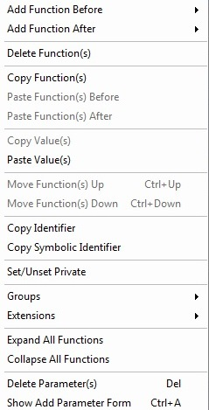
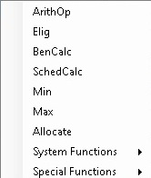
User Interface: Adding a function
Policy |  | System Name | Comment
Elig |  | on | Made-up example: eligibility condition
 | elig_cond | IsLoneParentOfDepChild | if a lone parent of a dependent child
 | TAX_UNIT | tu_bu_uk
find existing function, after/before which to place new function, and right-click on function or parameter name to open “menu”

Slide 124
User Interface: Adding a parameter (1)
Policy |  | System Name | Comment
Elig |  | on | Made-up example: eligibility condition
 | elig_cond | IsLoneParentOfDepChild | if a lone parent of a dependent child
 | TAX_UNIT | tu_bu_uk
ArithOp |  | on | Made-up example: child benefit supplement for lone parents
 | formula | 15#w | £15 per week for the assessment unit
 | output_add_var | bch_s | add answer to the result of the previous function, saved in the variable bch_s
 | TAX_UNIT | tu_bu_uk
find relevant function and right-click on function or parameter name to open “menu”

Slide 125
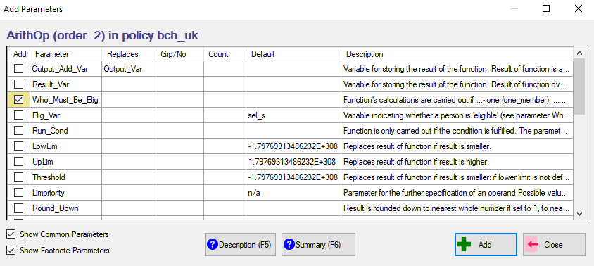

User Interface: Adding a parameter (2)
function parameters refer to

Slide 126

End of Day 1

