Slide 1
UKMOD training course –set up meeting
Daria Popova, Matteo Richiardi & Justin van de Ven
ISER, University of Essex
April 2022
Course based on UKMOD_A3.23+

Slide 2
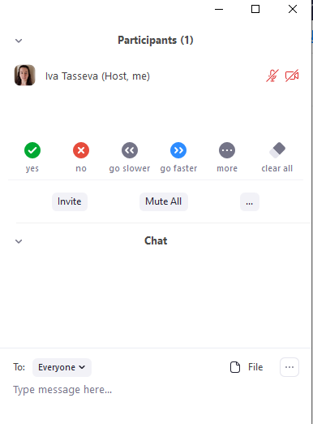
The Zoom meeting
Justin van de Ven will be the host for this session
Feel free to unmute yourself and ask a question; or type in a question in the chat
meeting controls

Slide 3
Outline
Download materials and install on your computer
EUROMOD software 3.4.10
UKMOD files version A3.23+
UKMOD data: UK_2019_a1
Online directions for model set-up can also be found at: https://www.microsimulation.ac.uk/ukmod/access/

Slide 4
Step 1: installing the euromod software (3.4.10)

Slide 5
EUROMOD installer file
Download the installer file from:
https://www.microsimulation.ac.uk/euromod/access/
In most cases, you should download the 64 bit installer. If you are in doubt, check settings>system>about>system type
Unzip the installer file, and run it
If you see a warning that “Windows protected your PC”, click on “More info”, and select “Run anyway”

Slide 6
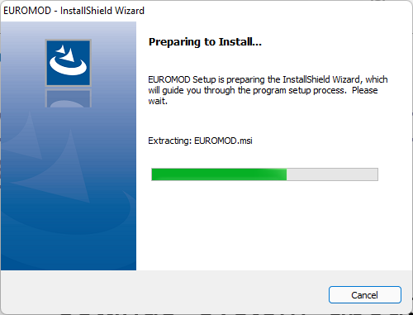
Installing the software

Slide 7
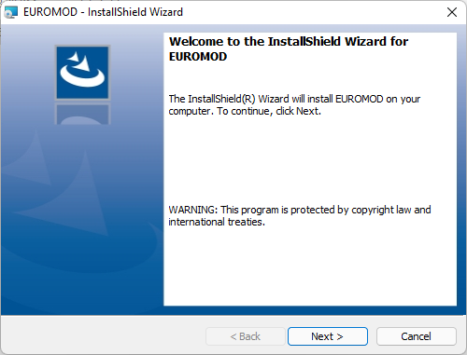
Installing the software (2)

Slide 8
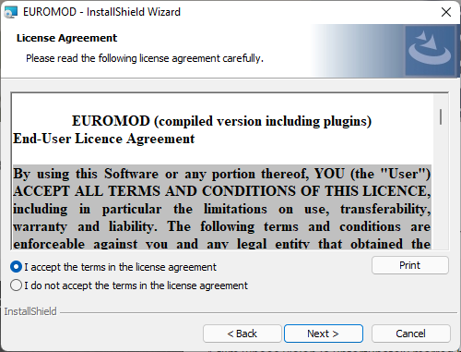
Installing the software (3)

Slide 9
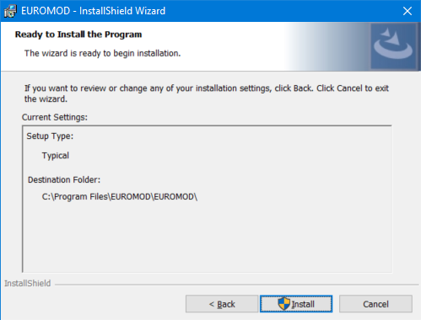
Installing the software (4)
You will need to have administrative rights to this computer!

Slide 10
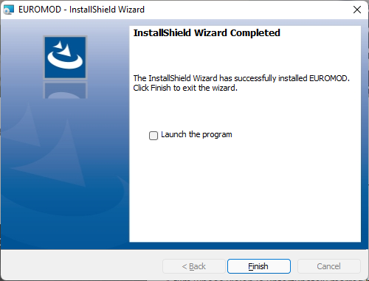
Installing the software (5)

Slide 11
Step 2: setting up UKMOD (a3.23+)

Slide 12
Download UKMOD from Redmine
https://iserredex.essex.ac.uk/euromod-redmine/projects/ukmod_a3-0-_installation_files
Log in with your Redmine Password
email received from Iser-ukmod@essex.ac.uk
Click on Files and download

Slide 13
Extract the zip folder
The UKMOD_PUBLIC_A3.23+.zip folder should be saved in your downloads folder
Extract the files to a folder you can easily access. Here I am extracting them to c:\UKMOD
A3.23+ is the version number of the latest release. Future versions might have a different number e.g. A3.57+

Slide 14
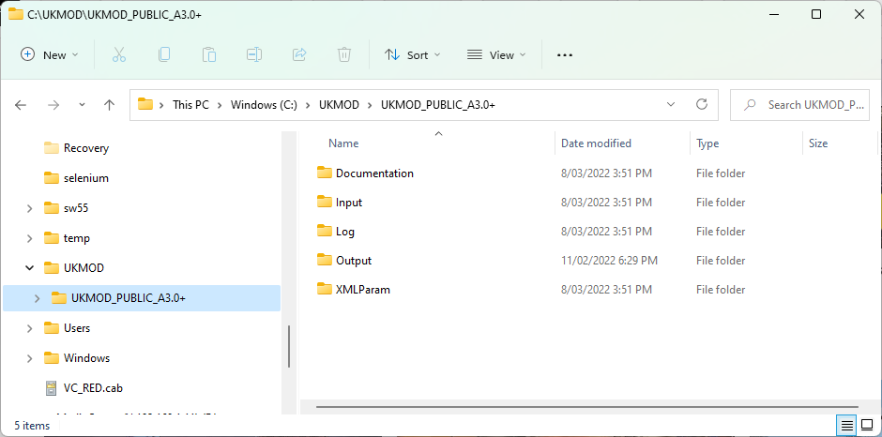
UKMOD Folders

Slide 15
UKMOD Folders
Documentation files (Country Report, help file, etc.)

Slide 16
UKMOD Folders
UKMOD input data to be stored here

Slide 17
UKMOD Folders
Log file (lists model changes)

Slide 18
UKMOD Folders
Simulation output will be saved here

Slide 19
UKMOD Folders
Tax-benefit code by country (in xml format)

Slide 20
Linking EUROMOD with UKMOD
Open EUROMOD
Add path to UKMOD
the path to the model

Slide 21
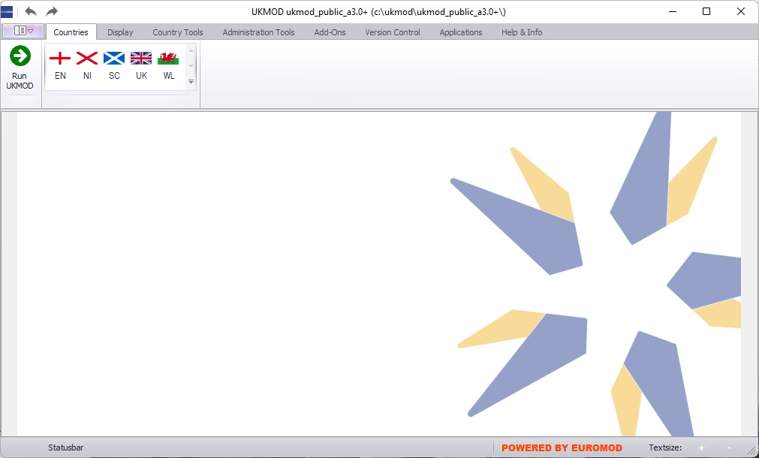
EUROMOD and UKMOD are linked!

Slide 22
Step 3: downloading UKMOD data (2019_a1)

Slide 23
Download UKMOD from Redmine
https://iserredex.essex.ac.uk/euromod-redmine/projects/uk_2019_latest_release/files
Download UK_2019_a1.zip

Slide 24
Extract the zip folder
The UK_2019_a1.zip folder should be saved in your downloads folder
Extract the files to the Input folder of your UKMOD installation: e.g. c:\UKMOD\UKMOD_PUBLIC_A3.23+\Input

Slide 25
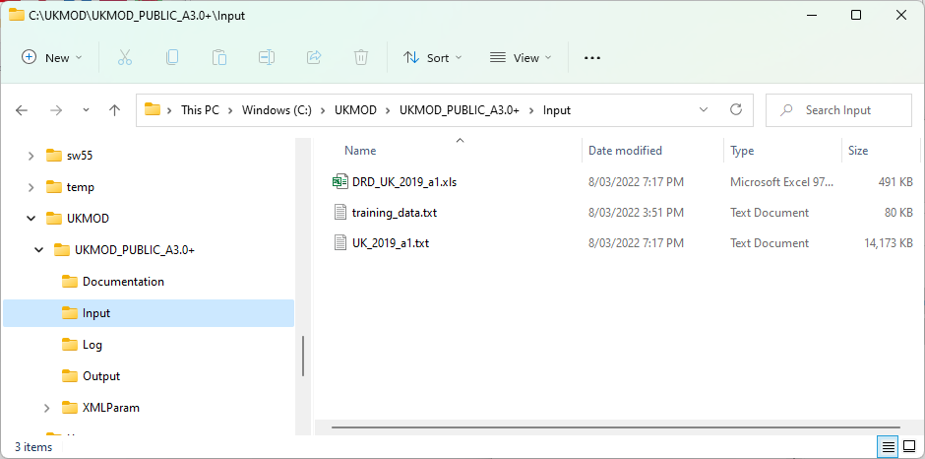
UKMOD data
Documentation (Data Requirement Document)

Slide 26
UKMOD data
Synthetic data useful for testing purposes

Slide 27
UKMOD data
The UKMOD input data file

Slide 28
Questions

