Slide 1
UKMOD Basic Income training course
Jerome De Henau, Sue Himmelweit & Sara Reis
Women’s Budget Group
ISER, University of Essex
April 2021
Course based on UKMOD_A2.0+_BI_2021

Slide 2
Welcome!
Session 1 - Interaction of BI with the tax-ben systems
Introducing a Basic Income policy
Making decisions around means-tested benefits and (income) tax reform in BI schemes
Exercise
Session 2 – Pensioners and Children
Pensioners, state pension and BI
A BI for children
Exercise
Session 3 – Fiscal neutrality (loops)
Introduce the loop function in UKMOD
How loops work to achieve fiscal neutrality
Exercise
Final questions

Slide 3
1. Introducing Basic Income: Interaction with the tax-ben system

Slide 4
In this lecture, you will:
Understand how a Basic Income policy interacts with the tax and benefit systems in UKMOD
Perform a policy reform that involves changing one element of that interaction: making BI non-taxable

Slide 5
UKMOD in this course
EUROMOD Software version: 3.3.2
Model (tax-benefit code):
Version A2.0+_BI_2021
Models for the UK, England, NI, Scotland and Wales
policy years (systems) for 2018-2024
Includes 3 BI-specific systems (BI, BI_Biloop, BI_taxloop)
Input micro-data
Family Resources Survey (UK) – the latest for 2018/2019 (UK_2018_a3)

Slide 6
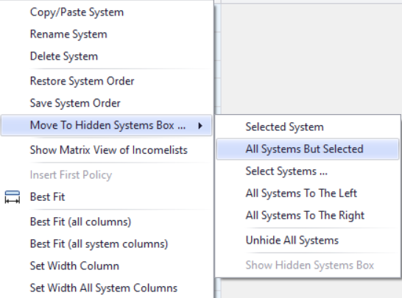
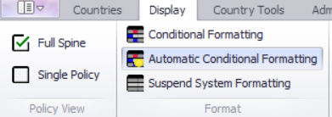
Before we start
Hide all systems but BI and 2020_precovid19
Switch on Conditional Formatting to see changes

Slide 7
BASIC INCOME IN THE POLICY SPINE

Slide 8
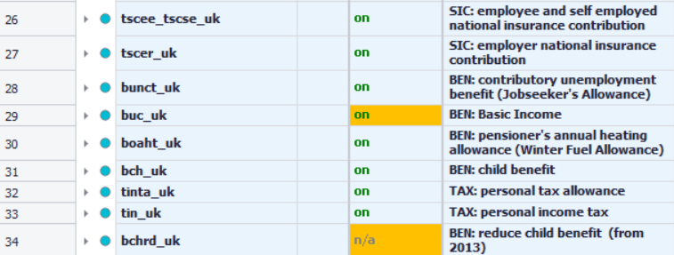
Basic Income policy
BI policy defined in line 29
After contr. & non-sim benefits
Before tax
Before other ben
Notes:
After contrib. and non-sim. benefits (no effect on them)
Before other benefits (may have an impact on eligibility and level paid)
Before personal income tax (line 32) as BI may have impact on taxable income and we may want to make tax rates vary according to the level of BI

Slide 9
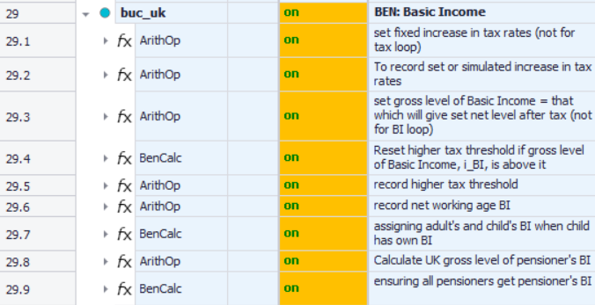
Basic Income policy
BI policy expanded

Slide 10
Basic Income policy
BI policy expanded
BI for children and adults
BI for pensioners

Slide 11
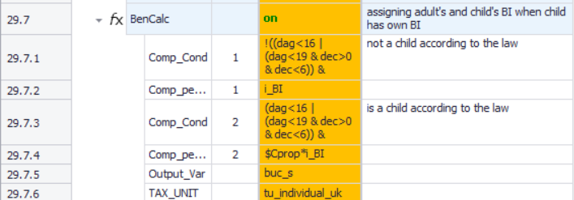
Basic Income policy
Allocate BI to adults and children:
Allocate BI to pensioners:
Notes:
Will see in more detail in Session 2

Slide 12
Basic Income policy
If BI is taxable, gross and net calculations:

Slide 13
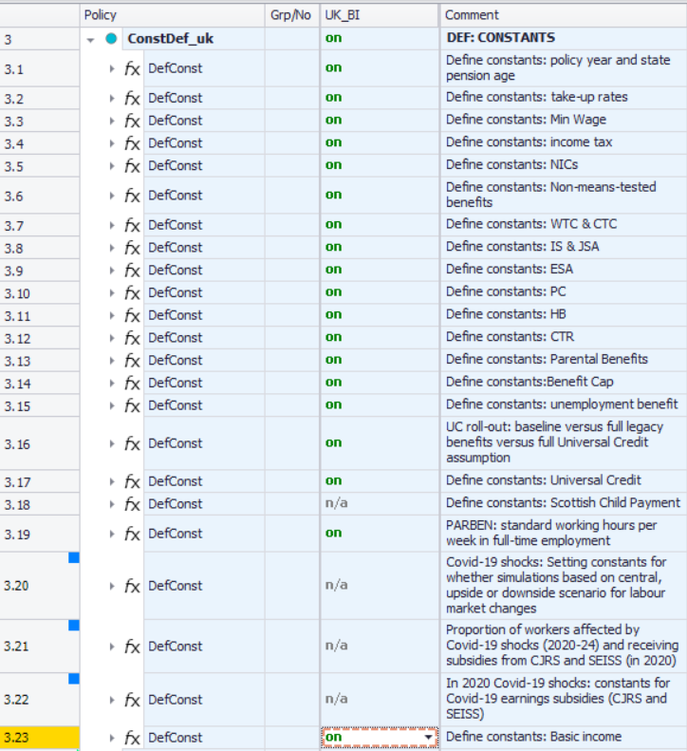
Constants for Basic Income
BI constants defined in 3.23

Slide 14
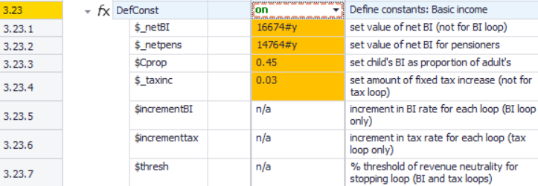
Constants for Basic Income
BI constants defined in 3.23
(Net) amounts for adult and pensioners BI (based on MIS values)

Slide 15
Constants for Basic Income
BI constants defined in 3.23
Tax rates increase 3 ppts:

Slide 16
Constants for Basic Income
BI constants defined in 3.23
Other constants related to loops:

Slide 17
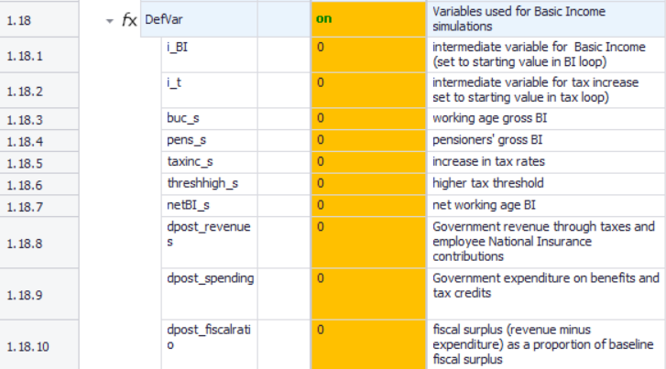
Variables for Basic Income
Variables for BI set in 1.18:
Intermediate calcs for loop

Slide 18
Variables for Basic Income
Variables for BI set in 1.18:
Variables to simulate (all set to 0 here)

Slide 19
Changes to existing tax-ben system

Slide 20
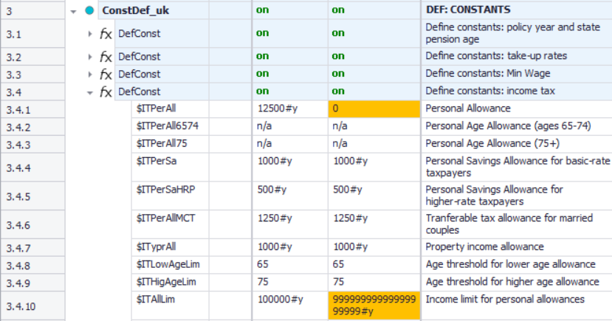
Changes to tax-ben system
Suggestions for what can be done:
PTA – remove it or change
Set to 0 to remove
Imposs. high limit

Slide 21
Changes to tax-ben system
Suggestions for what can be done:
NICs – can alter (we kept only one band)
kept only 1 band

Slide 22
Changes to tax-ben system
Suggestions for what can be done:
Income tax – fixed tax increase (set in line 3.23.4 & added in tax schedule)

Slide 23
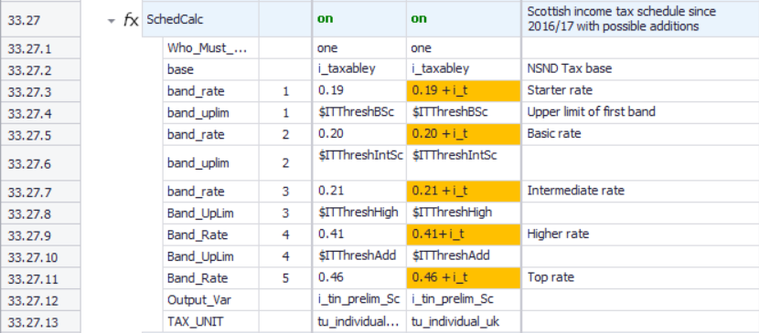
Changes to tax-ben system
Suggestions for what can be done:
Income tax – fixed tax increase (set in line 3.23.4 & added in tax schedule)

Slide 24
Decisions about basic income

Slide 25
Decisions about Basic Income
What we did:
Basic Income is taxable
Basic Income enters means-test for means-tested benefits

Slide 26
Decisions about Basic Income
How?
Adding Basic Income to Income Lists
These are where we define which components constitute a variable (e.g. the elements that it needs to sum)

Slide 27
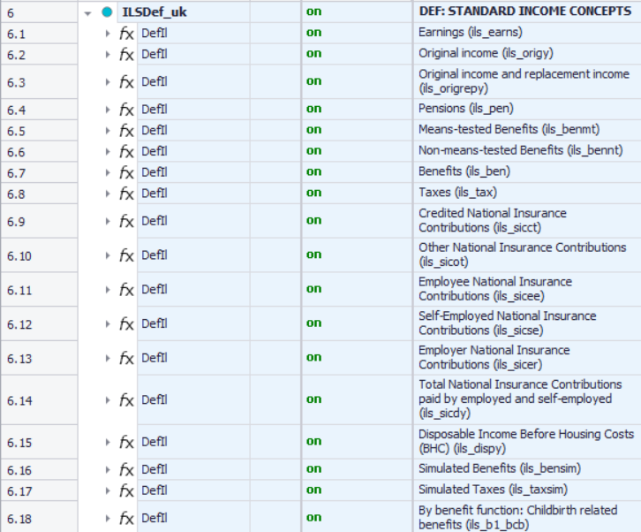
Decisions about Basic Income
add buc_s
add buc_s

Slide 28
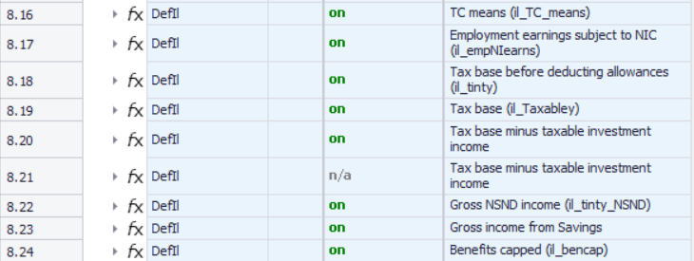
Decisions about Basic Income
Make BI taxable
add buc_s
add buc_s

Slide 29
Decisions about Basic Income
BI enters means-test
Add buc_s to means-tested benefits in:
Income support (8.3.38)
Guarantee credit (8.4.36)
HB (if SC) (8.11.39)
HB and CTB <60 (8.12.41)
HB and CTG >=60 (8.13.38)
Tax credits (8.16.23)
UC unearned income (8.27.19)

Slide 30
Questions

Slide 31
LUNCH BREAK!

Slide 32
Exercise 1
You will:
Understand how a Basic Income policy interacts with the tax and benefit systems.
Perform a policy reform that involves changing one element of that interaction: making BI non-taxable (from a taxable baseline).
Run reformed system and analyse its distributional impact using the Statistics Presenter

Slide 33
Questions

Slide 34
Welcome!
Session 1 - Interaction of BI with the tax-ben systems
Introducing a Basic Income policy
Making decisions around means-tested benefits and (income) tax reform in BI schemes
Exercise
Session 2 – Pensioners and Children
Pensioners, state pension and BI
A BI for children
Exercise
Session 3 – Fiscal neutrality (loops)
Introduce the loop function in UKMOD
How loops work to achieve fiscal neutrality
Exercise
Final questions

Slide 35
2. Pensioners and children

Slide 36
In this lecture, you will:
Understand how Basic Income can be allocated to a particular group (e.g. pensioners and children) in a different way.
Perform a policy reform that involves using Child Benefit as the UBI for children.

Slide 37
Pensioners and children
In this model, pensioners and children receive a different BI from working-age adults.
Pensioners get their Basic State Pension and/or top-up until set BI level
Children get a proportion of adult BI (45%)

Slide 38
Basic Income for Pensioners

Slide 39
Pensioners
We treat basic State Pension as a form of BI
SP below set (net) BI amount?
Gets top up to reach that amount (MIS for pensioners defined in 3.23)
SP above set (net) BI amount?
Keep it so never loses out

Slide 40
Pensioners
(Net) BI amount for pensioners is set in the basic income constants (3.23):
Equivalent to Minimum Income Standard (MIS) for pensioners

Slide 41
Pensioners
Who gets it?
All above Female Pension Age (defined in the BI policy line 29.9)
Back at buc_uk

Slide 42
Pensioners
The top up:
If State Pension less than pensioner’s BI, they get a top up
Back at buc_uk

Slide 43
Pensioners
To calculate gross BI:
Changes to tax rates (or other alterations to tax system) will affect gross BI to get to the fixed (net) BI for pensioners.

Slide 44
Variables in the output file
Some parameters (variables) can be checked in the output file – including the BI amount (and state pension) pensioners get:
Open in Excel and search for buc_s (BI amount) and boact (State Pension) – figures are monthly.

Slide 45
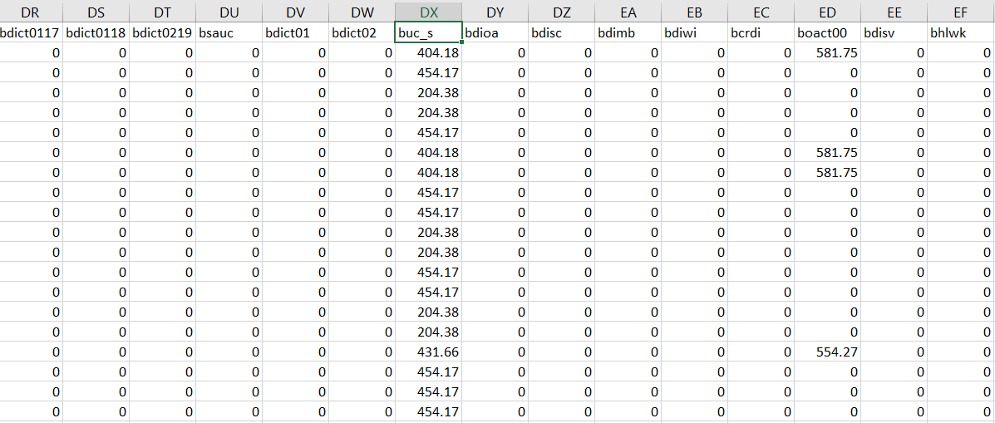
Variables in the output file
Output file in Excel:
Open in Excel and search for buc_s (BI amount) and boact (State Pension) – figures are monthly.

Slide 46
Basic Income for CHILDREN

Slide 47
Children
Children get a proportion of adult’s BI (45%)
This proportion is calculated as the excess MIS of lone parents compared to single adults

Slide 48
Children
Children get a proportion of adult’s BI (45%)
Child Benefit a quasi-universal BI for children
So we remove it to avoid duplication – how?
Set CB constants to zero

Slide 49
Questions

Slide 50
Exercise 2
You will:
Understand how Basic Income can be allocated to a particular group (e.g. children) in a different way.
Perform a policy reform that involves using Child Benefit as the UBI for children.
Run reformed system and analyse its distributional impact using the Statistics Presenter

Slide 51
Exercise 2
How is CB different to child BI?
Not taxable and doesn’t enter means-test for means-tested benefits.
What other changes does the 2020 system need if CB is to be a form of BI?
It shouldn’t be withdrawn with higher incomes (line 34, to make it truly universal), shouldn’t enter benefit cap (n/a in line 8.24.13).

Slide 52
Questions

Slide 53
COMFORT BREAK!

Slide 54
Welcome!
Session 1 - Interaction of BI with the tax-ben systems
Introducing a Basic Income policy
Making decisions around means-tested benefits and (income) tax reform in BI schemes
Exercise
Session 2 – Pensioners and Children
Pensioners, state pension and BI
A BI for children
Exercise
Session 3 – Fiscal neutrality (loops)
Introduce the loop function in UKMOD
How loops work to achieve fiscal neutrality
Exercise
Final questions

Slide 55
3. FISCAL NEUTRALITY (LOOPS)

Slide 56
In this lecture, you will:
Learn how the loop function works in UKMOD
How to use loops to achieve fiscal neutrality through different variables (BI amount and tax rates)
Perform a policy reform in the tax schedule to achieve a different amount of BI using a loop.

Slide 57
Fiscal Neutrality and Basic Income
How do we pay for it? – feature of many BI discussions
What level of BI could be achieved with current benefit spending and/or if we raised taxes
Loops in UKMOD allow us to experiment with these fiscal options.
We vary a parameter and calculate how much that parameter needs to change to maintain the same fiscal balance (fiscal neutrality).
But limitations: in UKMOD only income tax and NICs so fiscal neutrality always limited to these revenue sources.

Slide 58
USING LOOPS TO GET FISCAL NEUTRALITY

Slide 59
Using loops to get fiscal neutrality
Two extra systems called BI_BIloop and BI_taxloop
BI_BIloop: fixed tax-ben system, changeable BI amount
BI_taxloop: fixed BI amount (net amount), changeable tax rate

Slide 60
Using loops to get fiscal neutrality
Any loop requires three things:
Knowing where the loop calculations should start and end
Increments that are made on each run of the loop: NB only one parameter can be used
The condition for calculations to stop

Slide 61
Using loops to get fiscal neutrality
Loop policy in UKMOD:
NB: Using the BI_Biloop system

Slide 62
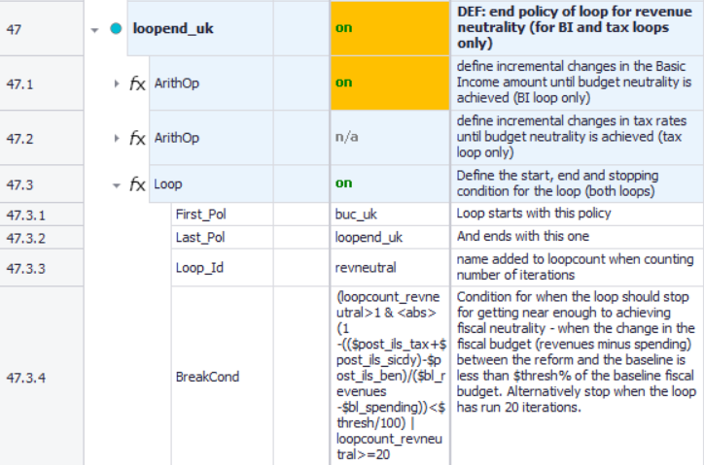
Using loops to get fiscal neutrality
Knowing where the loop calculations should start and end

Slide 63
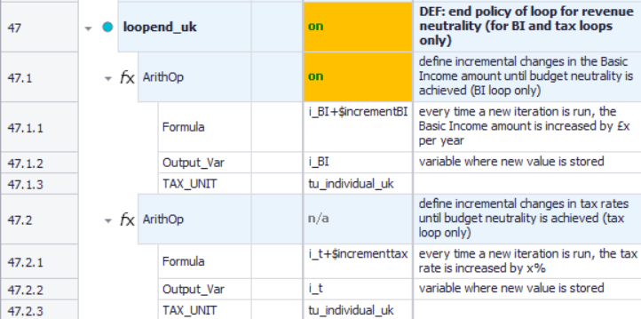
Using loops to get fiscal neutrality
2. Increments that are made on each run of the loop: NB only one parameter can be used at once
for BI loop
for tax loop

Slide 64
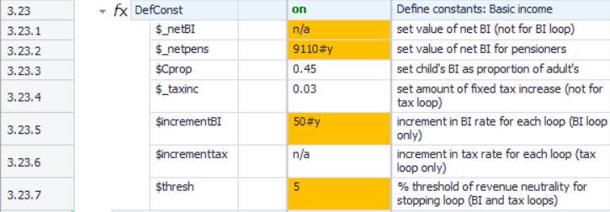
Using loops to get fiscal neutrality
The value of increments are defined in constants:
BI loop
tax loop
Notes:
Loop stops when fiscal balance (revenues minus spending) differs from the fiscal balance of the baseline scenario by less than a % threshold. It is based on variables defined in the previous policy 46 fiscaltotals_uk.

Slide 65
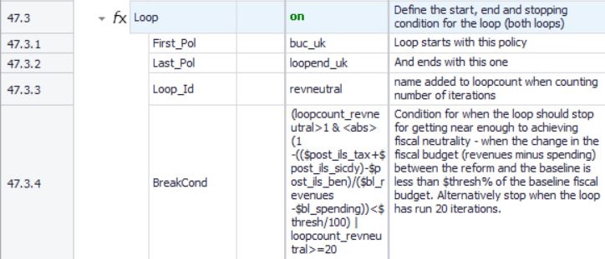
Using loops to get fiscal neutrality
3. The condition for calculations to stop: fiscal balance
Notes:
Loop stops when fiscal balance (revenues minus spending) differs from the fiscal balance of the baseline scenario by less than a % threshold. It is based on variables defined in the previous policy 46 fiscaltotals_uk.

Slide 66
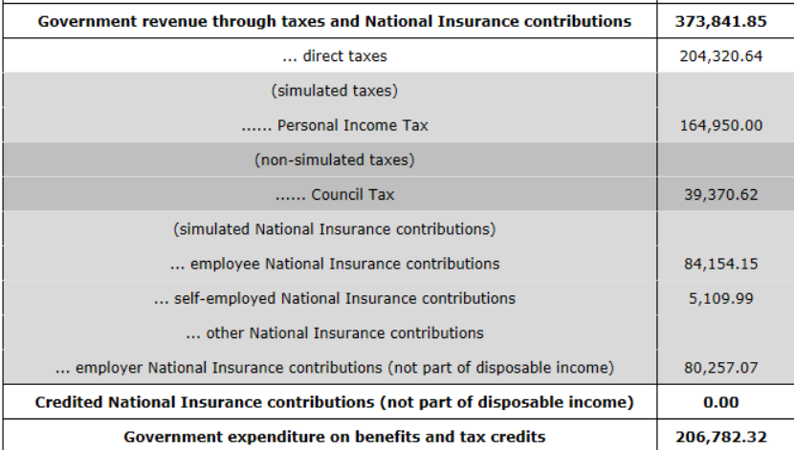
Using loops to get fiscal neutrality
3. The condition for calculations to stop: fiscal balance
Revenue and spending amounts are derived from baseline system – check Stats Presenter
revenue
expenditure

Slide 67
Using loops to get fiscal neutrality
3. The condition for calculations to stop: fiscal balance
… and include amounts here:
expenditure
revenue

Slide 68
Using loops to get fiscal neutrality
Also need to remove (by making n/a) whatever we are making variable in each loop:
$_netBI, the fixed amount of net BI, for the BI_loop (at 3.23.1)
$_taxinc, the fixed amount of tax increments, for the tax_loop (at 3.23.4)

Slide 69
HOW TO ACHIEVE CONVERGENCE

Slide 70
How to achieve convergence
Getting convergence in a loop is a process of trial and error.
How to get convergence:
To guess an initial starting point and set it under 1.18.1 or 1.18.2
To set a relatively large threshold under 1.19.7
Run the system and if it seems to have converged, use the outcome of that run as starting point of new run with a smaller threshold
Notes:
The only way to be sure if a run has converged is to check in the output file that loopcount_revneutral (ie the number of runs) is less than 20, but one can often guess from the Stats Presenter output, by running it as a reform scenario with baseline UK_2020precovid19 whether there has been convergence by whether in the Difference to base column the numbers for Government revenue through taxes and National Insurance contributions and for Government expenditure on benefits and tax credits are close to each other.

Slide 71
How to achieve convergence
Check convergence by looking at whether the change in revenue is roughly balanced by change in spending (in Stats Presenter using baseline/reform comparison)
If no convergence:
1. If the increase in revenue is higher than the increase in expenditure,
In a BI loop, BI needs to be higher, so use a starting value for i_BI greater than or equal to buc_s
In a tax loop, the tax rate needs to be lower, so use a lower starting value for i_t
2. If the increase in expenditure is higher than the increase in revenue,
In a BI loop, BI needs to be lower, so use a starting value for i_BI lower
In a tax loop, the tax rate needs to be higher, so use a starting value for i_t greater than or equal to taxinc_s
Notes:
The only way to be sure if a run has converged is to check in the output file that loopcount_revneutral (ie the number of runs) is less than 20, but one can often guess from the Stats Presenter output, by running it as a reform scenario with baseline UK_2020precovid19 whether there has been convergence by whether in the Difference to base column the numbers for Government revenue through taxes and National Insurance contributions and for Government expenditure on benefits and tax credits are close to each other.

Slide 72
Questions

Slide 73
Exercise 3
You will:
Learn how to use the loop function in UKMOD
Perform a policy reform in the tax schedule to achieve a different amount of BI using a loop
Run reformed system and analyse its distributional impact using the Statistics Presenter

Slide 74
Questions

Slide 75
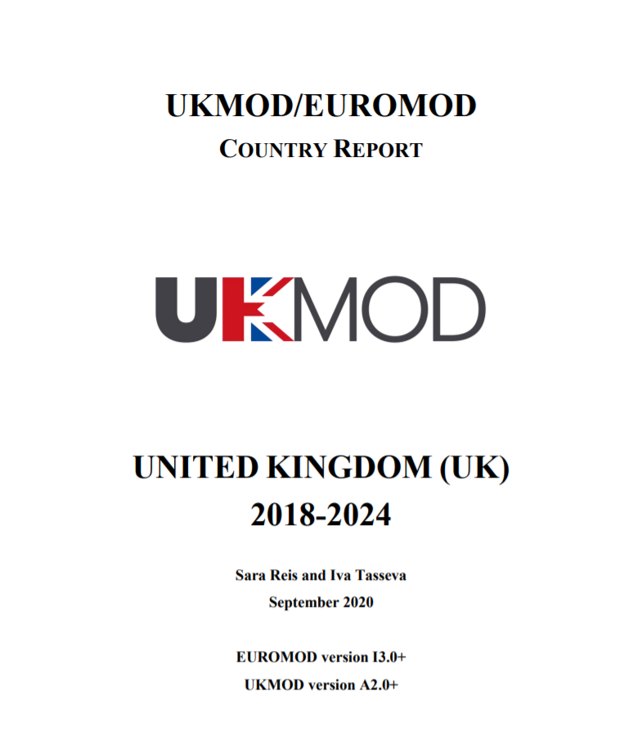
Documentation

Slide 76
Documentation
CeMPA website
https://www.microsimulation.ac.uk/
UKMOD Country Reports (CR)
Previous: https://www.euromod.ac.uk/using-euromod/country-reports
Latest: https://www.microsimulation.ac.uk/ukmod/resources/
Basic Income paper
https://www.iser.essex.ac.uk/research/publications/working-papers/cempa/cempa3-21
EUROMOD Working Paper series
https://www.euromod.ac.uk/publications/type/EUROMOD%20Working%20Paper%20Series
Data Requirement Document (DRD)-1 per dataset

Slide 77
Thank You
Find more about UKMOD: https://www.iser.essex.ac.uk/research/projects/ukmod
Find out more about Women’s Budget Group:
https://wbg.org.uk/

