Slide 1
HS563: EXAM WORKSHOP
Karen Hudson

Slide 2
LEARNING OUTCOMES
1) To explore the numeracy skills for drug administration in a guided, simulated practical context including:
Applying either the standard nursing formula or valid alternative strategies to calculate medication doses relating to:
Tablets & capsules, liquid medicines and injections
IV infusions (flow and drip rates)
SI Unit Conversions
2) To offer targeted additional support for underpinning numeracy skills.

Slide 3
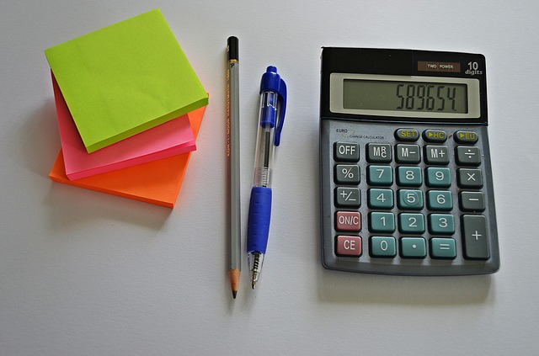
HS563: EXAM
This is a 100-mark exam
You need to score 40% to pass
Medicines management accounts for 18 marks
The medicines management section is not weighted
UNITS must be correct
You may use a calculator
Any other questions?

Slide 4
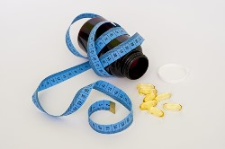
MEDICINES
SI Unit Conversions
Tablets & capsules, liquid medicines and injections
Dosages by body weight
Divided doses by body weight
IV infusions – flow rates and drip rates
Unit, sub-unit and multiple unit doses
Embedded conversions
Complex calculations

Slide 5
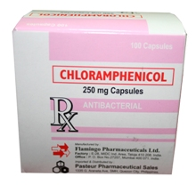
DIVIDED DOSES/BODY WEIGHT
A drug chart shows that a patient requires 50mg/kg daily of chloramphenicol in four divided doses.
The patient weighs 40kgs and the capsules available are 250mg.
How many capsules would you administer for each dose?

Slide 6
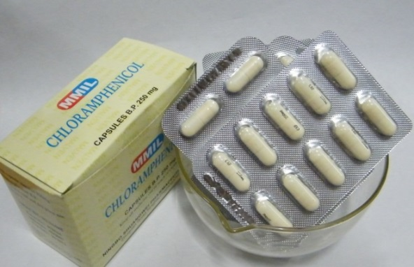
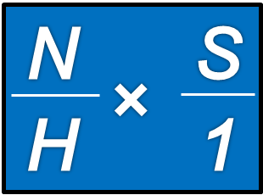
DIVIDED DOSES/BODY WEIGHT
Step 1 Work out the total daily dosage
50mg x 40 = 2,000mg
Step 2 Work out the amount for each dose
(4 divided doses)
2,000 mg ÷ 4 = 500 mg per dose
Step 3 Work out the number of capsules for each dose
500 x 1 = 2 x 1 = 2 capsules
250 1 1 1
Step 4: Check your calculation 250[mg] x 2 [capsules] = 500[mg]
500[mg] x 4 [doses] = 2000[mg]

Slide 7
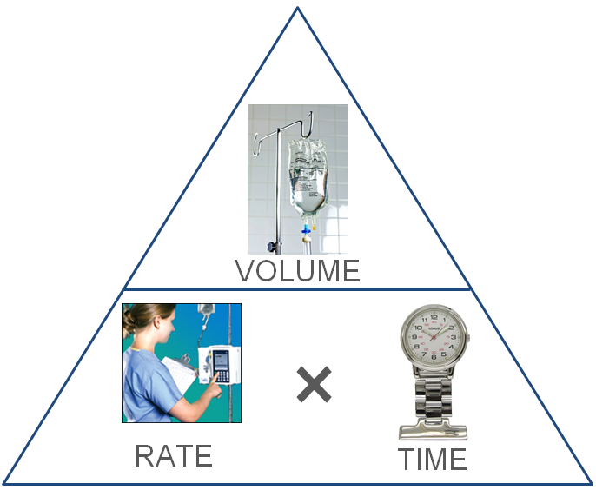
INFUSIONS: FLOW RATES
Volume = Time x Rate
Rate = Volume ÷ Time
Time = Volume ÷ Rate
Very
Rarely
Troubled!

Slide 8
INFUSIONS: DRIP RATES
Drip Rate (drops/min) = $\frac{Volume \left(mls\right)}{Time (mins)}$ $×$ $\frac{Drop Factor \left(drops/ml\right)}{1}$
Worked Example: A patient requires 1 litre of fluid to be infused over 10 hours. The giving set delivers 15 drops/ml. Calculate the drip rate.
Drip Rate (drops/min) = $\frac{1000 \left(mls\right)}{600 (mins)}$ $×$ $\frac{15 \left(drops/ml\right)}{1}$
Cancel down Multiply Solve
$\frac{1000 \left(mls\right)}{600 (mins)}$ = $\frac{10}{6}$= $\frac{5}{3}$ $\frac{5}{3}$ $× \frac{15}{1}$ = $\frac{75}{3}$ 75 $÷3=25$
The answer is therefore 25 drops per minute.

Slide 9
INFUSIONS: DRIP RATES
Time (mins) = $\frac{Volume \left(mls\right)}{Rate (drops/min)}$ $×$ $\frac{Drop Factor \left(drops/ml\right)}{1}$
Worked Example: A patient has 90ml left in their infusion bag. It is dripping at a rate of 45 drops/min via a drop factor of 20 drops/ml. How long will it take to complete the infusion?
Cancel down Multiply Solve
$\frac{90 \left(mls\right)}{45 (d.p.m.)}$ = $\frac{2}{1}$ $\frac{2}{1}$ $× \frac{20}{1}$ = $\frac{40}{1}$ 40 $÷1=40$
The answer is therefore 40 minutes.
Time (mins) = $\frac{90 \left(mls\right)}{45 (d.p.m.)}$ $×$ $\frac{20 \left(drops/ml\right)}{1}$

Slide 10
INFUSIONS: DRIP RATES
Volume (mls) =$\frac{Drip Rate \left(d.p.m.\right)× Time (mins)}{Drop Factor (\text{drops}\text{/}\text{ml})}$
Worked Example: A patient is receiving an infusion via a giving set delivering 20 drops/ml. The infusion is dripping at a rate of 42 drops per minute. How much fluid should have infused after 5 hours?
Multiply Cancel Down Solve
42 x 300 = 12,600 $\frac{12,600}{20 }$ = $\frac{6,300}{10}$= $\frac{630}{1}$ 630 $÷1=630$
(42 x 100 = 4,200 – then use repeated addition!)
The answer is therefore 630ml.
Volume (mls) =$\frac{42 \left(d.p.m.\right)× 300 (mins)}{20(\text{drops}\text{/}\text{ml})}$

Slide 11
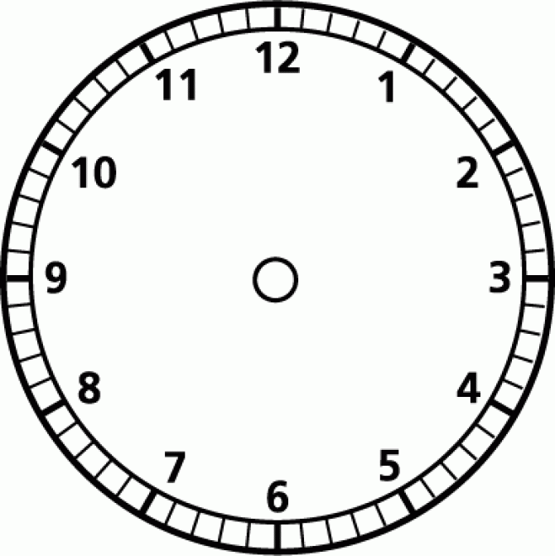
INFUSIONS: DRIP RATES
When inserting your TIME into your formula, remember:
ml/hr – work in HOURS
drops/min – work in MINUTES
drops/min?
ml/hr?

