Slide 1
HS564: EXAM WORKSHOP
Karen Hudson

Slide 2
LEARNING OUTCOMES
1) To explore the numeracy skills for drug administration in a guided, simulated practical context including:
Applying either the standard nursing formula or valid alternative strategies to calculate medication doses relating to:
Tablets & capsules, liquid medicines and injections
IV infusions (flow and drip rates)
SI Unit Conversions
2) To offer targeted additional support for underpinning numeracy skills.

Slide 3
HS564: EXAM
This is a 70-mark exam
You need to score 40% (28/70) to pass
Medicines management accounts for 23 marks
The medicines management section is not weighted
UNITS must be correct
You may use a calculator
Any other questions?

Slide 4
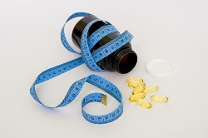
MEDICINES
SI Unit Conversions
Tablets & capsules, liquid medicines and injections
Embedded conversions
Medication management (i.e. look beyond the numbers!)

Slide 5
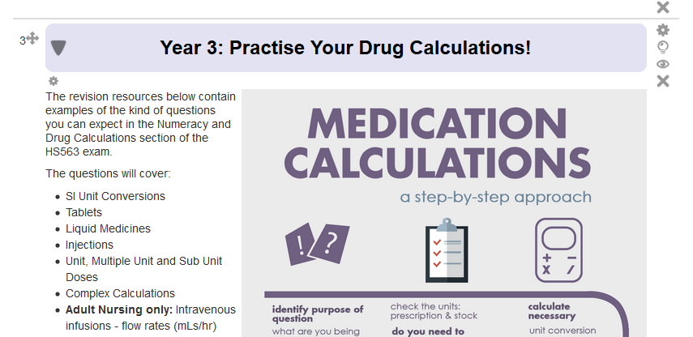
REVISION RESOURCES
Numeracy Moodle
Year 3: Practise Your Drug Calculation Skills

