Slide 1
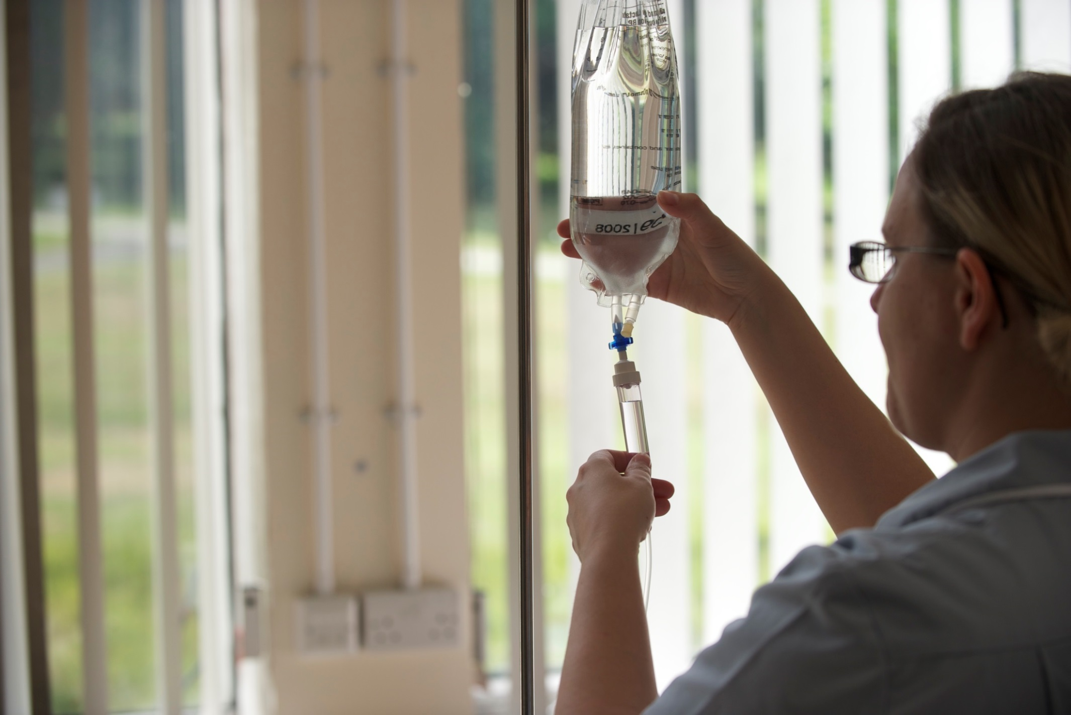
Numeracy for Nursing –Drip Rate Calculations

Slide 2
Learning Outcomes:
By the end of the session, all students will be able to:
Set up and solve a range of drip rate calculations
Additionally, some students may also be able to:
Set up and solve complex calculations
Solve a range of problems without using a calculator

Slide 3
Simplifying/Multiplying Fractions
http://ws.mathsdoctor.tv/M61
https://www.khanacademy.org/math/arithmetic/fractions/multiplying_fractions/v/multiplying-fractions

Slide 4
Infusion Rate Calculations - mL/h

Slide 5
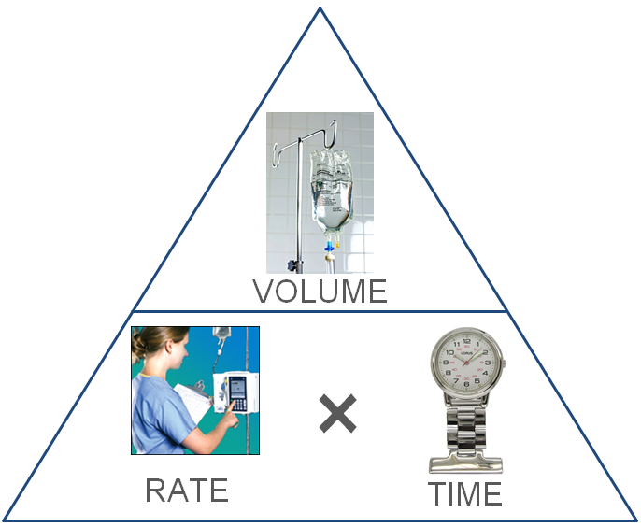
3. Elements of Infusion Rate Calculations
A fluid regime asks for 240 ml of Hartmann’s to be delivered over 4 hrs.
At how many ml/hr does the pump need to be set?
Rate = Volume ÷ Time
= 240ml ÷ 4hrs
= 60 ml/hr

Slide 6
Infusion Rate Calculations - mL/h
This formula forms the basic structure of all drip rate calculations
REMEMBER TO USE THE CORRECT VOLUME & TIME UNITS!
The only extra information we need is where to insert the Drop Factor element
ALSO…
REMEMBER TO USE THE CORRECT VOLUME AND TIME UNITS!
What do we do with the Drop Factor?

Slide 7
Drip Rate Calculations - Rate
Drip Rate (drops/min) = $\frac{Volume \left(mls\right)}{Time (mins)}$ $×$ $\frac{Drop Factor \left(drops/ml\right)}{1}$
Worked Example: A patient requires 1 litre of fluid to be infused over 10 hours. The giving set delivers 15 drops/ml. Calculate the drip rate.
Cancel down Multiply Solve
$\frac{1000 \left(mls\right)}{600 (mins)}$ = $\frac{10}{6}$= $\frac{5}{3}$ $\frac{5}{3}$ $× \frac{15}{1}$ = $\frac{75}{3}$ 75 $÷3=25$
The answer is therefore 25 drops per minute.
Drip Rate (drops/min) = $\frac{1000 \left(mls\right)}{600 (mins)}$ $×$ $\frac{15 \left(drops/ml\right)}{1}$

Slide 8
Drip Rate Calculations
Time (mins) = $\frac{Volume \left(mls\right)}{Rate (drops/min)}$ $×$ $\frac{Drop Factor \left(drops/ml\right)}{1}$
Worked Example: A patient has 90ml left in their infusion bag. It is dripping at a rate of 45 drops/min via a drop factor of 20 drops/ml. How long will it take to complete the infusion?
Cancel down Multiply Solve
$\frac{90 \left(mls\right)}{45 (d.p.m.)}$ = $\frac{2}{1}$ $\frac{2}{1}$ $× \frac{20}{1}$ = $\frac{40}{1}$ 40 $÷1=40$
The answer is therefore 40 minutes.
Time (mins) = $\frac{90 \left(mls\right)}{45 (d.p.m.)}$ $×$ $\frac{20 \left(drops/ml\right)}{1}$

Slide 9
Drip Rate Calculations - Volume
Volume (mls) =$\frac{Drip Rate \left(d.p.m.\right)× Time (mins)}{Drop Factor (\text{drops}\text{/}\text{ml})}$
Worked Example: A patient is receiving an infusion via a giving set delivering 20 drops/ml. The infusion is dripping at a rate of 42 drops per minute. How much fluid should have infused after 5 hours?
Multiply Cancel Down Solve
42 x 300 = 12,600 $\frac{12,600}{20 }$ = $\frac{6,300}{10}$= $\frac{630}{1}$ 630 $÷1=630$
(42 x 100 = 4,200 – then use repeated addition!)
The answer is therefore 630ml.
Volume (mls) =$\frac{42 \left(d.p.m.\right)× 300 (mins)}{20(\text{drops}\text{/}\text{ml})}$

Slide 10
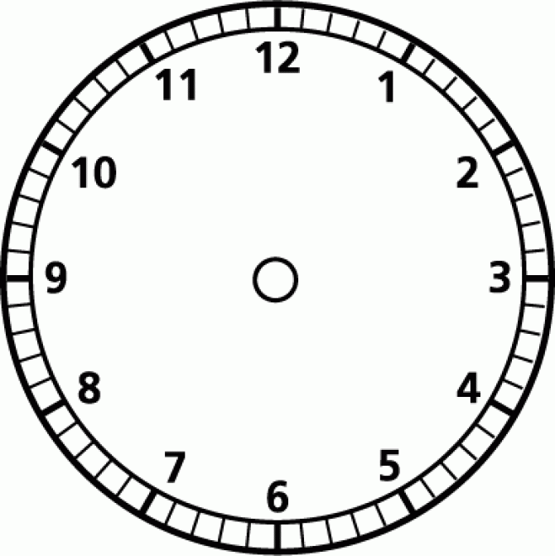
TIME to remember…
When inserting your TIME into your formula, remember:
ml/hr – work in HOURS
drops/min – work in MINUTES
drops/min?
ml/hr?

