Slide 1
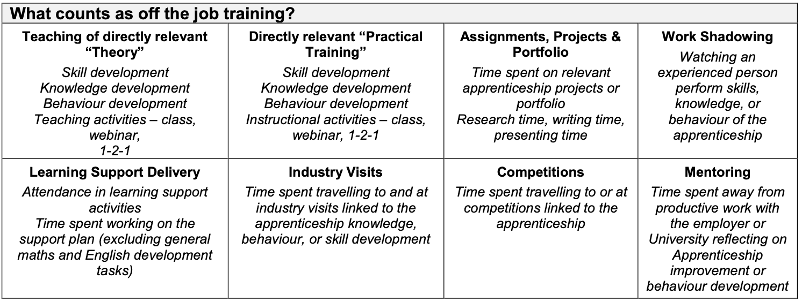
OTJ (off the job) Learning Hours
OTJ is training relevant to the apprenticeship. This means training which contributes to mastery and demonstration of competence of the KSB’s listed in the apprenticeship standard. Training can be facilitated by the university or employer.
The training plan* provides this guidance about what constitutes OTJ.
Apprentices must complete at least 6 hours of OTJ for each week of their ‘practical period’*.
*The training plan is a formal document setting out the roles and responsibilities of all parties involved in the apprenticeship. The practical period is the time in which the apprentice is receiving training. It is anticipated the practical period for the UoE physiotherapy apprenticeship ends in academic week 11 of year 4.

Slide 2
OTJ Learning hours
30 credit module
Directed: 140 hours
Undirected: 70 hours
Directed: 70 hours
Total: 210 hours
15 credit module
15 credit placement module
30 credit placement module
Undirected: 35 hours
Total: 105 hours
Directed: 187.5 hours
Undirected: 35 hours
Total: 222.5 hours
Directed: 225 hours
Undirected:75 hours
Total: 300 hours
The total expected OTJ hours for the Physiotherapy degree apprenticeship has been calculated as 2935*.
2935 can be broken down into OTJ hours per module size
2935 can be broken down into OTJ hours per year of training
Year 1
Directed: 560 hours
Directed: 537.5 hours
Year 2
Year 3
Year 4
Undirected: 280 hours
Total 840 hours
Undirected: 210 hours
Total: 747.5 hours
Directed: 622.5 hours
Undirected: 215 hours
Total: 837.5 hours
Directed: 365 hours
Undirected:145 hours
Total: 510 hours
Documentation of OTJ activities is mandatory and monitored during progress reviews.
These definitions should inform documentation:
Direct Study
Examples: University lectures, practical and placement
Examples: Workplace directed e.g. IST’s or journal club, summative assessment preparation; personal study towards module aims and KSB’s
Undirected Study
ePAD categories: Placement 1/2/3/4; university lecture; university practical
ePAD categories: Self-directed study; assessment/coursework preparation or workplace led
* Completion of workplace tasks is NOT considered OTJ, but the documentation of the learning from the task is.

