Slide 1
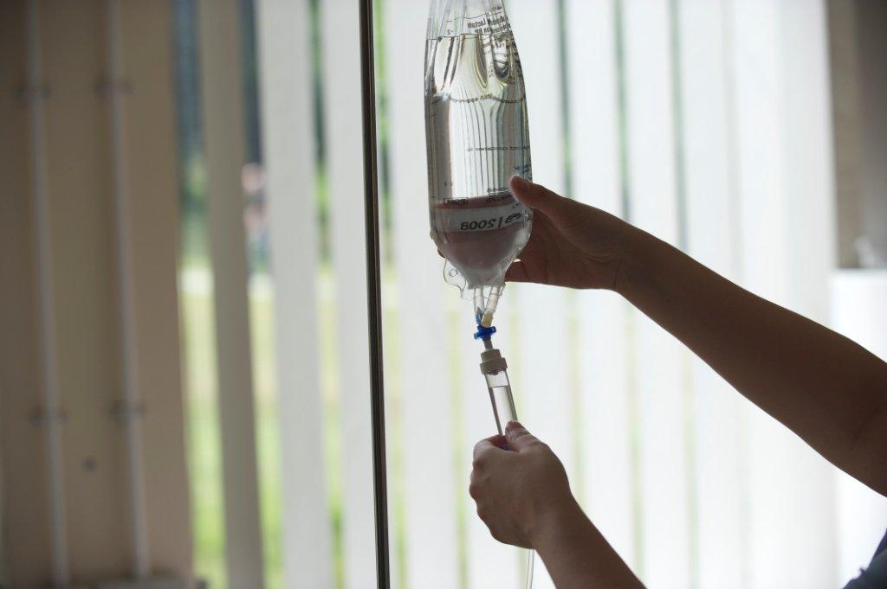
Numeracy for Nursing – IV Infusion Rates

Slide 2
Infusion Rate Calculations – Learning Objectives
Identify the three elements that make up an infusion rate calculation
Understand how everyday problem solving strategies can be expressed as formulae
Choose the appropriate formula when solving an infusion rate problem

Slide 3
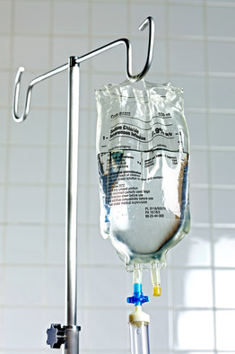
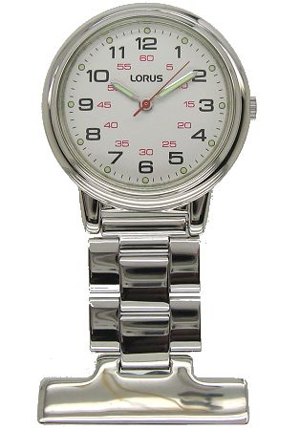
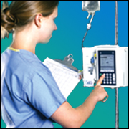
3. Elements of Infusion Rate Calculations
Volume – how much fluid (ml)
Rate – how quickly the infusion is given (ml/hr, drops/min)
Time – how long does it take (hrs, mins)

Slide 4
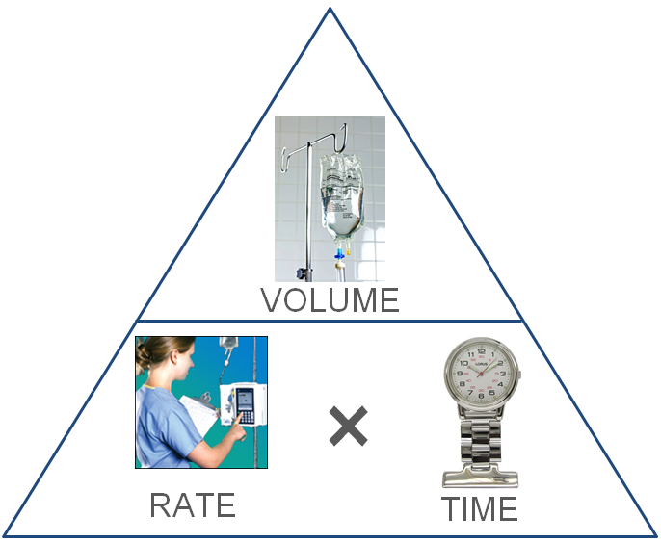
3. Elements of Infusion Rate Calculations
Volume = Time x Rate
Rate = Volume ÷ Time
Time = Volume ÷ Rate
Very
Rarely
Troubled!

Slide 5
3. Elements of Infusion Rate Calculations
A fluid regime asks for 240 ml of Hartmann’s to be delivered over 4 hrs.
At how many ml/hr does the pump need to be set?
Rate = Volume ÷ Time
= 240ml ÷ 4hrs
= 60 ml/hr

Slide 6
3. Elements of Infusion Rate Calculations
A patient receives 100ml saline by infusion at a drip rate adjusted to deliver 25 ml/hr
How long will it take to give the solution?
Time = Volume ÷ Rate
= 100ml ÷ 25ml/hr
= 4 hrs

Slide 7
3. Elements of Infusion Rate Calculations
A patient is receiving dextrose 5% by infusion
The drip rate is set to deliver 40 ml per hr
How much fluid will the patient receive in 4 hrs?
Volume = Rate × Time
= 40ml × 4hrs
= 160 ml

